Slide 1
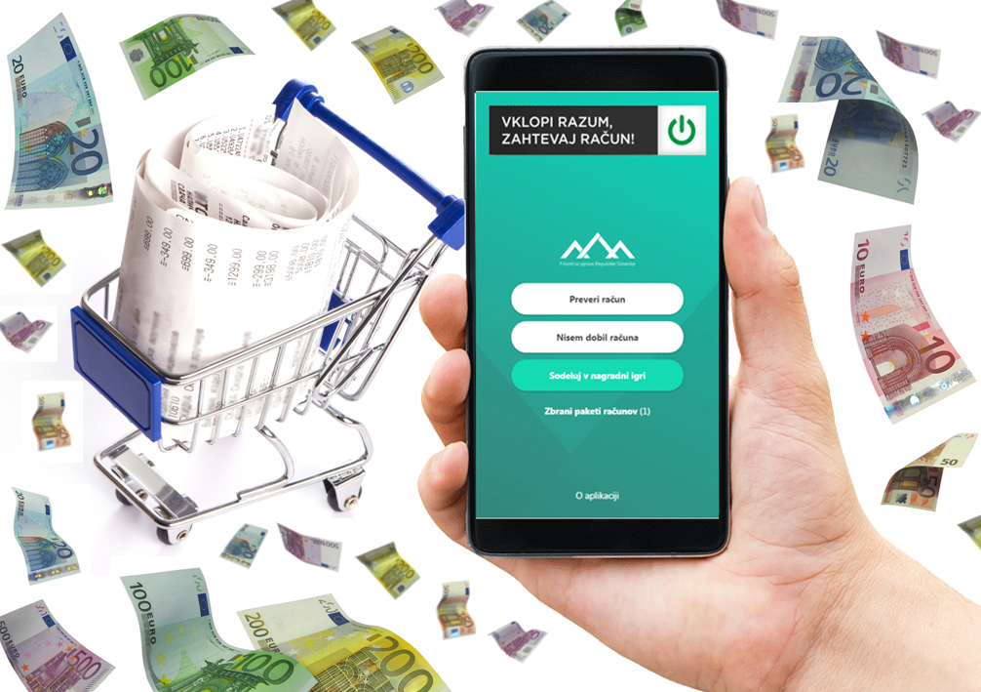
COMMUNICATION CAMPAIGN
Motivating consumers to check invoices

Slide 2
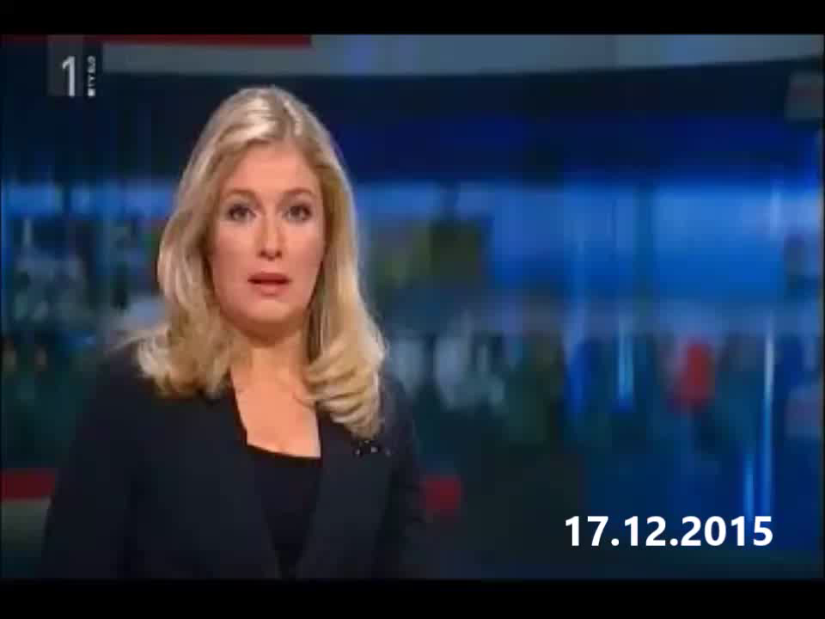

Slide 3
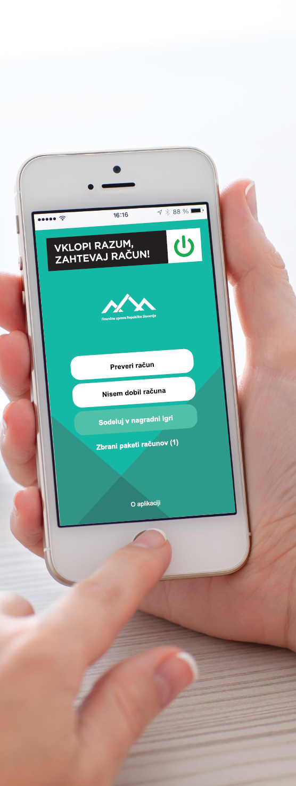



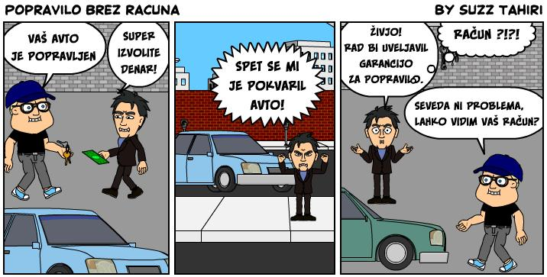
REPUBLIKA SLOVENIJA
MINISTRSTVO ZA FINANCE
FINANČNA UPRAVA REPUBLIKE SLOVENIJE
WHY the campaign?
Support to cash registers
Strengthening tax culture among consumers
Support to tax supervision of the Financial Administration
DAVČNE
BLAGAJNE
Finančna uprava RS
December, 2015
Vir: Nefiks

Slide 4
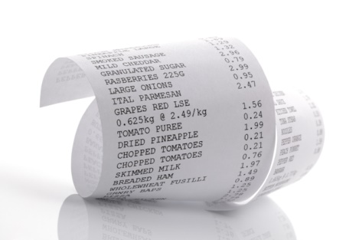
REPUBLIKA SLOVENIJA
MINISTRSTVO ZA FINANCE
FINANČNA UPRAVA REPUBLIKE SLOVENIJE
Key challenges
Promoting consumers to do 4 things:
to demand the receipt or an invoice upon the purchase of goods or services
to take it,
check whether the invoice is accurate,
send it to the Financial Administration.
To attract younger generations, since the aim was to influence the strengthening of tax culture.
DAVČNE
BLAGAJNE
Finančna uprava RS
December, 2015

Slide 5
REPUBLIKA SLOVENIJA
MINISTRSTVO ZA FINANCE
FINANČNA UPRAVA REPUBLIKE SLOVENIJE
Difficulty of the campaign
Due to the nature of its work (collection of taxes), the Financial Administration is not a very popular authority with the public, which could be an obstacle in motivating consumers to participate in verifying invoices on a voluntary basis.
Consumers and others (also media) could view the campaign as a way of denouncing or snitching on entrepreneurs or companies.
We would spend „taxpayers money“ on the campaign.
DAVČNE
BLAGAJNE
Finančna uprava RS
December, 2015

Slide 6
REPUBLIKA SLOVENIJA
MINISTRSTVO ZA FINANCE
FINANČNA UPRAVA REPUBLIKE SLOVENIJE
Key message
"Use your head: demand a receipt!„
„Against the shadow economy! “
The key to the success of the campaign
DAVČNE
BLAGAJNE
The right choice of a key communication tool:
a mobile application.
Finančna uprava RS
December, 2015

Slide 7
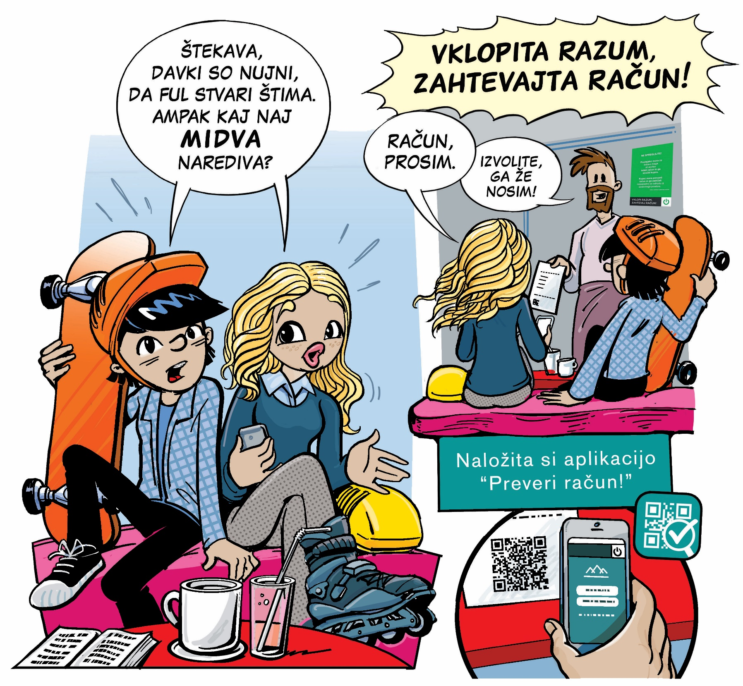

Slide 8
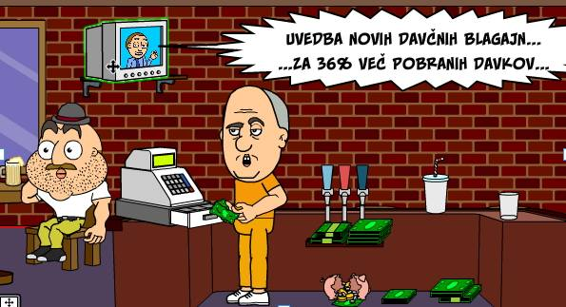
REPUBLIKA SLOVENIJA
MINISTRSTVO ZA FINANCE
FINANČNA UPRAVA REPUBLIKE SLOVENIJE
Campaign promotion
Publication on the website of the Financial Administration
Government Twitter and Facebook
Communication with the media
Advertising on TV Slovenia, Radio Slovenia and online advertising
80,000 promotional leaflets
Information on 1,500,000 income tax documents
Vir: Nefiks

Slide 9
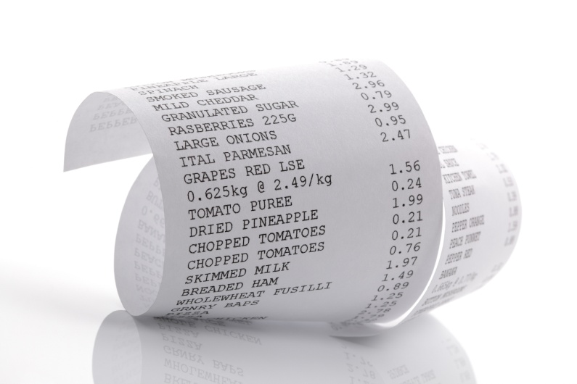
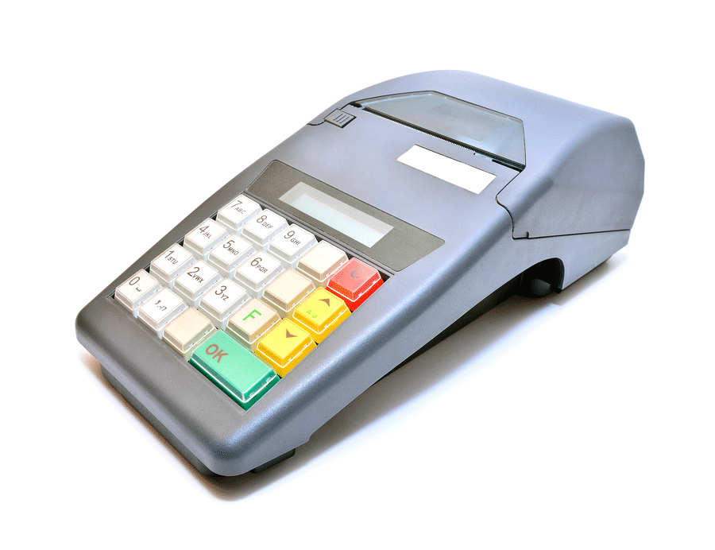
REPUBLIKA SLOVENIJA
MINISTRSTVO ZA FINANCE
FINANČNA UPRAVA REPUBLIKE SLOVENIJE
The effect of the campaign
112,887 consumers checked and sent 21 million accounts to Financial Administration
In one year, consumers checked the invoices of 75% of users of certified cash registers at least once.
Campaign costs estimated for 0.03% of the additional benefits of the fiscal cash registers.
DAVČNE
BLAGAJNE
Finančna uprava RS
December, 2015

Slide 10
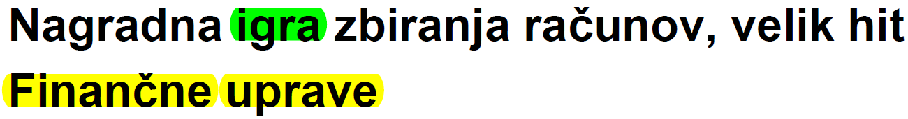
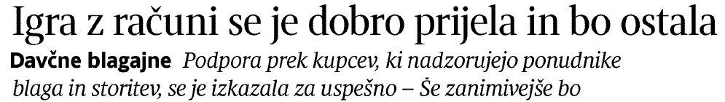
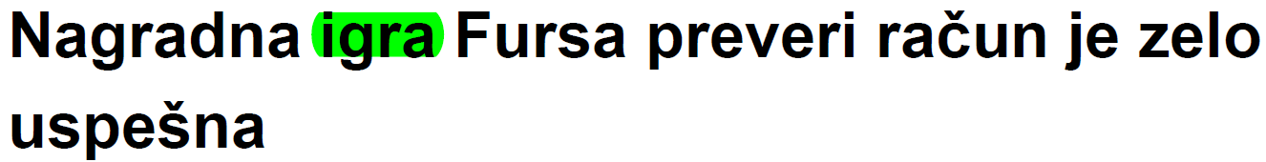

REPUBLIKA SLOVENIJA
MINISTRSTVO ZA FINANCE
FINANČNA UPRAVA REPUBLIKE SLOVENIJE
Very good public response
In one year, 114 media articles

