Slide 1
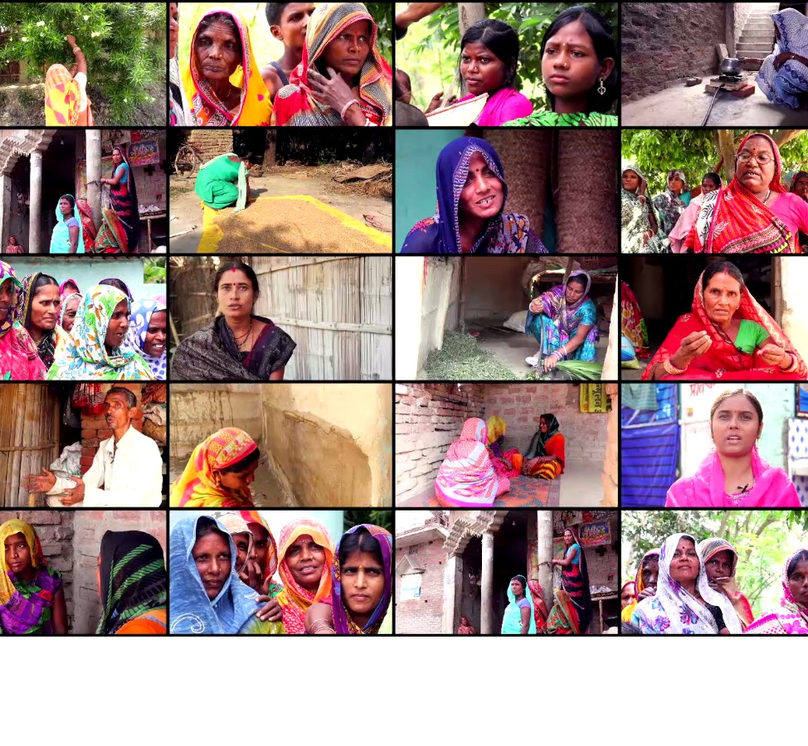

GOVERNMENT OF BIHAR
The Bihar Right to Public Grievance Redressal Act
Grievance Redressal through
Good Governance
Dr. Pratima, I.A.S.
Additional Mission Director
Bihar Prashasanik Sudhar Mission Society General Administration Department, Bihar

Slide 2
Journey so far
2018
2017
3.8 lakh grievances registered and 3.4 lakh disposed
2016
1.68 lakh grievances registered and 1.44 lakh disposed
2015
BRPGRA implementation started
BRPGRA
passed in legislature

Slide 3
PRESENTATION OUTLINE
Introduction
Achievements
Features
Legal Right
Redressal as the focus
Performance Indicators
Analytics
Few successful redressals
Digital Governance
Conclusion
Access
Process
Monitoring
Right to Grievance Redressal and Systematic Reforms
Monitoring & Evaluation
Basis of continuous improvements
Improvements made

Slide 4
INTRODUCTION

Slide 5







CITIZEN CENTRIC GOVERANCE
CITIZEN EMPOWERMENT
GRIEVANCE REDRESSAL
PUBLIC SERVICES
RTI 2005
RTPS 2011
BRPGRA 2015
THE RIGHT TO INFORMATION ACT 2005
BIHAR RIGHT TO PUBLIC SERVICES ACT 2011
The BIHAR RIGHT TO PUBLIC GRIEVANCE REDRESSAL ACT 2015
INFORMATION

Slide 6
Need for BRPGRA
Previous systems…
Administrative not a Legal Right of Grievance Redressal
Not legally enforceable
No fixed timelimit for redressal
In most of the cases, complaint to be resolved by the same Public Authority against whom the complaint was made
No independent decision making Authority
Citizen not always in loop of the action being taken
No penalty for non conformance

Slide 7

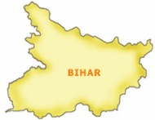











BRPGRA - Key Features
Legal Right
Coverage: Entire State, all 44 Departments (478 services)
Multi-modal Accessibility
Independent
Quasi-judicial Officer
vested with powers under CPC
Time Bound
Penalty for
Non-compliance
Power Parity
Reasoned Order
End to End Digitization and Monitoring
Transparent System
Appeals and Revision
Complainant Feedback
Regular Capacity Building

Slide 8




LEGAL RIGHT
Hearing
Redressal
Information about the decision
Provides legal right of opportunity of hearing and redressal of grievances to the citizens within the stipulated time limits

Slide 9


WHAT IS A COMPLAINT?
Any relief / benefit sought relating to any scheme / programme / service being executed by the State Government
The Act covers the entire State and all 44 Departments
478 schemes, programmes and services of the government that have been notified.

Slide 10


NO WRONG DOOR
Who can file a complaint?
Anyone!!!
No pre-qualification required for filing a grievance
No one is turned away – every complaint is registered

Slide 11
NO WRONG DOOR
Where to file a grievance?
Multi – modal accessibility!!!
At the Grievance receiving counters established at Sub-Division, District and State HQ level
Online
Mobile App
Toll free number
Email
Post

Slide 12

ONE STOP SOLUTION
All Grievances related to any relief/benefit sought from any Department, registered, heard and redressed under one roof

Slide 13


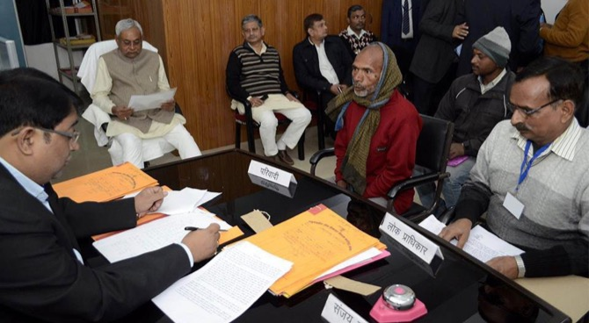
HEARING
Hearing and Decision by an Independent Quasi- Judicial Officer
Power parity: Complainant at par with the Public Authority
Reasoned order based on evidence and facts

Slide 14
Redressal as the Focus
Implementation and monitoring geared towards actual redressal providing benefit / relief sought not just disposal
NEUTRAL VIEW OF THE GRIEVANCE
POWER PARITY
The Public Grievance Redressal Officer being an independent authority does not have a vested interest or bias towards one party or the other
  The power asymmetry between the complainant and the Public Authority (PA) is eliminated through the institution of PGRO
THE LAW AND POLICY MANDATE
MONITORING FOR REDRESSAL
The mandate of both the Law and Policy is to redress the redressable grievances within the timelimit of 60 working days and where not redressable to provide reasons in writing – to both the complainant and the PA – for rejection of grievance.
In addition, delays in actual redressal of redressable grievances also have to be justified with reasons in writing.
PGRO orders are monitored by BPSMS to ensure that actual redressals are taking place.
Based on feedback and learning, currently the PGROs are being instructed to confirm that their orders for redressal have actually being complied with by the Public Authority.
Additionally, citizen satisfaction is captured at the time of final orders.

Slide 15
Business Process Re-engineering
Citizen as the focus!
Fundamental Rethinking
citizen empowerment through a legal right to redressal
Radical Redesign
  Ensuring power parity and time bound redressal
Dramatic improvements
Timebound redressal with about 90% complainants registering their satisfaction at the time of final order
Business Processes
Processes re-engineered to ensure maximum citizen satisfaction by no wrong door and one stop solution

Slide 16
DIGITAL GOVERNANCE

Slide 17
REDRESSAL PROCESS
Registration of grievance through multi-modal accessibility
Acknowledgement receipt with Complaint ID and Hearing date issued on spot
Notice issued to concerned Public Authority (PA)
Process ends if complainant satisfied or does not go on appeal
Reasoned order to be passed
Hearing with mandatory presence of PA; Complainant’s presence optional
Complainant receives the communication of the decision
Complainant goes on first appeal
Appeal filed
Hearing and appellate order
If complainant satisfied process ends.
Note: If PA/PGRO not satisfied with 2nd Appellate order, they can file a revision petition
If complainant not satisfied goes on second appeal

Slide 18
DIGITAL PROCESS STEPS FOR REGISTRATION, HEARING AND ORDERS

Slide 19

REGISTRATION
Physical access
At the Grievance receiving counters established at Sub-Division, District and State HQ level
Post
All complaints digitized
Digital access
Online through webportal http://lokshikayat.bihar.gov.in
Toll Free no. 1800 345 6284
Mobile App ‘Jan Samadhan’
Email: info-lokshikayat-bih@gov.in

Slide 20
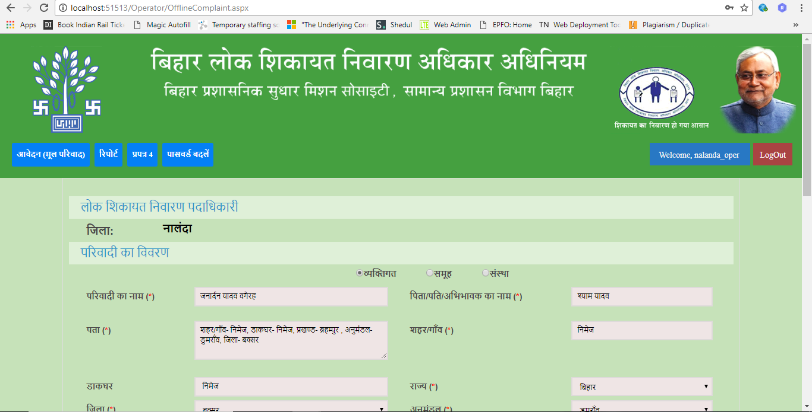
Registration of a complaint – at Counter
Individual
Group
Organisation
General Details about the Complainant

Slide 21
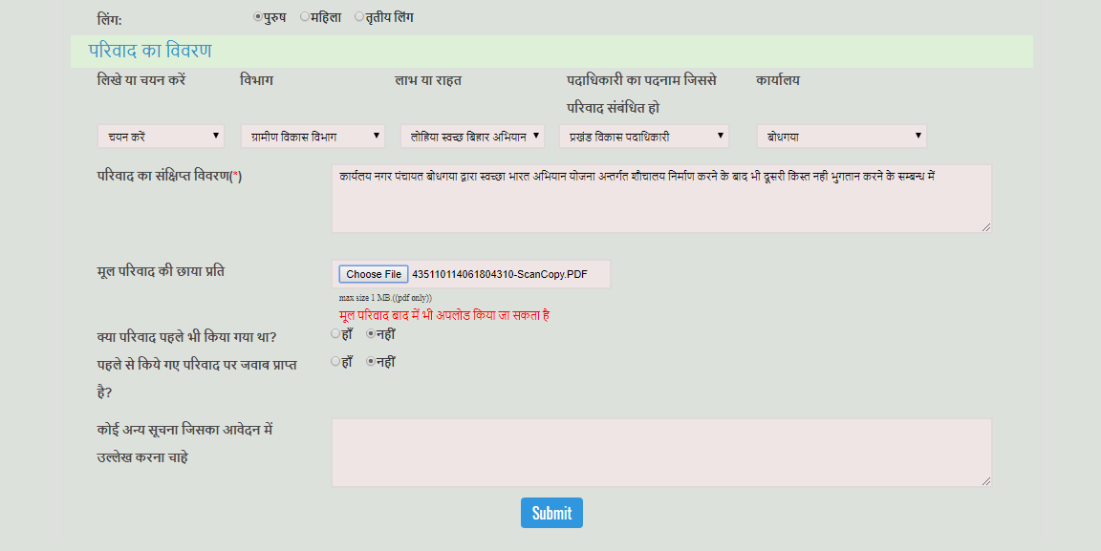
Registration of a complaint – at Counter
Department
Benefit/ Relief Sought
Officer Incharge
Office
Brief detail of the complaint
Has the complaint been filed previously. If yes whether received a decision on the same

Slide 22
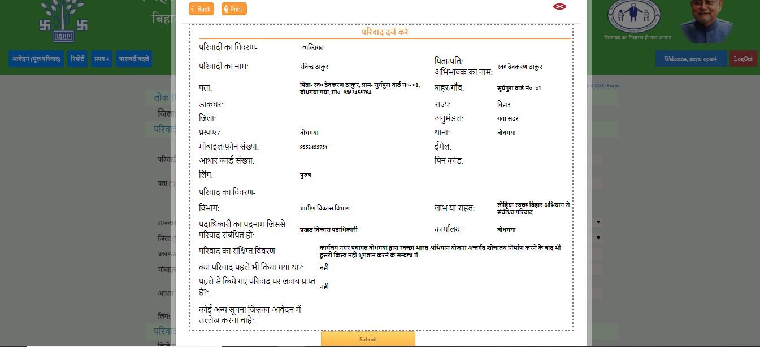
Registration of a complaint – Preview of complaint filed
Register the complaint

Slide 23
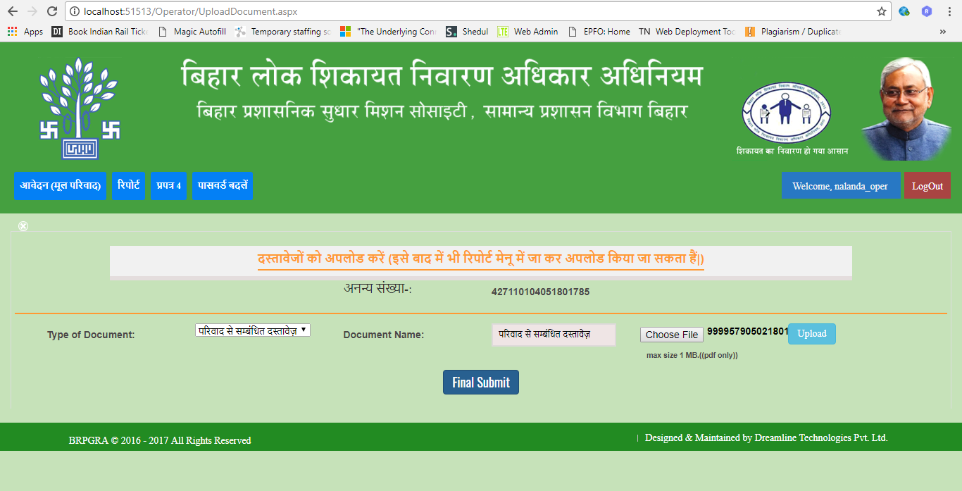
Registration of a complaint – Uploading of supporting documents
Upload Documents

Slide 24
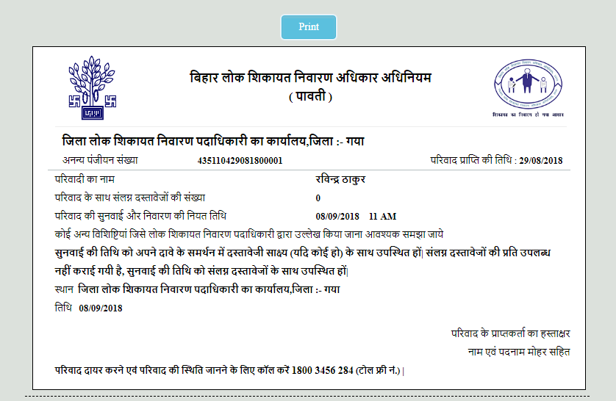
Acknowledgement slip of the Complainant
Complaint ID
(18 digit unique ID)
Complaint filing date
Date of the Hearing
Location: DPGRO, Nalanda
Complaint ID is the reference for all future information requirements

Slide 25
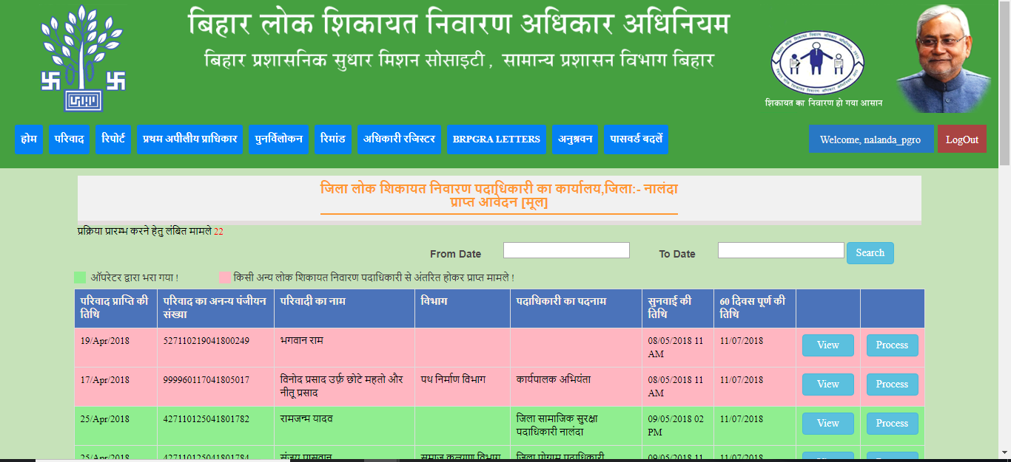
Processing of Complaint – by PGRO
Date of Complaint filing
Officer Incharge /Public Authority
Hearing Date
Date: Completion of 60 days
Complaint ID
Name of the complainant
Department
Transferred from another PGRO
Filled by Operator

Slide 26
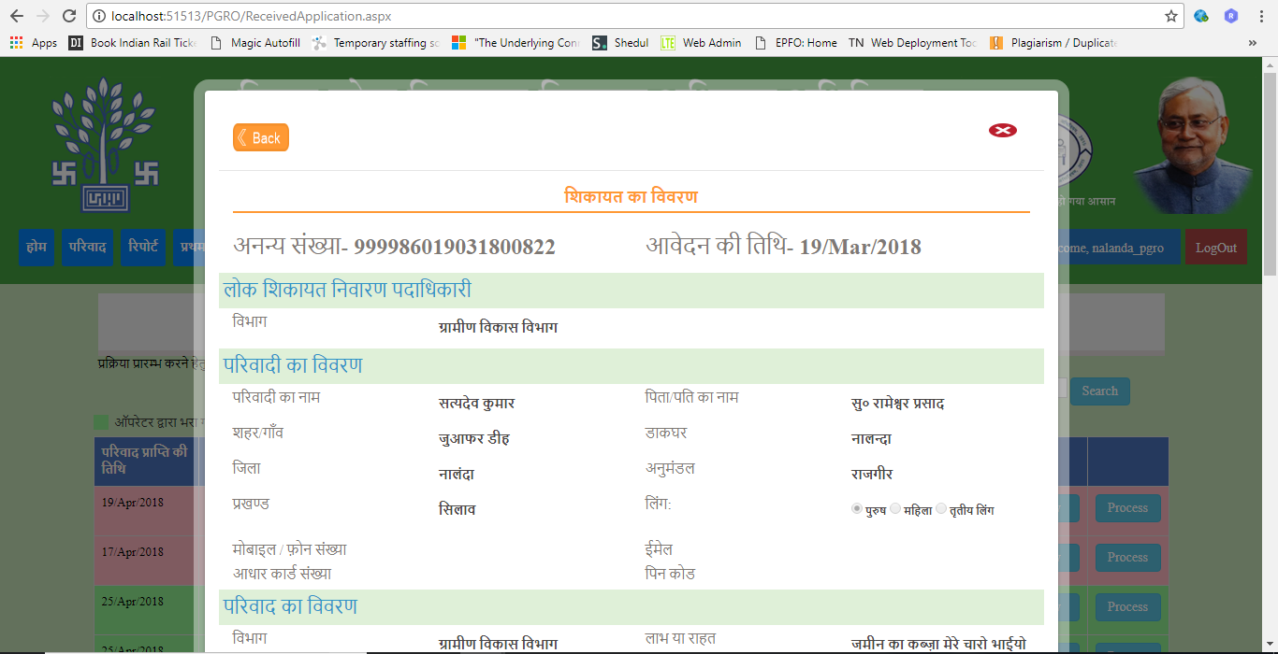
Processing of Compliant – Details of the Complaint filed
Details of the Complaint

Slide 27
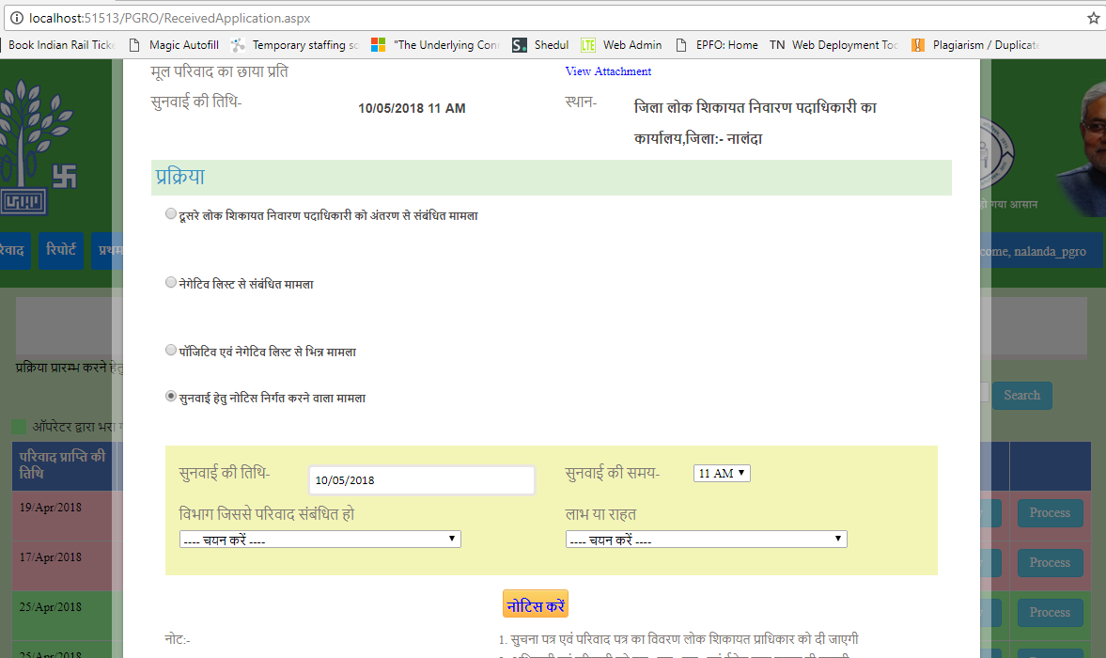
Processing of Compliant – Transfer, Categorization, Notice and Hearing Date
To be transferred to another PGRO
Notice to be issued for Hearing
Date of Hearing
Department to which complaint is related
Benefit / Relief Sought
Issue Notice

Slide 28
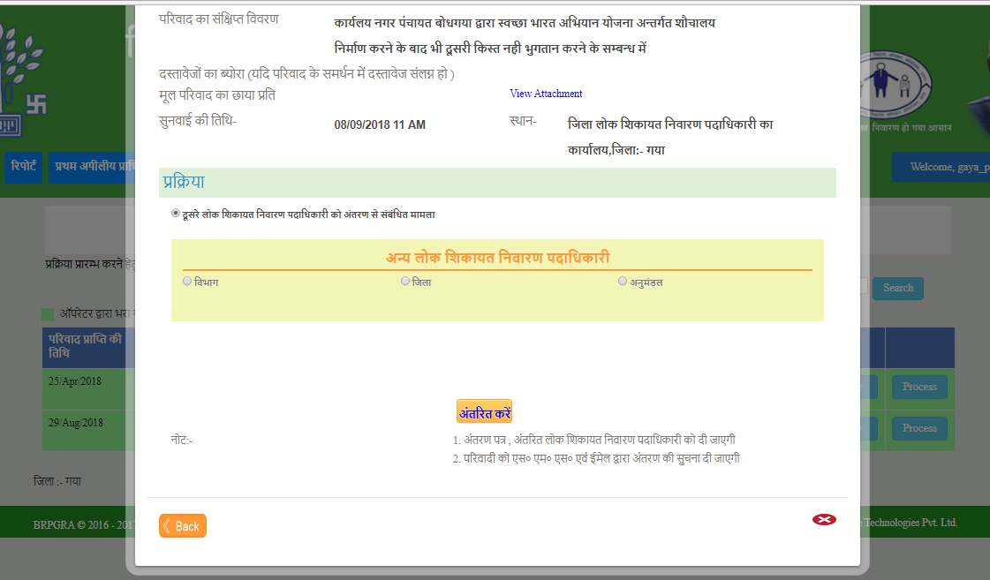
NO WRONG DOOR – Transfer to appropriate PGRO
Jurisdiction defined for all PGROs
District PGRO
Department PGRO
Sub-Division PGRO

Slide 29
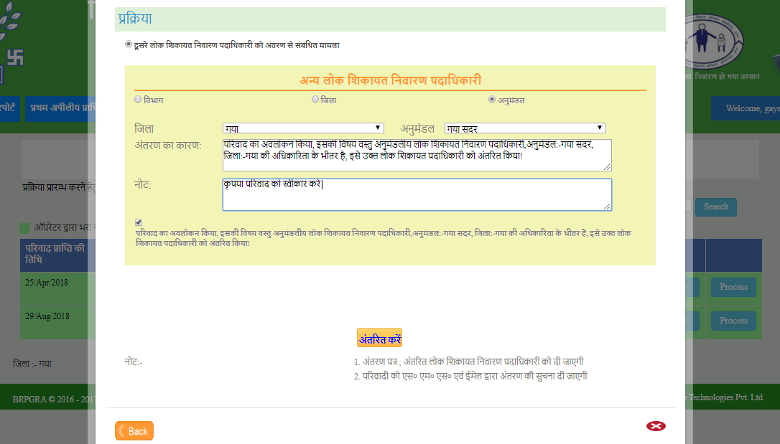
NO WRONG DOOR – Transfer to appropriate PGRO
Reason for transfer
Note
Transfer

Slide 30
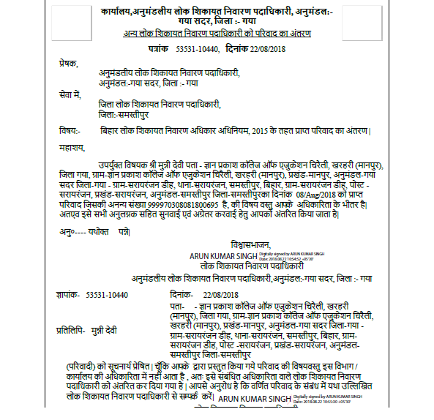


NO WRONG DOOR – Transfer to appropriate PGRO
From
Sub-Division PGRO, Gaya Sadar
To
District PGRO, Samastipur
Digitally signed

Slide 31
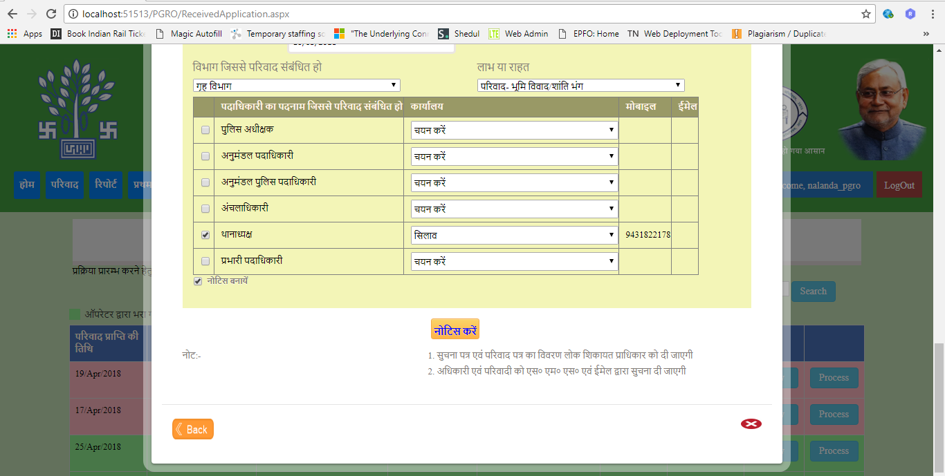
Processing of Compliant –Notice to Public Authority
Land Dispute / Breach of Peace
Home Department
Public Authorities
Issue Notice

Slide 32
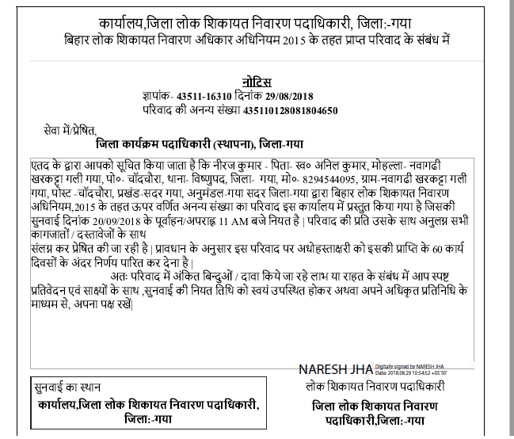
Digitally signed Notice issued to the concerned Public Authority
Details of the Complaint
Date and Time of the hearing

Slide 33
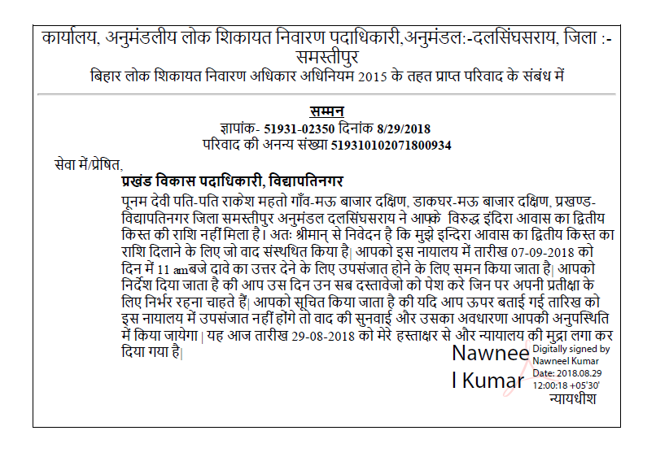
Digitally signed Summon

Slide 34
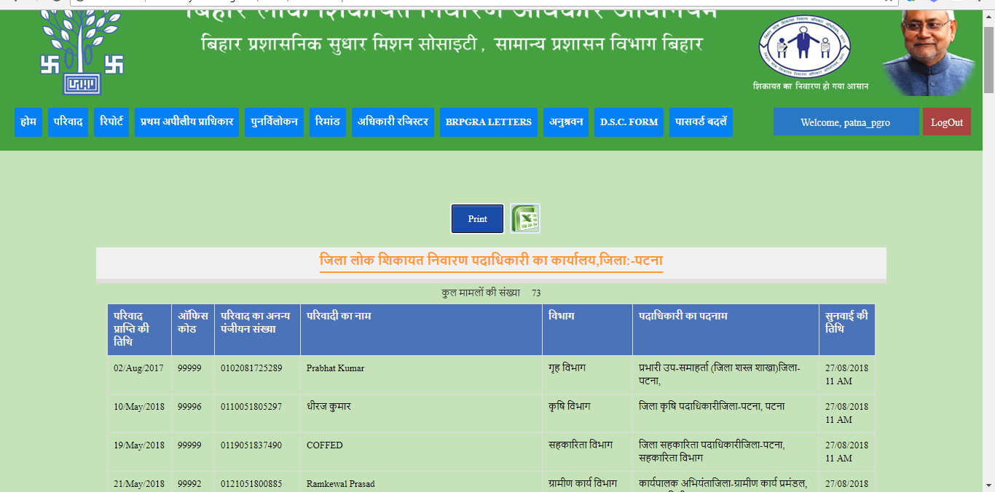
Cause list
Date of Complaint
Name of the complainant
Department
Name of Public Authority
Date and Time of hearing
Complaint ID

Slide 35
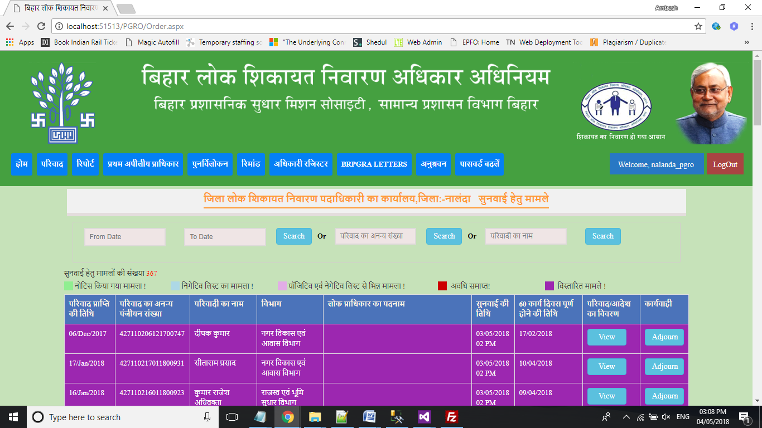
Orders: PGRO Dashboard with details of Cases for hearings
No. of cases for hearings
Timelimit completed
Extended cases
Notice Issued

Slide 36
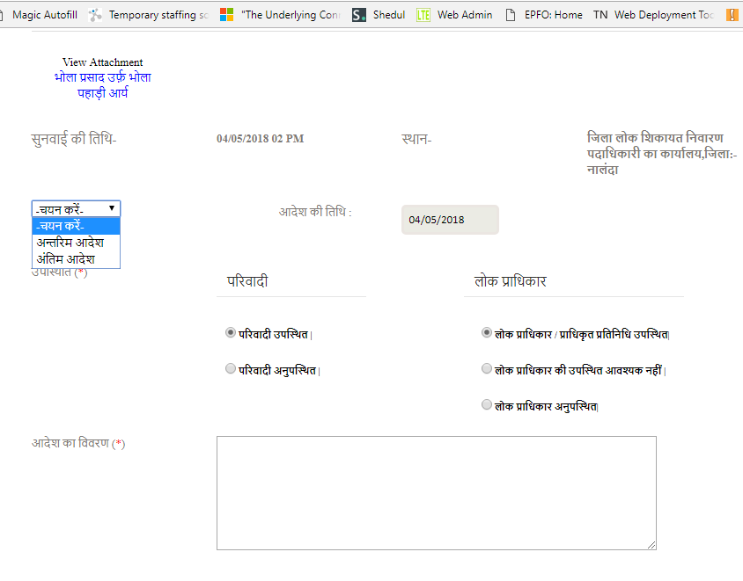
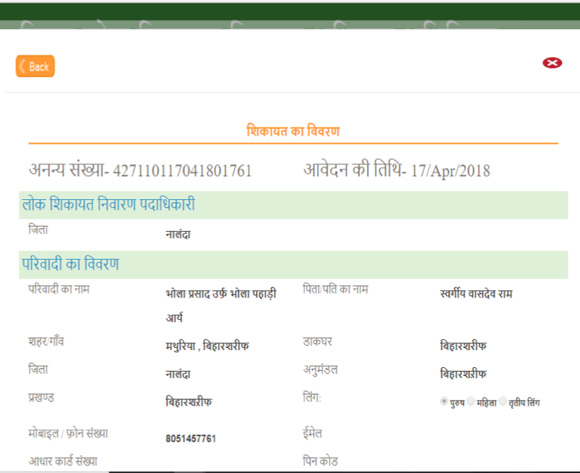
Orders
Date of Hearing
Details of Complaint
Complaint ID
Attendance of the Public Authority/ Representative
Type of Order: Interim / Final
Attendance of the Complainant
Order details to be entered

Slide 37
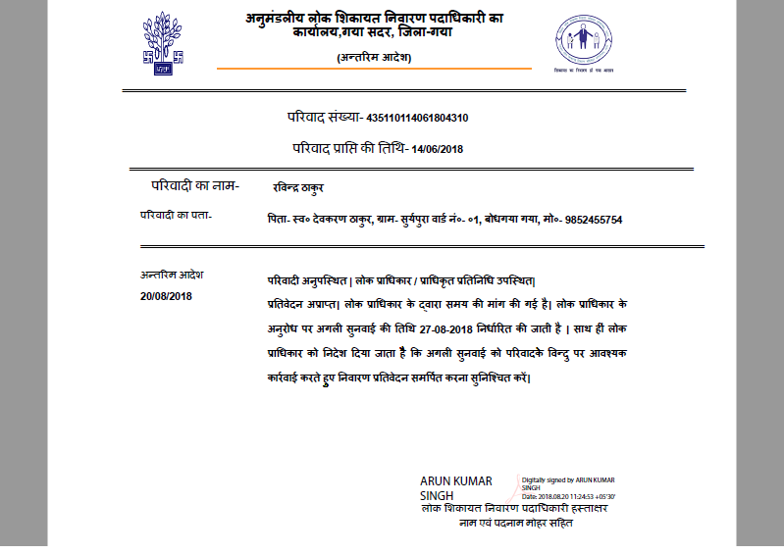
Orders: Interim
Type of Order and Date of Hearing
Details of the Interim Order

Slide 38
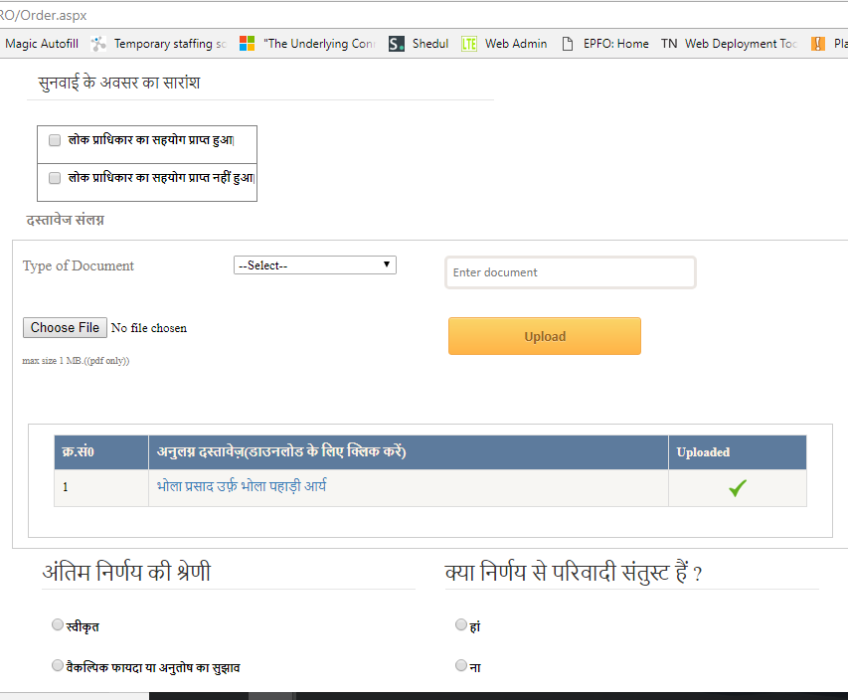
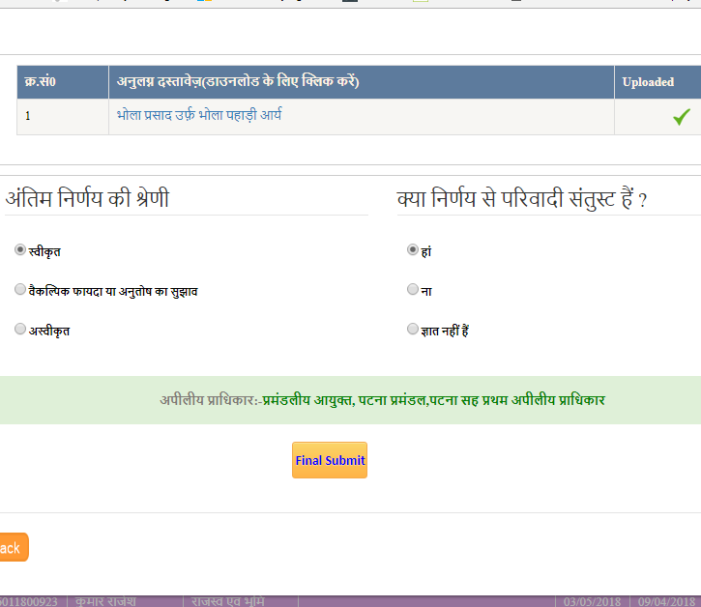
Orders: Final
Category of the final order:
Accepted (Redressed)
Alternative Remedy
Rejected
Complainant Satisfied with the Order or not
Support from Public Authority provided or not
Documents Uploaded
Appellate Authority

Slide 39
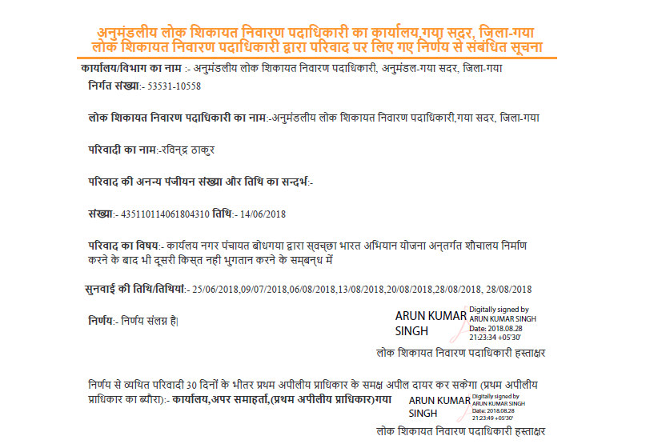
Final Order
Name of the PGRO
Name of the Complainant
Complaint Id and Date
Nature of Grievance
Dates of Hearings
Details of the First Appellate Authority

Slide 40
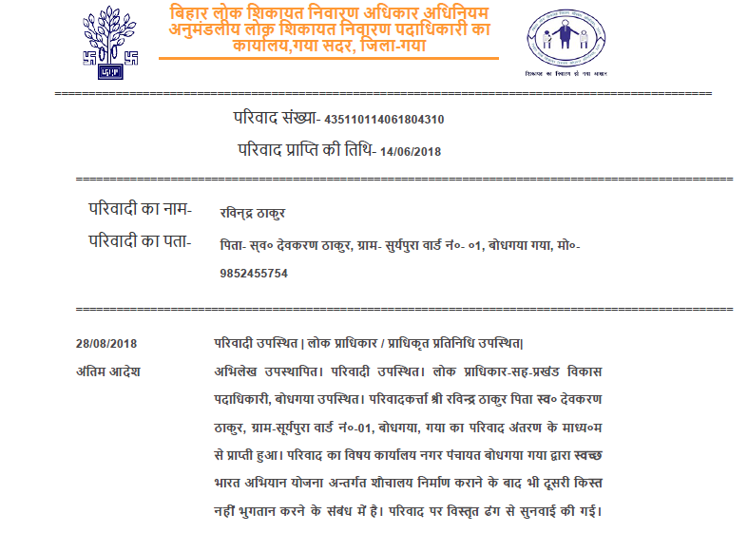
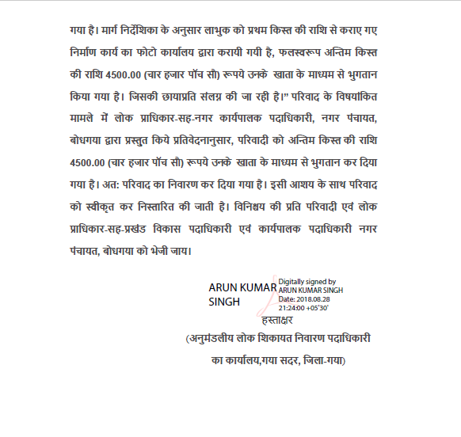
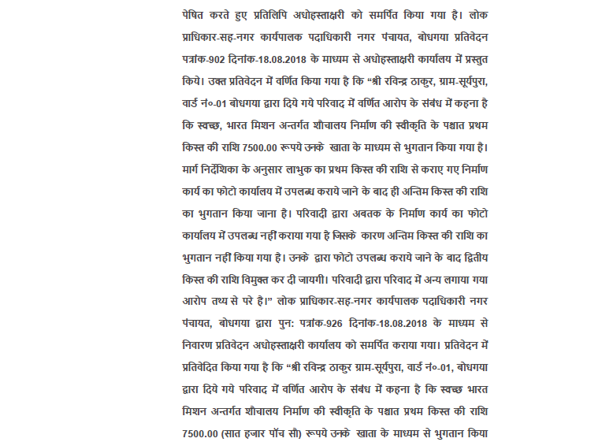
Final Order
Reasoned Order

Slide 41
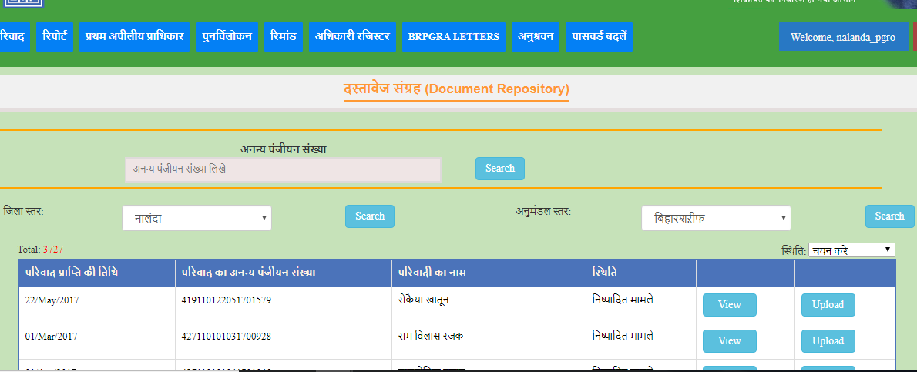
Document Repository – All documents relating to a complaint stored online
At District level
Search based on Complaint ID
At Sub Division level
The Appellate Authorities need not seek LCR related to any appeal filed as all the documents available online

Slide 42
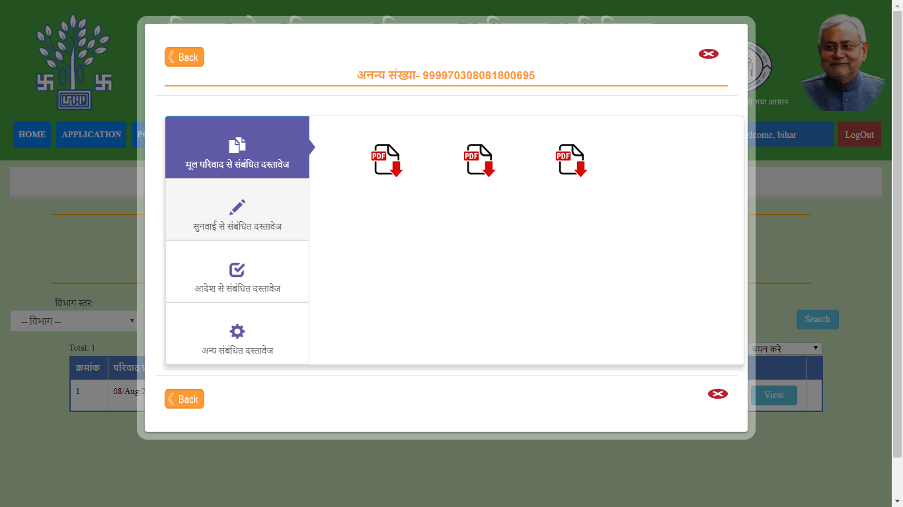
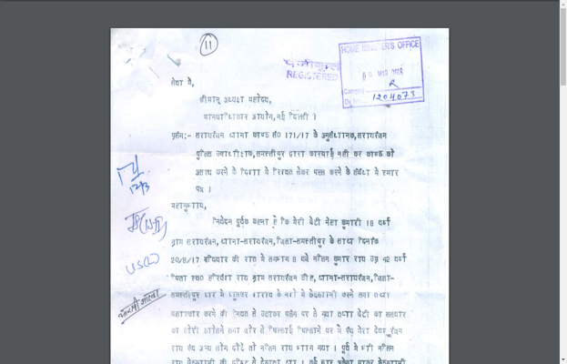
Document Repository – All documents relating to a complaint stored online
Uploaded Document

Slide 43
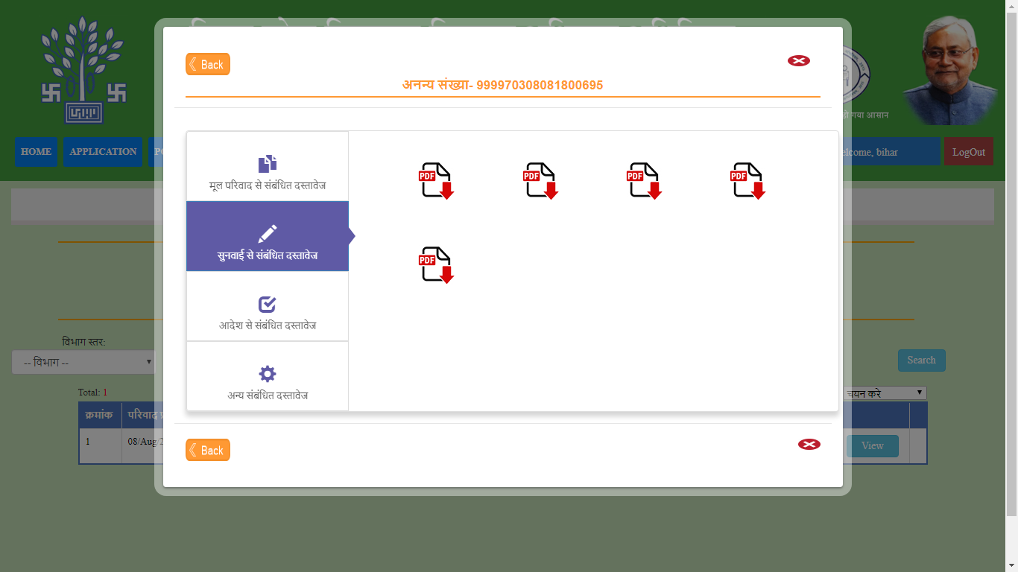
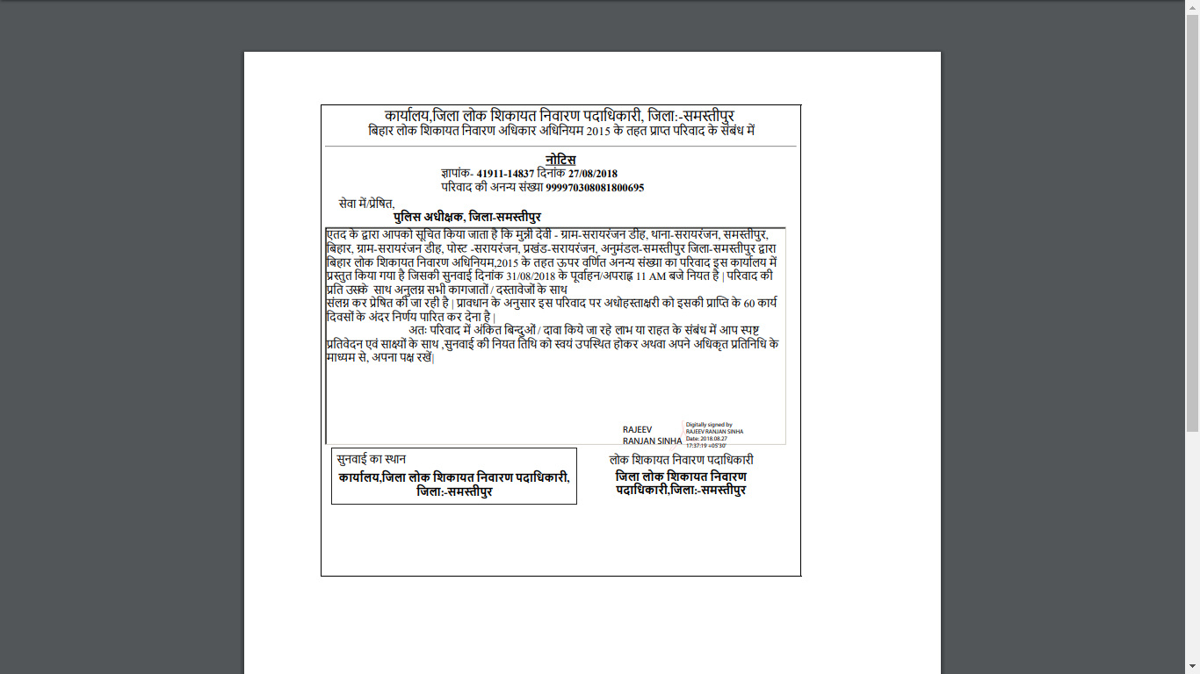
Document Repository – All documents relating to a complaint stored online

Slide 44
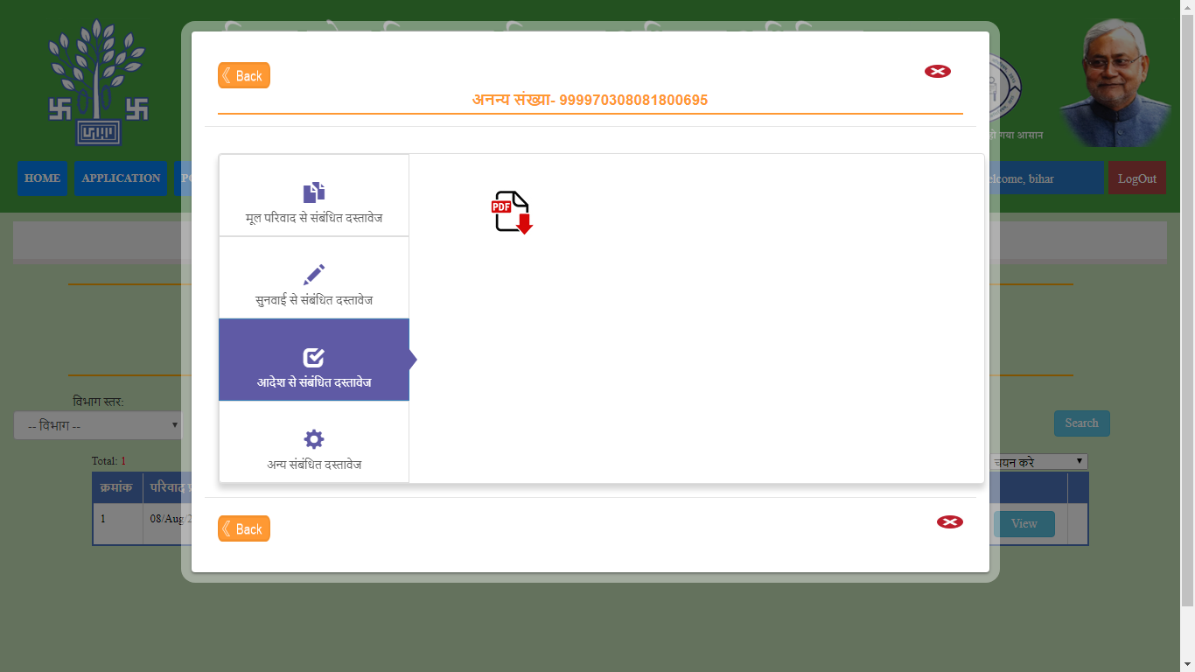
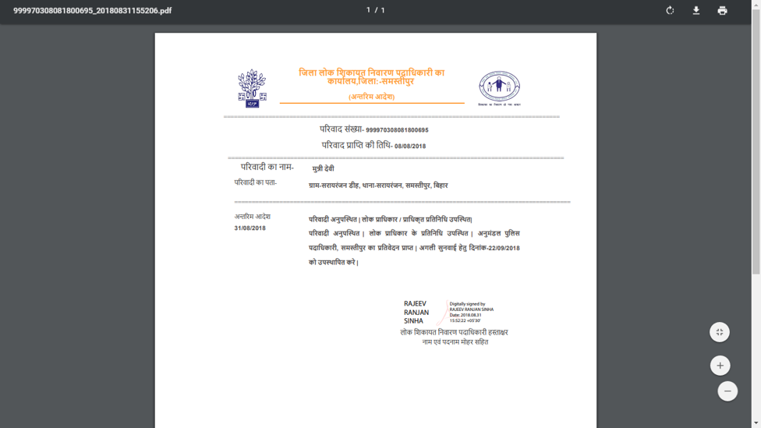
Document Repository – All documents relating to a complaint stored online

Slide 45
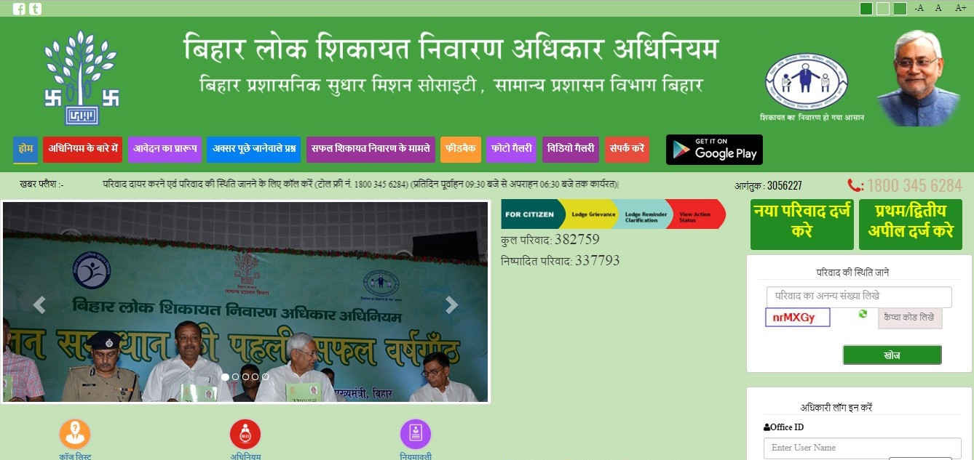
Appeals
Online filing of Appeals
The processes of registration, notice, hearing and order follow the same steps as those for a complaint and as with a complaint all information and documents are digitized.

Slide 46
DIGITAL MONITORING

Slide 47
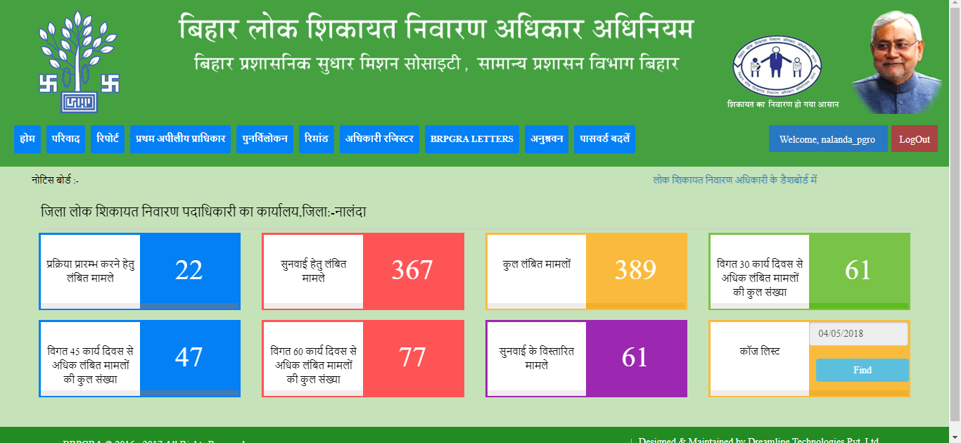
Monitoring – PGRO Dashboard
Cases to be initiated
Cases pending for hearings
Total Cases pending
Cases pending for more than 30 days
Cases pending for more than 45 days
Cases pending for more than 60 days
Cases extended for hearings
Cause List

Slide 48
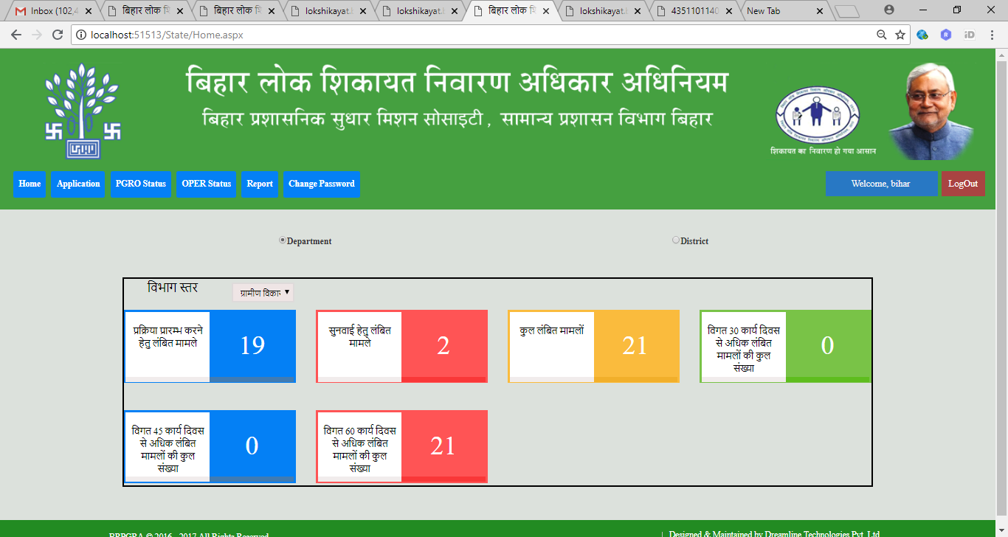
Monitoring – BPSMS
At Department level
Cases to be initiated
Cases pending for hearings
Total Cases pending
Cases pending for more than 30 days
Cases pending for more than 45 days
Cases pending for more than 60 days

Slide 49
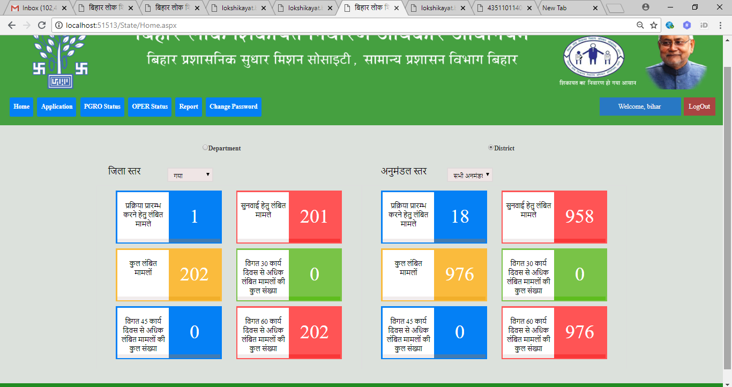
Monitoring – BPSMS
At District level
At Sub Division level
Cases to be initiated
Cases pending for hearings
Cases pending for more than 30 days
Total Cases pending
Cases pending for more than 45 days
Cases pending for more than 60 days
Similar dashboards for District Magistrate, Divisional Commissioner and Department

Slide 50
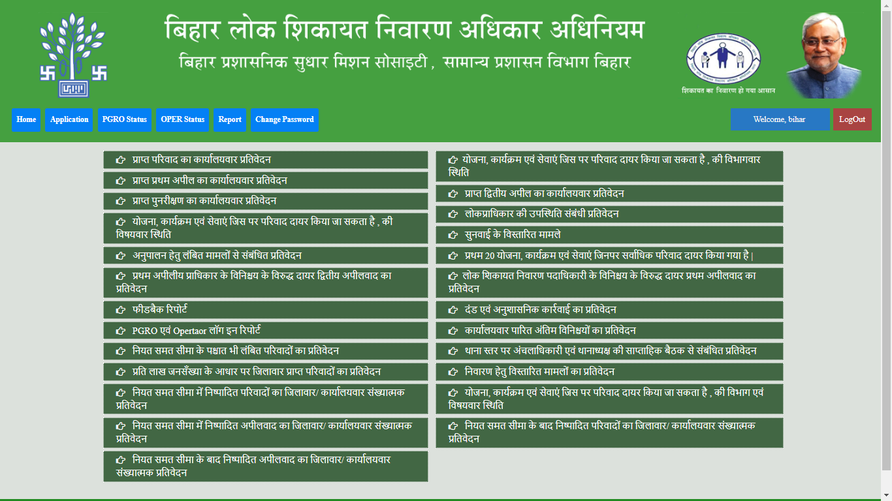
MIS - Reports
Officewise report on complaints received
Officewise report on First Appeals received
Officewise report on Revision Petitions received
Status of complaints filed based on nature of complaints
Report on Pending for compliance cases
Report on 2nd Appeals filed against first appeal orders
Feedback report
PGRO and Operator login report
Cases pending beyond timelimit
District wise report on complaints per lakh population
District wise/Office wise Report on complaints disposed within timelimit
District wise/Office wise Report on appeals disposed within timelimit
District wise/Office wise Report on appeals disposed after timelimit

Slide 51
MIS - Reports
Department wise Status of complaints filed based on nature of complaints
Officewise report on 2nd appeals received
Report on attendance of Public Authorities
Extended cases for hearing
Top 20 schemes/programmes/services registering highest number of grievances
Report on 1st Appeals filed against orders issued by PGROs
Report on penalty and disciplinary action
Office wise report on final orders passed
Report on weekly meeting held at SHO level with Circle Officers
Report on cases extended for redressal
Department and Nature of complaint wise report on schemes/programmes and services on which complaints can be filed
District wise / Office wise report on complaints disposed beyond timelimit

Slide 52
MONITORING & EVALUATION

Slide 53
Continuous Improvements
Based on
Reviews
Periodic field visits by the Hon’ble Chief Minister to all 38 districts of Bihar; Daily review of orders issued on to ensure the Act, Rules and Guidelines are being followed
Knowledge sharing
Regular review meetings/trainings held for capacity building knowledge/best practices dissemination
Independent Assessments
DFID supported Technical Assistance Team (IPE GLOBAL LTD.)
Third Party Evaluation
Third party evaluation through ASCI, Hyderabad under progress

Slide 54
Continuous Improvements
Enhanced implementation
95% Public Authority (PA) attendance ensured through emphasizing on mandatory presence of PA
Reduction in the average number of hearings per complaint to 2.9 from 5.5
Prevention of “pass the buck” syndrome
Ensuring redressal and recording of the same
Feedback
Citizen satisfaction captured at the time of issue of final order to ensure feedback
Digital solutions
Cloud storage introduced to enhance data security
Digital document data repository created
Digital signature for notices, orders and summons introduced to make the system paperless
Awareness and Dissemination
Campaigns intensified with many new modes of communication (such as CM’s voice SMS, Video Vans, Radio jingles, Outreach to panchayats by PGROs) to create awareness among citizens about their legal right and the ease of access
From a longer perspective, MoUs signed with 3 premier Institutes in Patna for sustained studies, research and new ideas

Slide 55
Proportion of Redressals within timelimit

Slide 56
Improvement in Attendance
95%
100
80%
90
80
Attendance of Public Authorities during hearings
70
60
55%
50
40
30
20
2%
10
0
Jun’16 – Dec’16
Jan’17 – Jun’17
Jul’17 – Dec’17
Jan’18 – May’18

Slide 57
Citizen centricity - Feedback
Complainant Satisfaction captured
89%
Complainants satisfied with the system

Slide 58
ACHIEVEMENTS

Slide 59
Performance Indicators
Email
0.6%
Call Centre
3.1%
Post
6.5%
0.4%
Mobile App
Online
6.7%
Grievances by Source
82.7%
Counter
Total Grievances Registered: 3,80,084
Data as on 03.09.2018

Slide 60
Performance Indicators
Pending beyond time limit
3%
Pending within time limit
8%
Grievances by status
89%
Disposed
Total Grievances disposed: 3,39,743

Slide 61
Appeals
Total First Appeals: 33,470
Total Second Appeals: 10,002

Slide 62
Analytics – basis for systematic reforms
Other than Positive and Negative List
4.2%
Negative List
12.3%
Grievances by Type
83.5%
Positive List

Slide 63
Analytics – basis for systematic reforms
Home
Revenue and Land Reforms
Rural Development
Energy
Social Welfare Department
16%
26%
11%
9%
8%
Electricity bill
Payment for various pensions/welfare schemes
Land dispute / breach of peace
IAY
Encroachment

Slide 64
FEW SUCCESSFUL REDRESSALS

Slide 65
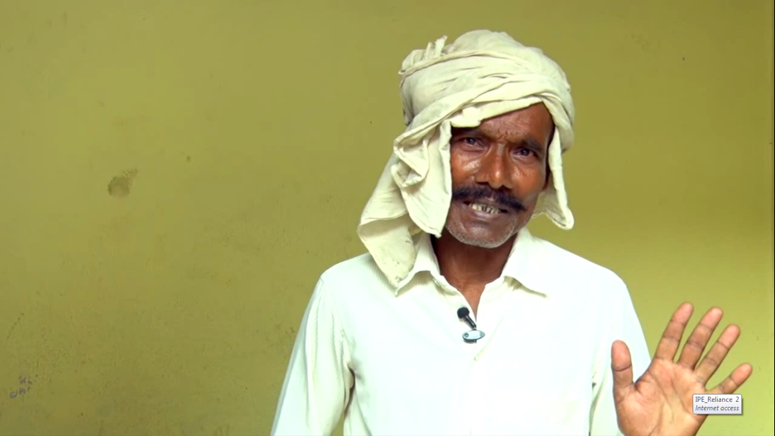
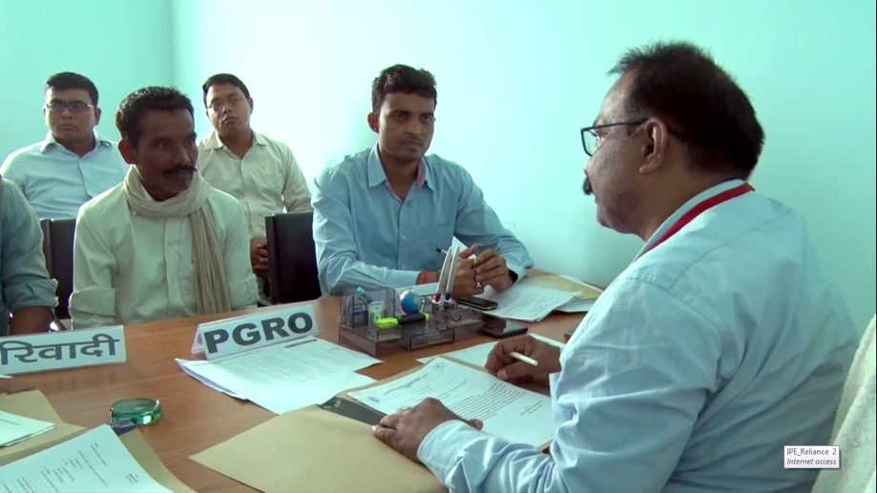
Paras Ram in Bhojpur gets possession of land
after 25 years
Got land receipt in 1993 but did not get the possession of the land for 25 years
But, once I filed a complaint under Bihar Lok Shikayat Adhikar Adhiniyam, I got the possession of land

Slide 66
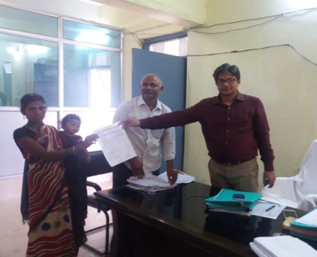
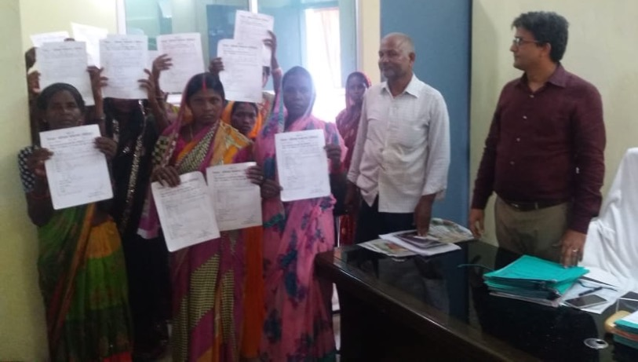
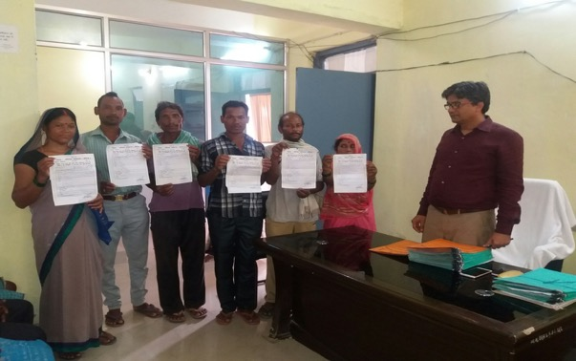
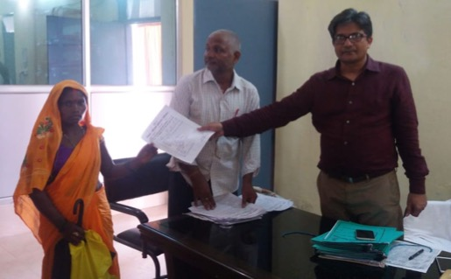
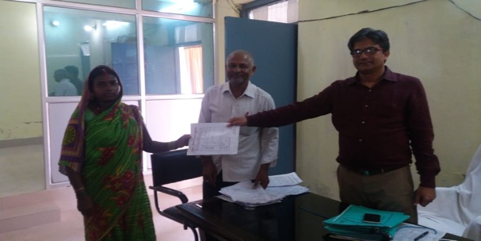
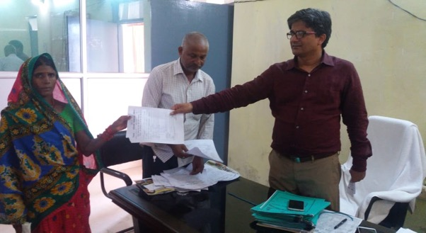
More than 95 Mahadalit landless families receive land
More than 95 Mahadalit landless families received land under the Bihar Privileged Persons Homestead Tenancy Act, 1947 for settlement. Many families said that due to lack of land papers they were not able to get the benefit of IAY till now, which they will be able to get now.

Slide 67

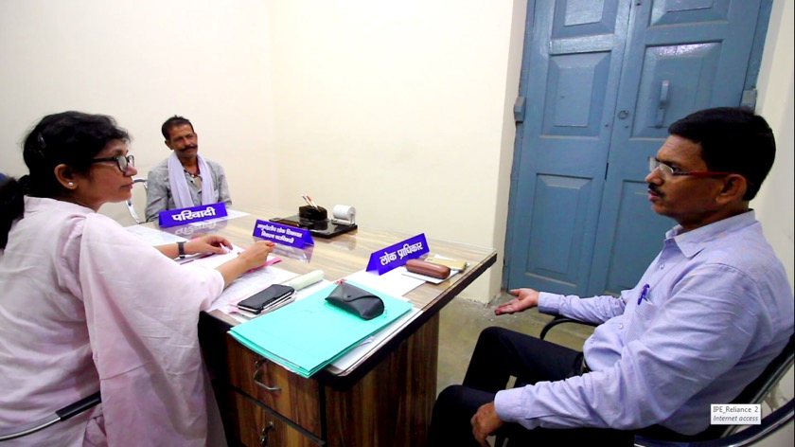
Somdutt Sharma, Jehanabad and many other farmers get irrigation facility
Encroachment on Government aahar pyne land led to obstruction in irrigation of approx. 100 acres of agriculture land
When I came to PGRO office, my work was done within 60 days

Slide 68
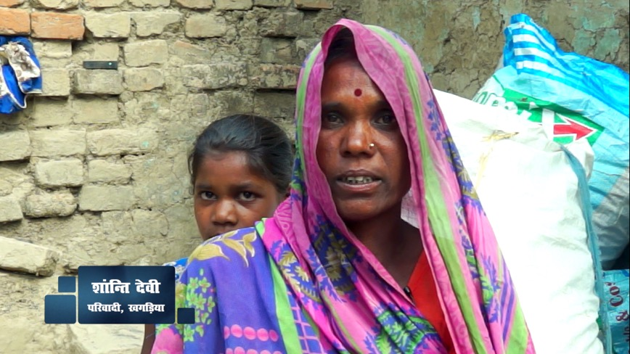

Shanti Devi’s abducted son returns home
13 year old son got abducted but even after 4 months no one responded to her requests for action.
After the Sub-Division PGRO, Gogri taking action on the complaint filed, instructed the SHO for quick action, my son was recovered and returned back to me.

Slide 69



Madhuri Kumari, Lakhisarai gets access to deceased husband’s bank A/c
13 year old son got abducted but even after 4 months no one responded to her requests for action.
After my husband’s death, I was facing problems in accessing the amount in his A/c. But when I came to BRPGR office my work was done in very short period.

Slide 70

Vishnu Dev Yadav, Madhepura receives pension
I was getting Old age pension for many years but the pension stopped for 6 months. No action taken even after many complaints. But after filing a complaint under BRPGRA I got the due pension within 45 days.

Slide 71



Md. Anwar Ali’s village in Madhubani district gets electricity supply
Even after installation of poles for village electrification, electricity supply was not done. But after coming to lok shikayat, within one month my problem was resolved.
Today more than 150 BPL HHs in this village have access to electricity.

Slide 72



Chandra Kishore Shah, Sheohar receives 2nd instalment of PM Awas Yojana
I received the 1st instalment under IAY but was not getting the 2nd instalment. But after filing my complaint in Sub-Division PGRO, Sheohar I got the 2nd instalment of Rs. 1 lakh for constructing my house.

Slide 73



Krishna Prasad Singh, Jehanabad gets more than
Rs. 2 cr. as land acquisition compensation
Was not getting the due land acquisition compensation amount for more than 2 years, even after providing all the supporting documents. But, under BRPGRA I only gave one document and within one month my problem was resolved (received more than Rs. 2 cr.)

Slide 74


Khushi Priya, Vaishali gets matriculation incentive amount
Even after passing the matriculation exam, she was not receiving the matriculation incentive amount.
After filing the complaint under BRPGRA, within a fortnight the incentive amount was released to Khushi Priya.

Slide 75

Usha Devi in Patna gets corrected electricity bill
I was getting incorrect electricity bill from more than 2 years but despite regular requests for correction kept receiving the incorrect bills. I paid the bill amount 2-3 times as well. But when I came to PGRO office my complaint was resolved in less than 2 months.

Slide 76



Recognition for outstanding innovation in Governance
National
BPSMS awarded the prestigious Kalam Innovation in Governance Award 2018 in January 2018 for Implementation and Monitoring of BRPGRA
Skoch Order-of-Merit and Skoch Gold Award 2018 conferred in June 2018 on BPSMS for Governance reforms through BRPGRA
International
CAPAM International Innovation Award 2018: Finalist in the Citizen focused reforms category.
Presentation to be made in Georgetown,
Guyana in October 2018.

Slide 77
CONCLUSIONS

Slide 78


Foundation for a successful implementation.
Information Technology
End to End digitization - from receipt till redressal
Document repository and digital signature
Cloud storage for data security
Human Resources and Capacity Building
Independent Administrative structure: PGROs selected after intensive selection process
More than 1000 IT skilled support staff
Dedicated infrastructure
141 Grievance Receiving cum Facilitation Centres
Separate Counters, Basic amenities for citizens provided

Slide 79
Ensuring Accountability –
Rewards and Punishments
Recognition for good performance:
Best performing Districts have been awarded during the Civil Services Day
Best performing District and Sub-Divisional PGROs have been felicitated during the June 5th 2017 & 2018 events by the Hon’ble Chief Minister

Slide 80
Ensuring Accountability –
Rewards and Punishments
Punishment for poor performance
RS. 7.52 lakh IMPOSED
ON A TOTAL OF 254 PUBLIC AUTHORITIES
Disciplinary action initiated on 64 Public Authorities

Slide 81




ACHIEVING OUR AIM OF GOOD GOVERNANCE
SUCCESS
CITIZN EMPOWERMENT AND SATISFACTION
ENSURING GRIEVANCE REDRESSAL
POWER PARITY
ACCESSIBILITY, ACCOUNTABILITY AND TRANSPARENCY

Slide 82
See it to believe!
Interested in this innovative initiative?
Bihar Prashasanik Sudhar Mission Society would be happy to provide any support
We arrange exposure visits to experience this initiative firsthand.

Slide 83
Replicability
BRPGRA, its implementation and monitoring systems are easily replicable across the country in all States and UTs

Slide 84
‘Samadhan’ – documentary

Slide 85
Moving ahead with Good Governance
Thank You
For Your Patience
Tel.: 0612-2215908
Email: bpsms1@gmail.com
Website: http://lokshikayat.bihar.gov.in/

