Slide 1


Increasing the Take-Up of the Canada Learning Bond: Targeting Children at Key Educational Milestones with Behavioural Insights
Mathieu Audet & Monica Soliman,
with Emilie Eve Gravel & Rebecca Friesdorf
Employment and Social Development Canada

Slide 2




Roadmap
The Canada Learning Bond
Approach and Methodology
Results
Lessons Learned

Slide 3
The Canada Learning Bond

Slide 4
The Canada Learning Bond
  The Canada Learning Bond (CLB) is a part of the Canada Education Savings Program (CESP). It is designed to encourage and reinforce the importance of saving for a child’s post-secondary education by using Registered Education Savings Plans (RESPs).
  Low-income families receive $500 upon opening an RESP and applying for the CLB and $100 for every year that they are eligible until the child turns 15.
  These families are defined as earning $45,916 or less in adjusted net family income children for two children or less. This income increases for families with 3 or more children.
      No personal contributions are required for the CLB and retroactive payments can be received prior to the child’s 15th birthday.
  Low-income families that contribute to their RESP can also receive additional CESP benefits like the Canada Education Saving Grant (CESG).

Slide 5
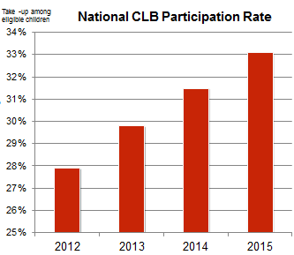
The Canada Learning Bond
The CESP provides the greatest incentives to low-income families (including the CLB), yet those families have the lowest participation rate.
Progress has been made at increasing CLB take-up through various outreach and experimentation initiatives.
As of 2015, 2 in 3 eligible children were not signed up for the program.
Approximately 1.68 million eligible children have yet to receive the benefit.

Slide 6
The Canada Learning Bond
Possible barriers to participation among low income families that were identified with the major project:
  1. Misperceptions about RESPs
    e.g., a need to contribute your own money, thinking that it only covers tuition for universities
  2. Process barriers
    e.g., requiring Social Insurance Numbers for parents and children, opening an RESP account
  3. Subjective distance
      The benefits of the program (supporting child’s post-secondary education) may feel distant in time and difficult to visualize. This can reduce people’s willingness to join the program now.
  4. Low awareness of the CLB

Slide 7
Approach and Methodology

Slide 8
Trial Overview
Context
CESP is involved in a number of research projects with various partners to improve take-up of the CLB as well as better understand their clients. This is the third behavioral insights trial undertaken to test the effectiveness of mailings to Canadian families living in low income.
Specifically, previous experiments demonstrated the effectiveness of these mailings and also showed that caregivers of older children were less likely to open an RESP in response to the letter.
Building on this work, this trial focused on the oldest eligible cohort (i.e., children born in 2004) to test the effectiveness of targeted messaging approaches.
.

Slide 9
Trial Overview
The Approach: Iterative and Mixed-Method
Trial 1 & 2
Interventions were developed using evidenced-based principles from behavioral insights. The impact of the new, revised letters was underwhelming.
Major Design Project
In response, the Innovation Lab’s Design Team conducted qualitative field research, speaking with parents of eligible children, community organizations supporting program outreach, and teachers to better understand the barriers and other factors contributing to low sign-up.
Trial 3
Design of the letters was informed by results and insights from both the quantitative and qualitative work.

Slide 10
The Virtuous Cycle of Mixed Methods
Insights from field work inform the design of new interventions
Quantitative results validate qualitative insights and new findings emerge
Qualitative research captures needs and experiences of program users

Slide 11
Trial Overview
Objective
Test the effectiveness of different letters sent to caregivers of the oldest cohort of CLB-eligible children for opening an RESP and requesting the CLB.
Method
Using a randomized controlled trial (RCT) 147,758 PCGs were randomly assigned to one of six equivalent groups.
Take-up was tracked and analyzed to assess the effectiveness of the letters and determine which messages were most effective.
Outputs and Outcomes
The trial seeks to understand the causal impact of letters informed by behavioral insights and design work on CLB take-up (outcome).

Slide 12
Mailing Interventions
  Control Group
  Did not receive a letter, represented the natural take-up rate of the CLB.
  Mailing Group 1
  Received the standard letter used by the CESP, which integrated the behavioral insights principles of personalization (i.e., letter addressed with name of child; Trial 1) and simplification (Trial 2).
  Mailing Group 2
  Received a letter presenting the exact amount the child was eligible to receive (i.e., dynamic field that changes a function of years of eligibility). In the field research, caregivers shared that the most confusing part of the letter was that it indicated the minimum and maximum CLB amounts that the child may receive.

Slide 13
Mailing Interventions
  Mailing Group 3
  Included a social norm emphasizing the number of children already enrolled in the program. Based on the BI principle that people are more likely to engage in a behaviour if they think many other people are.
  Mailing Group 4
  Increased salience of PSE options by presenting an image of different types of PSE options (i.e., apprenticeship, trade school, CEGEP, college, or university) to address concerns about the feasibility of attending post-secondary education (i.e., that PSE is not just university). For older children, feasibility concerns tend to become more salient, including financial and ability (children’s grades in school).
  Mailing Group 5
  Emphasis on “savings” was reduced. The qualitative research revealed that many eligible caregivers, given their precarious financial situation, did not feel that they could save, and thus the term “savings” did not resonate with them.
  For Group 3, 4, 5 the letter also specified the exact amount the child was eligible for.

Slide 14
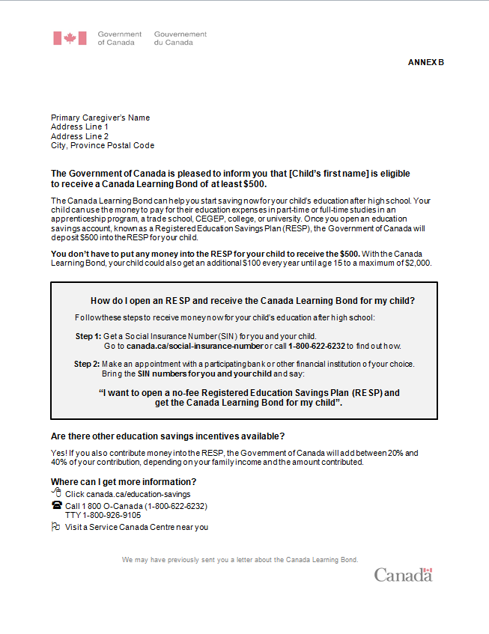
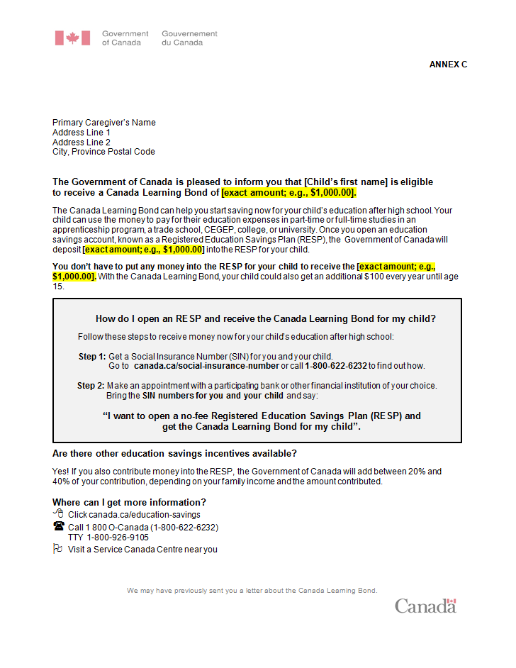
Mailing Interventions
Standard Letter
Exact Amount Letter
Personalization
(Trial 1)
Exact
Amount
(qualitative
insight)
Simplification
(Trial 2)

Slide 15
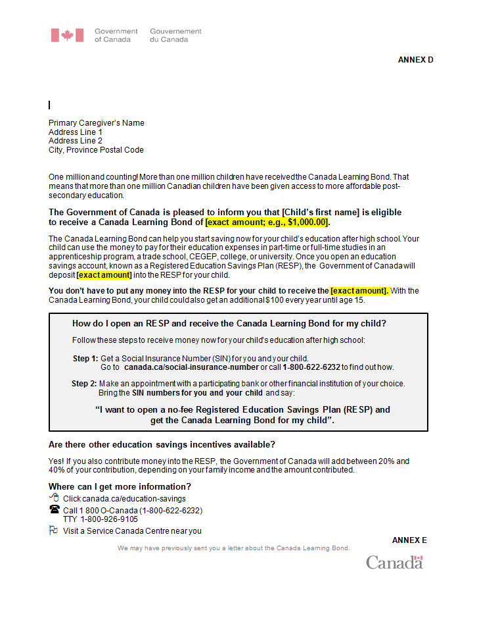

Mailing Interventions
Exact Amount + Social Norm
Exact Amount + Salience of PSE options
Social norm
Exact amount
(qualitative insight)
Exact amount
(qualitative insight)
Diversity of PSE options
(qualitative
insight)

Slide 16

Mailing Interventions
Exact Amount - Savings
Reducing emphasis on term “savings”
(qualitative insight)

Slide 17
Results

Slide 18


How effective were the letters at increasing the take-up of the CLB overall?
Modified letters
Without receiving any letters, approximately 2 out of 100 children received the CLB over a 7 month period
Receiving the letters resulted in 3-4 additional children out of 100 receiving the CLB.
Receiving a modified letter resulted on average in 5-6 additional children out of 100 receiving the CLB

Slide 19
Which letter worked best overall?
Notes:
This analysis was conducted while controlling for province, family size, language, demographic density and years of eligibility.

Slide 20
What other factors influenced take-up of the bond?
Region
Consistent with previous trials, British-Colombia and Québec had the highest take-up rates of all provinces and territories.
Language
Contrary to previous trials, language was not found to significantly influence take-up. However, a more robust analysis controlling for differences betwen provinces was used, which may have reduced the effect of language.
Family size
Contrary to previous trials, family size was not found to significantly influence take-up. This may be due to the fact that this trial targeted children age12-13 and that most families did not have had more than one eligible child in the trial.
Demographic density
Consistent with previous trials, PCGs living in rural areas had a lower take-up than those living in urban areas.
Length of eligibility
Consistent with previous trials, newly eligible children had a higher take-up than those who were previously eligible.

Slide 21
Which letter worked best with newly eligible children?
All letters worked better than sending no letters, but there were no differences in performance between the letters.

Slide 22
Which letter worked best with previously eligible children?
Exact amount-savings had the highest take-up

Slide 23
Which letter worked best with children living in rural areas?
All modified letter had higher take-up than the standard letter or the control group; there were no differences between the modified letters.

Slide 24
Which letter worked best with children living in urban areas?
Exact amount-savings had the highest take-up

Slide 25

Overall Projected Impact
Highest performer:
Dynamic Field - Savings
No letter
217 potential 13 years old children benefit
$206,602
Standard letter
+ 356 letters
573 potential 13 years old children benefit
$569,790
Letter + Dynamic field/Nudge
+ 298 letters
878 potential 13 years old children benefit
$977,789

Slide 26
Lessons Learned about Communicating with Canadians
Simplification is key
The success of the letters with a dynamic field reveals that ambiguity needs to be reduced to a minimum, if not eliminated altogether.
Personalization is important
Tailoring messages to relevant characteristics of program users may enhance the effectiveness of mailings. Low income Canadian families may prefer communications avoiding language that does not personally resonate with their financial situation.
  Minimizing references to savings was effective at increasing take-up; this was a consistent trend across groups.
Everything is contextual
One size-fits-all approach is not optimal. Families eligible for CLB are diverse. CLB take-up is influenced by locale (e.g., provinces, rural/urban settings) and personal characteristics (e.g., numbers of years living in low income, age of child). Again, message tailoring is an important direction for future mailings

Slide 27
Lessons Learned about Communicating with Canadians
Reminders are useful
Most children in this trial were previously eligible. Thus, this trial can be viewed as a test of reminders to register for the CLB. In previous trials, take-up was lower in older children. The findings from the current trial indicate that reminders are particularly effective at increasing take-up in this population.
Bland is the brand
Consistent with the findings of Trial 2, the imagery letter performed worse compared to the exact amount and exact amount – savings letters. This is further evidence that Canadians may expect and prefer a formal look in communications from the Government of Canada.

Slide 28
Lessons Learned about Experimentation
Iteration pays off
The findings from previous trials and field have helped to design letters that may resonate more with the needs and experiences of eligible Canadian. Overall, it takes several trial to not only nail what works best, but what doesn’t.
Replication is critical
Cumulative evidence is necessary for reliable and valid conclusions. Taken together, evidence from this trial and previous ones suggest that:
  Social norms and imagery may not resonate with eligible families
  Simple and crystal clear information work best at increasing CLB uptake
Mix and match innovative tools/research methods.
Using mixed-method approaches allows a better understanding of the needs and experience of program users. In turn, insights from field work can help inform the design of new interventions. Conversely, using quantitative methodologies can validate insights from qualitative field work.

Slide 29
Limitations and Future Directions
What drove the performance of Letter 5?
It’s difficult to determine at this point whether the performance of the exact amount – saving letter was due to content or the fact that the letter was more simple.
Small sample sizes
Larger sample sizes are needed to produce more reliable results for groups with smaller populations (e.g., provinces with low population, families living in rural/isolated areas).
What other factors influence take-up?
The effect of other important demographic characteristics remain to be investigated (e.g., gender, ethnicity, education, disability, income, martial status).
Understanding the underlying diversity of needs of eligible families
Better message tailoring requires that we consider researching the needs and experiences of specific populations (e.g., First Nations, families living in isolated and rural communities). Additionally, we know next to nothing on families who have not gotten the bond.

Slide 30



Merçi!
Mathieu Audet
Manager, Behavioural Insights
Innovation Lab, Employment and Social Development Canada
mathieu.audet@hrsdc-rhdcc.gc.ca
Monica Soliman
Research Advisor
Client Experience Branch
Immigration, Refugees and Citizenship Canada
Monica.Soliman@cic.gc.ca
Emilie Eve Gravel
Behavior Scientist,
Innovation Lab, Employment and Social Development Canada
emilie.e.gravel@hrsdc-rhdcc.gc.ca
Rebecca Friesdorf
Behavior Scientist,
Innovation Lab, Employment and Social Development Canada
rebecca.friesdorf@hrsdc-rhdcc.gc.ca

