Slide 1



Energy Efficiency Citizen-Centric Design
Report on Research Findings & Recommendations
Jess McMullin, Situ Strategy
Joël Bourgeoys, Natural Resources Canada
Laura Read, Alberta Energy CoLab
March 31st, 2017

Slide 2
Table of Contents
Overview & Key Principles…………..………………....05
Why This Approach………………………………………...07
Visual Summary…………………………………………..…08
Lessons Learned & Recommendations……….……22
Next Steps & Future Opportunities….………………27

Slide 3
Overview & Key Principles

Slide 4
Project Overview
The City of Edmonton, The Government of Alberta, and the Federal Ministry Natural Resources Canada partnered together to help deliver improved programs for citizens to undertake energy efficiency improvements in their homes.
This collaboration will inform the City of Edmonton’s Residential Energy Labeling Program, Natural Resource Canada’s EnerGuide label for homes, and the Province of Alberta’s housing and energy efficiency divisions.
This project focuses on research and design for the energy efficiency behaviour and motivations of homeowners and landlords. This includes the actual energy audit, labeling, and renovation process. It also includes broader behaviour and motivation around energy and cost savings, home maintenance, environmental considerations, etc. The research team conducted different phases of research with NRCan, COE, and GOA internal stakeholders, members of the public, and other external stakeholders.
This research complements _{existing} research and information that has already been done by the project partners in the past.
Based on the insights from the initial research, the team prototyped and tested several concepts with residents. These prototypes were low-fidelity ‘quick and dirty’ prototypes that allowed low cost rapid exploration of ideas for improving and supporting residential energy labeling.

Slide 5
Key Principles for Success
Collaboration Across Jurisdictions
The collaboration between the levels of government is key to the success this project has had. The connection between frontline program delivery at the local level through to national programs and policy provides an invaluable context in understanding the energy efficiency experience.
The opportunity to use the city as a lab is a great opportunity for NRCan to see the direct impact of programs and policy in citizen’s lives. It also helps participants, and our city and provincial partners knowing that the insights gained will inform programs and policy across all three levels of government.
Onsite Collaboration
The ability for NRCan staff to join the onsite team in Edmonton was also invaluable for several reasons:
Increased ease for remote collaboration
Greater familiarity with the content and process so that an internal NRCan resource can become the owner for the experience and insights generated.
Greater credibility as a partner with other levels of government.
Ability to bring NRCan perspective and expertise directly into conversations about insights, opportunities, feasibility, etc.

Slide 6
Key Principles, Continued
Direct Deep-Dive Research with Citizens
Direct observational and behavioural research with citizens is a key principle of human-centred design. This approach builds on and extends from more typical engagement or survey work.
It provides a stronger foundation for insights based on deeper research into behaviours, not simply preferences that dominate survey data. And the rich narratives from this work both build empathy and expand our insights into the system as a whole.
Finally, this approach helps avoid the risk of only looking at what people say, rather than what they do. As polls vs. votes over the past year have shown, relying on people to be clear in their survey responses carries significant risks.
Privacy and Consent
All participants gave informed consent and signed consent forms for their participation as required by privacy legislation.
The Design Process
We worked together through a design process that included:
Behavioural field research
Focusing on understanding people in their own context.
Codesign workshops with citizens and with the team
Designing with people, rather than simply for them.
Prototyping and prototype testing
Trying ideas for learning and risk management by making them concrete and tangible.

Slide 7
Key Principle:
Total Value

Slide 8

Instagram
13 Employees
$86 Million book value
$1.1. Billion Acquisition

Slide 9
In the private sector we call that ‘goodwill’. In the public sector we call it trust and confidence in government.

Slide 10
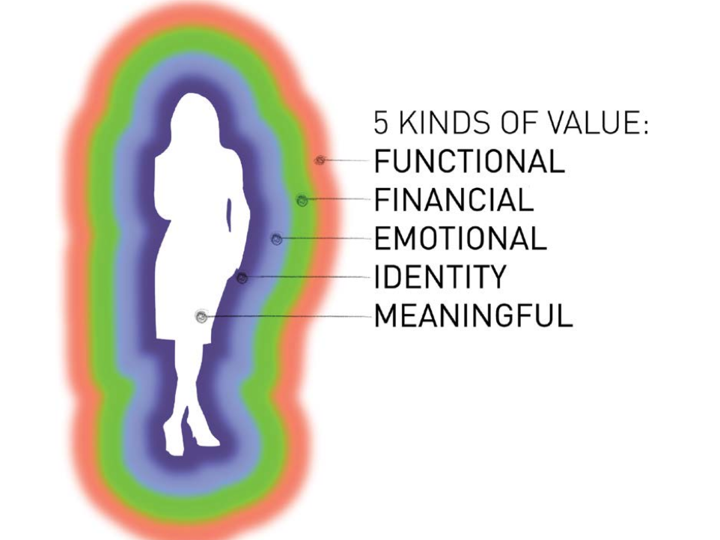
Total Value Comes from 5 Kinds of Value
Image from Blind Spot, Nathan Shedroff, Steve Diller, 2016

Slide 11
Design Thinking: Applying design logic and design methods to solve nontraditional design problems such as strategy, policy, business models, organizational structure, and culture.
Design logic: generating alternatives. Transformative innovations don’t come from incremental improvements. They must come from a deep well of possibility that looks beyond the linear trends in past data to see new opportunities and new futures.

Slide 12
Field Research

Slide 13
Fieldwork Approach
We visited people in their homes during their energy audit. We observed the audit process and interviewed homeowners about their energy use, past activities with energy efficiency and home upgrades, reviewed the EnerGuide label and their understanding of it, and their understanding of the EnerGuide process.
Analysis
Members from each organization came together over two days, reviewed the notes from each session, and extracted highlights from each interview. Then the team themed, clustered, and structured these elements to look for patterns, insights, and opportunities.

Slide 14
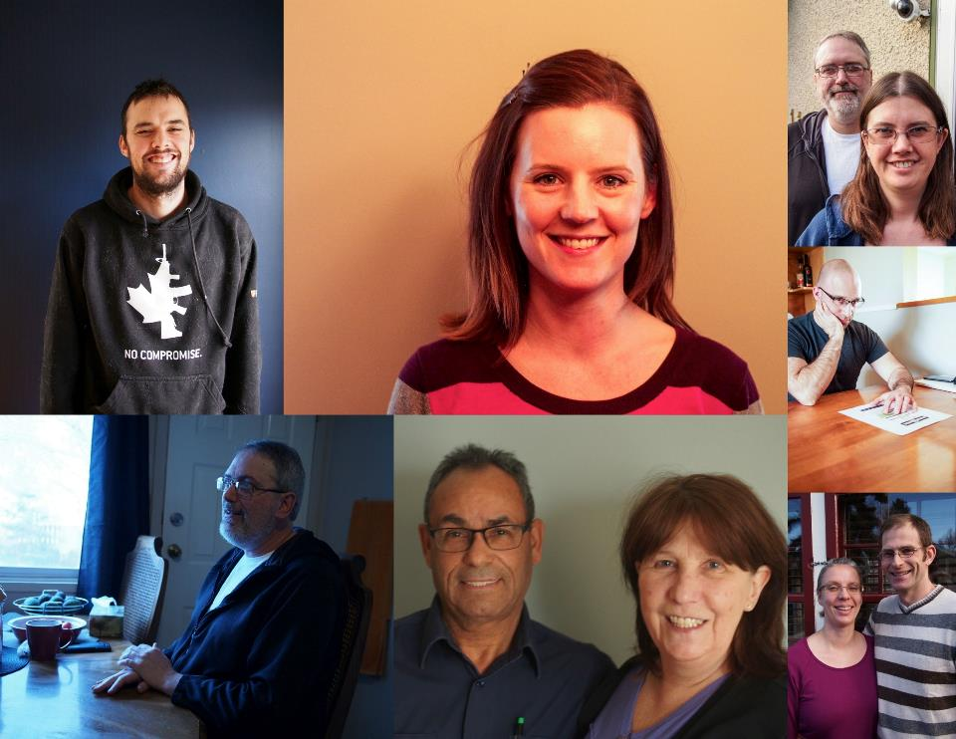
Just a few of our 24 participants

Slide 15
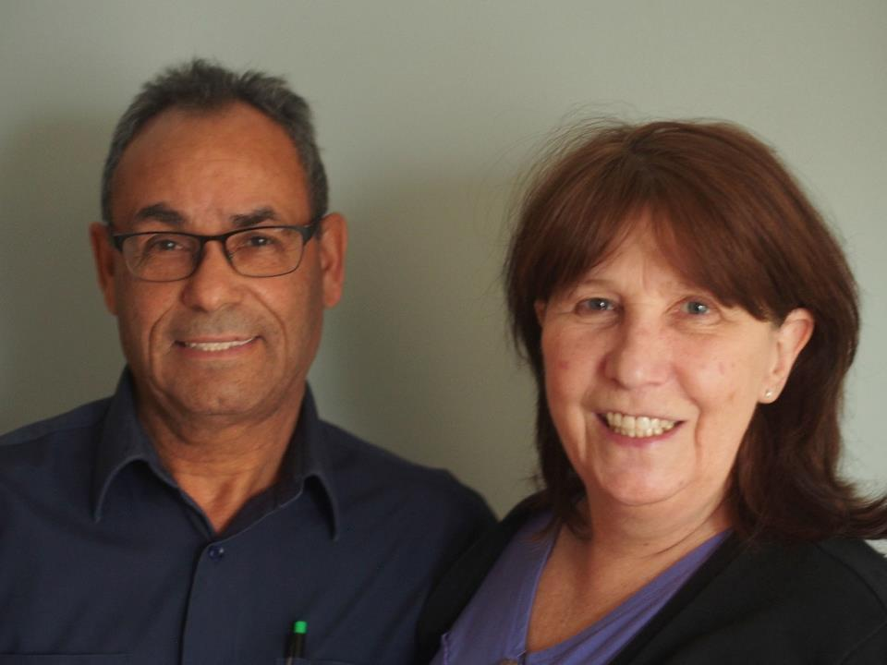
We came to people’s homes during their

Slide 16
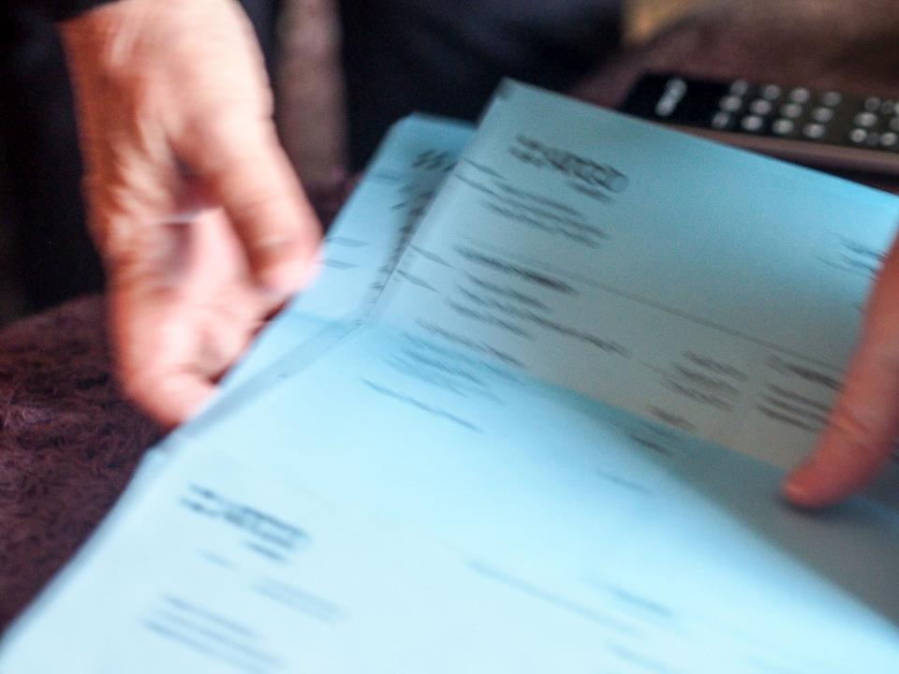
energy audit and listened to their energy stories

Slide 17
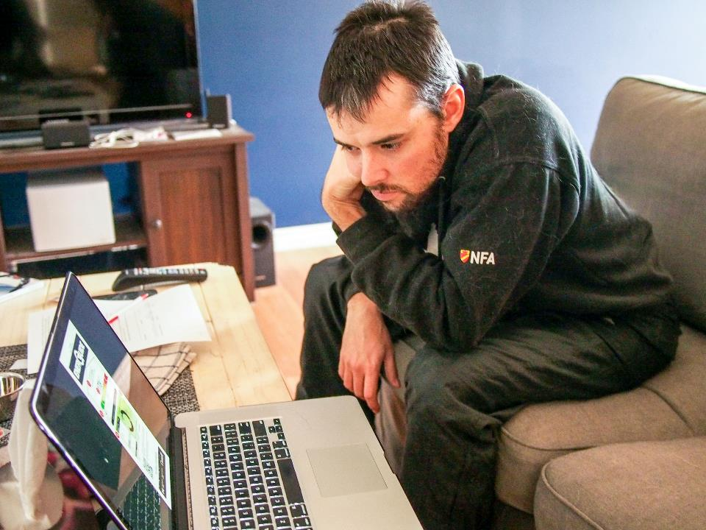
We also showed people the EnerGuide label

Slide 18
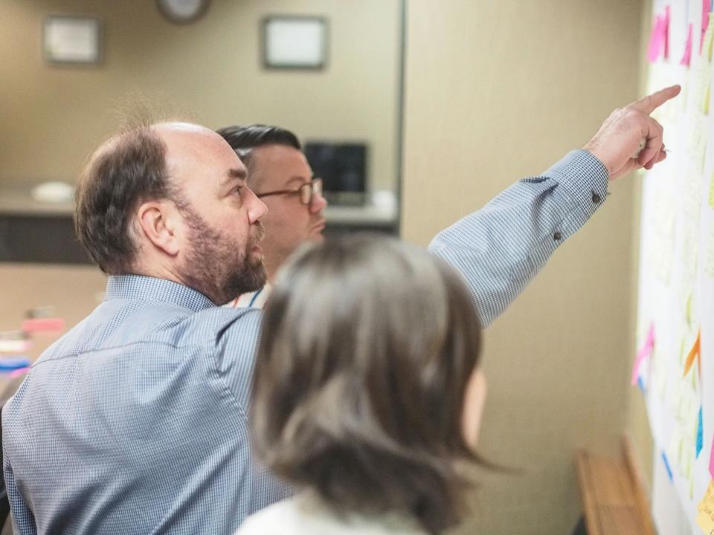
After our 24 interviews, we pulled granular

Slide 19
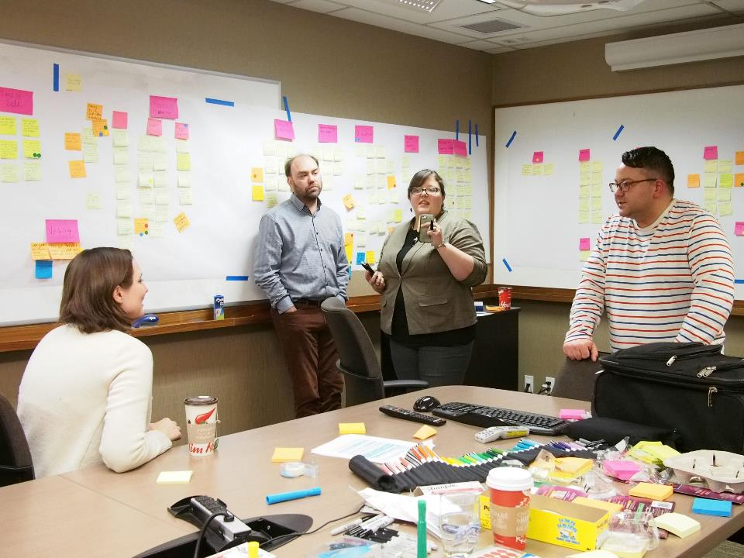
themes, topics, and insights over 2 days.

Slide 20
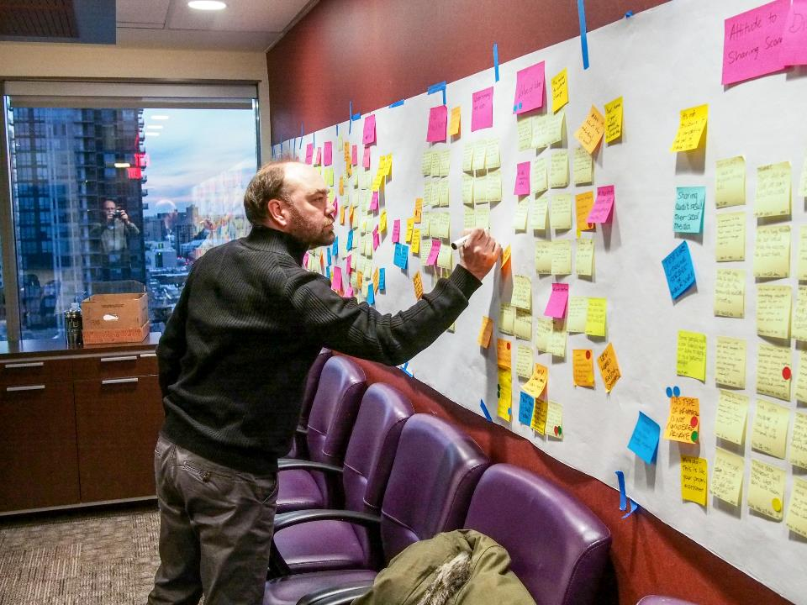
And we grouped these into our key findings

Slide 21
Key Fieldwork Findings
1. The research revealed a rich picture of people’s motivations for taking on energy efficiency projects.
The environment isn’t a motivator all on it’s own. It has to be combined with other elements for people to act on energy efficiency in the home.
Other motivators included:
• Comfort
• Education and family time
• Novelty
• Autonomy and DIY
• Safety
• Minimizing costs (wanting to see smaller bill payments)
• Home maintenance
2. Participants were very comfortable disclosing the results from their EnerGuide label.
• Participants considered the information from the energy efficiency audit on par with other data about the house that would be shared with potential buyers.
• “This is the house’s info, not mine.”
3. Participants wanted an energy efficiency audit because: “I want more confidence in how to prioritize things”.
4. All participants were unclear on what a ‘typical house’ was within the context of the EnerGuide label.
5. People over estimate the effects on their behaviour on their home’s energy efficiency.
• Occupant behaviour is separate from home performance

Slide 22
6. Participants are interested in having the label represent the amount of improvements they made to their house over time.
• They are seeking recognition for their actions.
• They don’t want to penalized for an inaccurate / out of date label
7. Promoting energy efficiency programs as cost savings initiatives is not effective in getting people to act.
• As a financial investment, energy efficiency upgrades provide a low return on investment.
• Although money is not enough of a motivator to encourage action on energy efficiency - it is the most frequent barrier to committing to an upgrade or project.
Gaps in Information
How does the participant’s preference for disclosing the EnerGuide assessment change throughout the lifecycle as a homeowner?
• The homeownership cycle (moving in, customizing, getting ready to sell, etc.) provides context to the label’s lifespan. Are people getting ready to sell as likely to participate in the assessment and disclose their results?
• The word disclosure has baggage.
- Potential to reframe the term ‘disclosure’ towards ‘sharing’ or ‘completing the set of information about your house’.

Slide 23
Fieldwork Insights & Opportunities
1. Shift from occupancy behaviours to ownership behaviours. Most energy efficiency campaigns are about changing behaviour as an occupant (turning out lights) vs. deeper investments in maintenance and comfort made by owners such as major appliances, mechanical, insulation, or windows. These ownership behaviours have greater impacts, but require more commitment in time, money, and effort.
How can we level up behaviours? Can we use occupancy behaviour as a springboard to more ownership behaviour? Next level energy efficiency.
2. People need a frame or focus for behavioural change. Considerations included creating an enemy (“Winter” or “Cold”). #FightWinter. A more positive concept for Love Winter Outside, Love Winter Inside to showcase things people can do in their homes to make them more energy efficient and comfortable in winter.
3. Promoting cost savings is counter-productive. Energy efficiency improvements lose out to other investments for financial returns. When we adopt the frame of financial return we invite comparisons to other financial choices (vacation, home aesthetics, etc.). The homeowner’s opportunity costs often outweigh the financial benefit of energy retrofits. So what are the other benefits we should lead with?
4. Home responsibility and maintenance. People have a high focus on maintaining their homes, both in terms of responsibility as homeowners, and in preserving the value of their largest asset.

Slide 24
5. Making the invisible visible by making it social. The abstract and invisible nature of energy efficiency makes it difficult for people to take action. We can make the invisible visible by making it social—developing tools, activities, and messages that support people talking with their peers at work or in their community. There is likely a special role for neighbourhood influencers in the creation of social visibility of energy behaviour.

Slide 25
Codesign Workshops

Slide 26
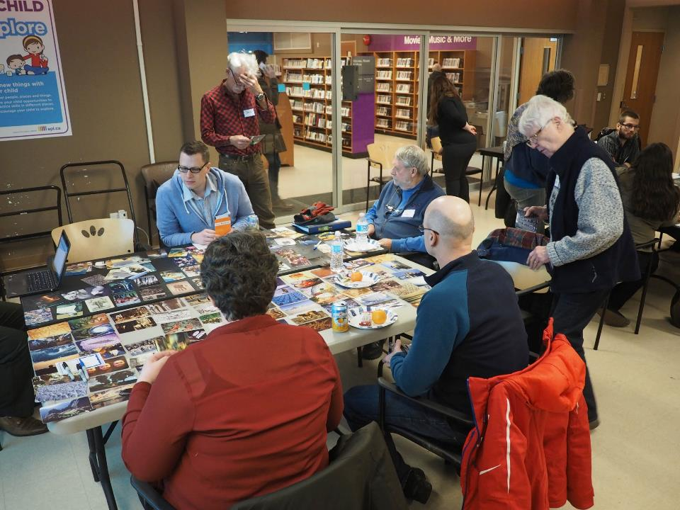
We invited people to reflect on before/after

Slide 27
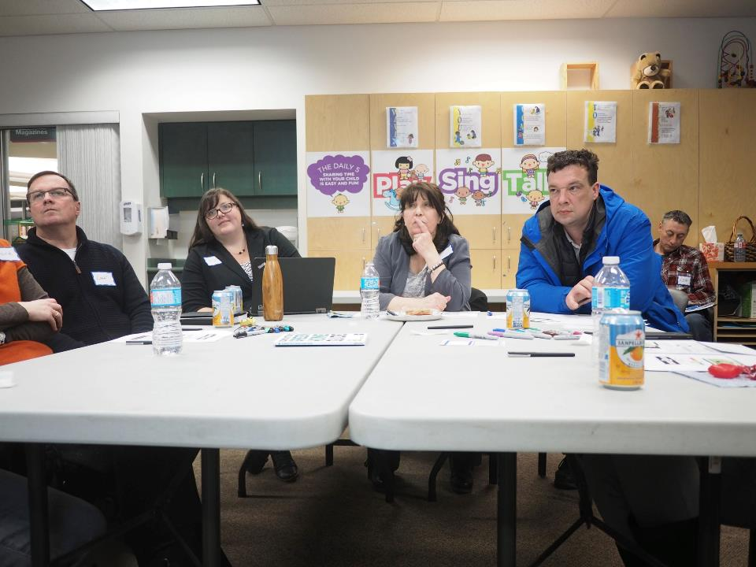
And to ask about the EnerGuide report

Slide 28
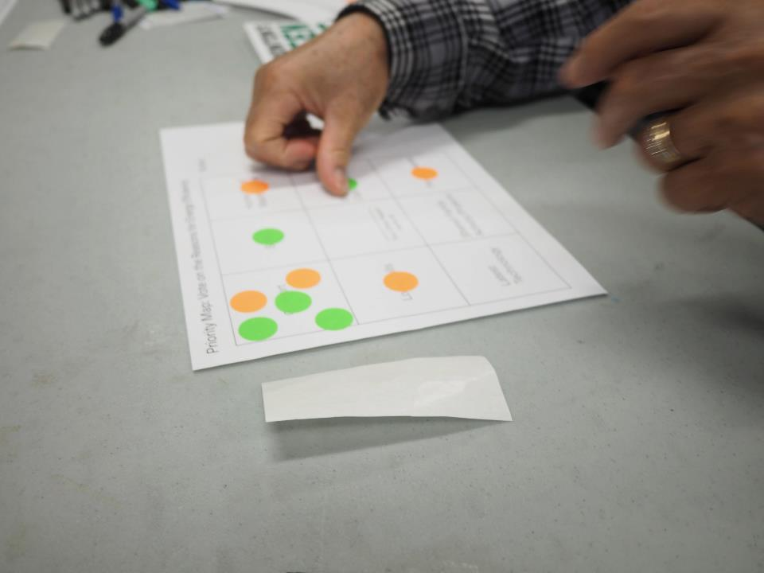
We also explore motivations for efficiency

Slide 29
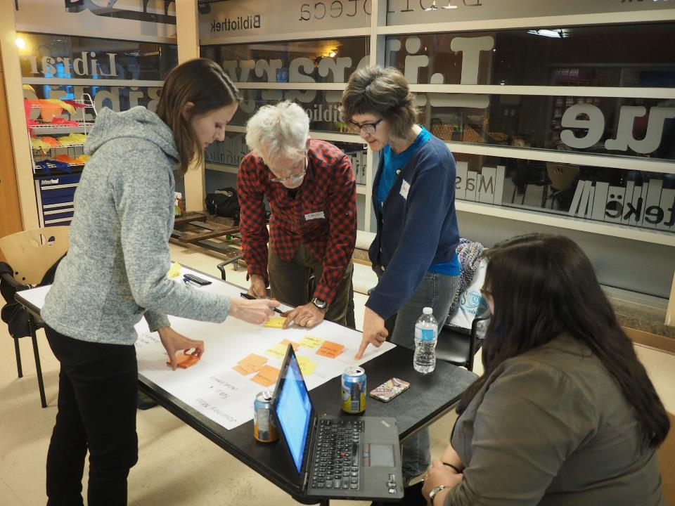
And looked at next steps for retrofits

Slide 30
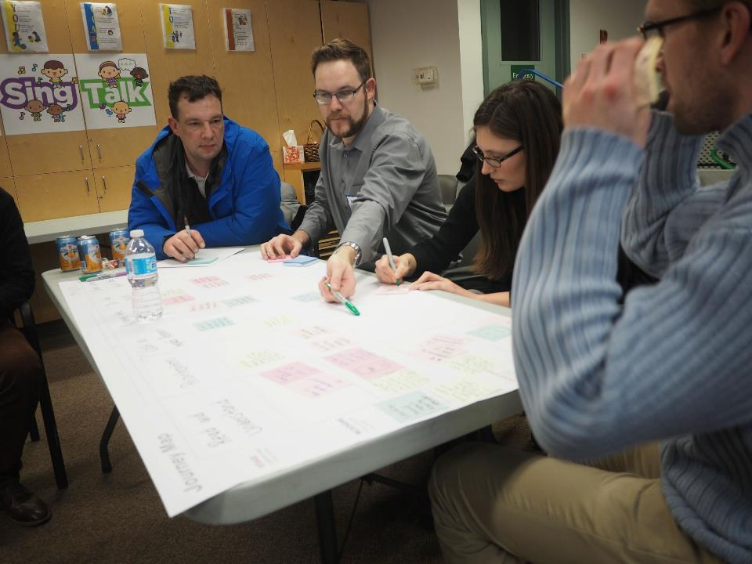
Which showed us some common challenges

Slide 31
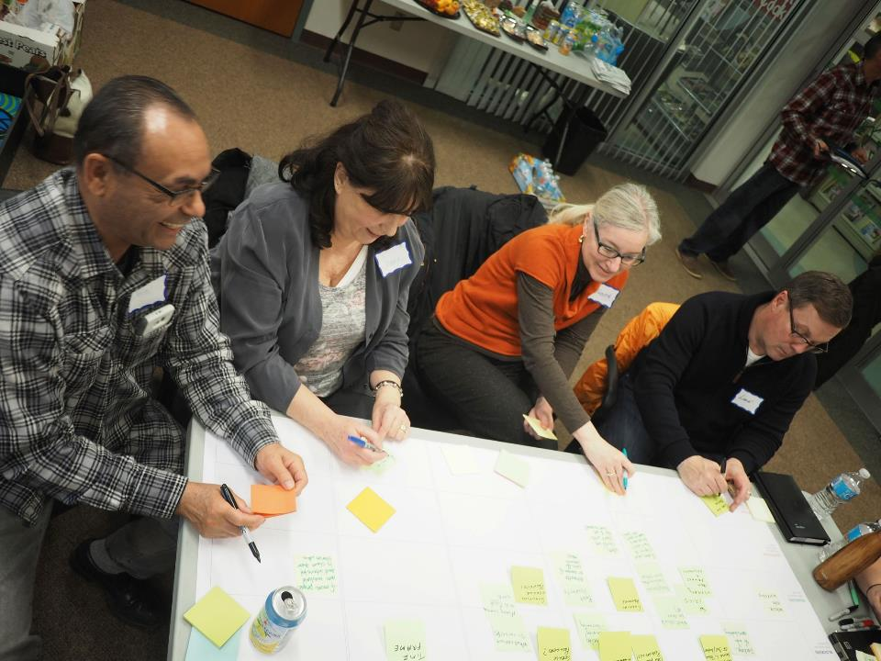
And also some common opportunities

Slide 32
Codesign Findings
Before and After Attitudes
Participants selected two images that represented their thoughts and feelings about energy efficiency before and after the audit process.
Most participants chose a positive shift in their before and after exercise. They described the change in terms of becoming more aware, more familiar with energy efficiency, and thinking about energy use more often in their daily routines.
Several participants also shared that they had realized the amount of work required to become more energy efficient, which was intimidating or challenging.
EnerGuide Challenges & Questions
Participants appreciated their EnerGuide packages.
Participants understood that their house was measured on overall energy use, and relative to a ‘typical’ house. They appreciated the additional detail on the label around energy consumption breakdown, particularly the ring chart.
However, they did have some challenges, especially in knowing specifically what to do next. Challenges included:
Knowledge Gaps, Errors, and Trust
Participants universally missed the key conceptual building blocks of “a typical house” and “standard operating conditions”.
Some participants wanted to understand the underlying mechanisms for how the energy usage breakdown chart was determined. Their confidence in the label depended on understanding the logic of the label.

Slide 33
A very small number of reports (3) had errors or omissions, which lowered trust in the report and the overall process.
Not knowing what good looks like. “The questions we have are more related to what we should do? What is the best bang for the buck: insolation, furnace, windows… Furnace is old but report says 85% efficiency.” An 85% is an A on a report card but a B on a furnace. Most participants did not know what the current state of the art is
Report Layout and Detail
All participants were challenged by the level of technical detail and jargon.
Some participants were unclear on what a gigajoule meant in real world terms. They also had difficulties relating gigajoules to electricity consumption billed in kilowatt hours.
The QR code only led to the web address printed on the label, which was seen as redundant (and a let down for the people who made extra effort to get a QR code app just for the label).
The layout of the report was unclear about the separate sections, and the purpose of each.
Reading renovation recommendations was complicated by the curved layout.
Overall Label
The overall amount of information was overwhelming to single out the parts that are actionable.
Participants wanted to know how their score measured up to comparable houses (footprint and age)—was their score good, fair, or poor relative to a similar house, not just a ‘typical house’.
Participants were concerned about the lifespan of the label—what is the intended timeframe for use?
Participants were concerned about having an out-of-date label once they made some retrofits. The label wouldn’t show their investment and their care in maintaining their home.

Slide 34
Sharing the EnerGuide Label
We demonstrated the City of Edmonton online sharing platform website and video. We then asked people to rank their comfort sharing their EnerGuide Label, the home information sheet, and the renovation recommendations using a 3 point scale (no, concerned, or yes) represented by red, yellow, or green coloured stickers on a worksheet.
18 out of 19 participants were comfortable sharing their EnerGuide label publically. They considered it as part of the information about the house, like property taxes. The one participant who was hesitant about sharing was in the process of selling his home, and was concerned about how the label may impact his sales prospects.
No other participants were in the active home sale cycle. The comfort sharing this information may shift when they are actively selling / buying a home.
Participants were much less comfortable publically sharing more detail i.e. from their home report or renovation recommendations. Only about 25% [JOEL?] of participants were comfortable this depth of information.
Importantly, we framed this explicitly as “sharing” rather than “disclosure”.
People appreciated the idea that they could compare their homes with others, and requested the ability to filter for homes similar to their own.
Participants also suggested the ability to add information about the house in the online listing to reflect upgrades made since the audit process.

Slide 35
Priority Grid
We asked participants to show where their priorities were in investing in home upgrades.
One interesting observation is that in our group sessions there was an overall negative feeling about framing energy savings as ‘environment / carbon’ motivation. This contrasted strongly with most participants agreed that the environment was important (if often a lower priority beneath other motivations) in our field research.
Two reasons are worth exploring: that ‘carbon’ is associated with the carbon tax and government regulations and/or that people in Alberta feel social pressure to dismiss environmental concerns in groups.
Retrofit Journey
We asked people about their anticipated actions moving forward, based on their experiences with past renovations or home improvements. Participants mapped their experience across a common set of phases or stages of retrofit, and considered barriers, enablers, and questions.
The phases were: Read & Understand Report, Prioritization, Costs / Impact Research, Arrange the Work, Do the Work, Share Results.
Common retrofit challenges throughout this lifecycle include:
Difficulty understanding the EnerGuide package. Participants were not always clear on what the package was telling them (see above section on EnerGuide label).
Knowing where to start. Challenges prioritizing upgrades because of the interplay between energy savings and cost—it takes more work to calculate the energy ROI, the financial ROI, and the connection between them.
Other competing financial needs, and the overall significant costs for many upgrades.
Lack of confidence about home upgrades to make decisions and judgment calls.
Challenges in finding trusted and competent tradespeople and providers.

Slide 36
Concerns that tradespeople had experience with energy efficiency related work.
Challenges with the disruption of preparing and managing a renovation project.
Cost as a barrier. Participants has questions about programs to offset costs. Some referenced past programs for renovation tax credits.
While these challenges were identified in our workshop, future research can provide more insight into the retrofit journey.
Energy ROI + Financial ROI = Complicated
Calculating the intersection between financial return from a given renovation and the energy impact of that renovation created significant complexity for our participants as they looked at different recommended upgrades.
Sharing with family, friends, and neighbours.
We also asked about how participants might share their experience with others. They universally said that they would share the program with people in their life who they saw as needing help with energy efficiency. They were less enthused about sharing broadly (e.g. initiating a conversation with a neighbor specifically to talk about retrofits). However, they were open to discussing the work with others if it came up in conversation.
“My parents house is so old, it’s always cold. They could definitely use an energy audit”. – workshop participant
Participants were open to different sharing options, including social media and signage or window stickers.

Slide 37
Better Team Brainstorming

Slide 38
Team Ideation & Brainstorming
The team worked to explore ideas through immersion in the codesign findings, surfacing themes and insights, and then rapid brainstorming.
We generated dozens of ideas and narrowed them down to a shortlist.
This opportunity to work together in person to immerse ourselves in the themes and topics emerging from our field work and codesign workshops prepared the team for the most productive and efficient idea generation.
Focus Areas
Clustering our shortlisted ideas led to five focus areas:
Energy Literacy
Get the Label
Understand the Label
Sharing
Retrofit
Prototype Selection
From this shortlist participants voted on ideas based on impact, feasibility in the organization, and feasibility to prototype.
From this selection we aimed for three prototypes:
Messaging
Alternative Messaging and Framing through brochures or Google Ads
Energy Efficiency Block Party
Work with neighbourhoods or community leagues to raise energy literacy and awareness.
The EnerGuide Report
Create a redesigned EnerGuide report to address issues identified in our codesign workshops.

Slide 39
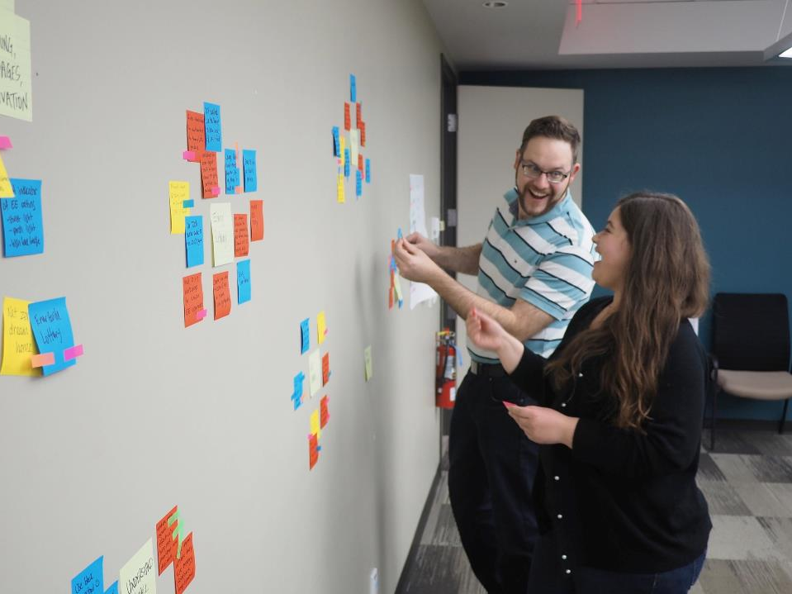

Slide 40
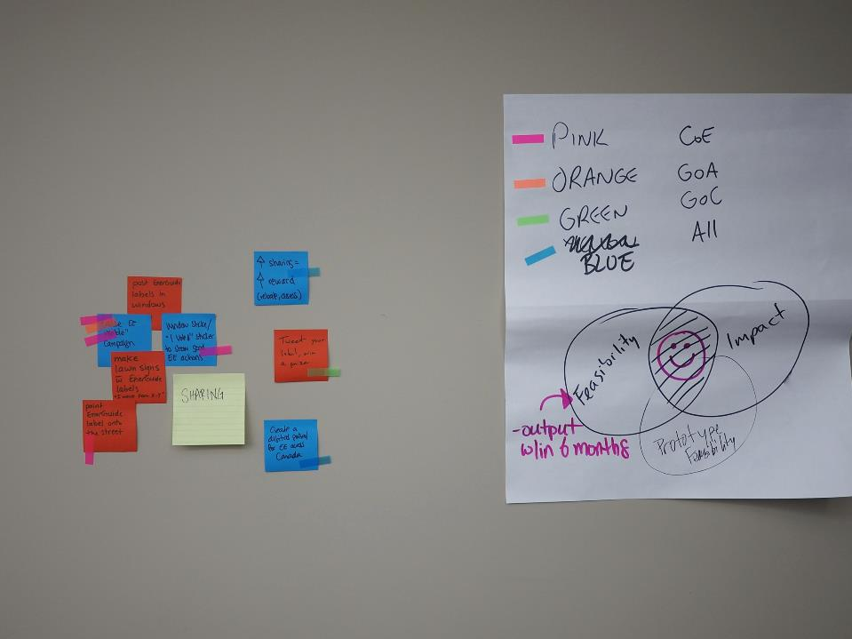

Slide 41
Selecting Prototype Options
Impact
Prototyping Feasibility
Organizational Feasibility

Slide 42
Prototyping

Slide 43
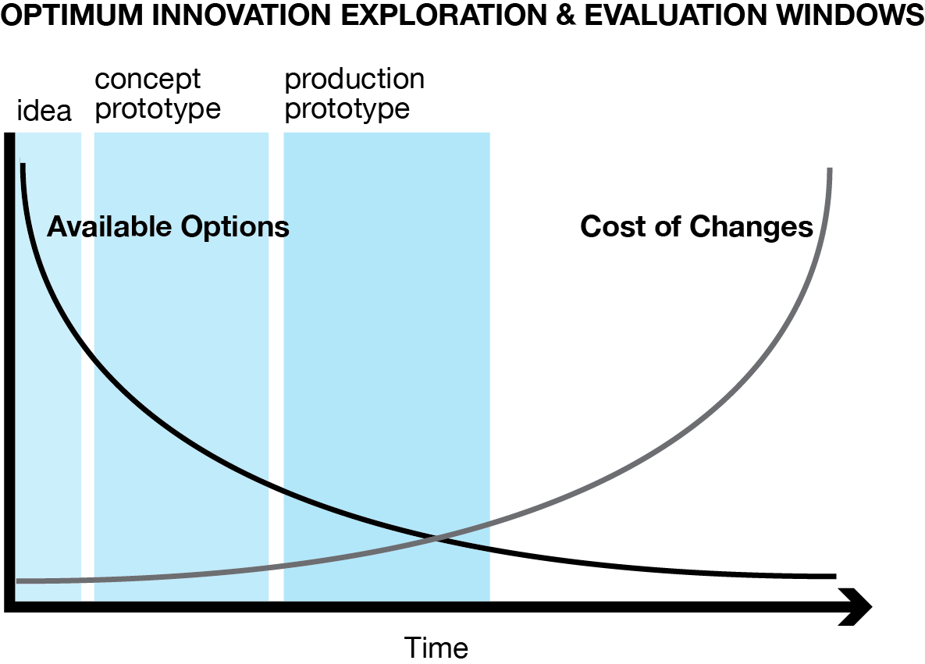

Slide 44
Horizontal & Vertical Prototyping

Slide 45
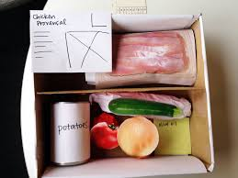
Prototype Realism & Fidelity
Match the level of realism to the kind of learning you need.

Slide 46

The Learning Loop

Slide 47
The Energy Efficiency Block Party

Slide 48
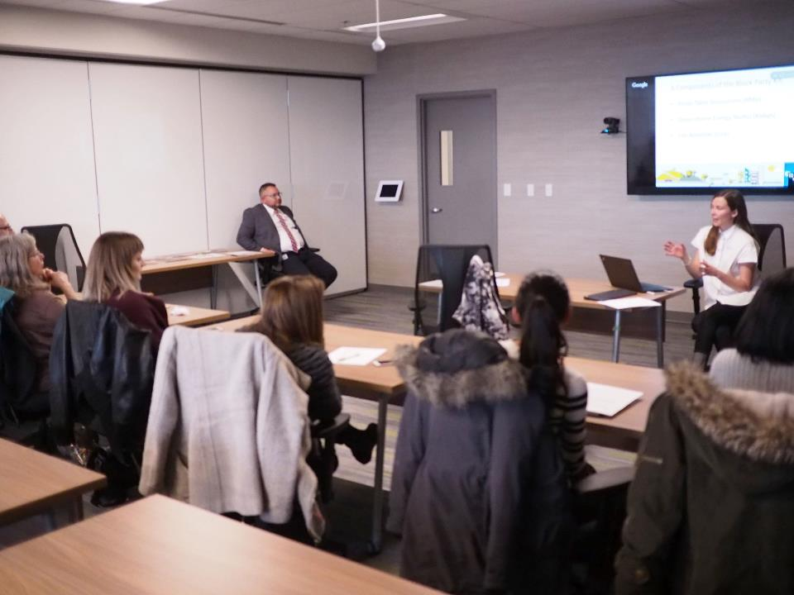
We outlined the City’s Energy Transition Plan

Slide 49
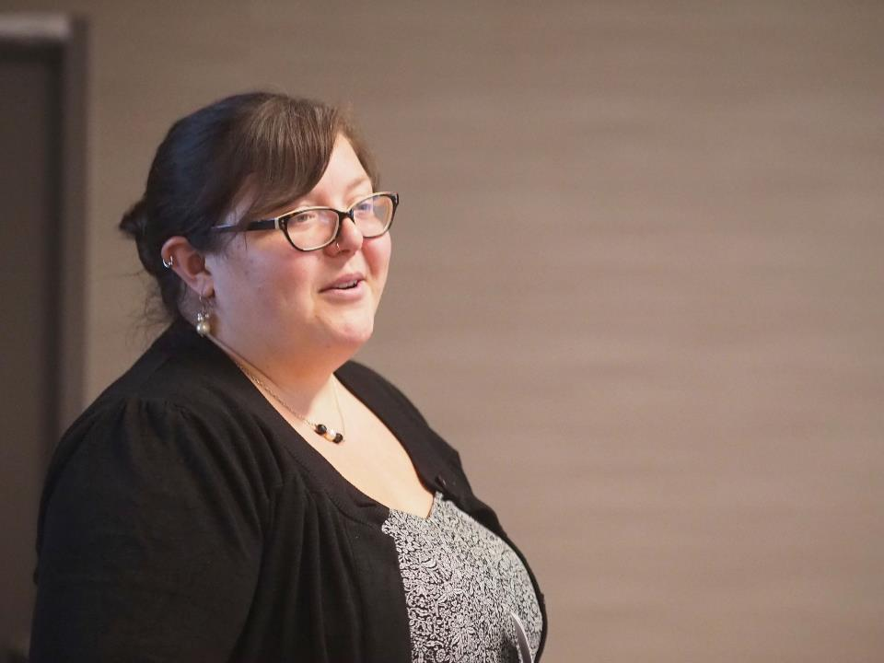
Then introduced 3 block party elements

Slide 50
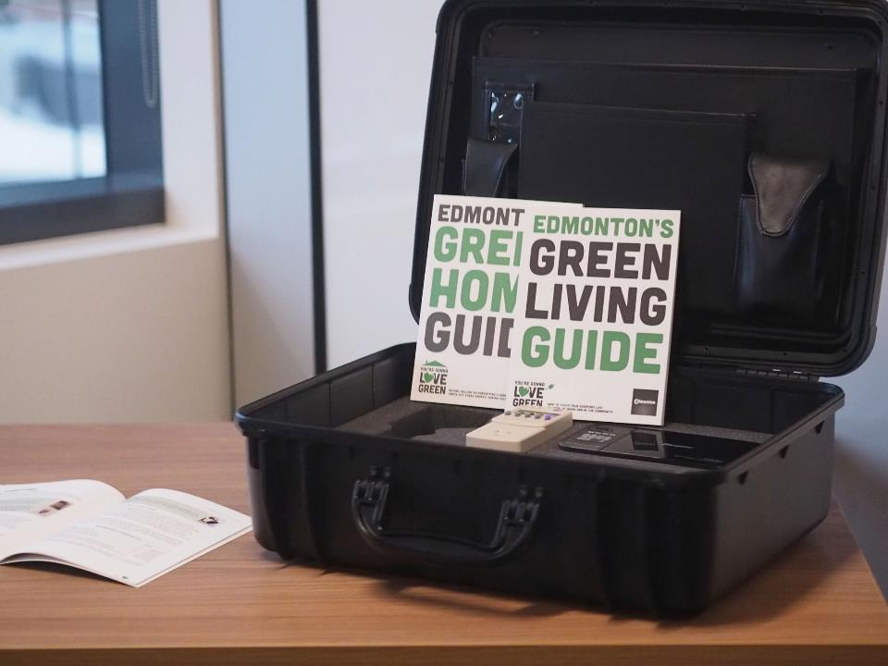
Fun, Facts, and Tools

Slide 51
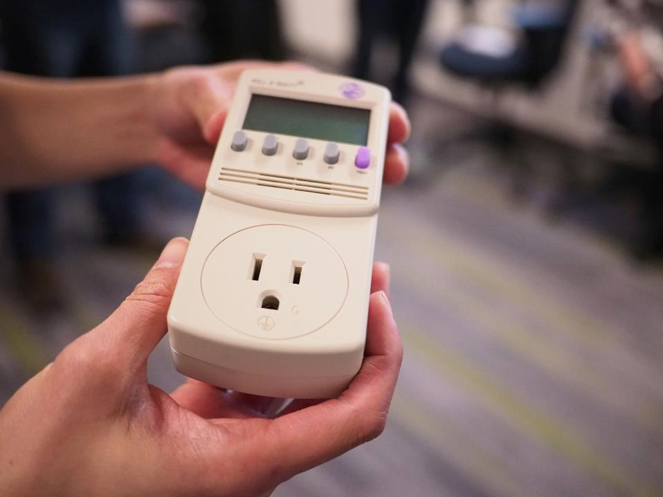
We also had hands-on time with each

Slide 52

To try out each component of the package

Slide 53
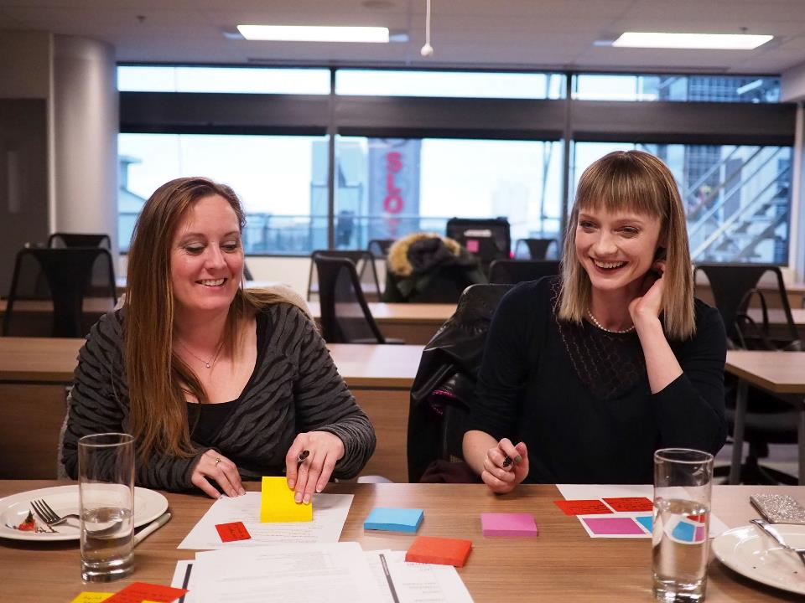
Then we gathered feedback on each element

Slide 54
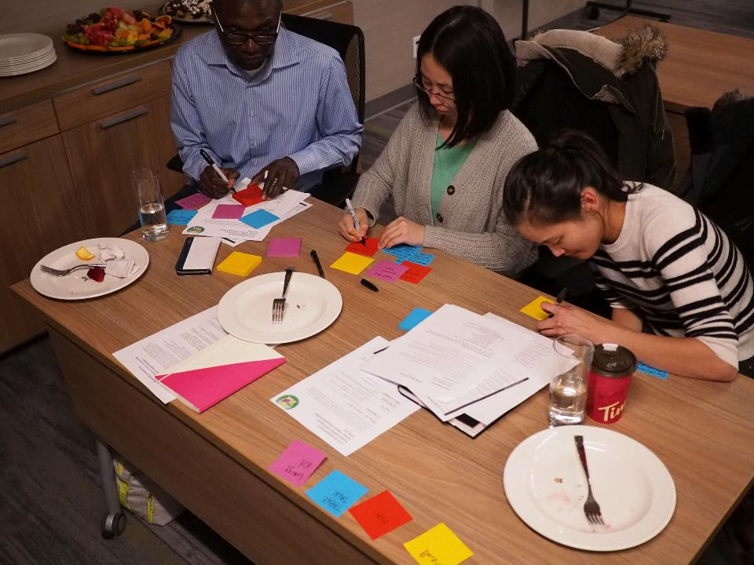
And on the concept as a whole

Slide 55

Overall response was very positive

Slide 56
Energy Efficiency Block Party Prototype
We created a preliminary package for a social energy efficiency event—and energy efficiency block party. The package consisted of three main components—a discussion guide for energy efficiency conversations, a section on fun activities, and an energy efficiency home kit that included tools to measure a home’s energy efficiency such as a thermal camera, an infrared thermometer, a light meter, and a plug-in watt hour meter. We also included some of the City of Edmonton’s existing collateral, such as the Green Home Guide, a printed manual.
Additional elements of the prototype included a window sticker mockup, and the opportunity to sign up for an energy audit at a discounted price.
The intent of the block party package is to partner with community organizations such as community leagues who can add an energy efficiency component to their programming (either as a stand-alone event or as part of a larger event).
Principles & Prototype Goals
The aim of the prototype was to establish social, peer-driven avenues for building energy literacy in communities. We hope to reach more people by tapping into the existing neighbourhood networks, and provide supports and tools to make it attractive for community organizations or active individuals to engage with their neighbours in positive conversations about energy.
Our hypothesis is that presenting energy literacy and energy audit information at the neighbourhood level will create more awareness of specifics and opportunities to take action, and build on a regular city-wide advertising campaign (also planned for Edmonton).

Slide 57
Testing & Findings
Six sustainability leaders from local community associations attended an evening workshop. The workshop began with an overview of the energy labeling program in the City. Then each of the three components was shared with a show and tell and try option—a member of our team from the City presented each of the three components. After each was shared or demonstrated, participants had a few minutes to try out the material (walking through a checklist, trying an icebreaker activity, or handling the toolkit). Finally, we gathered feedback on the components, and discussed the overall concept. We ended with having participants rate their interest in such a program in their community.
Successes
The overall concept was strongly supported, but not necessarily as a “block party”
Participants really liked the hands-on activities, especially the toolkit.
The provided checklist was useful.
The scavenger hunt was interesting but hard to implement.
Future Improvements
The ‘fun’ elements seemed somewhat forced, and there was a question of appropriateness for different ages—who did we expect to participate?
The facts elements were too dry, though the checklist was useful
Make it more intimate—in home, or at a corporate event. Think Tupperware party rather than block party.

Slide 58
The Alternative Energy Messages

Slide 59
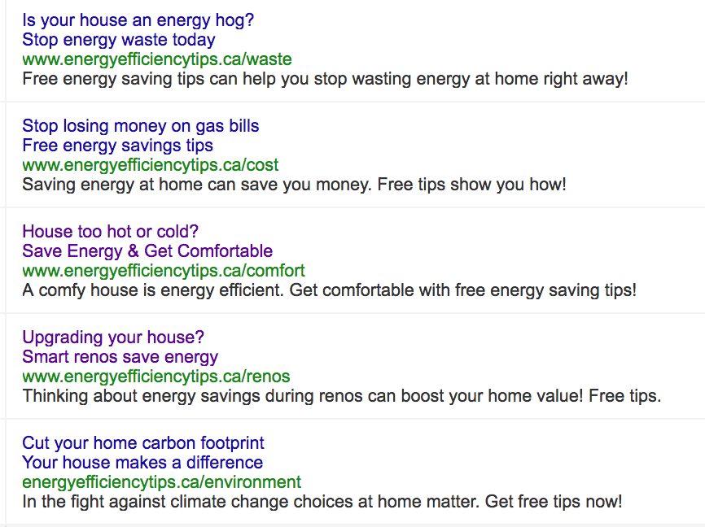

Slide 60
Alternative Messaging Prototype
Based on the insights from field research, our codesign sessions, and our team brainstorming we focused on messages as a high impact activity. People need alternative messages to connect with motivations outside our well-worn (and counterproductive) emphasis on cost-savings.
One way to test messages is to run ads on Google. By tracking clicks on the ads we can compare what sort of conversion rate each ad has (how many people act, compared to how many people see the ad). This should help us evaluate how different messages resonate.
One challenge of this approach is that searches for energy efficiency related items are relatively low volume (only a few hundred per month in Edmonton).
Our messages focused on five topical areas:
Cost
This is the baseline control group, reflecting a standard appeal to finances. This message may indeed perform well—it is in actually taking action where cost becomes a barrier and shifts thinking about cost savings from “saving money” to the investment evaluation “spending how much money to save how much money”.
Environment
We also need to test an environmental responsibility message, showing that people can make a difference in their footprint by the choices that they make at home.
Waste
Loss aversion and a cultural value to prevent waste is the focus of our waste message. While the money itself may not be a significant amount, the fact that the person is wasting is deeply contrary to many of our participants’ values. Stopping waste may be more compelling than simple appeals to cost.

Slide 61
Comfort
Most of our participants rated comfort highly in their priorities. Given that the campaign is running in warmer weather (Spring 2017), this may resonate more in a cold snap. However, we expect that this is a key message to capture people who otherwise would not consider energy efficiency.
Home Maintenance and Value
Many people are interested in retrofits as part of the overall responsibility of home ownership. They want to maintain the value and integrity of their house. They are interested and open to energy efficiency considerations as they consider what to invest in for home upgrades and renovation.
The specific ad copy is below—note that we are not professional advertisers, and like the EnerGuide prototype these are not meant to become production ads. They are simply to help us have a more strategic conversation about options for our various programs.
The ads link to a website Situ Strategy created specifically for this prototype. The website does not identify any individual government participation, but does disclose that the site is part of a research project into energy efficiency programs.
Principles & Prototype Goals
A key principle for messaging prototypes is that we need to activate multiple motivations to get people to shift from occupancy behaviour (turning off the lights) to ownership behaviours (retrofits).
Our hypothesis is that messages that test well as Google ads help to validate the direction of the message for overall communications.
Our goal with these prototypes is to explore alternative messaging in order to move past our traditional focus on cost.

Slide 62
The Experimental EnerGuide Report

Slide 63
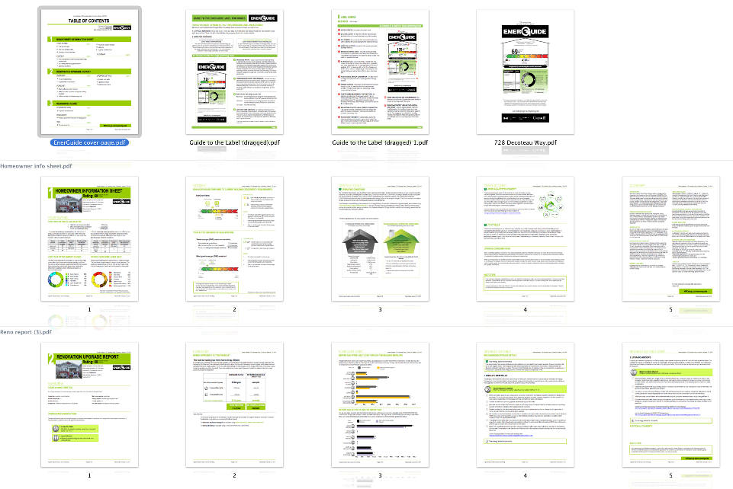
We created an EnerGuide report addressing the challenges we saw in our codesign workshops.

Slide 64
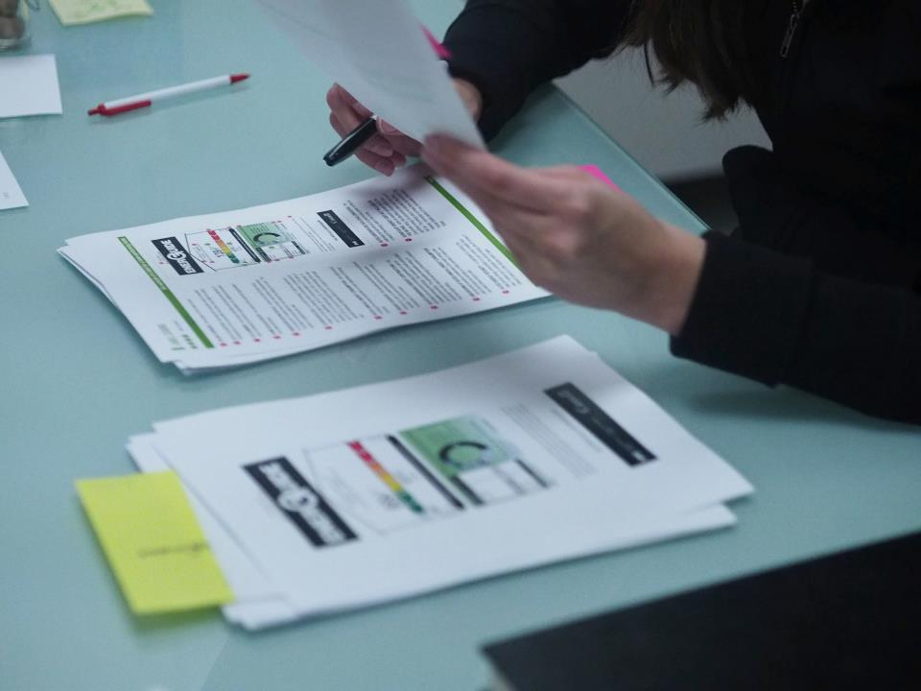
We showed current and experimental version

Slide 65
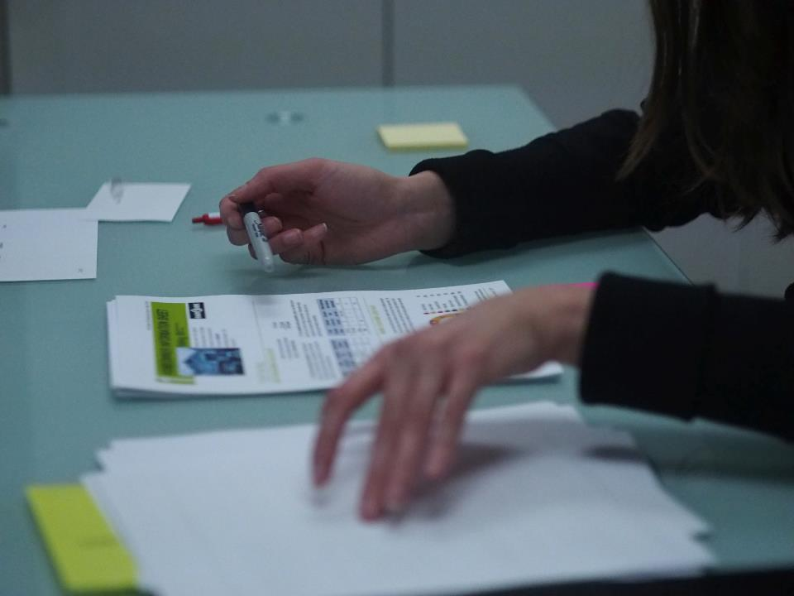
And got feedback on both

Slide 66
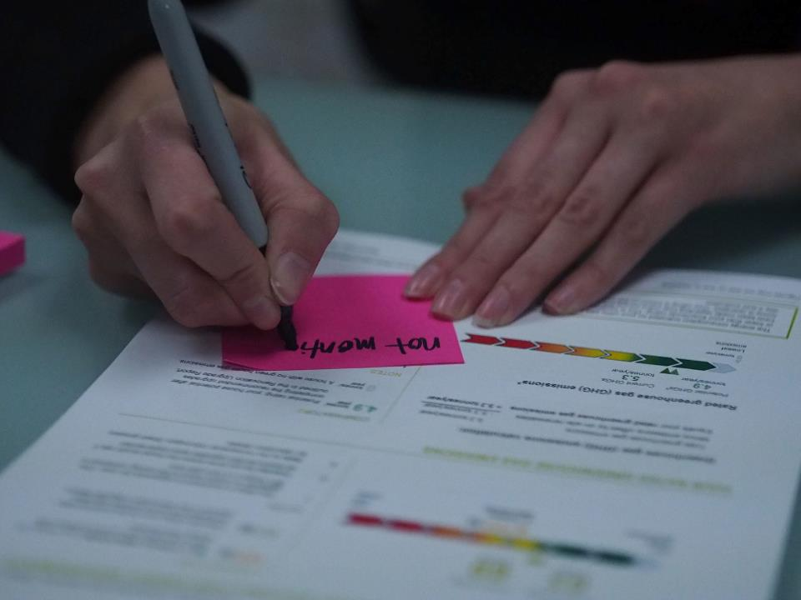
The experiment performed well but had some challenges itself

Slide 67
Principles & Prototype Goals
The focus of the prototype was to improve clarity to increase action. Our hypothesis is that people with clearer understanding of the report are more likely to take action on it (this remains to be explored in future research).
We increased the clarity of the report by:
Visual Design
We created a visual design that used more white space, more graphics, and simplified table layouts.
We also used visual markers to separate sections more clearly.
Conceptual Design
We removed technical details, especially the house information data and the label’s QR code.
We added a table of contents.
We defined the ‘typical house’ and ‘standard operating conditions’ up front.

Slide 68
Test Findings
We had participants read through the current EnerGuide report, and then through the redesigned report prototype. We used a think-aloud protocol, where people talked out loud about their expectations, thoughts, and understanding throughout.
Successes:
Improved clarity and separation of sections recognized.
Use of graphics and visual design.
Table listing for renovations simpler to read and understand.
People did not miss removed information (QR Code, and House Data). When this was pointed out, comments included that ‘it was better without it—simpler’.
Participants really liked the checklist from Keeping the Heat In for each renovation recommendation. This was the most commented on addition.
Future Improvements:
Age-friendliness—the light green used did not provide enough contrast for easy readability. Some type was quite small.
Consider design for content dependent sections—how to show tables or other information when some data does not exist (e.g. renewable energy sources or household energy estimates based on use, rather than standard conditions).
The transition between renovation recommendations and the graphs showing overall lower rates of energy use and emissions were not clear.
The graphs themselves were not as well understood—why were all the categories shown when only two kinds of renovations were recommended?

Slide 69
In summary:
1. Partnership for deeper insights
2. Behaviour in the wild mitigates risk & generates opportunity
3. Design with, not for to build more resilient options
4. Prototype to explore options and mitigate risk
5. Collaboration is key

Slide 70
Merci Beaucoup!
Thank you!
Questions & Discussion

