Slide 1
Policy Innovation & Experimentation for
Energy Efficiency Impacts
An Update & Next Steps Towards an Open Collaboration Model
Office of Energy Efficiency
Natural Resources Canada
DRAFT
© Her Majesty the Queen in Right of Canada, as represented by the Minister of Natural Resources, 2017

Slide 2
OBJECTIVE
Demonstrate and scale up a collaboration model to transform the Office of Energy Efficiency's service delivery
Title
Title
Title
Title
Title
Title
From…
Title
Title
Title
Title
Title
Title
Title
Title
Title
Title
Title
Title
Org B
Core policy functions
To…
Org C
Org A
Core Program
Core Program
Core Program
Core Program
Core Policy Functions & Programs
Partners and stakeholders
Notes:
The purpose of this deck is to:
Provide an overview on OEE Social Innovation Unit’s work to date and
Demonstrate how OEE is pivoting to embed a model and practice of continuous improvement and innovation to transform our service delivery.
The image on the left is a hierarchical org structure. The one on the left is a platform structure. Arguably, OEE works in a platform way when it mobilizes people and resources from within and beyond our organization to advance policy and program priorities. What we’re proposing here is that we’ll have to scale that platform practice and, increasingly, do it in more open, digital and social ways to be a responsive, adaptive and resilient organization.

Slide 3
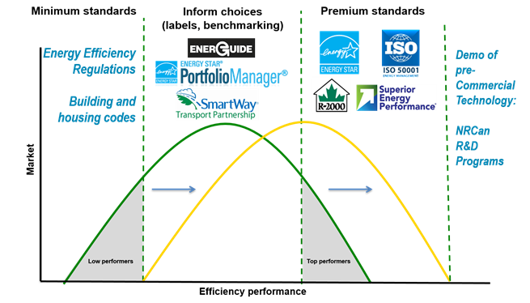
CURRENT MODEL
OEE is focused on implementing & scaling
existing tools and services
Delivery Model
Policies, Services & Tools
Existing policy functions:
Policy coordination & stakeholder engagement
Priority setting & business planning
Economic and statistical modeling & analysis
Communications & outreach
Performance measurement & reporting
Demand Policy & Analysis
Housing
Transportation
Buildings & Industry
Equipment
Mandated policy & program delivery
OEE policy & program teams
Tools & services
External Partners & Stakeholders
Provinces and territories, service organizations, industry, manufacturers, Canadians, etc
Tools & Services
Tools & Services
Tools & Services
Tools & Services
Partners and stakeholders
Notes:
GENERALLY SPEAKING, these are some of our policies, services and tools and our default delivery model.
This is what we put in the onboarding package to new employees, how we delegate tasks, and how we develop and deliver policies and programs.
To date, OEE’s policy & program functions are focused primarily on implementing & scaling existing tools and services. We see much of what we do and how we do it through these lenses. That matters when you consider what’s shifting in relation to the design and delivery of what we do and how we do it.

Slide 4
CONTEXT
Evolving contexts and needs require OEE to be open, responsive & resilient to change
POLICY
Pan-Canadian Framework on
Clean Growth & Climate Change
TRANSFORMATION
Policy Innovation & Experimentation
in the Digital Age
Bold climate change commitments
Transitioning to a low carbon future
New & emerging technologies, actors and business models
Cross-jurisdictional & multi-sectoral policy solutions & delivery
User-centred services to meet shifting expectations
Engaging Canadians and stakeholders in policy shaping and delivery
Learning what works and why through experimentation
Sharing data and insights for easy access, analysis and problem-solving
Notes:
And things are shifting…significantly.
Evolving contexts and needs require OEE to create and support opportunities for innovation and experimentation and become open, responsive & resilient to change.
From a policy perspective, Canada will need cross-jurisdictional and multi-sectoral solutions, including those that include new and emerging technologies, actors and business models to realize a low carbon future.
Also, expectations for user-centred services, digital approaches and open policy shaping and delivery are increasing.
Focusing primarily on the delivery of existing tools and services will limit our effectiveness in delivering on our commitments and results.

Slide 5
OUR VALUE PROPOSITIONS
The Social Innovation Unit is enabling service transformation by applying new policy methods and approaches
Convening & Building
Relationships
Capacities
Shared understanding of contexts, needs and opportunities
To see possibilities for collaboration and change
Open
1
Engaging Canadians and stakeholders in policy shaping and delivery
2
Co-creating & Testing
Insights
Ideas
Prototypes
To generate evidence and learning
Digital
Using digital tools, technologies, and approaches
3
Adapting & Scaling
Program improvements
New policy approaches and measures
By implementing what works
Social
Co-designing and testing interventions & scaling what works
Notes:
OEE’s Social Innovation Unit is enabling service transformation by applying new policy methods and approaches, working with partners in and outside of OEE and government. We are working in open, digital and social ways to co-create value in three interrelated ways:
Building relationships and capacity for policy and service improvement and innovation via new methods and approaches (like service design, lean and foresight with Aimee’s team);
Co-creating and testing insights, interventions and pilots – we’re trying to instil a start small and experiment with citizens and stakeholders mindset and approach; and,
Implementing what works through program redesigns and new policy interventions.

Slide 6
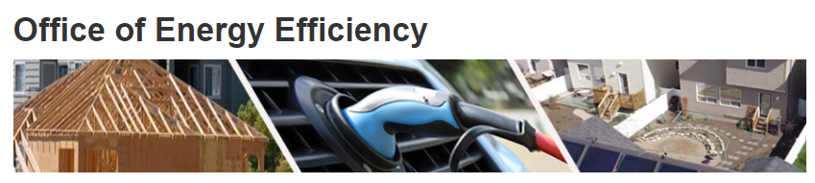


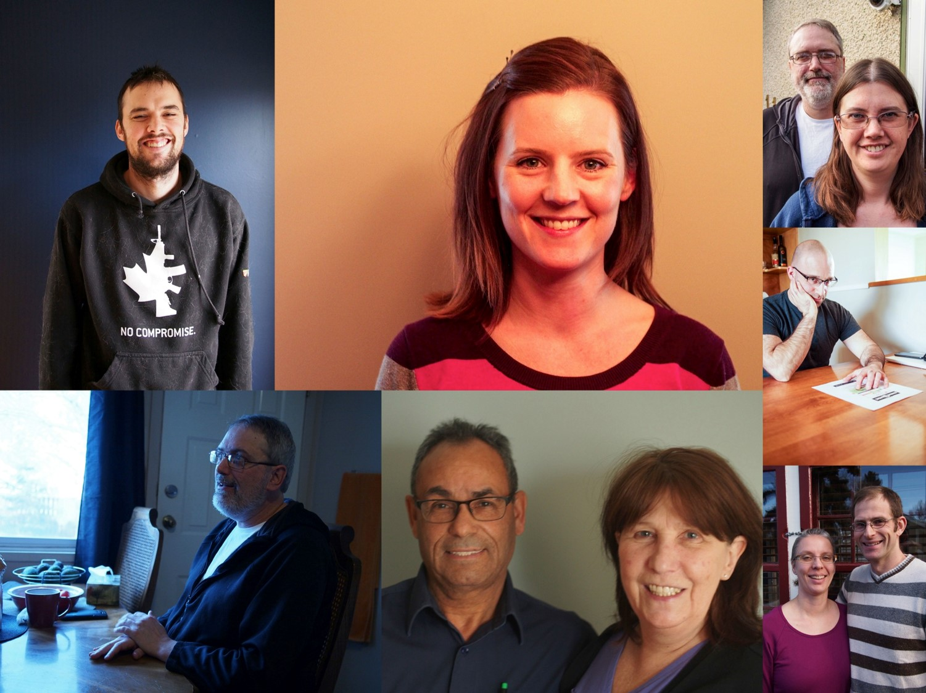
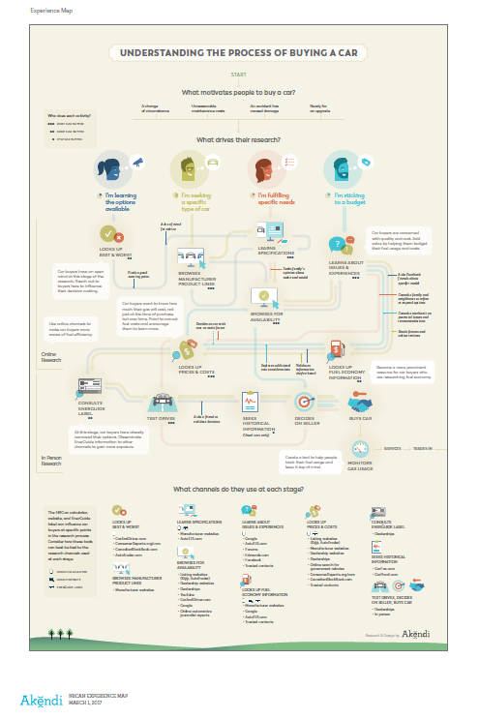
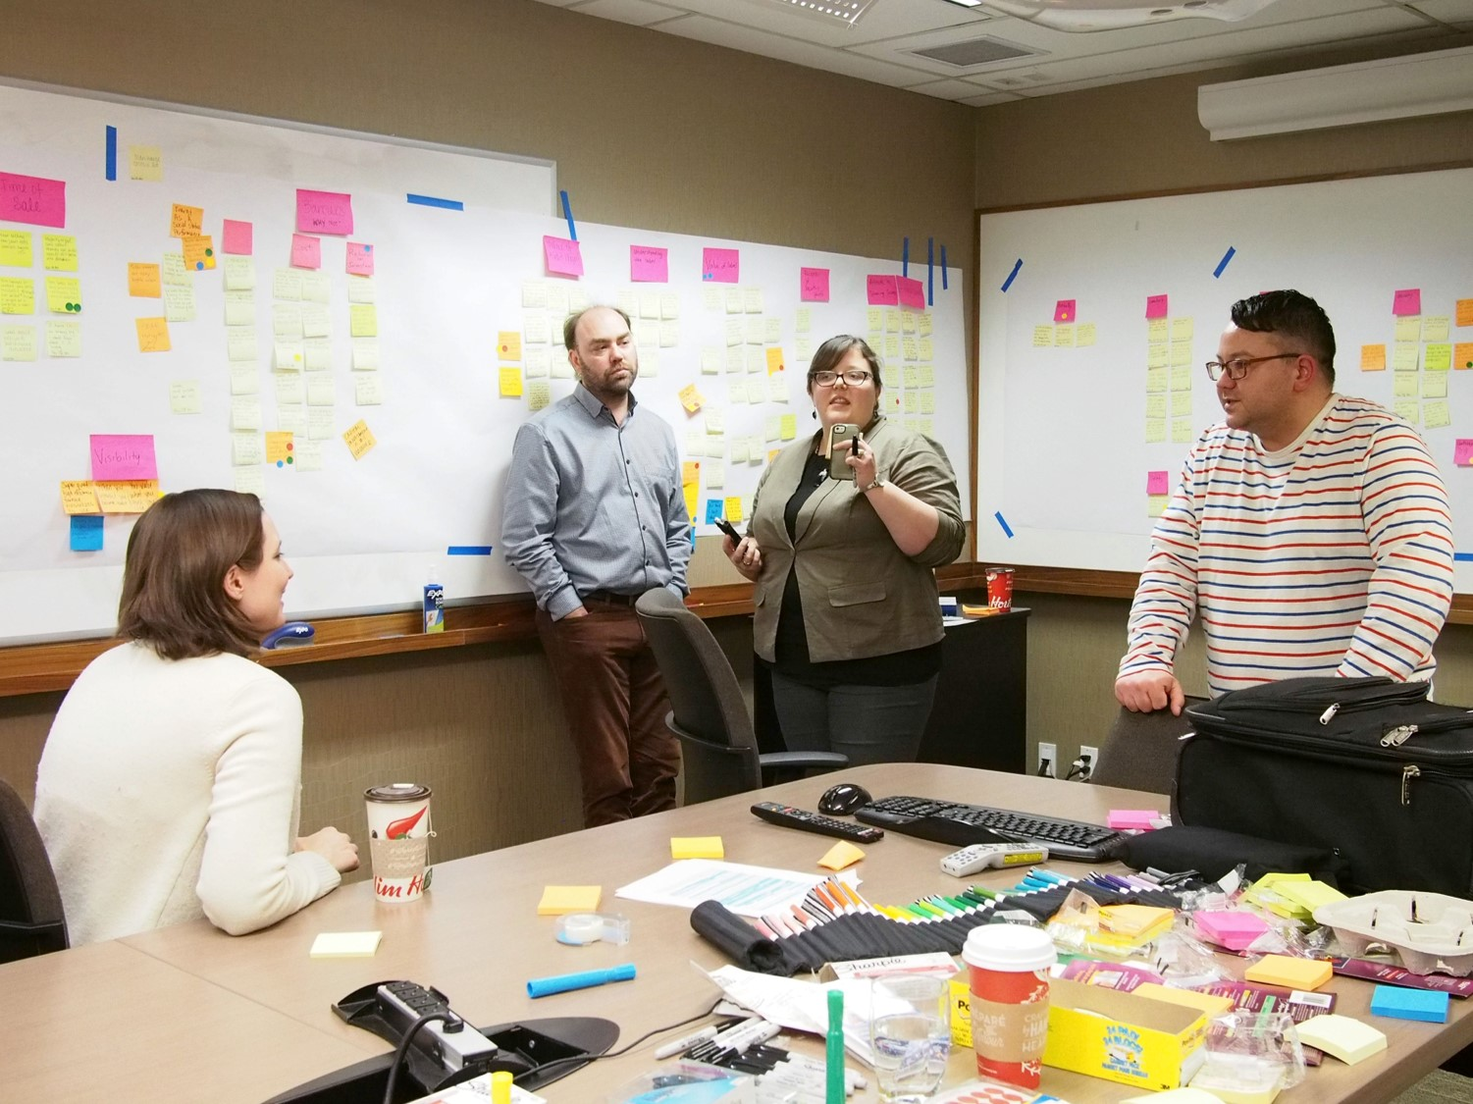






1
12
OEE policy & program teams engaged on projects to understand contexts, needs & opportunities
Foresight & Scanning club co-created to build capacity for policy innovation
of social innovation projects directly engaged citizens and stakeholders in the policy design process
1
71%
Building relationships & capacity to see possibilities for improvement & innovation
400K
Canadians engaged on energy efficiency via Carrot Rewards
levels of government & a citizen-centred approach to improve home labelling & reporting
car buyers engaged to improve awareness & uptake of fuel efficient vehicles
3
40
~80%
of Generation Energy participants (~300K) connected through Carrot Rewards
Generation Energy engagements on Canada’s low carbon future
workshops supported to understand how to build urban low carbon innovation capacity
Leaders & practitioners participated at OEE- supported Renewable Cities Global Learning Forum to advance low carbon energy transition
16
2
>300
Please refer the annex for info on select projects
Notes:
[amend notes]
Relationships are the foundation of our success…Relationships with citizens and stakeholders are required to understand contexts and needs from various perspectives and inform possibilities and commitments to action.
Digital engagement with rewards is proving to be a meaningful way to connect with Canadians.
We’ve also lead and supported divisions and others by designing and facilitating workshops on policy and program priorities.
By supporting and participating in community-based forums, like Renewable Cities, Livable Cities and Generation Energy-related events, we’ve also helped to build relationships with citizens, municipal sustainability managers, non-profits, social enterprises, and social innovation practitioners who are working at the community and municipal level on energy efficiency, low carbon energy transition and climate change mitigation and resiliency.

Slide 7



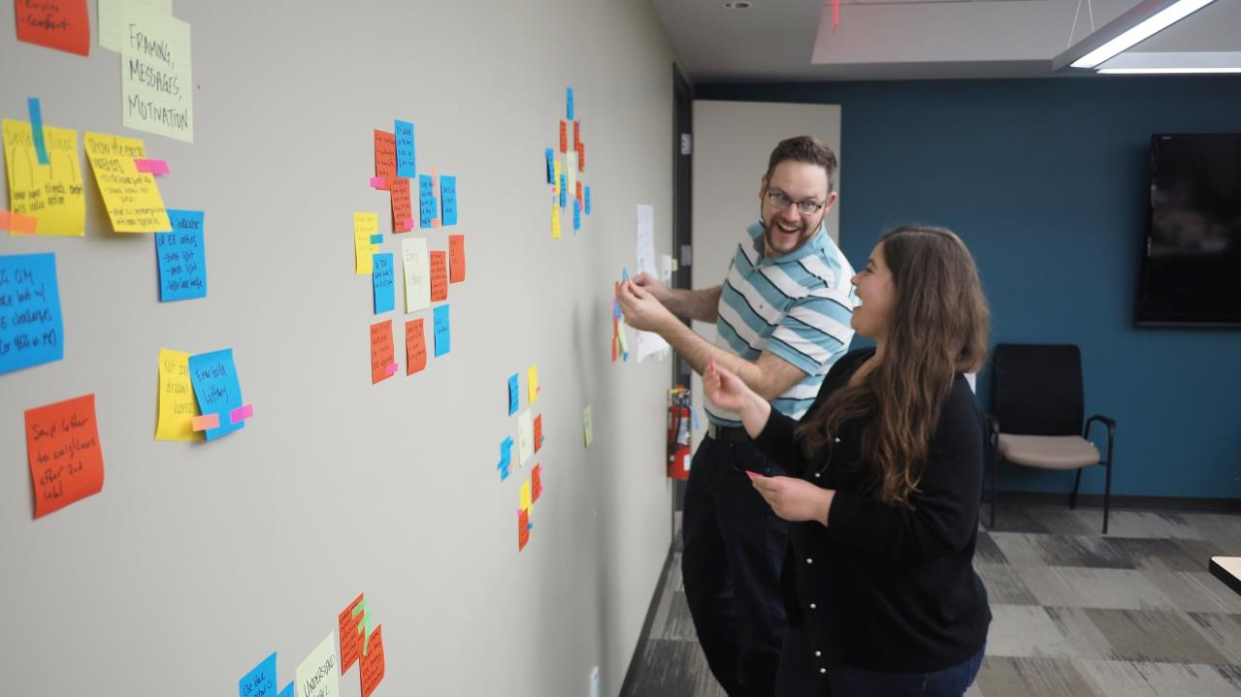
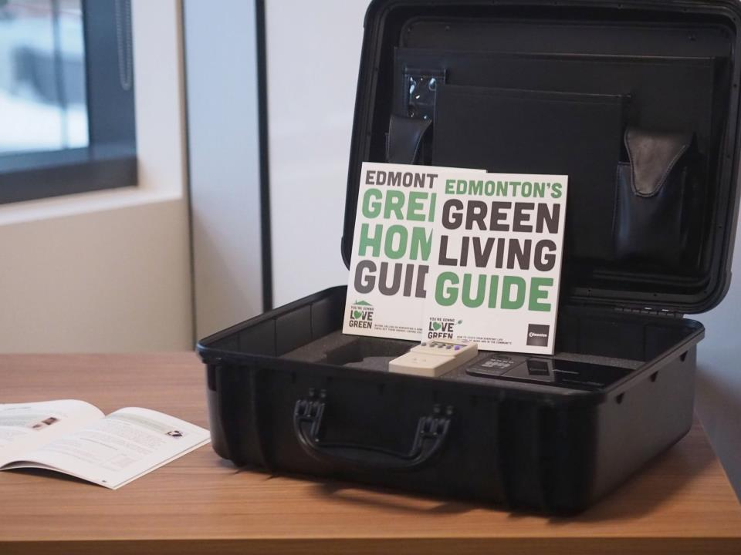
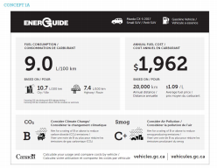
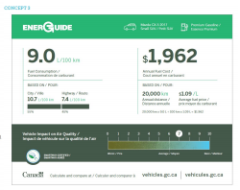

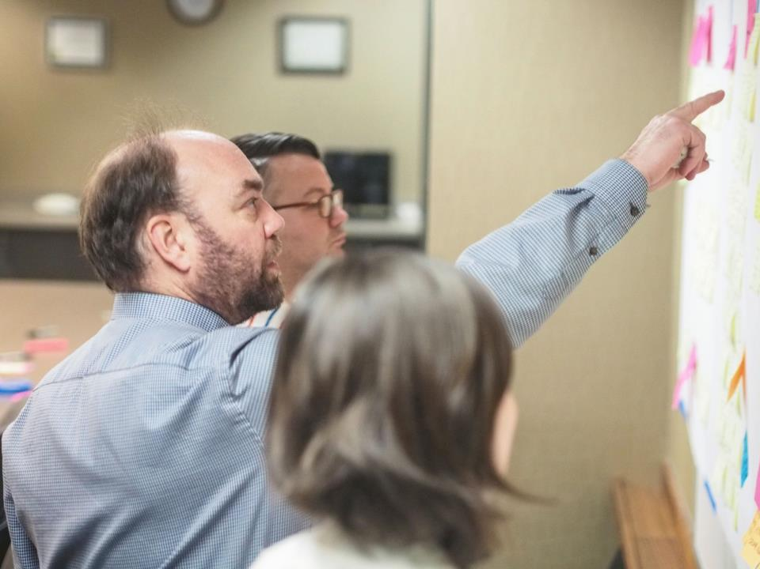
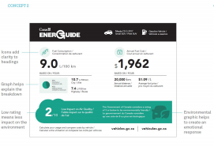


2
>2.3M
quizzes delivered via Carrot Rewards and over 860K completed
awareness of ENERGY STAR among app users (avg)
(+3,261) in new ENERGY STAR Twitter followers (ON pilot phase)
(+5,723) ENERGY STAR Facebook followers (ON pilot phase)
+26%
+111%
Co-creating evidence & learning by testing insights, prototypes & pilots
+87%
3
prototypes tested to inform EnerGuide home labeling experience & uptake in Edmonton
EnerGuide vehicle labels prototyped to inform digital transition & future testing
EnerGuide portal being prototyped with Canadian Digital Service to test digital service improvements
3
1
1
Smart Energy Community Scorecard (QUEST) proof of concept & stakeholder engagement supported
digital change drivers analyzed & 3 future scenarios created to compare against policy assumptions and inform improvements & new directions
low carbon city visions with energy mix pathways presented by cross-sector teams at “The Future Disrupted” GenEn Hackathon (with Deloitte)
8
6
Please refer the annex for info on select projects
Notes:
We’re introducing user research and prototyping practices into the OEE context with the aim of opening up more opportunities to experiment in the near future.
[amend notes with examples and results]

Slide 8



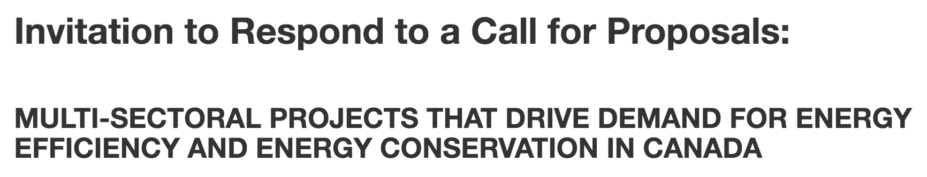

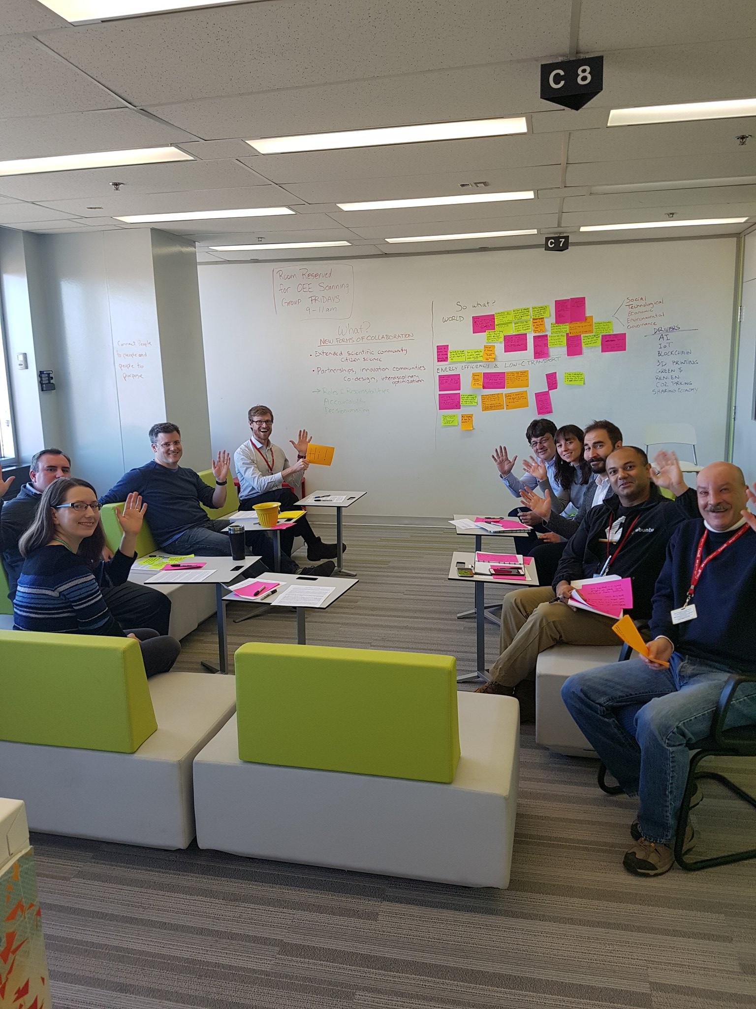
3
3
new Carrot pilot phases to be launched this fiscal with new content on home, appliance and vehicle energy use
utility and retail partners to test rewards in new contexts and influence behaviour change, like energy use reduction and ENERGY STAR purchases
Carrot users completed 2 Generation Energy polls which represented new content & significantly increased engagement on the GenEn website
5
>245K
Adapting & scaling learning & what works through service improvements & new policy directions
8
multi-sectoral partnerships co-funded (with OEE HD) that support innovative policy instruments & approaches to drive residential energy efficiency
is a City of Edmonton ‘Spot the Difference’ home labeling program that was informed by our initial cross-jurisdictional service R&D project
Improved EnerGuide home evaluation report being implemented to inform home retrofit actions
1
1
1
OEE Social Innovation Unit established with ongoing mandate
Foresight & Scanning Club established as an ongoing OEE policy function
OEE collaboration model designed to scale continuous improvement & innovation via an embedded policy & service R&D practice
1
1
Please refer the annex for info on select projects
Notes:
We’re scaling the Carrot Rewards pilot to test new content in new contexts via new partnerships.
We’ve scaled policy innovation and experimentation via contribution agreements through work with OEE’s Housing Division.
We’re 1.5 years young, but have been able to obtain on-going funding, inform improvements to the EnerGuide home evaluation report and co-create and sustain OEE’s foresight and scanning team and practice.
We’re also learning and adapting what we do to scale open, digital and social approaches, where needed.

Slide 9
THE SCALING CHALLENGE
We’ve run into challenges as we try to scale open, social and digital approaches
Isolated pilot projects
Ad hoc project selection
“What we do is what we do”
Untapped talent mobility & skills
The learning gap
Tunnel vision
Cracks in the foundation?
Notes:
Good work is being done but we’ve run into challenges as we try to scale open, social and digital approaches.
Isolated Pilot Projects - Policy and service transformation will not happen via isolated pilot projects and experiments.
Ad hoc Project Selection - We need to focus on where innovation and experimentation is needed most.
“What We Do is What We Do” - Focusing solely on the delivery of existing services leaves little bandwidth for continuous improvement and innovation beyond those existing services.
Untapped Talent Mobility & Skills - A heavy reliance on internal and existing skills and approaches will limit OEE’s ability to be an adaptive and responsive organization.
The Learning Gap - We need to be open to learning what works, what doesn’t and why. There are also opportunities to share and scale learning that is happening within, across and beyond the organization to inform collaborative action.
Tunnel Vision - Looking at complex behavioural and systemic challenges only through the lens of energy use and energy efficiency is limiting.
Cracks in the Foundation? - OEE’s foundational pillars (e.g. the Energy Efficiency Act, core tools and services, IM-IT infrastructure) require attention to enable us to be an adaptive and responsive organization in the digital era.

Slide 10
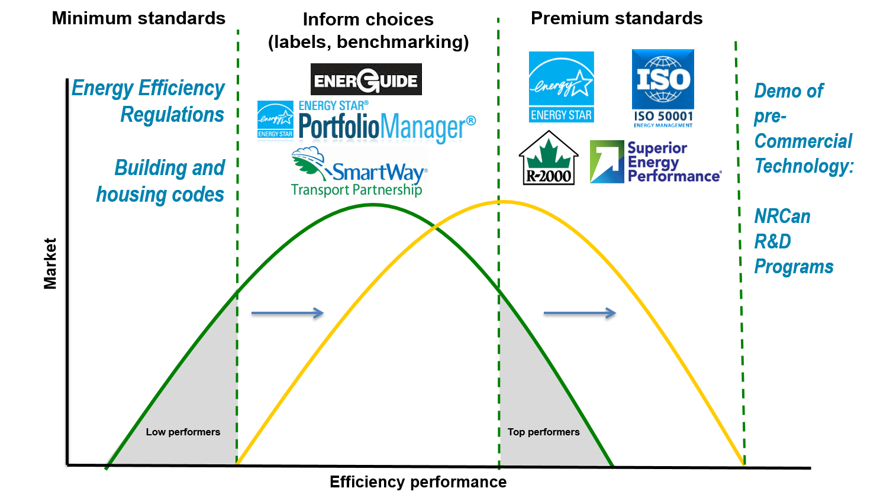
A NEW COLLABORATION MODEL
We are pivoting towards a more strategic & systematic approach…
Strategic Challenges
Policy, program and operational priorities and areas of focus that require systematic learning, experimentation and results
Policy and Service R&D Projects
Collaborative projects that require inter-disciplinary teams and structured engagement, action research, design and testing to inform (1) improvements to existing programs and policy levers and (2) new policy directions.
Core Policy & Program Functions
Existing:
Mandated policy & program levers
Priority setting
Policy coordination & stakeholder engagement
Economic and statistical modeling & analysis
Communications and outreach
Performance measurement & reporting
New & Emerging (to OEE):
Environmental scanning & foresight
Service design
Open dialogue, crowdsourcing & challenges
Data science & visualization
Developmental evaluation & storytelling
OEE Policy, Program & Research Teams
Colleagues interested in collaborative projects
External Partner & Stakeholder Networks
OGDs, Academia, Labs & Hubs, Other Jurisdictions, ENGOs, Social Enterprises, Start-ups, Service Organizations, Industry, Foundations, Canadians, etc
Porous boundaries for collaboration with internal & external partners & stakeholders
Source: Inspired by Purdue’s Postharvest Initiative Collaboration Platform graphic by Agile Strategy Lab: https://twitter.com/edmorrison/status/902594282216935431
Notes:
We are pivoting towards a more strategic & systematic approach to policy innovation and experimentation, which will require building a policy and service R&D function and innovation practice that operates on an interrelated, but distinct track from existing program delivery. The intention is to embed continuous improvement and innovation into OEE’s core policy and program functions and levers.
A new collaboration model is required that will:
Engage OEE senior management, colleagues (and others) to identify where innovation and experimentation is needed (strategic challenges) and policy/service R&D projects required to advance learning (underway and new);
For new projects, mobilize the people and skills (tapping into OEE and external networks) and approaches (existing and new policy functions) required to undertake action research, stakeholder engagement, prototyping and experimentation (where needed and applicable), communications and reporting;
Coordinate and curate knowledge and insights across the portfolio of projects per strategic challenge to scale learning and inform action, which could come in the form of further engagement, action research and/or policy and program changes (e.g. new policy interventions, legislative amendments, program design and delivery improvements, etc).

Slide 11
PATHWAY
…which will embed continuous to policy innovation & experimentation into our service delivery
Mobilize talent & interdisciplinary teams including via contracts, partnerships & internal expertise
FRAME OPPORTUNITIES
Conduct and support action research with users to generate new insights & experimentation opportunities
INTEGRATE & CURATE INSIGHTS
Monitor, collect and disseminate knowledge and learnings in engaging formats and channels
IMPLEMENT POLICY CHANGES
1
Implement new and improved core policies, programs & enabling mechanisms through legislative amendments, policy proposals and program delivery redesign
2
3
4
DEFINE CHALLENGES
Establish strategic focus areas requiring policy innovation and experimentation informed by secondary research, foresight & scanning, and internal & external engagement
5
TEST IDEAS
6
Test promising prototypes and solutions through rigorous experimentation
ADAPT & SCALE WHAT WORKS
Including though contracts, calls for proposals & open policy innovation
Engage, design and test as needed in new contexts
Notes:
Define the Challenges: Establish strategic focus areas requiring policy innovation and experimentation informed by secondary research, foresight & scanning, and internal & external engagement. We have three strategic challenges that could be considered to test the model and are open to others:
Redesigning the EnerGuide for Home Delivery Model (TBC);
Digitalization Task Team (relates to OEE’s MTP group);
Generation Energy Insights and Actions.
Frame the Opportunities (per Challenge area): Mobilize interdisciplinary teams including, if necessary via contracts, in-kind partnerships and OEE/NRCan/gov expertise to conduct and support action research, generate new insights & experimentation opportunities. The Social Innovation O&M budget can be used to support this work. Co-funding opportunties with divisions is also possible.
Test Ideas - Test promising prototypes and interventions through rigorous experimentation (where applicable), including via contracts, calls for proposals and prize challenges.
Integrate & Curate Insights: Monitor, analyse and disseminate knowledge and learnings in engaging formats and channels.
Adapt & Scale What Works: Engage, design and test (as needed) either in new contexts.
Implement Policy Changes: Implement new and improved core policies, programs & enabling mechanisms through legislative amendments, policy proposals and program delivery redesign.
If needed, an oversight committee of implicated directors could also be established per strategic challenge to provide strategic direction on continuous improvement and innovation interventions and learning.

Slide 12
AN EXAMPLE
Continuous Improvement of the EnerGuide for Homes Delivery Model
Policy and Service R&D Projects
Energy Use in the Home with PCO Innovation Hub
Cross-jurisdictional Service Design with CoLab & Edmonton
EnerGuide Process Improvement with Service Organizations
Rewarding EnerGuide & E-STAR learning & actions with Carrot Rewards
Driving Residential Energy Efficiency via Multi-sectoral approaches
Delivery Model Scan and Stakeholder Engagement by Dunsky
EU-Canada Knowledge Exchange on Labeling & Reporting
Strategic Challenge
Redesign the EnerGuide service delivery model for residential energy efficiency in light of shifting demands and contexts.
Core Functions
Existing:
Mandated policy & program levers – EnerGuide Labeling + contribution agreements to drive residential energy efficiency
Priority setting – PCF + Labeling
Policy coordination & stakeholder engagement – OEE-Edmonton relationships + Social innovation network
New & Emerging (to OEE):
Service design, co-creation, open policy making (i.e. citizen-centred approach with user research, prototyping & testing directly with partners & citizens)
Foresight & scanning – smart labels & other digital approaches & models
OEE policy, program & research teams
Social Innovation Unit & Housing Division reps
External Partner Networks
Labs & Hubs, Alberta, Edmonton, Service organizations, utilities, start-ups
Source: Inspired by Purdue’s Postharvest Initiative Collaboration Platform graphic by Agile Strategy Lab: https://twitter.com/edmorrison/status/902594282216935431
Notes:
The Social Innovation Unit’s experience to date has informed the model design and the fundamental elements already exist. For example, working with partners, since 2016, new policy functions have been introduced and applied to mobilize stakeholders and partners, generate new knowledge and inform action. There have been two projects in particular where initial policy & service R&D work was undertaken in advance of scaling promising actions:
Improving the EnerGuide for Homes Experience in Edmonton; and
Building Capacity for Urban Low Carbon Innovation.
In each case, OEE worked directly with partners to understand the context and needs, including from the perspectives of users, stakeholders, practitioners, etc, through a participatory and interdisciplinary process. The insights and actions from the work informed proposals to continue testing ways of advancing and scaling projects that align to NRCan desired outcomes (e.g. improving residential energy efficiency and building capacity for urban low carbon innovation).
Other new and emerging priorities also looking promising for policy R&D and experimentation:
Redesigning the EnerGuide for Homes Delivery Model (the example illustrated above)
Digitalization of Energy MTP action research and policy development
Generation Energy Insights and Actions
Retrofitting buildings at scale;
Indigenous energy contexts and needs

Slide 13
NEW PRINCIPLES & PRACTICES
Scaling energy efficiency requires scaling new ways of learning and advancing what works
    An alignment of people, purpose and priorities
    An openness at all levels to improve existing service delivery and chart out new policy directions
    A continuous learning mindset with the motivations and opportunities to understand what works and when to let go
    Quantitative and qualitative research to generate insights that inform ideas and actions
    Direct engagement with the stakeholders and users of our policies, services and tools to prototype and test improvements and new directions
Notes:
There is excellent work happening within OEE and across Canada related to energy efficiency, climate change mitigation, low carbon transition and related outcomes.
OEE transformation means adopting open, social and digital mindsets and approaches at scale over time. That means direct engagement with the stakeholders and users of our policies, services and tools to prototype and test new concepts, improvements and new policy directions.
Doing so will require embedding a practice of continuous improvement and innovation into our service delivery in a more proactive and deliberate way.
That will require leadership and an openness at all levels to surface and test the assumptions that underpin our existing policies, programs and services, and being open to adapting where needed and possible in response to shifting contexts and user needs.
We can convene, curate knowledge and scale collective learning to inform the next generation of policy and program interventions required to meet the government’s commitments and ensure that the OEE is an adaptive, responsive and resilient organization in the digital era.

Slide 14
Annex other info

Slide 15
Scanning emerging change drivers for policy insights & action
TESTING NEW POLICY METHODS & APPROACHES
Case study hypothesis: A foresight & scanning club (“The Sentinels”) that explores how change drivers might affect energy use, and to surface policy and program assumptions, will generate insights to inform new policy directions.
Approach [Partnership with Strategic Policy & Planning & Program reps]
Phase I: Continuous environmental scanning to analyse and understand change drivers and how they may affect energy efficiency and policies
Phase II: Use insights and analysis insights to inform medium-term policy planning and innovation opportunities
Results
Analyzed 8 change drivers & created 3 scenarios against assumptions underpinning current policies and programs
Generated new policy insights to inform continuous improvement, stakeholder engagement and new policy directions
Used scenarios and insights to inform Generation Energy engagement and actions, e.g. “The Future Disrupted” hackathon
Next Steps
Define 3 to 4 action research projects to lead and/or support (e.g. smart labels, smart contracts, Energy Efficiency Act review)
blockchain
Internet of things
Artificial Intelligence
Notes:
We have a number of examples of what that looks like in practice.
With DPAD’s Strategic Policy and Planning Team we coc-created a foresight & scanning club (“The Sentinels”) that explores how change drivers might affect energy use, and to surface policy and program assumptions, will generate insights to inform new policy directions.
To date, the Sentinels have generated new policy insights to inform continuous improvement, stakeholder engagement (e.g. Generation Energy) and new policy directions. Next steps include a Digitization of Energy task team that will undertake some action research to inform MTP planning and projects to lead and/or support (e.g. smart labels, smart contracts, Energy Efficiency Act review).

Slide 16
Engaging Canadians on their smartphones for energy efficiency awareness & action
TESTING NEW POLICY METHODS & APPROACHES
Case study hypothesis: Rewarding Canadians on a mobile app will increase public engagement in energy efficiency and nudge them to act.
Approach [Partners: OEE programs, Carrot Insights]
Phase I: Energy efficiency content co-created and delivered in BC and Newfoundland via Carrot Rewards app (employing gamification, nudge)
Phase II: Energy efficiency content co-created and delivered in Ontario; Generation Energy content delivered to BC, Newfoundland and Ontario
Results
400K Canadians engaged in energy efficiency content
24-27% increased awareness of ENERGY STAR among app users
Significant increase in ENERGY STAR Canada social media reach and in
Generation Energy online engagement
Insights to inform content, program development and potential new partners
Next Steps
Scaling app to additional provinces
Introducing new content
Establishing new partners to demonstrate behaviour change (e.g. (Home Depot, Enbridge, BC Hydro, Toronto Hydro, etc.)
Notes:
Carrot Rewards: We’ve had success in engaging Canadians on their smartphones for energy efficiency awareness & action. Specifically, the first phases of the Carrot Rewards pilot has focused on improving awareness and action related to ENERGY STAR and EnerGuide (e.g. 400K Canadians engaged in energy efficiency content; 24-27% increased awareness of ENERGY STAR among app users; Significant increase in ENERGY STAR Canada social media reach)
The second phase included two Generation Energy online engagements, which included polls on energy use and transition. Of the 370K+ Canadians engaged via Generation Energy, approximately 300K were through Carrot and the number of ideas and comments shared on the GenEn portal spiked whenever a rewards offer was launched.
Phase 3 content creation is well underway and new content will be launched in November 2017. We’re also working to scale the app by engaging utilities and retailers who are keen to test out the rewards app as means of engaging Canadians to and nudging behaviour change.

Slide 17
Cross-jurisdictional approach to improve home labelling & reporting
TESTING NEW POLICY METHODS & APPROACHES
Case study hypothesis: A cross-jurisdictional and citizen-centred approach will generate insights to improve the uptake of EnerGuide labelling and reporting in the housing sector
Approach [Partners: OEE Housing, Alberta CoLab, City of Edmonton & Situ Strategy]
Phase I: Action research and design project to inform learning and frame opportunities and challenges
Phase II: Call for proposals and fund further experimentation and delivery
Results
Relationships & capacity built across 3 levels of government (municipal, provincial, federal) for a citizen-centred approach
Generated new insights on home energy use behaviours
Tested 3 prototypes to inform EnerGuide service improvements and a project proposal by the City to conduct further experimentation
Next Steps
Monitor and support the multi-sectoral partnership
Learn from and disseminate results and findings
Notes:
OEE engaged in a cross-jurisdictional approach with the Province of Alberta’s CoLab and City of Edmonton to improve home labelling & reporting by conducting user research, prototyping and testing service improvements directly with citizens.
As a result, improvements have been made to the EnerGuide Home Evaluation Report to make it more reader-friendly and actionable, and the City of Edmonton successfully applied for NRCan funding to support further experimentation and the delivery of their home labelling and reporting program using EnerGuide tools.

Slide 18
TESTING NEW POLICY METHODS & APPROACHES
Funding multi-sectoral partnerships to drive demand for energy efficiency in homes
Case study hypothesis: Redesigning the contribution agreement process will improve reach and spur social innovation and energy efficiency in the residential sector
Approach [Partnership with OEE Housing]
Phase I: Redesign Call for Proposals to expand reach and support innovative projects
Phase II: Engage stakeholders to explore and possibly redesign the model to enable collaboration and outcomes-based funding
One of the 8 funded projects includes experimentation in the City of Edmonton informed by the collaboration on the previous slide
Results
48 proposals submitted (up from 15)
8 projects funded
$2.5 million to leverage more than $30M in total projects
100% of projects are using new instruments and approaches to drive energy efficiency
Next Steps
OEE (with IETS reps) will monitor, advise projects and reallocate funding as needed
Engage stakeholders and potential funding partners to explore common priorities and possibilities to collaborate

Slide 19
TESTING NEW POLICY METHODS & APPROACHES
Improving awareness & uptake of fuel efficient vehicles
Case study hypothesis: Improving our understanding of consumer purchasing decisions will lead to better policy interventions that inform fuel-efficient car choices
Approach [Partners: OEE Personal Vehicles team, Akendi]
Conduct user research, experience mapping and prototyping.
Results
Relationships and capacity built for a user-centred approach.
New insights of consumer behaviours and intervention points generated to inform prototyping.
3 EnerGuide label prototypes designed for future testing
Next Steps
Digital prototypes to be designed that engage and inform consumers (smart label, app/game) and continue learning.
Personal vehicles content creation for EE Rewards pilot

Slide 20
TESTING NEW POLICY METHODS & APPROACHES
Supporting Smart Energy Communities & Low Carbon Urban Futures
Case study hypothesis: Building relationships and supporting open dialogue will build capacity and advance energy efficient and low carbon cities and communities
Approaches
Contribution agreements to support open dialogue, prototyping and policy proposals.
Relationship building with new stakeholders.
Results to date
Relationships & capacity built to improve awareness and understanding of opportunities and barriers to energy efficiency and low carbon transition in cities and communities.
Prototypes created to advance energy efficiency and low carbon transition.
Next Steps
Continue building relationships and shared understandings of opportunities
Ensure their voices are heard in the Generation Energy Dialogue and Forum and future policy directions.

