Slide 1


Slide 2


Goals and vision
Increasing the quality of citizens’ life by providing better, faster and more innovative public services
Engaging Polish SMEs, which will provide services to an agile public Employer, without fear of procedural barriers

Slide 3
Goals
Developing models of cooperation with SMEs
Supporting SME’s
Engaging them in public tasks
access to more innovative solutions
idea-centered competition
Grinding out administative diamonds
Citizen-facing challenges
Working on challenges benefiting us all
Innovators within the administration can become natural ambassadors GovTech ambassadors

Slide 4

GovTech
Ecosystem
4

Slide 5
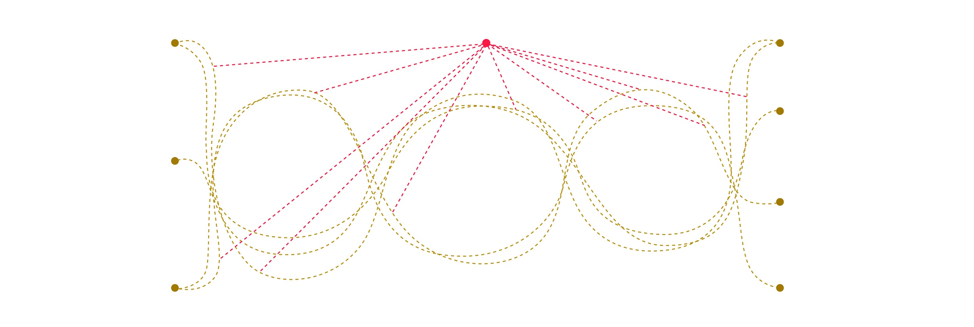
GovTech Ecosystem
GovTech Core Team
coordination
innovation
in
administration
Ministries
Subordinate units
Local administration
Comapnies, Foundations
Accelerators, Incubators
Scientific institutions
Software Houses
challenges
+
financing
ideas
+
solutions

Slide 6

Philosophy of action
6

Slide 7


A new model of cooperation between innovators and administration
All the way from a need to implementation
the contracting party identifies their challenges and then looks for solutions using competition models, e.g. hackathons, online contests
Technology purchased
faster and cheaper

Slide 8

Pilot
8

Slide 9




Challenge-driven approach
First model→ 3 stages of GovTech Polska process
Stage I
Stage II
Stage III
Nationwide brainstorming
⇉
Choosing solutions
+
Idea development
⇉
Implementation
Choosing 5 solutions/challenge
Workshops/design sprint
selecting the challenge winner

Slide 10


GovTech Pilot — schedule
Hackathon – start of Stage I
November 24 - 25
Contract with the winner
Preparing the challenges
Results of Stage I
Implementation
Stage I
Stage II
Stage III
2
weeks
1-2
weeks
1-4
weeks
2019
Challenges announced

Slide 11

Thank you!
11

