Slide 1
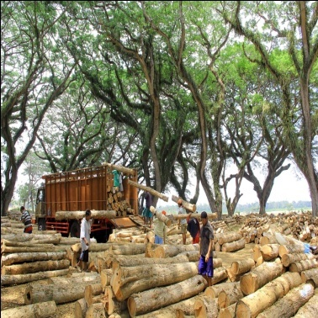
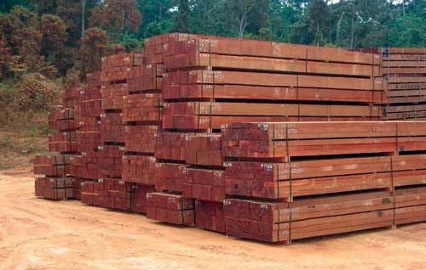
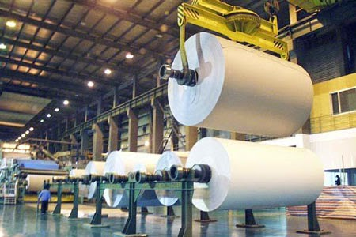
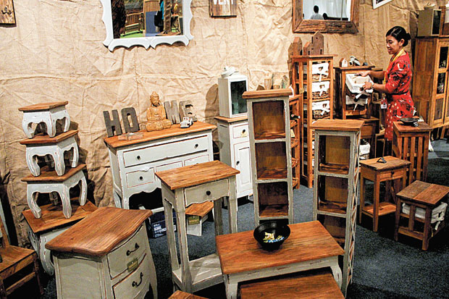

Promoting Trade of Legal Timber through Implementation of
SVLK and FLEGT-VPA
Ministry of Environment and Forestry
Republic of Indonesia
The 12th Meeting of APEC EGILAT,
Ho Chi Minh City Vietnam, 20-21 August 2017

Slide 2

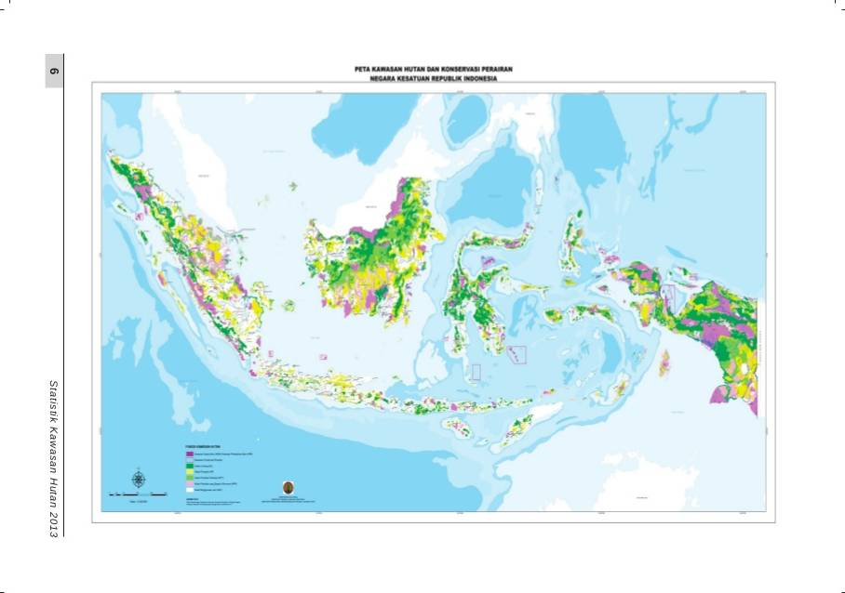
Indonesia
(187.9 mil Ha land area)

Slide 3

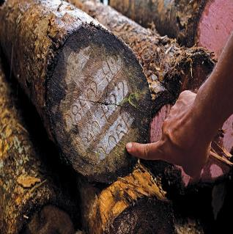
Toward Sustainable Forest Resources
SFM
GOOD
GOVERNANCE
LAW
ENFORCEMENT
TLAS/’SVLK’
DEVELOPMENT

Slide 4
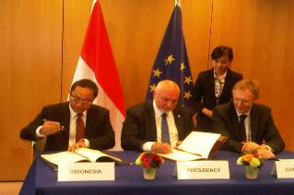
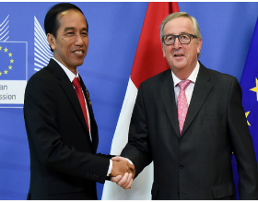
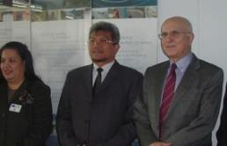
SVLK Development & FLEGT-VPA Progress
2014
FLEGT-VPA Ratification
2015
Joint Declaration
on SVLK Acceleration
23 March 2015
2001
Bali FLEG Declaration
2012
Trade Regulation on SVLK
2013
SILK online
2009
Forestry Regulation on SVLK
2003-2009
SVLK Development
Import Regulation
2011
Negotiation
Concluded
2013
Signing RI-EU FLEGT-VPA EUTR Take into Force
2014
EU Ratification
15 Nov 2016
FLEGT Licensing
2007
RI-EU FLEGT-VPA
initiated

Slide 5


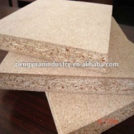
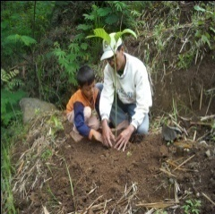


SVLK Scope
Legality & Sustainability
Primary Industry
Finished Products
State-forests
Secondary Industry
Legality
V-Legal Document
(FLEGT License)
via SILK ONLINE
Private forests
Legal
Legality
Legal
Market
Imported timber

Slide 6
SCHEME OF INDONESIAN TLAS
Government
Monitoring
Stipulation
Complaint
Complaint
National Accreditation Body
CSOs -Independent
Monitoring
Complaint
Accreditation Certificate
Acreditation
Appeal
Complaint
CABs/
Conformity Assessment Body
V-Legal Issuance
Export
Audit
Appeal
MoEF - LIU
SFM-C
TL-C
Auditees – On Farm and Off Farm
Import
Due Diligence

Slide 7
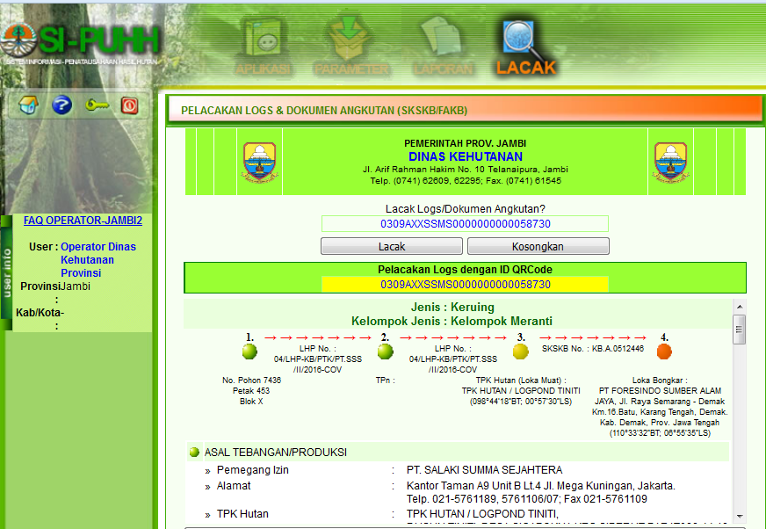
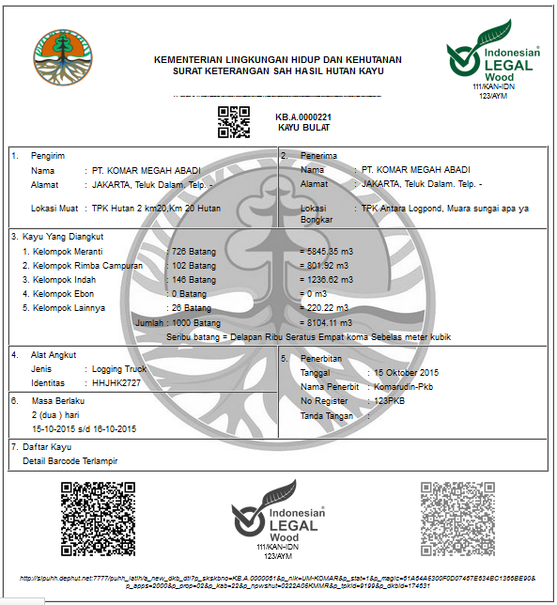
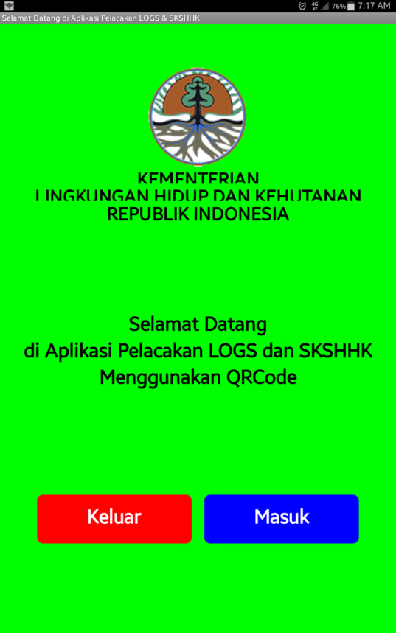
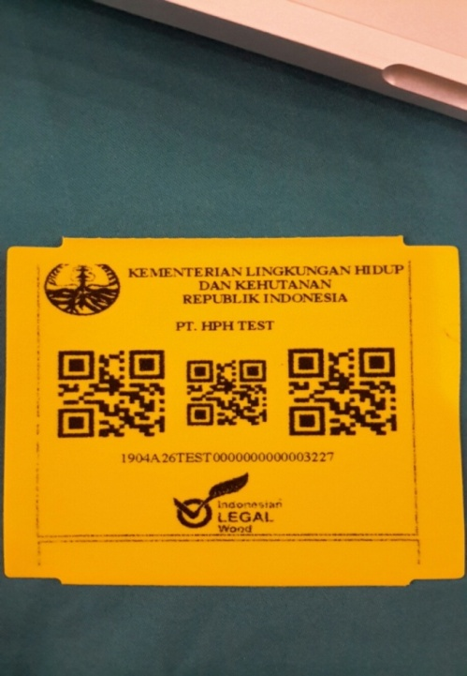
Online Timber Administration System
For Concessions of natural and plantation forest at State owned Forets:
Use barcode tracking
e-SKSHHK (transport documents)realtime tracking
Security by system
Transport documents
printed by users

Slide 8

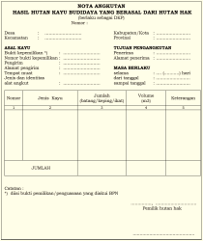
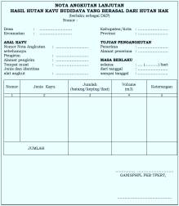

Timber Administration for Private Forests
Transport document (‘Nota Angkutan’)
Issued by land owner
Information on rights to land is inserted
Function as ‘Self Declaration of Compliance’
Timber Depot
Nota Angkutan (transport document)
Nota Angkutan
Lanjutan (transport document)
verified by timber depot (census)
verified by primary industry (sampling)
Harvesting Location
Primary Industry
Nota Angkutan
verified by primary industry (census)
Privately-owned forest trees:
planted/cultivated in privately-owned land
Species:
- commercial species: teak, mahogany
- fast-growing species : sengon (Falcataria), jabon (Antocephalus)
- fruit trees
Nota Perusahaan (transport document)
Secondary Industry/ Consumer
Verification/validation

Slide 9

ONLINE DUE DILIGENCE MECHANISM
FOR IMPORTD TIMBER & TIMBER PRODUCTS
DUE DILIGENCE PROCESS
(Inventory, Administrative Requirements
Inventory of imported material)
IMPORTER
Request Access
Denied
SFM and/or timber legality certificate
Approved
RISK ANALYSIS
Article 10 (1) c
LOGIN
FILLING DUE DILIGENCE FORMAT
Denied
Approved
7 WD
OR
Letter from Country of Origin on SFM and/or legality of timber/ timber products
IMPORT DECLARATION
(Due Diligence result is attached)
OR Country Specific Guidelines (CSG)
RISK MITIGATION
Article 10 (1) d
Import Recommendation Request
OR Mutual Recognize Agreement (MRA)
OR FLEGT-Licence
Approved/
Denied 3 WD
RECOMMENDATION

Slide 10
It does work!
Majority of companies/auditees
(on and off forests)
are becoming more acceptive/ cooperative/ supportive
25 Million
25 CABs
hectares of forest and
Have been accredited by the National Accreditation Committee
3249 Wood
manufacturers have been
CERTIFIED (since 2010)
CSO-consortium
Regulations are improved
Better forest governance
Illegal logging cases decreasing
GoI responds to problems raised/reported accordingly
(as an independent monitoring body)
is actively monitoring

Slide 11

Illegal Logging Cases in Indonesia
2005 - 2017
* up to May 2017
Source: DG of Fenvironment and Forestry Law Enforcement, MoEF

Slide 12

SVLK Certification Progress up to July 2017
385
Forest Management Unit
184 Timber Depot
111 non-Producer Exporters
3,249
Timber Industries
190 Groups of privately-owned Forest
Sumber: LVLK, Juli 2015
Picture source: www.samling.com

Slide 13

FLEGT-VPA INDONESIA – EU

Slide 14
SVLK Development & FLEGT-VPA Progress
2014
FLEGT-VPA Ratification
2015
Joint Declaration
on SVLK Acceleration
23 March 2015
2001
Bali FLEG Declaration
2012
Trade Regulation on SVLK
2013
SILK online
2009
Forestry Regulation on SVLK
2003-2009
SVLK Development
Import Regulation
2011
Negotiation
Concluded
2013
Signing RI-EU FLEGT-VPA EUTR Take into Force
2014
EU Ratification
15 Nov 2016
FLEGT Licensing
2007
RI-EU FLEGT-VPA
initiated

Slide 15
Working Structure
JPC
JPC
JIC
IMPLEMENTATION
2016
PREPARATION
2014 - 2015
NEGOTIATION
2007 - 2013
JEM
JEM
JEM
P
JWG
TWG
TWG

Slide 16
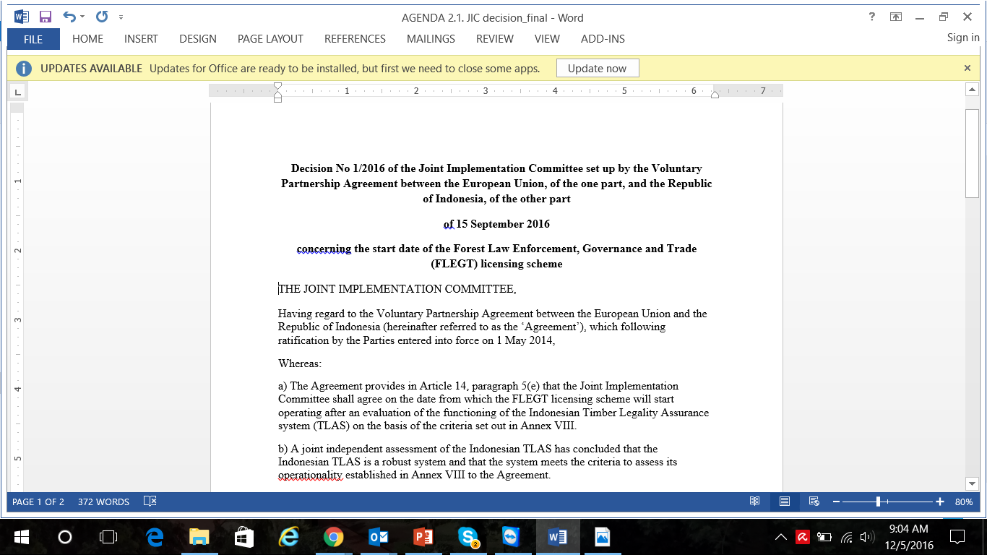
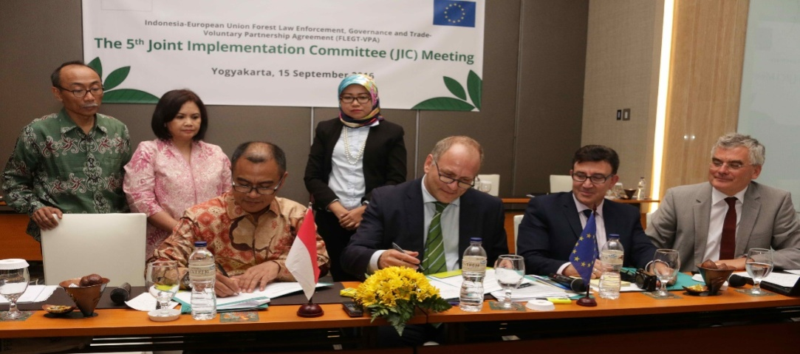
IDN- EU Joint Decision concerning
the Start Date of FLEGT Licensing Scheme
The 5th JIC Meeting, 15 September 2016

Slide 17
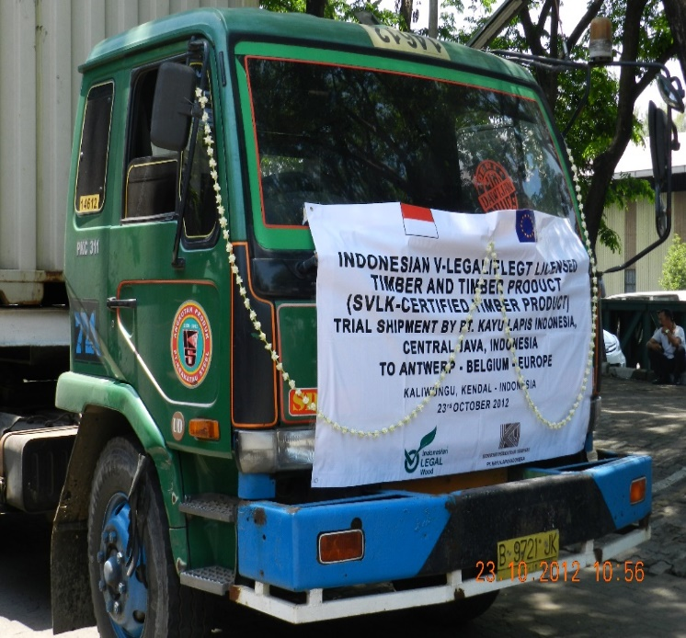
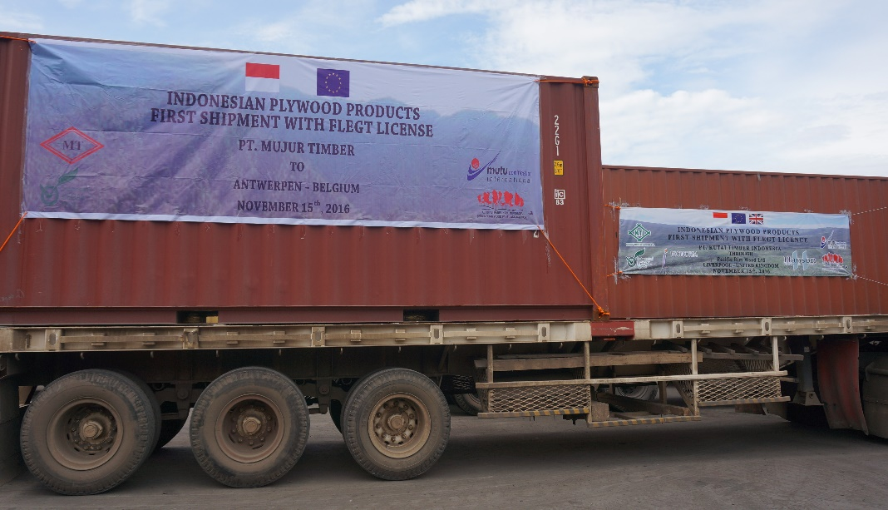
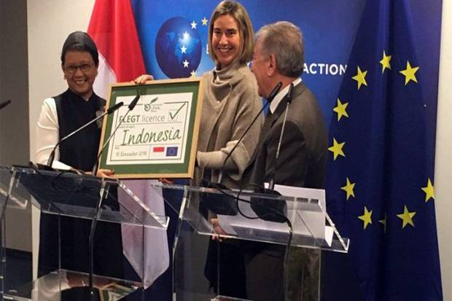
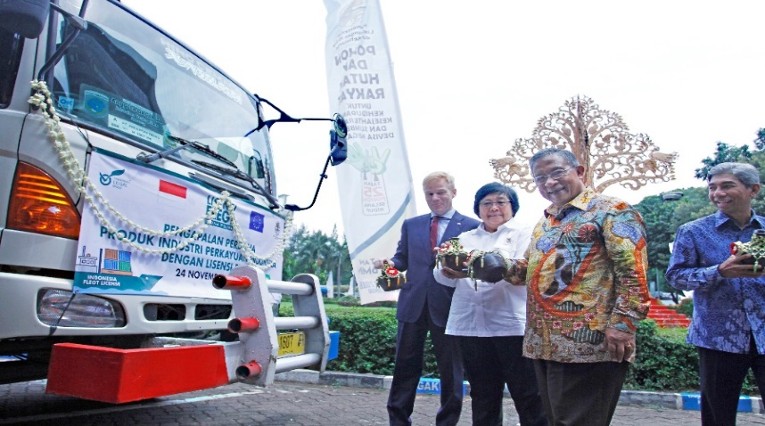
First Shipment using FLEGT Licence to Antwerp
15 November 2016
First Trial Shipment Timber Export to Antwerp using V-legal, 23 October 2012
Acceptance of Indonesia FLEGT License for Timber Products of by Minister of Foreign Affairs
Brussels, 30 November 2016
FLEGT License Celebration
24 November 2016

Slide 18





Flow of V-Legal Document/FLEGT licence
Issuance of
V-Legal Document/FLEGT licence
Country Destination (Market)
FLEGT licence
4
6
CABs (Licensing Authority)
SILK/ LIU (MoEF)
Competent Authority
(Validate & Process)
Customs
0
1
Online
2
3
Request
5
1
2
5
Exporter
(Certificate Holder)
7
IMPORTER
3
1
2
3

Slide 19
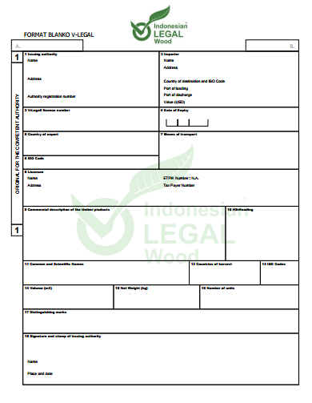
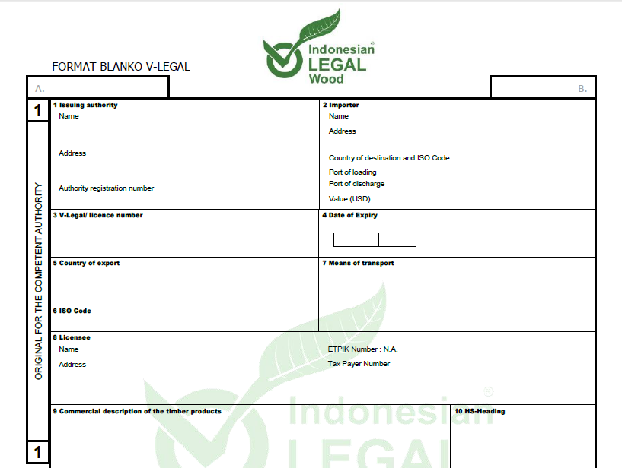
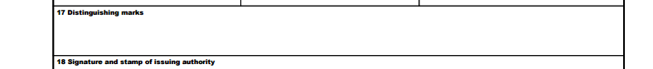
‘V-LEGAL DOCUMENT’ AS ‘FLEGT LICENCE SINCE NOVEMBER 15, 2016’
‘FLEGT’
NOTE:
Issued by the licensing authority through the online SILK system (also connected real-time with the online trade system/INATRADE and the single window Customs system/INSW).
Issued per invoice = per shipment.
Issued only for SVLK (IDN TLAS) certificate holder.
Invoice number & barcode

Slide 20
IMPORTERS OF INDONESIAN TIMBER PRODUCTS – 2016 (US$)
No. | Negara Tujuan | Value (USD) | %
1 | CHINA | 2,034,491,411 | 21.96
2 | JAPAN | 1,284,687,873 | 13.87
3 | EUROPEAN UNION | 873,247,810 | 9.43
4 | UNITED STATES OF AMERICA | 836,848,780.3 | 9.03
5 | REPUBLIC OF KOREA | 550,752,629.8 | 5.94
6 | INDIA | 368,166,495.2 | 3.97
7 | AUSTRALIA | 337,100,582.1 | 3.64
8 | MALAYSIA | 331,365,461.1 | 3.58
9 | TAIWAN, REPUBLIC OF CHINA | 299,712,419.2 | 3.23
10 | VIET NAM | 196,136,765.9 | 2.12
11 | OTHERS | 2,152,708,731.4 | 23.23
 | TOTAL | 9,265,218,959 | 100.00
Sumber : SILK Online, 1 April 2017

Slide 21
ISSUANCE OF V-LEGAL DOCUMENT/FLEGT LICENSE
1 January 2013 – 19 August 2017
No. | Uraian | Satuan | 2013* | 2014* | 2015** | 2016** | 1 Jan – 25 Juli 2017*** | Total
1 | Number of V–legal Document or shipment | Document | 77,894 | 94,199 | 181,170 | 178,804 | 133,150 | 665,217
2 | Number of Importing countries | Countries | 155 | 167 | 191 | 191 | 192 | 205
3 | Number of Importing countries – EU Destination | Countries | 27 | 27 | 28 | 27 | 27 | 28
4 | Number of HS Codes - 4 digit | HS | 40 | 39 | 43 | 43 | 46 | 48
5 | Number ports of discharge in Indonesia | Ports | 69 | 62 | 85 | 75 | 68 | 115
6 | Number of ports of destination in Importing countries | Ports | 1,109 | 1,263 | 2,055 | 1,875 | 1,754 | 3,363
7 | Weights | Kg | 8,009,062,497 | 9,501,794,305 | 15,727,248,483 | 17,459,509,441 | 9,174,847,177 | 59,872,461,903
8 | Value | US$ | 6,055,066,005 | 6,586,411,258 | 9,843,705,841 | 9,265,207,367 | 6,754,886,775 | 38,505,277,245
- Terdapat pos tarif/HS (4 digit) baru di tahun 2014, yaitu : 4804; 4602
- Terdapat pos tarif/HS (4 digit) baru di tahun 2015, yaitu : 4814; 4416; 4601
- Terdapat pos tarif/HS (4 digit) baru di tahun 2016, yaitu : 4702; 4704
- Terdapat 239 pelabuhan bongkar baru di tahun 2014 |  |  |  |  | FLEGT License issued: 30,394 Licenses Value : US $ 768,798,722
- Terdapat 963 pelabuhan bongkar baru di tahun 2015
- Terdapat 484 pelabuhan bongkar baru di tahun 2016
- Terdapat 307 pelabuhan bongkar baru di tahun 2017
- Terdapat 9 pelabuhan muat baru di tahun 2014, yaitu : Telok Air, Malang/Abdurrachman Saleh (u), Pekanbaru (Rumbai), Bengkulu,
Pekanbaru (Simpang Tiga) (u), Halim Perdana Kusuma (u), Yogyakarta/Adi Sucipto (u), Kabil/Panau dan Ujung Pandang / Hasanuddin (u)
- Terdapat 21 pelabuhan muat baru di tahun 2015, yaitu : Belakang Padang, Bintuni, Solo/Jebres/Adi Sumarmo, Surakarta, Yogyakarta (ptt)
Tanjung Kedabu, Tanjung Selor, Idi, Tanjung Sangata, Sumbawa (Brang-Biji), Manggar, Taliabu Celebes, Tanjung Pandan, Palu/Mutiara (u), Hulu Siau, Bosong Telaga,
Padang / Tabing (u) dan Bandung / Husein Sastranegara (u), Mulia, Lombok Strait, Benoa/Loloan
- Terdapat 9 pelabuhan muat baru di tahun 2016, yaitu : Sungai Selatan, Teluk Lamong, Tagulandang, Manokwari, Jambi/Palmerah/Sultan Taha (u), Pacitan, Tambak, Indonesia Bulk Terminal dan Jayapura/Sentani (u)
- Terdapat 7 pelabuhan muat baru di tahun 2017, yaitu : Long Bawan, Tamako, Tanah Merah Irian, Entikong, Palembang Plaju, Tanjung Leneng dan Sorong.
- Terdapat 18 negara tujuan ekspor baru di tahun 2014, yaitu :
Palau, Saint Lucia, Zimbabwe, Mongolia, Macedonia/The Former Yugoslav Republic, Montenegro, Barbados, Wallis and Futuna,
El Savador, Serbia, Belize, Aruba, Iceland, Suriname, Tonga, Turks and Caicos Islands, Monaco dan Afghanistan
- Terdapat 22 negara tujuan ekspor baru di tahun 2015, yaitu : Belarus, Sierra Leone, Equatorial Guinea, Mauritania, American Samoa, Bermuda, Botswana, Republic of Moldova, Paraguay, Dominica, Rwanda, Virgin Islands, Luxembourg, British Indian Ocean Territory, Gibraltar, Cayman Islands, Solomon Islands, Burkina Faso, Christmas Island, Bhutan dan Zambia.
- Terdapat 8 negara tujuan ekspor baru di tahun 2016, yaitu : Andorra, Guyana, Cape Verde, Uzbekistan, Guinea Bissau , Curacao, Bolivia dan Kiribati
- Terdapat 2 negara tujuan ekspor baru di tahun 2017, yaitu : Marshall Islans dan Micronesia, Federated States Of

Slide 22
Export Values of SVLK Certified
Wood Products
Year | Value (US $) |  | Total
 | EU | Non EU
2013 | 586,168,301.10 | 5,467,841,318.06 | 6,054,009,619.15
2014 | 641,973,223.31 | 5,944,438,034.19 | 6,586,411,257.50
2015 | 873,247,810.24 | 8,968,453,824.35 | 9,841,701,634.58
2016 | 868,850,245.73 | 8,396,355,631.64 | 9,265,205,877.37
Jan - May 2017 | 437,938,476.08 | 3,878,149,447.38 | 4,316,087,923.46
Source: silk.dephut.go.id, downloaded on 9 June 2017

Slide 23
Export Value of Wood Products to EU by Product Types
No | Product | 15 Nov 2015 - 31 May 2016 (before FLEGT- licence) | 15 Nov 2016 - 31 May 2017 (using FLEGT-licence)
 |  | Value (US $) | Value (US $)
1 | Building Prefab | 31,432.76 | 221,236.95
2 | Wood Chip | 1,102.00 | 25,008.20
3 | Wood Furniture | 65,050,644.38 | 200,287,882.89
4 | Handy Craft | 6,827,349.06 | 12,471,096.08
5 | Wood Panel | 44,067,833.96 | 121,545,218.83
6 | Paper | 54,643,651.13 | 107,202,226.07
7 | Pulp | 440,870.29 | 508,330.70
8 | Veneer | 2,906,106.39 | 7,868,656.21
9 | Woodworking | 61,021,226.78 | 113,707,879.81

Slide 24
Challenges
Capacity of small and medium enterprises dealing with certification
A small subset still against the system
Cost of certification issue
Demand of real impacts, e.g. better price or premium price
Technical issues:
carelessness in filling form, misinterpretation of HS codes, information inconsistency (accross the various documents, e.g. bill of lading, invoice, etc.)
Further evidence on the implementation of EUTR due diligence process (that it is not easier than using FLEGT-Licence in entering EU market)

Slide 25
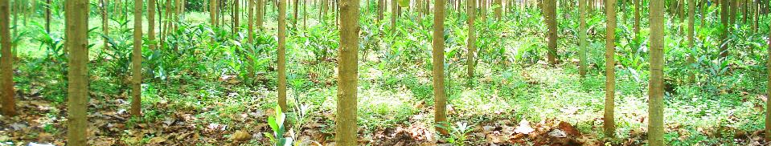
Concluding Note
Among issues remain to be addressed: maintain the credibility of the TLAS, domestic procurement policy, supports for smallholders, etc.
More effort at the demand sides: promotion, procurement policy, consistently close entrance of unknown/uncertified illegal timber, better access and price appreciation.

Slide 26
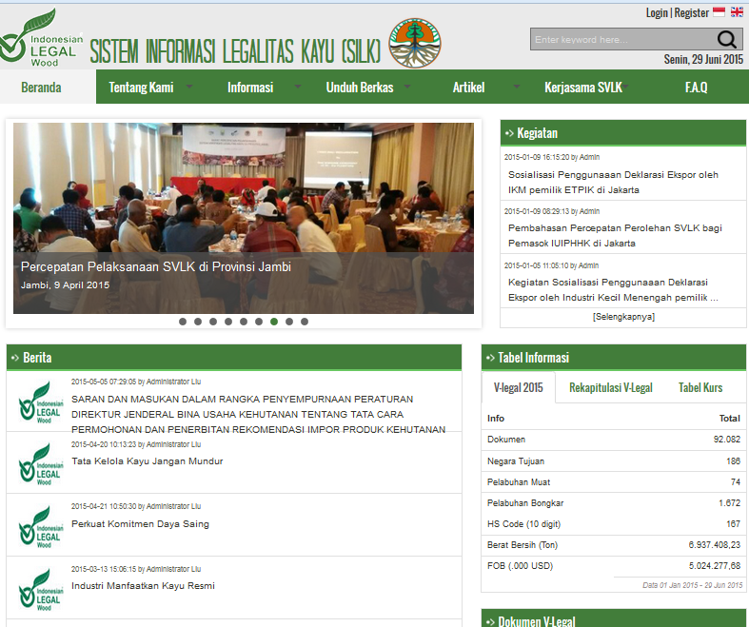
http://silk.dephut.go.id
Information Center for SVLK (IDN TLAS)

Slide 27

