Slide 1

Promoting legal trade in harvested wood products and strengthening supply chain connectivity
Ministry of Environment and Forestry of Indonesia
Nha Trang, Vietnam 18 Februari 2017

Slide 2
Indonesia
(187.9 mil Ha land area)
2
Notes:
Indonesia has been endowed with 120.9 million hectares of state-owned forest out of 187.9 million hectares land area. These forest are classified into 4 main functions, namely production forest of 56.1 million hectares, conservation forest of 22.1. million hectares, protection forest of 29.6 million hectares and convertible forest of 13.1 million hectares.

Slide 3

3
Notes:
In the production forest, 34% is managed by FME in natural forest; 19% is managed by FME in plantation forest; 7% is allocated for other permit, such as state-owned forest managed by community, forest utilization for NTFPs, ect. And 40% of production forest is not yet allocated for any permit or purposes.

Slide 4
SVLK Development
Law Enforcement
Good Governance
Sustainable Forest Resources
Notes:
In the past, Indonesia forest resources have suffered from illegal logging and illegal trade practices. The turning point was in 2001 following Bali Declaration on FLEG when Indonesia showed a high commitment on Forestry Law Enforcement and Governance (FLEG). The declaration constitutes a newa era on forest resource management and utilization by intensifying eradication of illegal logging and trade through law enforcement. However hard approach by law enforcement has not yet been considered as an effective way to combat such practices. Therefore, in 2003 Indonesia shifted the paradigm by developing a soft approach, SVLK. A system built by multistakeholders to improve forest governance, to sustainably manage the forest resources and ensure legality of timber and timber products.

Slide 5
Why Indonesia Should Implement SVLK?
Political: tackling illegal logging and associate trade →promote legal wood trade.
Economical: the value of trade in lumber product from Indonesia is still significant
Ecological/environment: uniquely mega-biodiversity in Indonesia, climate change prevention
Social/development: forests provide an income for milions of people of Indonesia → poverty eradication

Slide 6

Uniqueness of SVLK
SVLK is developed
  based on Indonesian law and regulations
  Based on ITTO Guidelines, ISO Standards
  Through multi-stakeholders consultation process
Implement by forest-based stakeholders
Mandatory
Forestry stakeholders high commitment to sustain forest resources

Slide 7
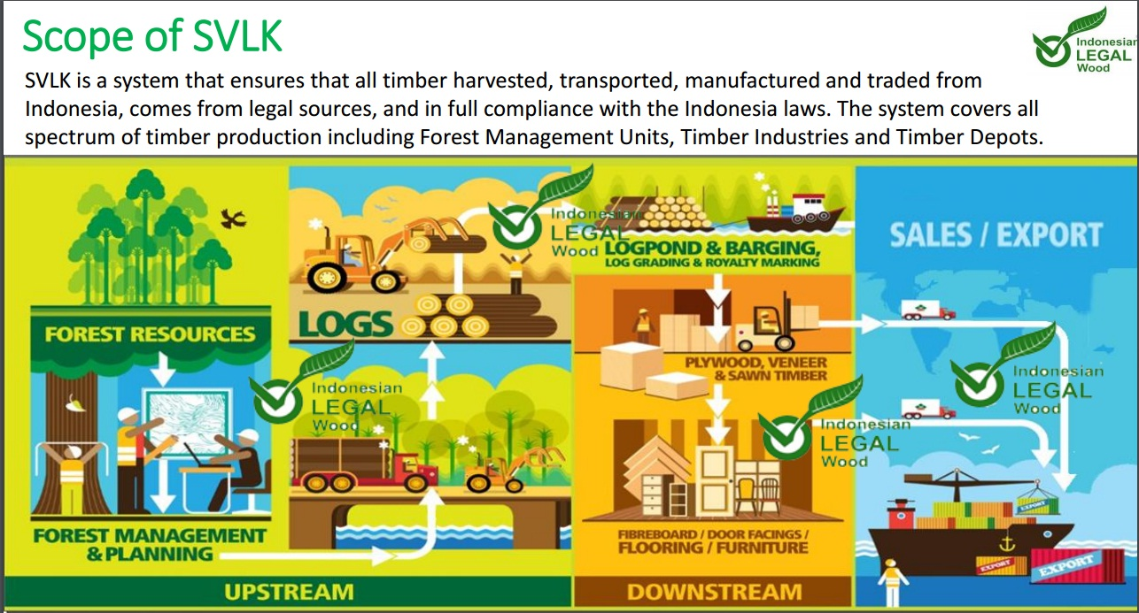

Slide 8


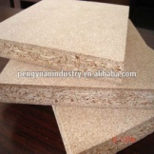
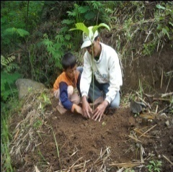


SVLK Scope
Legal & Sustainable
Primary Industry
Finished Products
State-forest
Secondary Industry
Legal
V-Legal Document
(FLEGT License)
via LIU
Privately-owned forest
Legal
Legal
Legal
Market
Imported timber
Notes:
SVLK covers assessment and/or verification from forest to market. The raw materials, if they are from state-owned forest, they have to be legal and sustainable. Timber from privately-owned forest or imported timber have to be verified legal. Specially for imported timber, SVLK request due diligence which inform Chain of Custody and Country of Harvest.
Industry and trader are also verified by the system to ensure their products are legal.

Slide 9
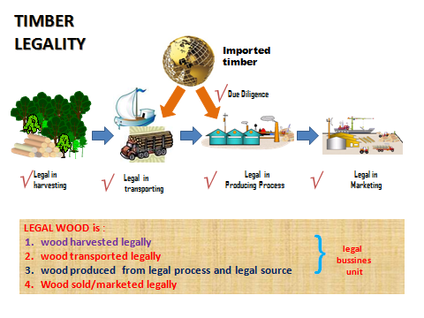

Slide 10


The Progress of Illegal Logging Cases
Sumber : Direktorat PHH, Ditjen PHKA (2015)
HARD APPROACH
SOFT APPROACH
Penindakan Hukum
Notes:
Dapat dikatakan bahwa sejak SVLK diberlakukan secara mandatory, ilegal logging turun secara drastis

Slide 11



Challenges in SMEs
Lack of finance and limited access to financial institution
Limited data
management
Limited labour skill (managerial, administratif)
Limited acces to
Market and
Limited capacity and technology
SMALL INDUSTRY
5-19 workers
Ivestmen : < IDR 1 bilion
MEDIUM INDUSTRY
20-99 workers
Investmen : < 15 IDR bilion

Slide 12
Government Support on SMEs
1.Simplified standard and guidelines
2. Group certification option
3. Public procurement
4. SVLK Acceleration by local goverment
POLICY
Technical assistance
Provide Funding for Certification and Suvaillance
a. National budget
b. Other sources (Private sector CSR, Foreign Project Cooperation : MFP3) and others
FACILITATION
1. National and International exhibition
2. Exchange program
PROMOTION
C S R
Stakeholder Support
COOPERATION

Slide 13




District Government Regulation to Accelarate SVLK Implementation
Simplified Permit
SVLK Dissemination and training
SVLK Clinic
JEPARA
Permit Incentives
Task force of SVLK Accelaration
Technical Assistace and certification facilitation
Klaten
Permit accelaration
SVLK training
Technical assistance and certification facilitation
Jombang

Slide 14
Thank You !

