Slide 2
Decision Support Model
Overview of project
A Purpose
B Approach
C Limitations
D Progress Update

Slide 3
STREAM 1
STREAM 2
STREAM 3
Current State
Assets (N, Capability, Location)
People (N, Capability, Location)
Equipment (N, location)
Hazards
(Cyclone, Fire, Road Accident, Rescue etc)
1000
Service Demand Scenario
(10 years of Service Demands)
3
999
Service Demand Scenario
(10 years of Service Demands)
2
Capital & Op Plan
∆ Assets (N, Capability, Location)
∆ People (N, Capability, Location)
∆ Equipment (N, location)
…
Service Demand Scenario
(10 years of Service Demands)
3
Service Demand Scenario
(10 years of Service Demands)
3652 (days) x 540 (SA2s) x Pr(Hazard)
2
Service Demand Scenario
(10 years of Service Demands)
1…3000
Service Demand Simulations
1
Service Demand Scenario
(10 years of QFES Service Demands)
Exposures
People, Structures, Assets
Adequacy Standards
1000 Generated
Scenarios
KPIs by SA2 by Plan
KPIs for Network by Plan

Slide 4
Limitations
Not a Capital Asset Plan that takes account of age and condition of assets
Does not calculate the delivery cost of individual services
Does not override ongoing operational distribution & predeployment of resources which are based on current fuel loads, current conditions, recent actual events – see CRRM
Is only as good as the data and estimates used to generate the frequency and severity of QFES service demands – lots of scope to improve the accuracy and reliability of these
Does not generate the optimized Corporate and Operational plans: it assess proposed ones against generated service demands for resource availability and speed-of-response
Does not automatically find best balance between investment in response vs investment in PPR, but can assess proposed balances

Slide 5
STREAM 1 – Hazard & Exposure Prediction
Simple Data

Slide 6
STREAM 1 – Hazard & Exposure Prediction
Central Tendency
(average across the data points)

Slide 7
STREAM 1 – Hazard & Exposure Prediction
Basic Reporting
Incidents:
SUM
COUNT
AVERAGE SPEND

Slide 8
STREAM 1 – Hazard & Exposure Prediction
Enter the world of big data

Slide 9
STREAM 1 – Hazard & Exposure Prediction
Too complex for humans alone

Slide 10
STREAM 1 – Hazard & Exposure Prediction
AI simplifies a complex picture

Slide 11
STREAM 1 – Hazard & Exposure Prediction
And renders it for us humans

Slide 12
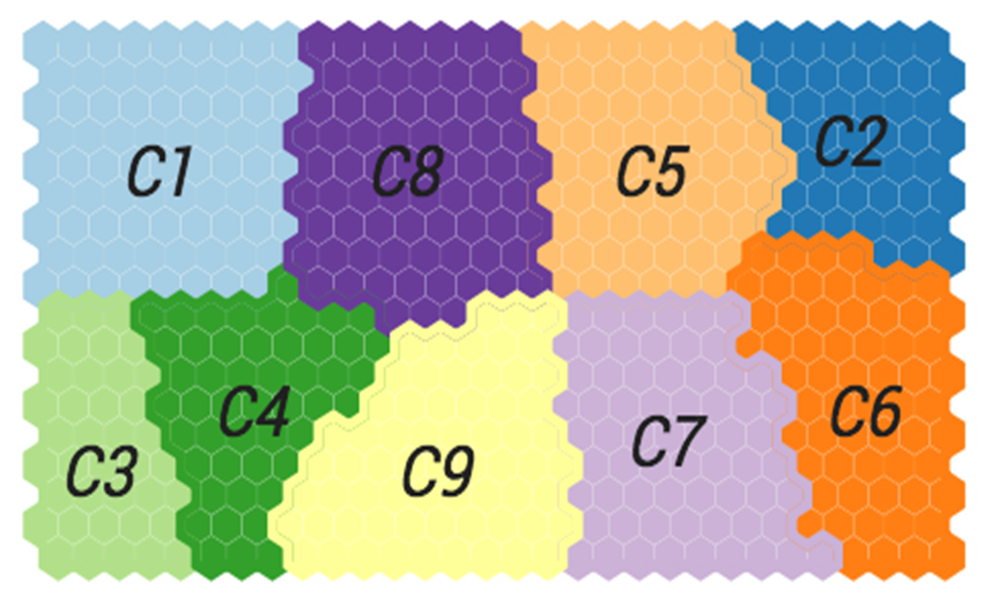
STREAM 1 – Hazard & Exposure Prediction
For Example

Slide 13
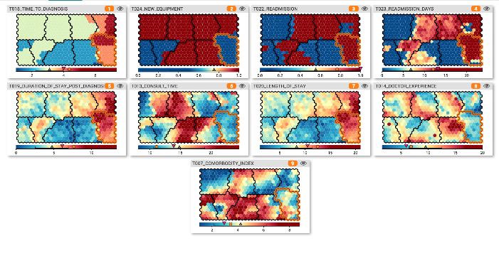
STREAM 1 – Hazard & Exposure Prediction
Cross-sectional slices by each variable / attribute
preserving the cluster boundaries and underlying
grid positions

Slide 14
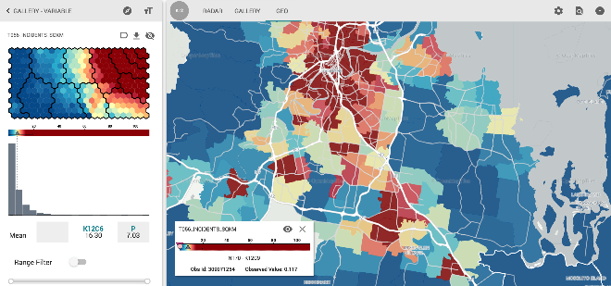
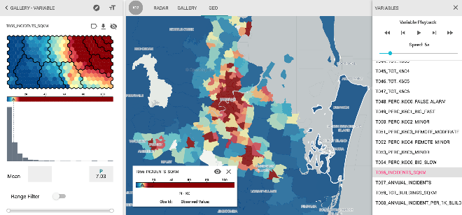
STREAM 1 – Hazard & Exposure Prediction

Slide 15
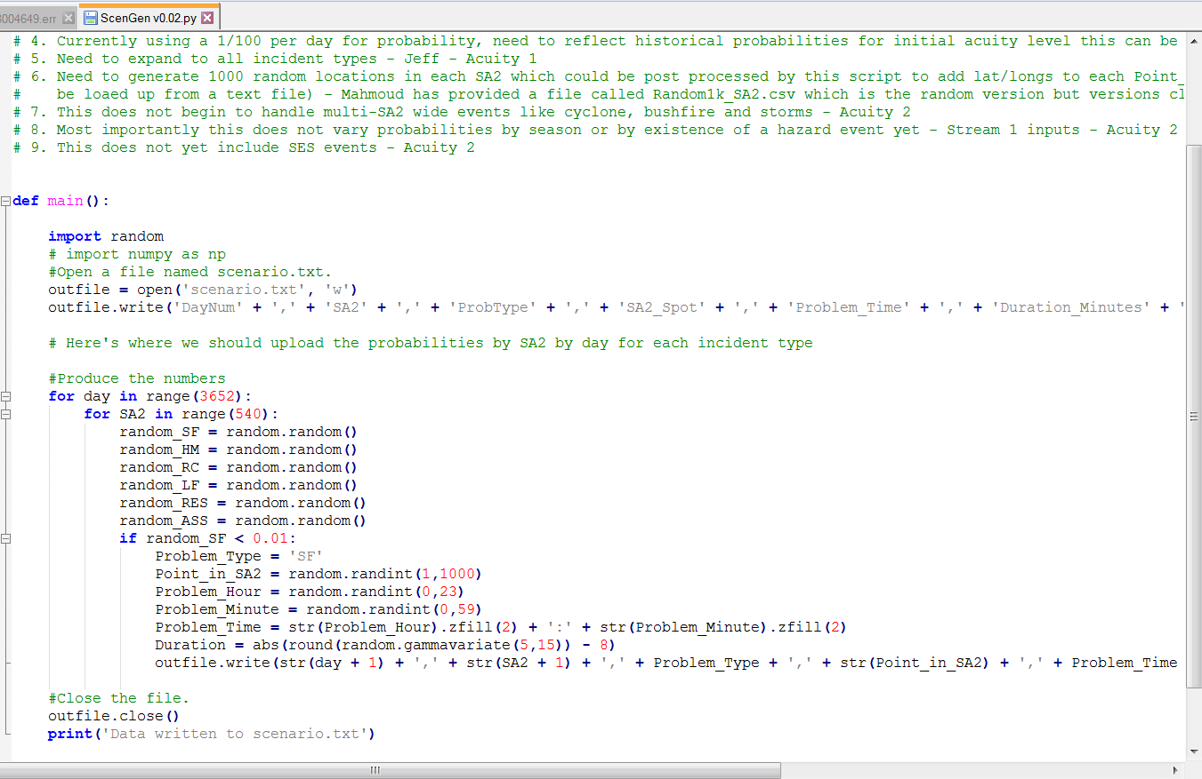
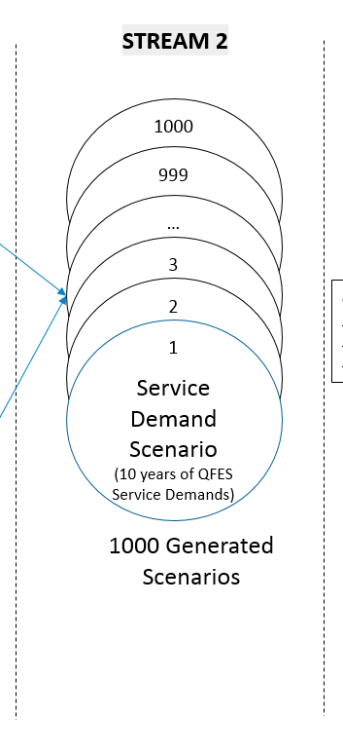
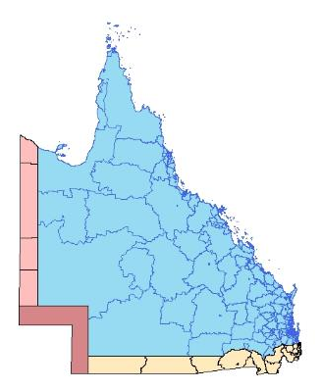
STREAM 2 – Service Demand Scenario Generation

Slide 16

STREAM 3 – Plan Assessments Against Scenarios

Slide 17
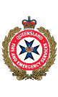

Document details
Classification Unclassified
Version v0.1
Creative
Commons State of Queensland
(Queensland Fire and Emergency Services) 2018
Author QFES, Futures
Queensland Fire and Emergency Services
Contact Nicole Lott
Director QFES Futures
nicole.lott@qfes.qld.gov.au
0409 873 203

