Slide 1

READ ME
THIS IS A TEMPLATE SLIDE DECK FOR THE WORKSHOP.
REVIEW SLIDES AND CUSTOMISE ITEMS IN RED WITH YOUR OWN INFORMATION AND GUIDANCE
SLIDES WITH A GREY BACKGROUND ARE INTENDED FOR ONLY THE FACILITATORS TO SEE AND GUIDE THE ACTIVITIES
[Your title]
© 2017. All rights reserved.

Slide 2


Innovation Facets Workshop
{Date}
{Occasion}
[insert date and occasion]

Slide 3
01
WELCOME

Slide 4

WORKSHOP OBJECTIVES
Why are we here today?
Develop a nuanced understanding of what public sector innovation entails
Learn how to use the OPSI Innovation Facets Model to achieve your innovation aims
Practice how to explore options and take action on an innovation portfolio
INNOVATION FACETS WORKSHOP

Slide 5


ABOUT [Host of workshop]
Integer porta lobortis quam. Fusce quis eleifend eros. Maecenas bibendum orci vel est tristique molestie. Cras pellentesque cursus efficitur. Vivamus faucibus, massa id commodo posuere, ante mauris viverra risus, ut fermentum risus lectus in justo. In hac habitasse platea dictumst.
[Information about your organisation
Information about today’s workshop]

Slide 6

01
Welcome
02
Why innovate?
03
The Innovation Facets model
04
Portfolio thinking for innovation initatives
AGENDA
05
Closing

Slide 7


FACILITATORS
SMITH WELLS
WILLIAMS WOODS
JACKSON BLACK
Integer porta lobortis quam. Fusce quis eleifend eros. Maecenas bibendum orci vel est tristique molestie. Cras pellentesque cursus efficitur. Vivamus faucibus,
Integer porta lobortis quam. Fusce quis eleifend eros. Maecenas bibendum orci vel est tristique molestie. Cras pellentesque cursus efficitur. Vivamus faucibus,
Integer porta lobortis quam. Fusce quis eleifend eros. Maecenas bibendum orci vel est tristique molestie. Cras pellentesque cursus efficitur. Vivamus faucibus,
Substitute with your facilitator(s)
INNOVATION FACETS WORKSHOP

Slide 8
02
WHY INNOVATE?

Slide 9
ICE BREAKER ACTIVITY

Slide 10
01
ICE BREAKER ACTIVITY
0:15
All participants
WHY?
Participants understand that
there are different purposes for innovation.
All of them are correct.
HOW?
Introduce the participants to 4 questions in the next slide. Each question is represented by one corner of the workshop room.
Ask the participants to decide which question is most important for their own work and to go in the corner.
Pick four participants and ask them why they chose their position in the room.
Explain that all participants are right and that there are different facets of innovation.
Split up into groups of 5-7. Every group is gathers around a table and is joined by a facilitator.
HINTS
Participants can chose to stand in between corners, or even in the middle of the room, if they want.
Questions to ask:
“What are you doing in your organization and why did you pick the position you are standing in?”
“Can you name an example where you were trying to solve this question?”
MATERIAL
None
FACILITATOR‘S GUIDE

Slide 11
WHICH QUESTION DRIVES
YOUR INNOVATION ACTIVITIES?
“How might we achieve X?”
“How might emerging possibilities fundamentally change what X could or should be?”
“How might we do X better?”
“How might our evolved situation
change how we do X?”

Slide 12
THE PURPOSE OF INNOVATION

Slide 13
02
WHAT IS THE PURPOSE OF INNOVATION?
0:20 + 0:15
Table activity
WHY?
Participants deepen their understanding of the purposes of innovation by discussing how each might manifest itself as a project.
HOW?
Introduce the participants to the canvas and project list.
Instruct them to map the projects to the canvas. They have 20 minutes.
Facilitate a 15 minute debrief of what they learned from this activity.
HINTS
Questions to ask:
“Which projects did you find it difficult to map?”
“Were there any disagreements on where to map a particular project?”
“Did you uncover any biases or preferences towards or against a particular purpose? Why do you think that is?”
MATERIAL
For each table:
Purpose of innovation canvas
Sample project list
FACILITATOR‘S GUIDE

Slide 14


WHAT IS THE PURPOSE OF INNOVATION?
INSTRUCTIONS
At each table:
Review the five sample project cards
Map each project card to the canvas
Discuss why you placed it in that corner
Time: 20 minutes

Slide 15

DEBRIEF

Slide 16
03
THE INNOVATION FACETS

Slide 17

THE INNOVATION FACETS MODEL
[Play video. Be ready to answer questions about the Innovation Facets Model]

Slide 18
03
MAPPING PROJECTS TO THE FACETS
0:20 + 0:15
Table activity
WHY?
Learn how to contextualize projects by using the Facets Model.
HOW?
Introduce the participants to the canvas and project list.
Instruct them to map the projects to the canvas.
After 20 minutes are up, facilitate a 15 minute debrief of what they learned from this activity.
HINTS
Some tables might have trouble with mapping a particular project. If they seem stuck, prompt them to move on.
Debrief questions:
”Were there any projects that you weren’t sure where to map? (Follow up) What did other groups decide on?”
”What kind of discussions did you have at your table?”
”Do you have any questions about any of the facets?”
MATERIAL
For each table:
Facets canvas
Extended sample project list
FACILITATOR‘S GUIDE

Slide 19
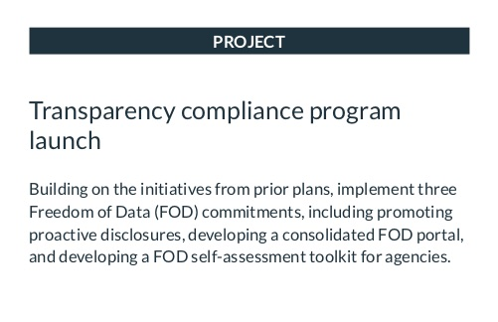
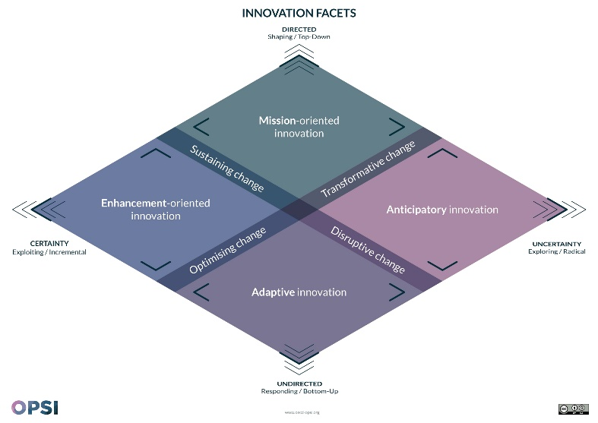
MAPPING PROJECTS TO THE FACETS
INSTRUCTIONS
At each table:
Go through the deck of sample projects
For each project, map it to the Facets Canvas
And discuss why you placed it there
Time: 20 minutes
Notes:
OP

Slide 20


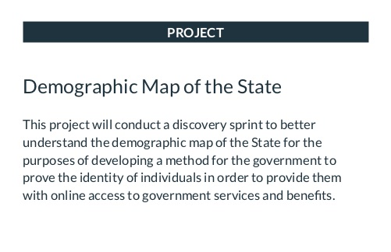
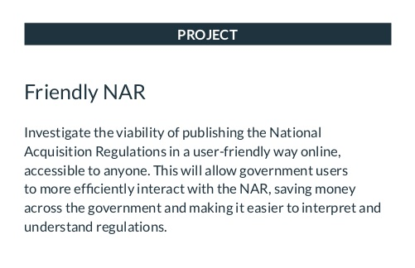

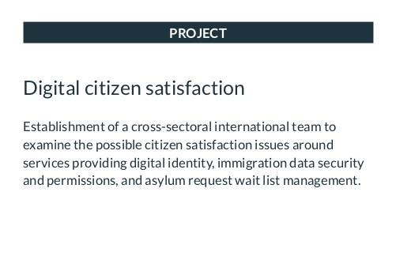
SAMPLE PROJECTS
x18

Slide 21
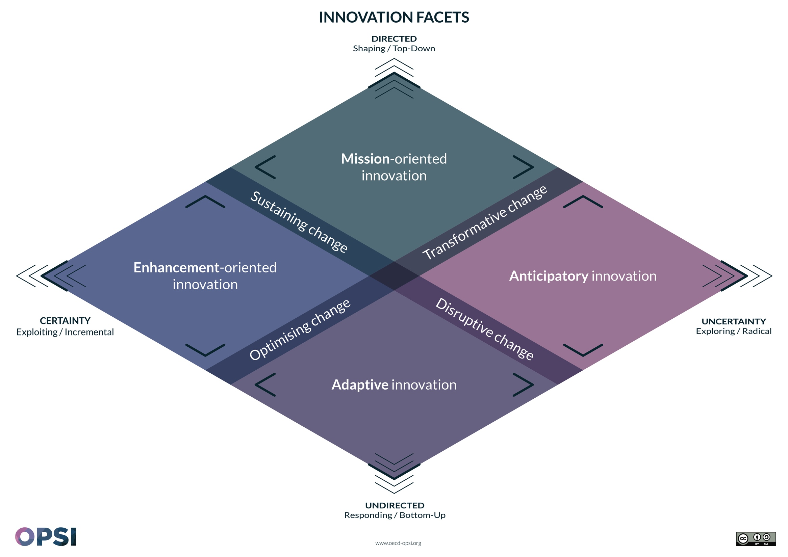
DEBRIEF

Slide 22
COFFEE BREAK

Slide 23
04
EVOLVING YOUR INNOVATION PORTFOLIO

Slide 24
A PORTFOLIO APPROACH
[To be adapted by facilitator]

Slide 25
AMPLIFYING ACTIONS & TRANSITIONS
[To be adapted by facilitator]

Slide 26
04
EVOLVING YOUR INNOVATION PORTFOLIO
0:40 + 0:20
Table activity
WHY?
Participants deepen their understanding that portfolios can and should be pro-actively managed, by cycling through strategies and plausible scenarios.
HOW?
Introduce participants to the four types of Challenge cards.
Introduce participants to the seven types of Assets.
Explain the Visual Checklist canvas.
Do one round together, to make sure that people understand the flow.
Each group start their own rounds.
After 40 minutes, facilitate a discussion on what they learned.
HINTS
Take sufficient time to explain all the elements, or else there will be a lot of confusion.
Debrief questions:
“What did you find easy? What did you find difficult?”
“Any discoveries about the Assets that we have for evolving a portfolio?”
MATERIAL
For each table:
Stack of Challenge cards
Facet Canvas, used in the previous activity
Visual checklist canvases
Black pens
FACILITATOR‘S GUIDE

Slide 27




CHALLENGE CARDS
Increase the impact of your projects within a Facet
Move projects from one Innovation Facet to another
Assess and balance your innovation portfolio
Imagine how you would react to changing conditions

Slide 28
ASSETS
Structures & Organisation
Budget
Sets of skills
Tools
Process & Methods
Interpersonal capital
Information

Slide 29
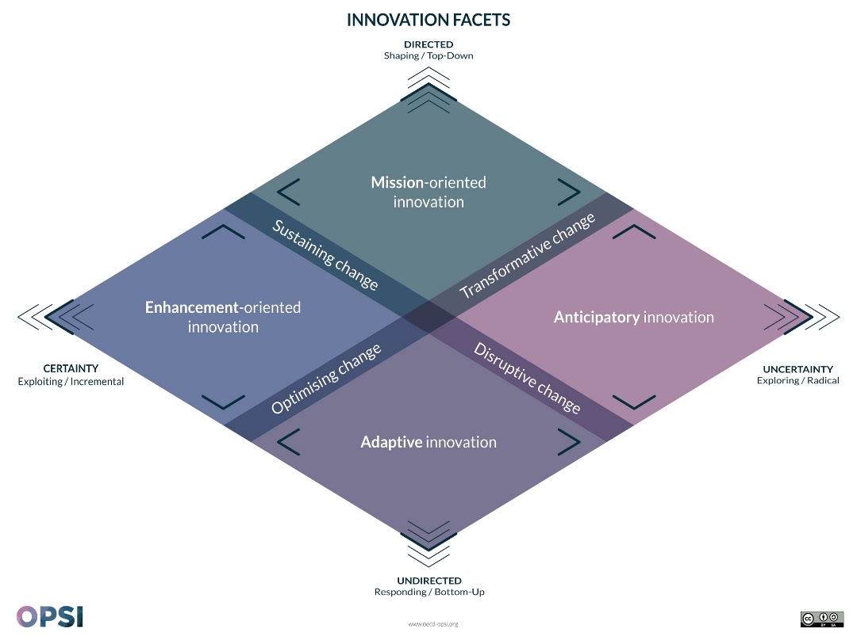



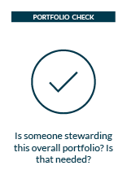
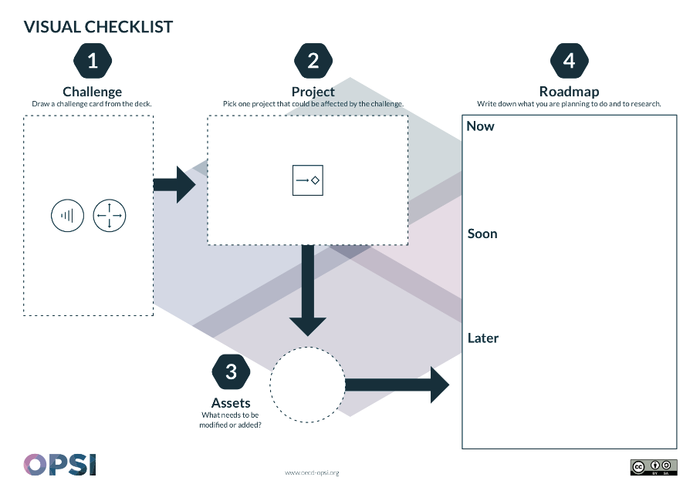
EVOLVING YOUR PORTFOLIO
INSTRUCTIONS
At each table:
Draw a Challenge card
Select applicable project(s) from the Facets Canvas to respond to this challenge
Select an Asset to invest
Define a sequence of actions and write down your Roadmap
Start again from 1.
Structures
Budget
Sets of skills

Slide 30
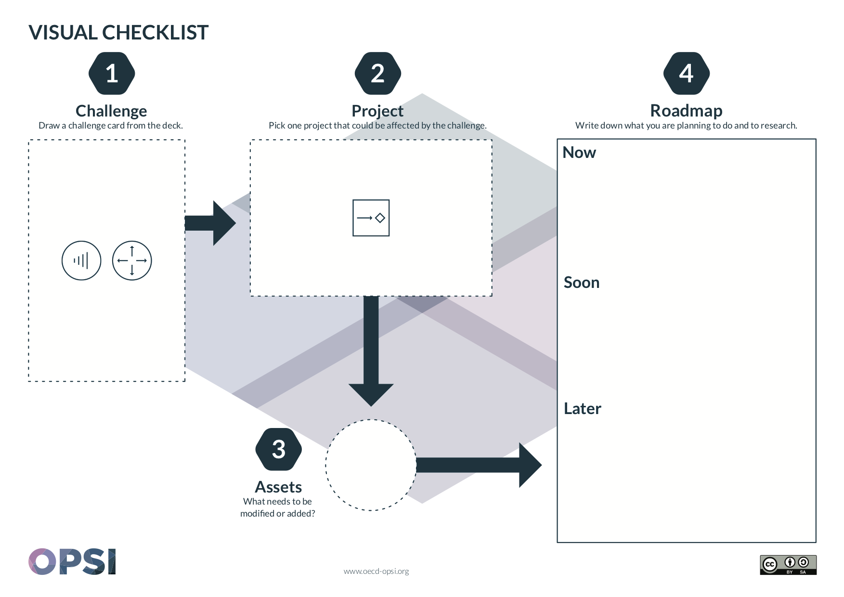
TAKING ACTION

Slide 31
DEBRIEF

Slide 32
05
CLOSING

Slide 33
IN REVIEW
[To be adapted by facilitator]
Notes:
Recap of key concepts

Slide 34
05
CLOSING CIRCLE
0:20
All participants
WHY?
Reflect on what you learned in this workshop, and reinforce understanding of the new ideas by hearing what your peers will take away.
HOW?
Take a few minutes of silent time for everyone to write down what they’ll take away from this workshop.
Ask everyone to gather in a circle.
Go around the circle and ask each person to share what they’ll take away.
HINTS
Keep the tempo light by being intentional about selecting the first person to share, and thank each person when they finish and nudge the next person.
Questions to ask:
“What will you take away from this workshop?”
MATERIAL
Post-its
Black pens
FACILITATOR‘S GUIDE

Slide 35
CLOSING CIRCLE

Slide 36
RESOURCES
[To be adapted by facilitator]
Notes:
Links on where they can learn more

Slide 37
CONTACT
[To be adapted by facilitator]
Notes:
How they can get in touch, make a sales pitch on what you can help with

Slide 38

Slide 09
[This slide must remain in this presentation per licensing requirements. DO NOT DELETE IT. You may delete this red text after reading]
This workshop was adapted from the Innovation Portfolio Exploration Workshop originally created by:
oe.cd/opsi
@OPSIgov
opsi@oecd.org

