Slide 1
Kol Zchut (All Rights)
Vision, and 2018 status

Slide 2






Who wants to know their rights?
The Underpaid
People with Disabilities
The Unemployed
Single Parent Families, Veterans, Anyone with Chronic Disease
Parents of Children
with Special Needs
(Learning disabilities, Autism…)
Anyone who Wants to Know about Tax Breaks
Is there anyone who does NOT need
to know about their rights?

Slide 3




So how would you learn about your rights?
!
But…
  You get TOO MUCH information
  It is written in legal language
  It tries to draw you to commercial stake-holders

Slide 4

Let’s dream…
Wouldn’t it be great if everyone could find
all the information about their rights…
in one place,
in plain language,
and for free?

Slide 5

Introducing: Kol Zchut
A non-profit, collaborative project that provides information on social benefits

Slide 6
Kol Zchut is growing continuously, including in 2018
More unique users annually
Increase in page views
29.2%
21.0%
increase
increase
2018 – 5,643,076
2017 - 4,662,851
2018 - 26,414,313
2017 - 20,449,989
More unique users on an average work day
Many more Loyal visitors (8+ visits)
39.6%
44.8%
increase
increase
2018 – 44,746
2017 - 32,055
2018 – 257,951
2017 - 178,086

Slide 7
Kol Zchut is increasingly effective in referring the public to government web sites
More users referred directly to the low-income tax return claim forms
More Kol Zchut users clicked on on-line National Insurance claim forms
56.3%
increase
61.3%
increase
2018 – 20,317
2017 - 12,996
2018 – 36,082
2017 - 22,365
More users interested in rent support programs by the Housing ministry
More users referred directly to government web sites
71%
increase
71.9%
increase
2018 – 343,599
2017 - 200,738
2018 – 1,512,567
2017 - 879,952

Slide 8
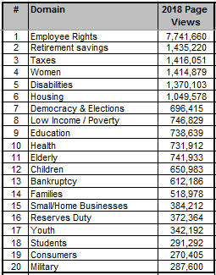
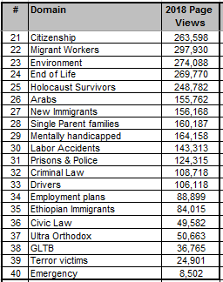
Main domains used by our users

Slide 9
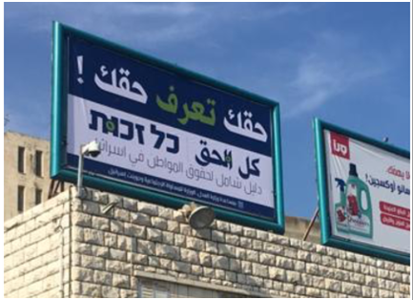
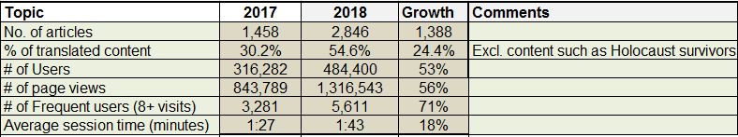
Kol Zchut in Arabic is developing continuously
The translation project gained its full momentum this year, reaching over 54% of required content
In November & December we ran a publicity campaign, based mainly on street signs, radio, and social network
Here is a short summary of our achievements:

Slide 10
Feedback
In the end of November 2018, we added an option of ranking our content pages. By the end of 2018 the results were that nearly 80% (6,496 out of 8,177) ranked the contents as helpful
Our random surveys yielded these great results (similar to 2107):
Professional users (e.g. social workers) reporting high level of satisfaction
General public users reporting high level of satisfaction
86%
Using desktop
92%
64%
Using mobile

Slide 11
Warm feedback from users (translated)
Keep up the good work you’re doing! It is blessed, it is helpful, it is accessible, it is professional, I really applaud you! Yay Kol Zchut ☺
Go on with your work! You saved me thousands of Sheqels throughout the years!
I volunteer in Pa’amoni, an NGO for financial assistance, and Kol Zchut is one of the most reliable sources for our work. The interface is friendly, the information is well arranged, and the site contains a lot of information that helps us assist families in financial distress. Just go on like this
Your web site is an asset to all Israeli citizens. Your contribution to the welfare of the citizens and taking care of their rights. The web site is non for profit and that is highly commendable. Go on with your doing and you will be rewarded.
Thank you! Keep on with your immense doing! Your reward is endless!
As a social worker, working for many years with families in poverty and social alienation, I tried for a long time to access relevant information by myself. Although being part of the public sector myself, the level of bureaucracy I encountered was overwhelming, difficult, full of forms and terms known only by experts in every specific field. Often I felt that in spite of my academic and practical knowledge – I could not help my clients.
They would arrive, ask for assistance I was not able to provide, mostly from lack of information. I would refer them to others, try to find my way in the dark looking for answers I could not find, and disappoint them…
When I got to know of Kol Zchut and its potential for social workers, I found a wonderful world of professionality, accessibility, and incomprehensive amounts of information. All of that, in a user friendly and clear approach. With one click, all the information would open up to me in a structured categorized manner, which I could present easily to my clients.
The fact that the web site includes not only theoretical information, but also details of bureaucratic processes – including the relevant forms, office hours of public institutions, phone numbers an more – helped me in giving a comprehensive service to my clients, and also acquire professional knowledge for similar cases in the future.

Slide 12

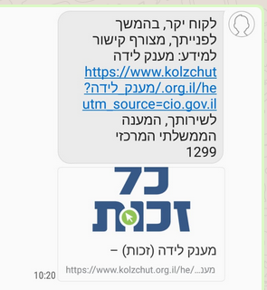
Integration with public service centers
Kol Zchut became a standard tool serving knowledge management systems in public service centers such as:
  Benefits take-up centers in the public health system
  The central government call center
  International Fellowship of Christian and Jews call center
In many cases, clients receive emails/ text messages including a reference to specific pages in Kol Zchut

Slide 13
Training of professionals
Kol Zchut finds it crucial to train all professionals and volunteers in effective and efficient usage of Kol Zchut, so they can better help the public
Training sessions are held in public offices around the country and in academic departments for social work, in Hebrew and Arabic
No. of trainees | No. of training sessions | Target audience
737 | 17 | Universities and colleges
442 | 32 | NGOs
1757 | 105 | Public welfare and social support system
304 | 18 | Other government offices
356 | 22 | Health system
3596 | 194 | Total
378 | 28 | Sessions for professionals serving Arabs
182 | 13 | Sessions for professionals serving Jewish orthodox

Slide 14
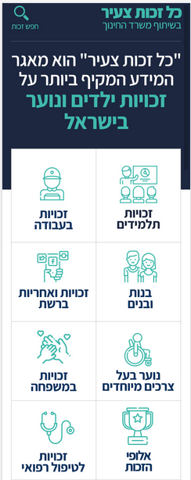
Our 2019 planned highlights
Continuing to grow in activities and results, including:
  Adding new and substantial information on health and nursing insurance
  Continuing and accelerating the translation to Arabic
  Achieve even higher usage of the Hebrew web site, with emphasis on frequent (returning) users
  Breaking the barrier of usage in Arabic
Expanding and improving collaborations with the public sector, and further integration in service processes
Technologic developments such as a “who will help me” functionality that will match a user with local social services / NGO’s
Developing a web site targeting high-school kids, in collaboration with the ministry of education (in Hebrew and Arabic). See here a preliminary design >>

Slide 15
As of June 2017, 75% of Kol Zchut resources are based on the support of the Ministry of Justice, the Ministry for Social Equality, and JDC-Israel, and we are very thankful for that.

