Slide 1




MTENDER
DIGITAL PROCUREMENT - MOLDOVA

Slide 2
CONTENTS OF PRESENTATION
EBRD Technical Assistance Project
Solution – MTender pilot
Next steps

Slide 3
1. EBRD TECHNICAL CO-OPERATION PROJECT
Moldova: Policy and Business Advice and Support in Legislative Drafting for eProcurement Reforms
The EBRD TC project covers:
          preparation of the concept for eProcurement reform;
          preparation of the Reform Implementation Plan;
          preparation of a draft new section of primary legislation that would underpin the implementation of eProcurement in the national legal framework;
          preparation and delivery of training on the recommendation on eProcurement;
          provision of on-going policy, regulatory and business advice on eProcurement reform preparation and piloting of a digital eProcurement system for:
              micro value contracts,
              three procurement methods
              online contracts.

Slide 4
1. EBRD TECHNICAL CO-OPERATION PROJECT (2)
Goal
Objective
Outcome
Develop an Open Source system architecture for electronic public
procurement to facilitate better and quicker uptake of the modern rules and practices based on current legislative trends as well as internationally accepted best practice and UNCITRAL model law
Implementation of digital tools which should include standardised business models for operating electronic procurement system/scheme and an
Open Source and Open Contracting architecture for electronic public procurement
Open Source electronic procurement pilot system for electronic open tender, reverse auctions, aggregated
procurement planning and online framework agreements ready for online publication, together with the user manual and implementation guidelines

Slide 5
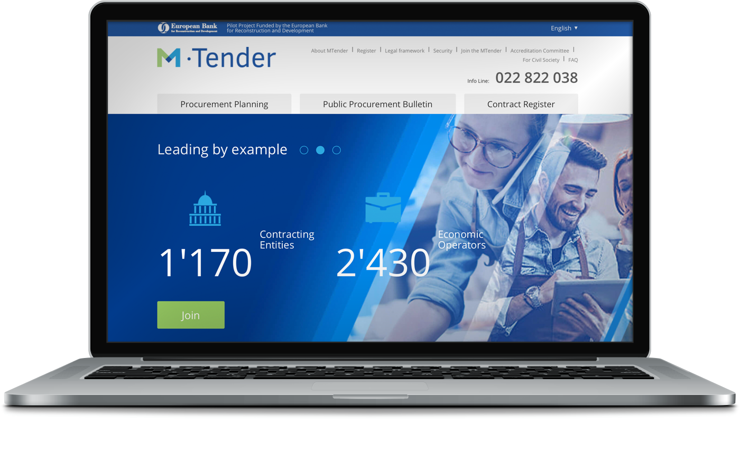
2. WHAT IS MTENDER 2.0?
Multi-platform networking digital eProcurement service for procurement planning, tendering, multiple-round electronic auction and contracting.
A government-operated web portal and Open Data central unit;
Integrated with commercial electronic platforms;
M-Tender Procurement Document based on model of ESPD and most of EU Notices (TED eForms 2014) + Procurement Record;
Integration with eGov: M-Services, State Treasury, number of State Registers;
Open source architecture;
Developed using the Open Contracting Data Standard;
API provides civil society with data to advance open contracting in Moldova.
https://mtender.gov.md

Slide 6








2. MTENDER EMBEDS UNCITRAL MODEL LAW PRINCIPLES AND OBJECTIVES
Key principles
Objectives
Transparency
Value for money
Fair treatment
Competition
Public confidence
Objectivity
Participation
Efficiency

Slide 7





2. EMBEDS UNCITRAL MODEL LAW STANDARDS
Requirements to identify object of procurement
Open procedures unless justification for exclusion
Pre-determined evaluation criteria and award procedures
Prescribed and standardized procurement methods
Challenge
mechanism for breaches of rules

Slide 8





2. PROVIDES MANDATORY TOOLS REQUIRED BY UNCITRAL
Aggregated procurement
planning
Single-stage procurement
methods
Multi-stage procurement
methods
Different types
of Framework Agreements
Electronic auction based on different models

Slide 9






2. LEGAL COMPLIANCE AND INTEROPERABILITY
Based on global best
practice in the 2011
UNCITRAL Model Law on Public Procurement
Compliant with the 2012 WTO GPA and the 2014 EU Directives on Public Procurement
Designed to be
interoperable, also with existing EU resources
(ESPD, TED)
Easy to customise to support procurement of different public and commercial buyers
Ready to be integrated into existing IT environment and cooperate with other State eServices
Built using the advanced level of the Open
Contracting Data
Standard

Slide 10
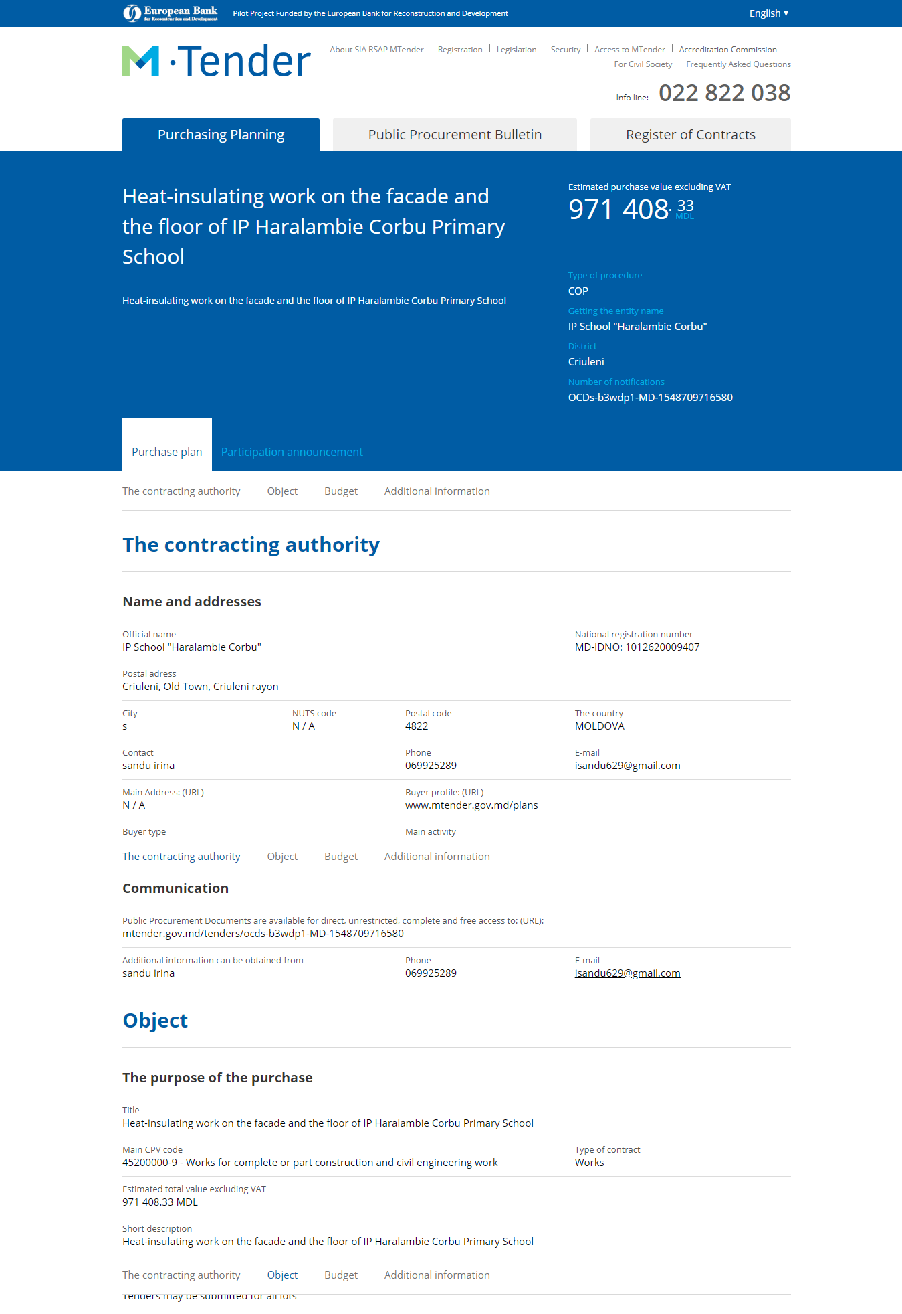
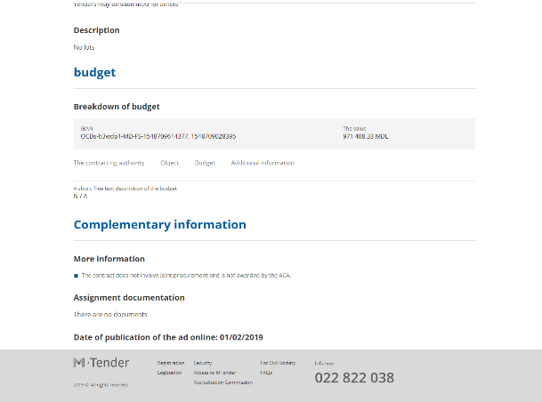
2. MTENDER E-PROCUREMENT PLANNING
ePlanning
Fully digitised procurement planning tool
Buyer’s profile related with budgeting and tendering parts
Automated tracking
of execution progress
Calculation of funding
blocked, committed, spent

Slide 11
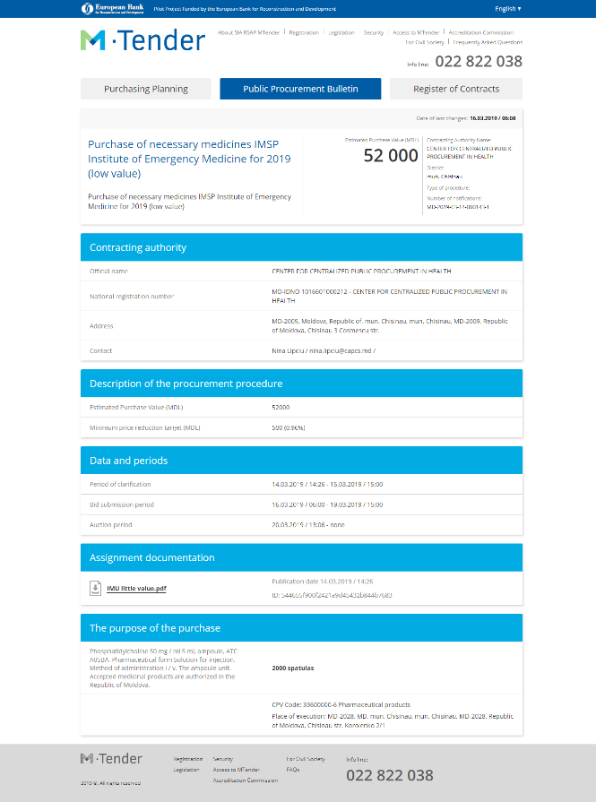
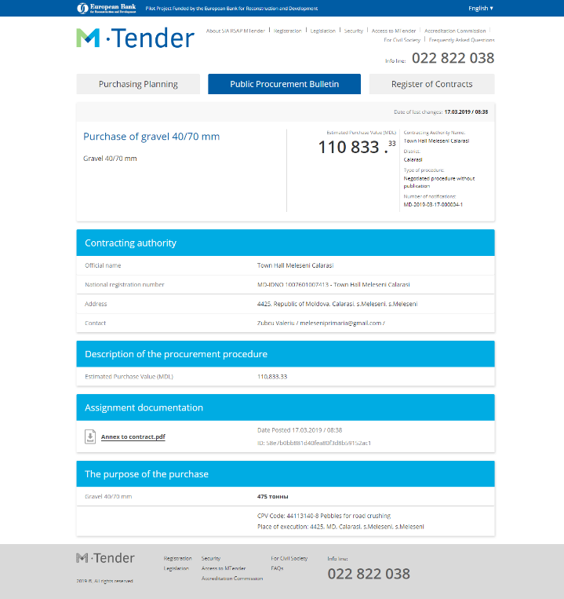
2. MTENDER E-TENDERING
E-Tendering
Request
for quotation
Open
tender
Negotiated procedure
without publication

Slide 12
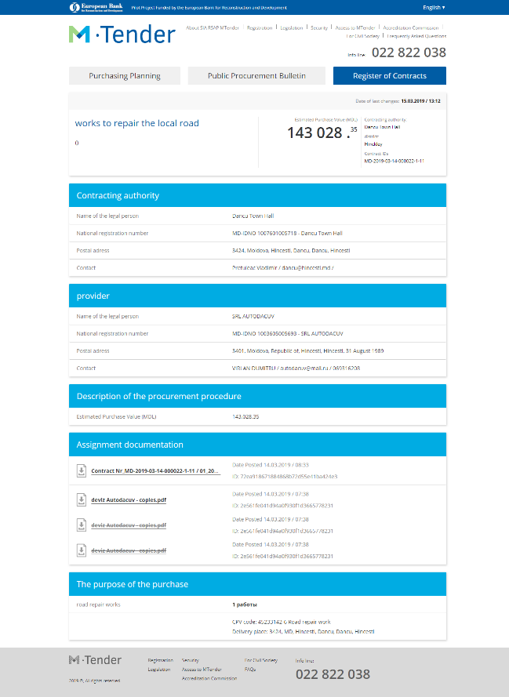
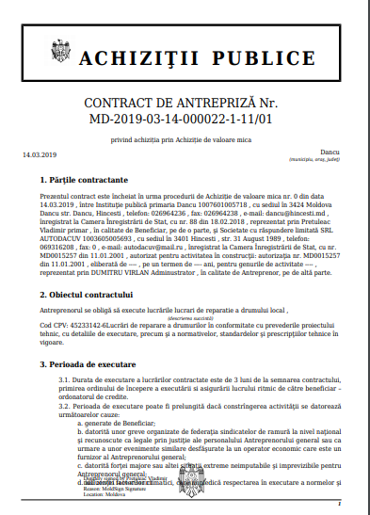
2. MTENDER ECONTRACTING
eContracting
digital contract generated on
data set received as an outcome
pre-defined general
and specific conditions
templates for each
procurement category
Publication of copy of contract and any amendments

Slide 13
3. MTENDER DEVELOPMENT TIMELINE
November 2016 Memorandum of Cooperation for the development of a new electronic procurement system in Moldova.
April 2017
Pilot 1 pilot of the MTender system launched.
June 2018
e-Contracting introduced
July 2018
Law on Public Procurement no. 131 of 03.07.2015 amended to introduce the electronic auction as a standard for all Moldovan public sector entities.
October 2018
RfQ & Open Tender New types of electronically tendered auctions become available on MTender.
October 2018
Pilot 2 Transparent but easy-to-use online bidding procedures with the lowest prices and price-based selection criteria or other non-price-related criteria become available to state-owned enterprises and interested private sector customers.

Slide 14
3. IMPACT SO FAR
MTender is now available to all key central government ministries. It is free of charge to all public sector and commercial buyers.
14067 electronic tenders are advertised on the system;
2195 electronic tenders are being processed;
6209 contracts have been signed and made publicly available;
1170 public sector and commercial buyers are actively using MTender to procure goods;
2430 suppliers are openly bidding for contracts on MTender.

Slide 15
3. IMPACT SO FAR
MTender will soon be rolled out across government – we expect early payoffs to increase exponentially
Makes government more efficient, transparent & cost-effective
Creates a level playing field for business
Brings new companies to market, fostering innovation & inclusion
Makes government more accountable & builds trust
Fosters collaboration between private and public sectors
Encourages foreign direct investment
Shows other governments what is possible using open data and raises the bar for open government

Slide 16



3. WHAT WILL THE MTENDER 2.1 BE ?
‘Digital first’
wherever
it is possible instead of documents
Aggregation
and other tools for centralized planning
and procurement
Smart-contract
Contract implementation based on facts

