Slide 1


What is “WORKNET”?
2019. 10.18.

Slide 2

Contents
Ⅰ. Overview & Current Status
Ⅱ. Main Services
Ⅲ. Future Development Plan
Notes:
주요서비스

Slide 3

Introduction of
Worknet
Ⅰ. Overview &
Current Status

Slide 4




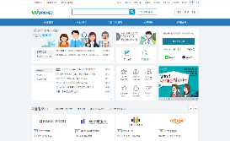


Ⅰ. Overview & Current Status
1. Overview
‘Worknet(work.go.kr)’ Service was launched in 1998 by the Ministry of Employment and Labor
[Job Opening] Provides a service to search for human resources who meet the needs of job-provider companies
[Job Seeking] Provide comprehensive job information by combining the scattered information in public and private
sector in one place
[Job ∙ Career] Provide job & career guidance service such as job information(10,000 sets of information),
occupation psychological tests(20 kinds) and online career-counseling service
Job seeking confirmation/Job Placement/Employment support / Vocational guidance
Employment
Support Agency
(Job center, Local government, job center for women, and related organizations)
Job opening certification / Recruitment support / Job stabilization/ Employment Deputize
Job Placement Conductin work
Public Enterprise / Public organization / Small but strong company / Large-sized company / International company / Venture Company, etc.
Ordinary people
The youth
Women
The elderly
Job Seeking
Job Opening
Job-seeker
(Valid number of Job seekers
: 1.32 million)
Job-Openings Information, Enterprise Information / Job application support service / job&career info
HR Information / Employment Support service / Recruitment agency service
Company in need of staffing
(Valid number of Job-Openings Information : 90,000)
Worknet

Slide 5










Ⅰ. Overview & Current Status
2. History
Worknet’s Past, Present and Future
2007 The advent of Smartphones
1980
1990
2000
2010
2020
2000
2002
2004
1998
2003
2014
2020 AI Job Matching Service
1998
2002
OPEN
2019 Chat-Bot Service
Launching Job-placement
System Service
1987 Text-based Service
1998 Web Service
2010 Mobile Service
2018 Big-Data Service

Slide 6


Ⅰ. Overview & Current Status
3. Overall Status (As of July 2019)
Q . How many people use Worknet?
The accumulated number of
registered members
18.36 million
Daily Users(on average)
784 Thousand
Individual :
Business :
16.67 million members
1.69 million members
Number of Views : 61.26 million times
(As of the end of July 2019)
During the past one year, Worknet helped
1.81 million people successfuly find a job!
(From Jan. to Dec, 2018)

Slide 7





Ⅰ. Overview & Current Status
3. Overall Status (As of July 2019)
Cumulated number of
Worknet application
download
Number of valid
job-openings
5.5 million
90,000
Average number
of visitors per day
Registered and integrated
corporate information
780,000
1.84 million
Visitors by countries : Germany 200,000, Japan 460,000, France 120,000, Netherlands 180,000
Youth-friendly Unicorn Company : 1,127
Worknet Members
Job information
connection nationwide
18.36 million
154 Places
Public organization/local government 22,
Local Worknet 122, Private job portal 10

Slide 8


Ⅰ. Overview & Current Status
4. Service Composition
Organize Menu system with easily accessible to everyone based on purpose of use
Utility Menu
Local Worknet
Work + Center
Employment for disabled Portal
NEW
Chat-Bot
User Guide
Customer Center
Remote Support
Site Map
Demand-based Worknet
The youth
Women
The elderly
Job Opening
By Occupation
By Regional
NEW
By theme
Recruitment Calendar
Open-employment Section for
Specialized for 4th Revolution
e-Recruitment
JobㆍCareer
Occupation psychological Test
Job Information
Curriculum Information
Career Counseling
Reference
library
Recruitment Guide
Recruitment News
Recruitment Video
Enterprise Information
Welfare Policy
Employment policy
Welfare policy
Recruitment support program
Job support agency
Training
Job seeker training
Worker training
Enterprise training
HR Information
By occupation
By regional
By major
By certification
Master/
Doctorate
International recruitment
Job Preference Pool
Members
Only
Individual
Resume managementㆍ
Job Application
Job Application Management
User customized Information
User interest Information
e-Recruitment
Online Application Management
Customized Employment & Welfare Service
Member Information Management
My Page
Business
Job-offering request Management
View HR Information
User customized HR Information
e-Recruitment Management
Online Application
Customized Employment & Welfare Service
Member Information Management

Slide 9


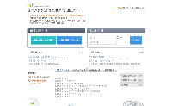
Ⅰ. Overview & Current Status
5. Job-Searching Work Process
Job-opening Work Process
Job-seeking Work Process
Worknet Main Page
Administration Main Site
Worknet Main Page
Administration Main Site
External Network for
Resume Registration
External Network for
Job openings Registration
Individual Member Log-In
Enterprise Member Log-In
Regular
Job-seeking
Day Labor Job-seeking
Regular Recruitment
Day Labor Recruitment
Register Resume
Register Job-openings Information
Request for Certification
Request for Certification
Job-seeking Certification
Recruitment Certification
Issue Recommendation
Apply for Recruitment support service
Job Application Management
Regular Job Placement
Day Labor Job Placement
Recruitment Management
Regular Recruitment support
Day Labor Recruitment support
Issue result notification
Join
Join
If succeed
Regular Job-seeking completed
Day Labor Job-seeking completed
If succeed
Regular Job-seeking completed
Day Labor Job-seeking completed

Slide 10
Introduction of
Worknet
Ⅱ. Main Services

Slide 11
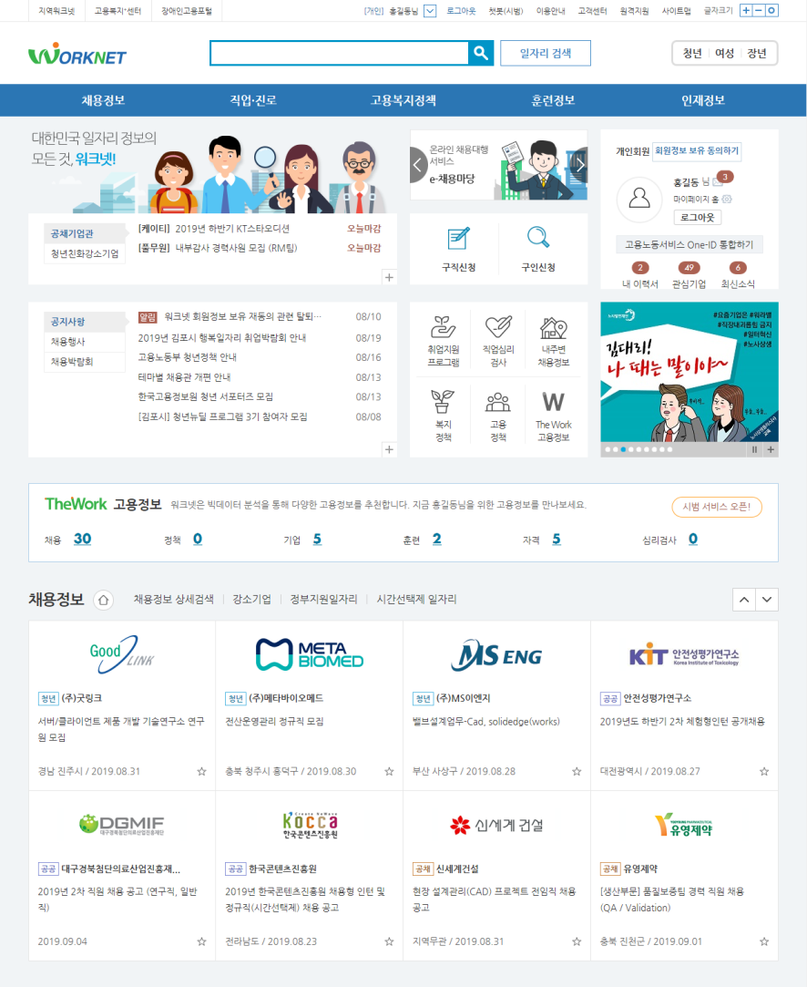
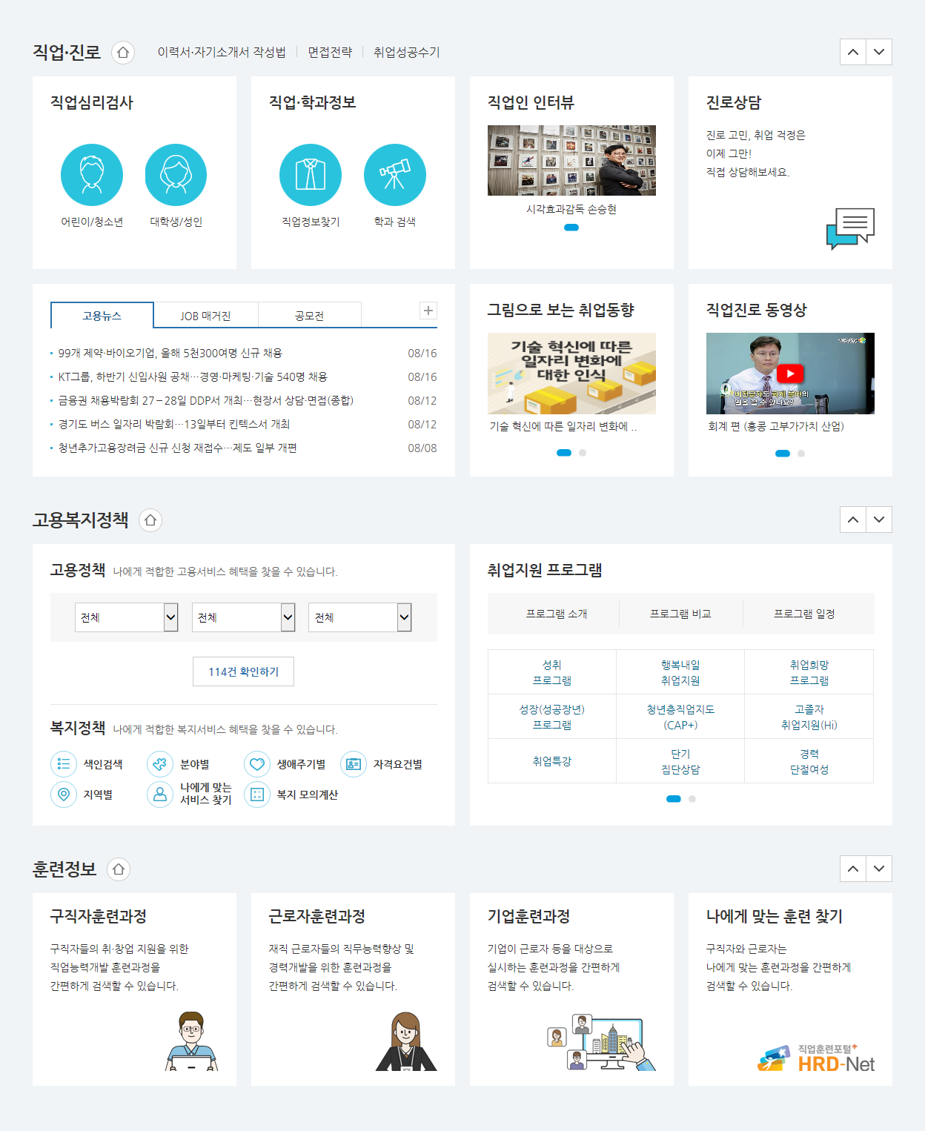
Ⅱ. Main Services
1. Main Page
https://www.work.go.kr

Slide 12
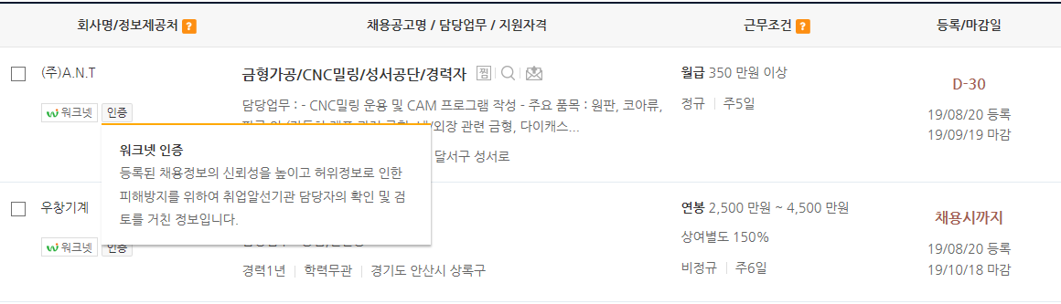
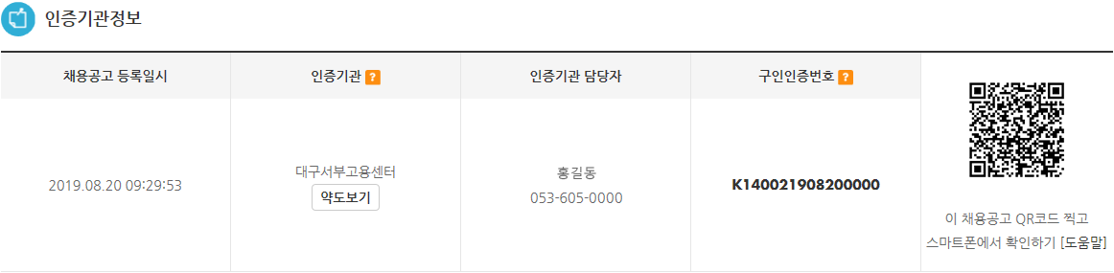
Ⅱ. Main Services
2. Reliable job information accredited by the government
Reliable public job information websites operated by the government
Job vacancy information service certification system via user identification
Provides information on wages and benefits
Operates a monitoring group on job vacancy information separately.
Salary Information
User Authentication on job opening Information

Slide 13



Ⅱ. Main Services
3. Provide Job Openings Information : 90,000+ cases
Connection and integrating of job openings information
(Connected with 161 information in total)
[Public sector] Connected with job vacancy information from Government Jobs, Job-Alio of the government and public organizations (17)
[Private sector] Connected with job vacancy information from private job portals such as Saramin, Incruit, etc. (8)
[Local Worknet] Connected with 15 metropolitan autonomous governments, such as Incheon and Busan and 121 local governments (136)
[Information Share] Alignment of Job-related information on recruitment, occupation, curriculum and others by applying Open
API System. (Total 1,144 organizations and 6,238 information in total)
Jobseeker
Public Sector
Private Sector
Public Institution / Local Government
Private employment Portal
Job-openings Info.
Job-openings Info.
Local Worknet
17
( Government Jobs by Ministry of Personnel Management, Job-Alio by Ministry of Economy and Finance, Korea Employment Agency for Person with Disabilities, and Seoul Metropolitan City Government, etc.)
136
( 15 Metropolitan councils
121 Local governments )
8
( Saramin, Career, Incruit etc. )
Job vacancy information
Job vacancy information
Recruitment Company

Slide 14
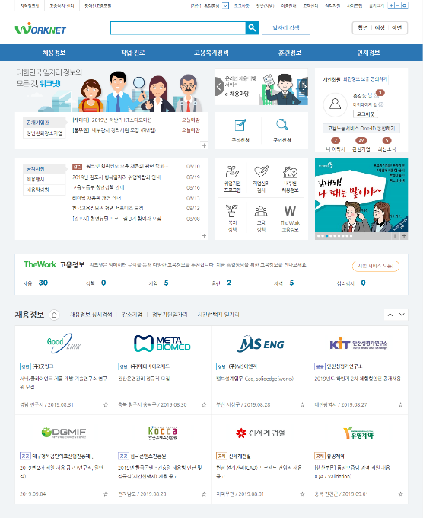
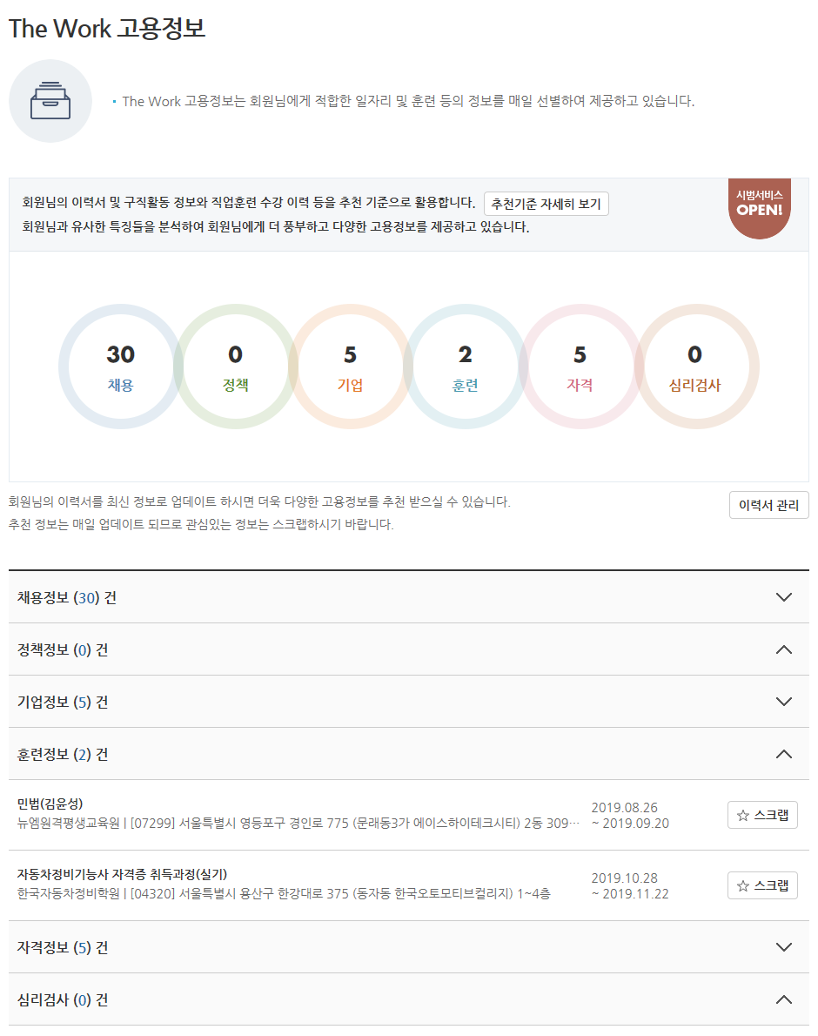
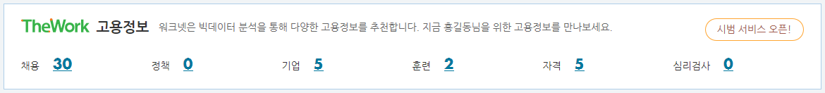

Ⅱ. Main Services
4. The Work Employment Information
Providing customized services for individual based on Big-Data Analysis
The Work Employment Information provides job information customized for each individual considering each user’s resume and analyzing other Big-Data (Application history, preferred occupation type/region, education level, work experiences, etc.)

Slide 15
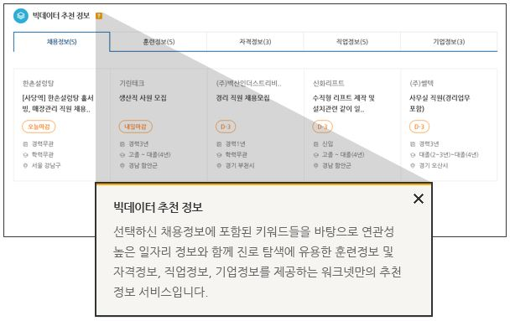
Ⅱ. Main Services
5. 5 Integrated Employment Information
Providing 5 major integrated employment information(relevant contents) related to job vacancy
Carefully selects and provides information which is related to already selected occupation most considering each user’s personal interest. (e.g. job vacancy, training, qualification, company information)
Information recommended by Big-Data

Slide 16
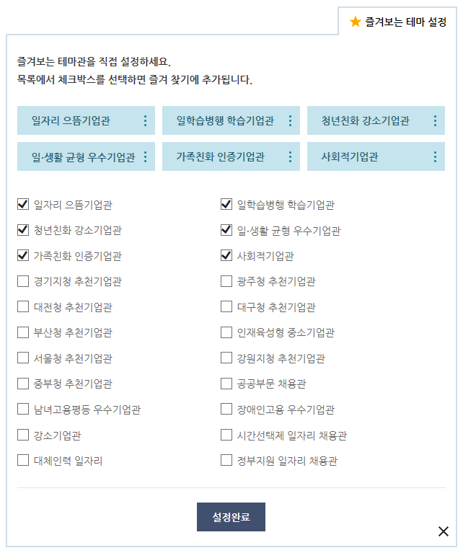
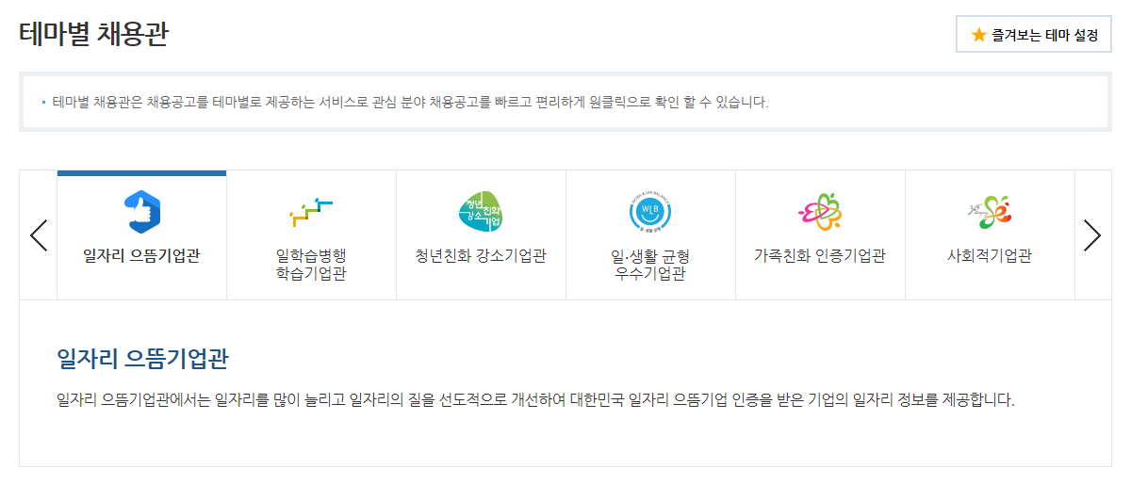
Ⅱ. Main Services
6. Recruitment Information by Theme
Providing quality information on job vacancy by theme which is accredited and identified by the government
Check recruitment information by theme(category) quickly and conveniently with one click away
Recruitment information is categorized into 23 different themes such as by policy and region and available form Aug. 12, 2019. Flexible operation by considering utilization
Job Openings section categorized by themes

Slide 17
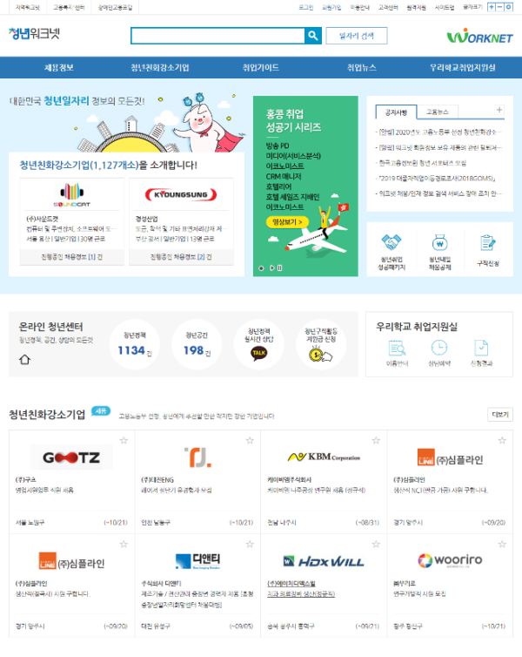
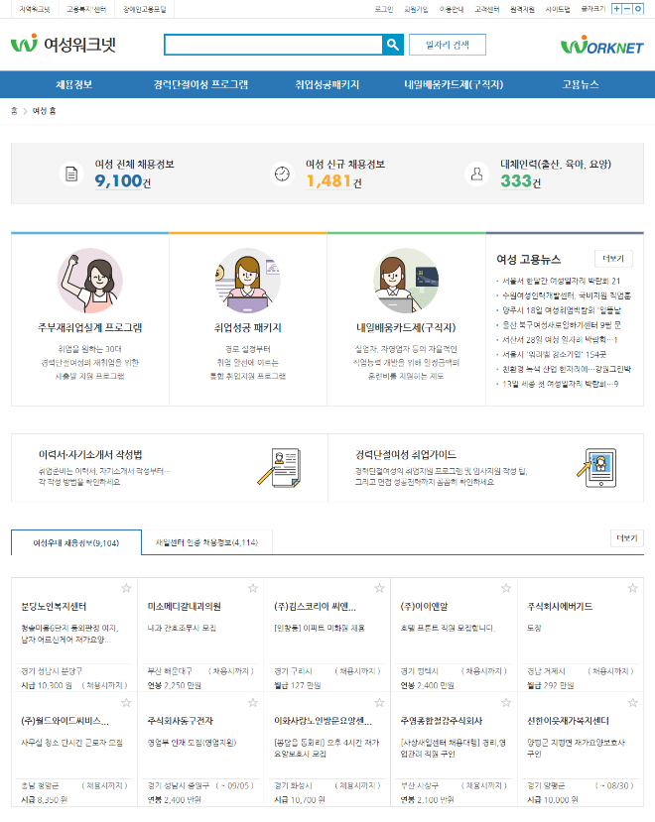
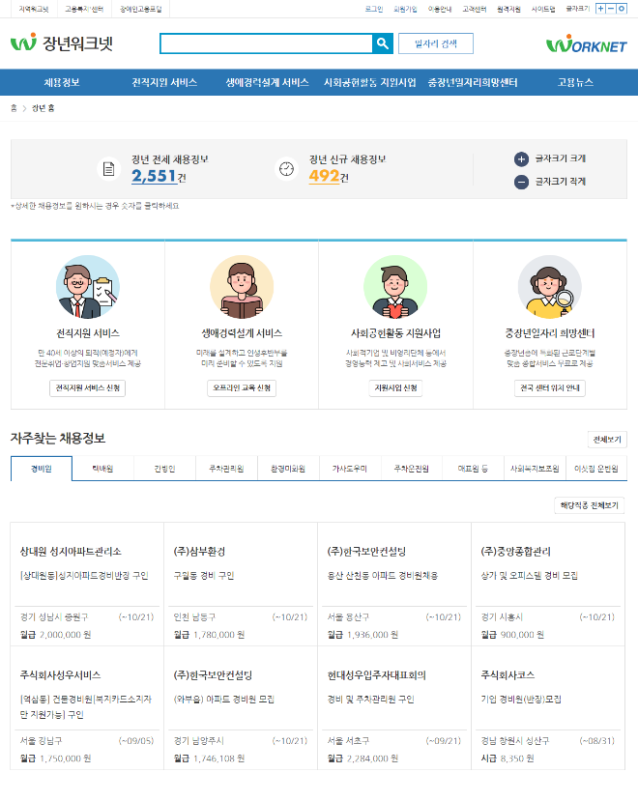
Ⅱ. Main Services
7. Services for the Youth · Women · the Middle-aged
Providing customer-specific job information and contents for employment support
(The youth) Provide information on youth-friendly small giant enterprises excellent in terms of wage, work-life balance and employment stability.
(Women) Provide information on job vacancies with preferential treatment to women, and job vacancies accredited by new job centers, programs for women whose career has discontinued, Employment Success Package, Tomorrow Learning Card System, etc.
(The elderly) Provide information on job vacancies with preferential treatment to the elderly, job-change support, life-long career development, support programs for social contribution, and relevant policies for supporting the elderly.

Slide 18
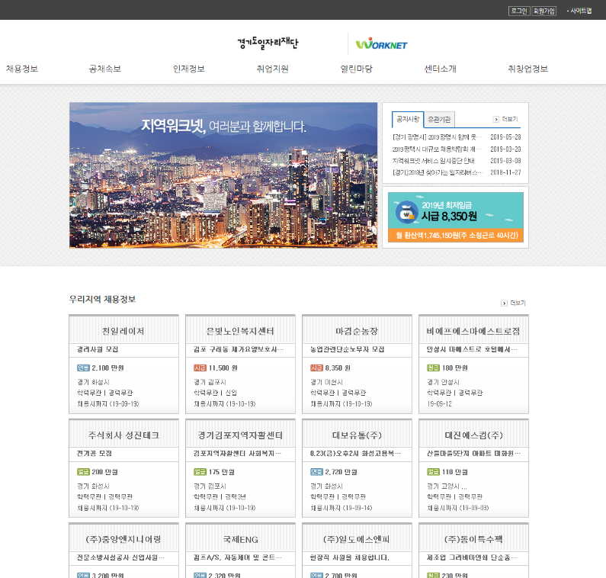
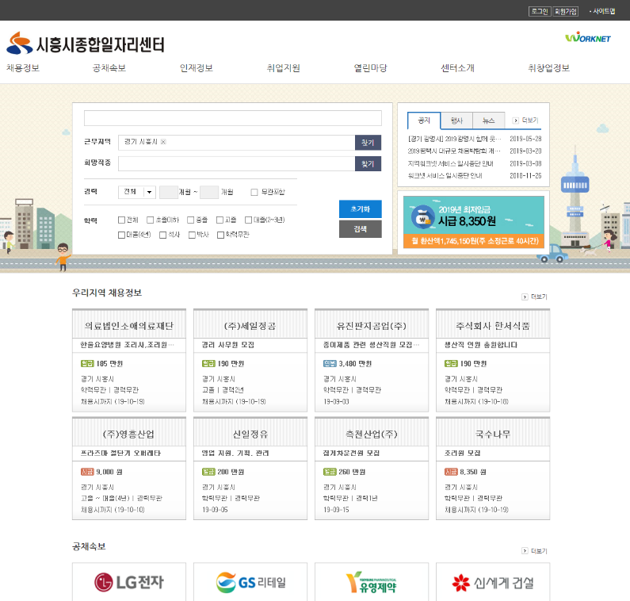
Ⅱ. Main Services
8. Local WORKNET
Providing information on local jobs considering the circumstances of local areas (to 136 organizations).
Provides information on local job openings, local job seekers on notice boards in metropolitan governments and local governments
Metropolitan governments (15)
Local Government (121)

Slide 19
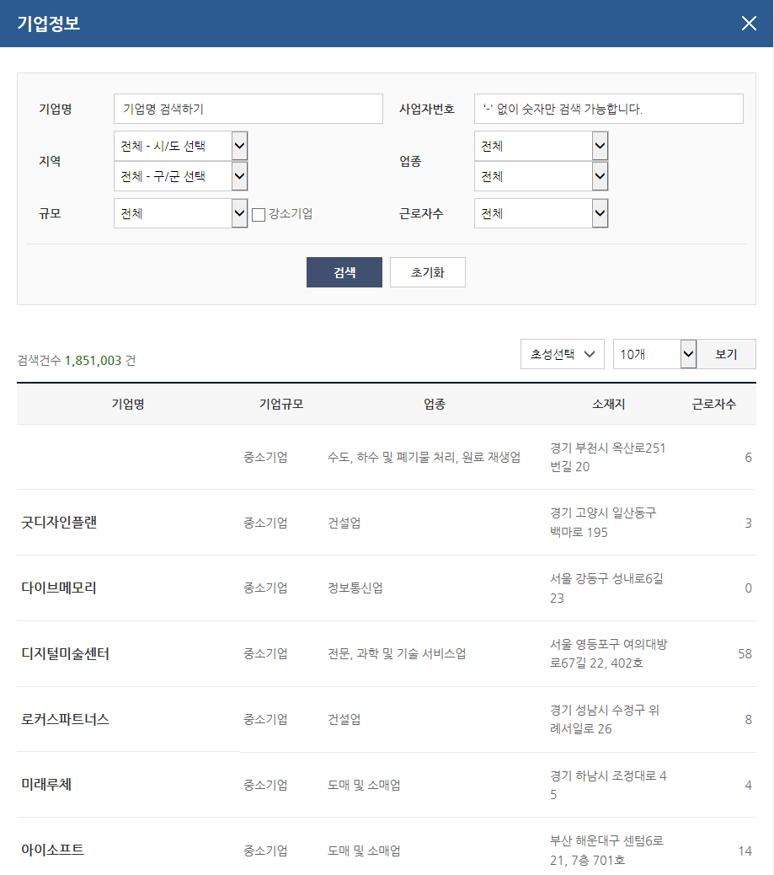
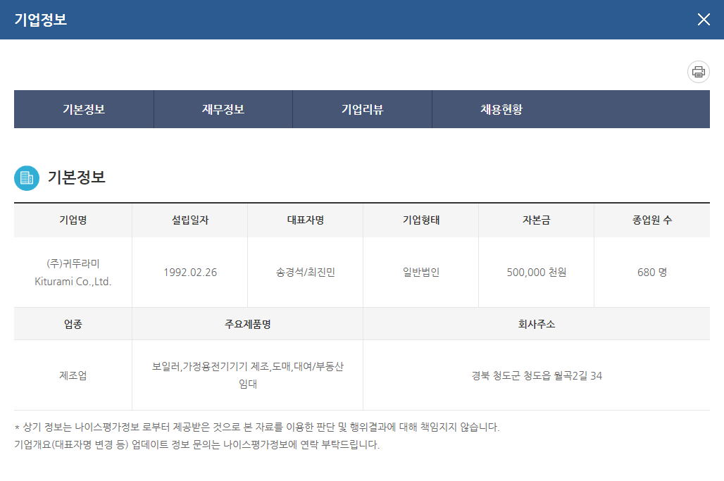
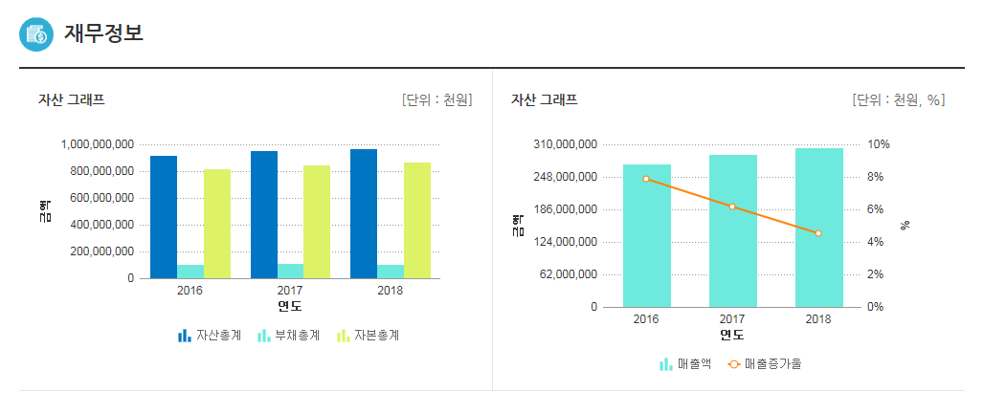
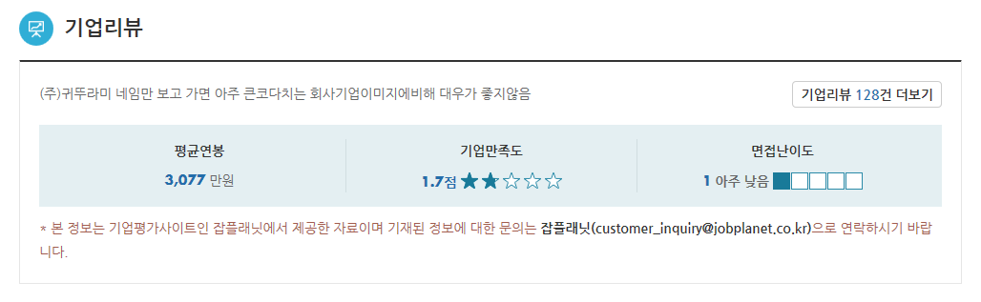
Ⅱ. Main Services
9. Integrated Information on Companies(1/2)
Providing 1.84 million sets of integrated information on enterprises and information on 1,127 small but strong companies which give preferential treatment to young people
Provides basic information on companies such as the number of employees, financial report, feedback on companies, recruitment progress, etc.
Provides
1.84 million sets of company info.
in total

Slide 20
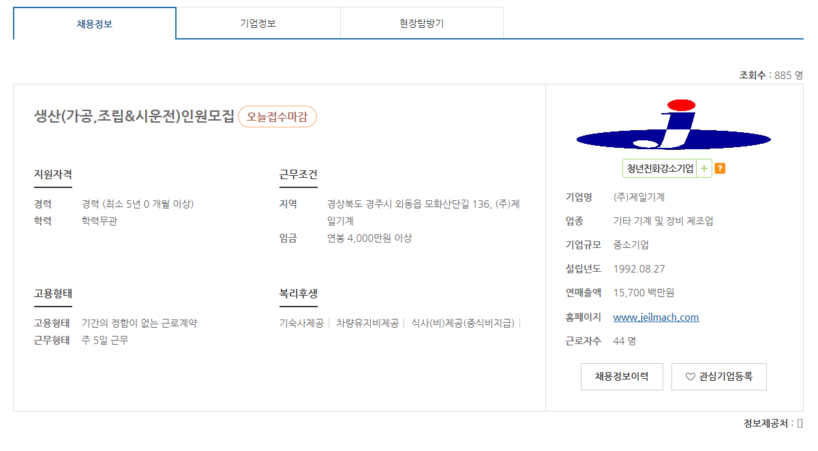
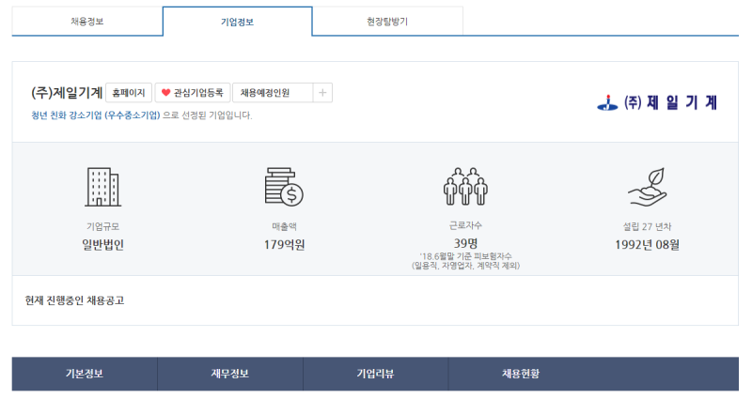
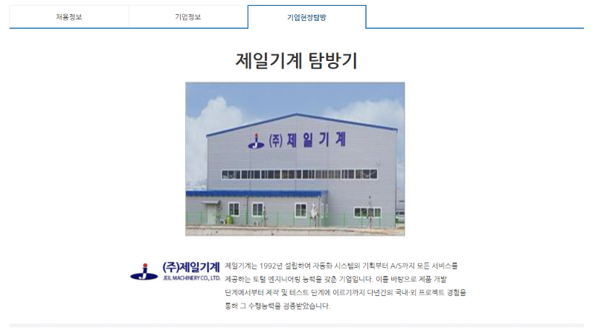
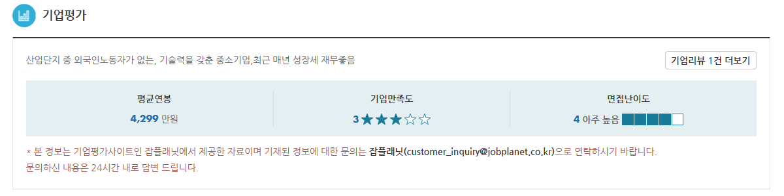
Ⅱ. Main Services
9. Integrated Information on Companies(2/2)
Provide information in storytelling on companies in which jobseekers are interested
Reorganizes company information in a story form by highlighting the information such recruitment, on-site visit to small but strong companies, as feedback on companies.
Connects to Job-planet(a website for providing feedback on companies) information (March 2016) and conducts on-site visit to companies using job centers, university student reporters

Slide 21
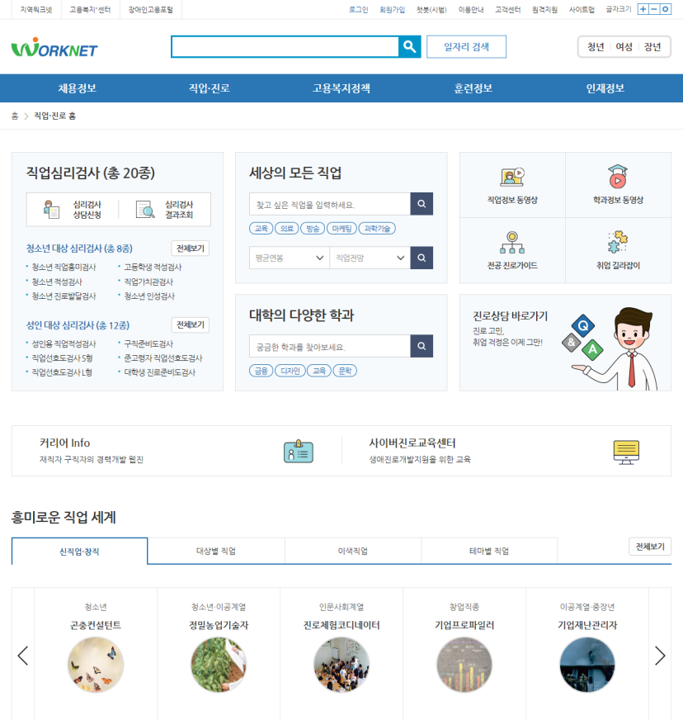
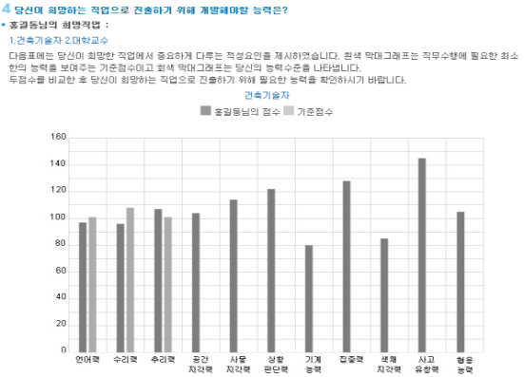

Ⅱ. Main Services
10. Job·Career Guidance Service
Providing 20 kinds of occupation psychological tests, information about occupation ∙ curriculum and other related contents
Provides 20 kinds of occupation psychological tests (8 for teenager, 12 for adult)
Occupation ∙ Curriculum information, company visit experience and related video contents
직업, 취업준비 동영상

Slide 22
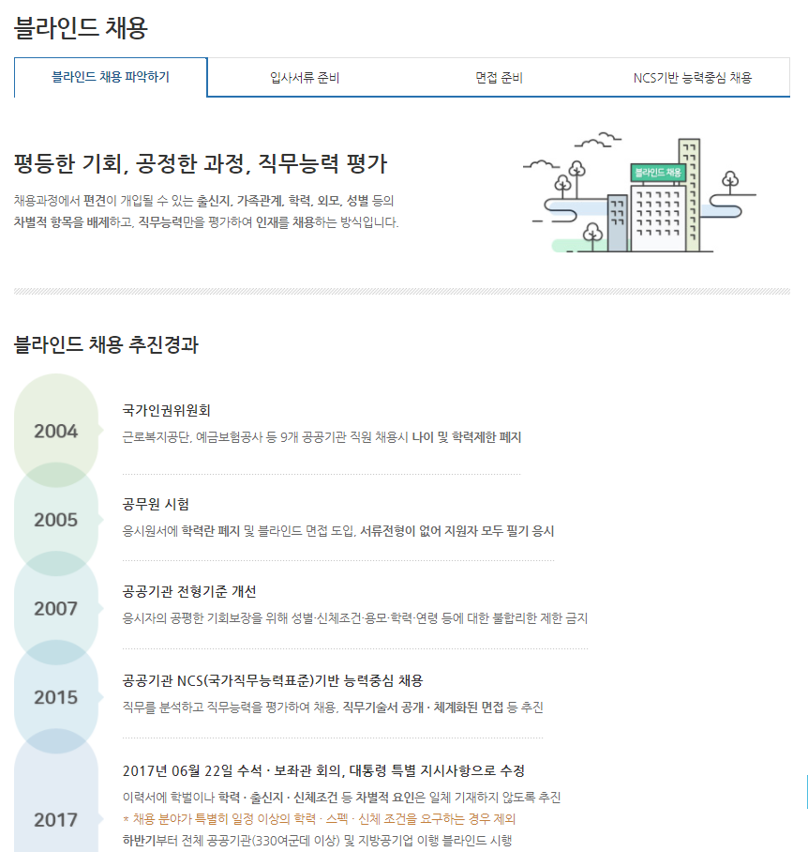
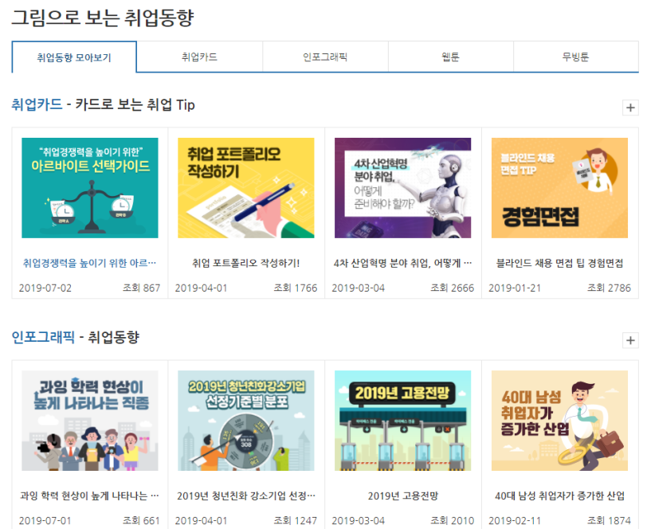
Ⅱ. Main Services
11. Employment Support Contents
Providing various employment support contents for jobseeker
Providing card news and infographic information on employment trend, blind employment, how to write a resume · cover letter, interview strategy, etc.
Job Guidelines
Illustration showing employment trend

Slide 23
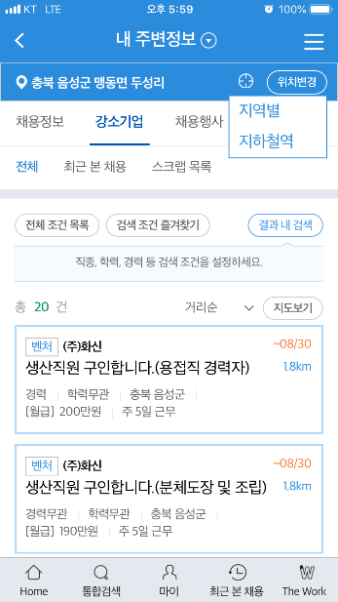
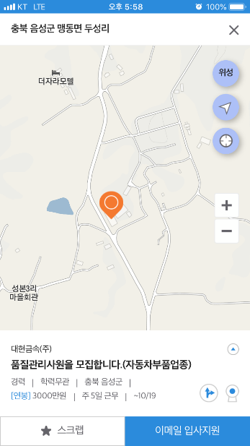
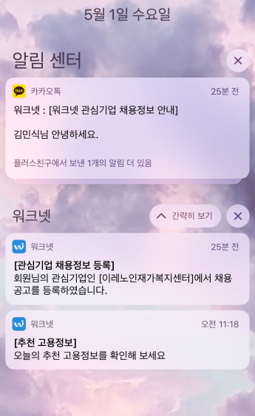
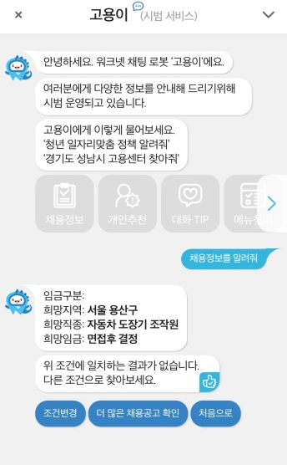

Ⅱ. Main Services
12. Mobile Services
Providing services friendly to mobile users
Providing information by nearby search on job openings, small but strong companies, job fair, and guiding the
way based location data
Providing information in real time about recruitment, job application status from push notifications, Kakaotalk
and Chatbot services
Location based data
Real-time notification
Chatbot

Slide 24
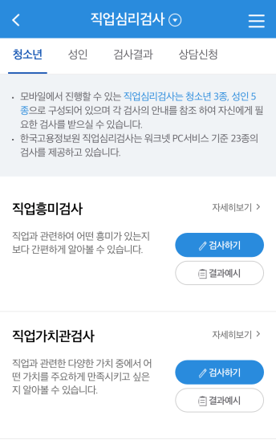
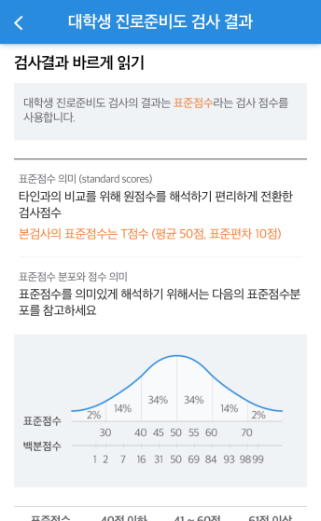
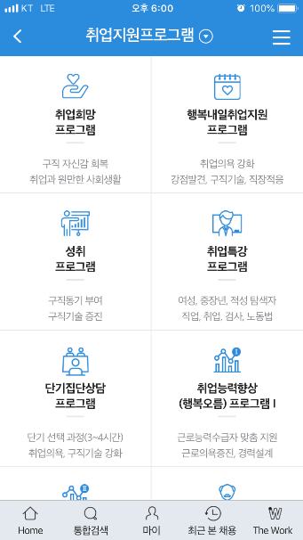
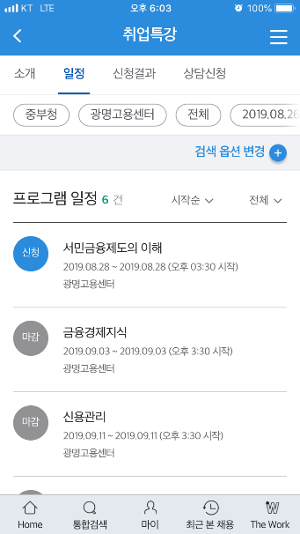
Ⅱ. Main Services
12. Mobile Service
Strengthening mobile version psychological tests and online application service
Identifying industries or work suitable for oneself according to 8 kinds of psychological tests in Worknet
Enables to apply for various employment support programs on mobile phones directly
Occupation psychological test
Online application service

Slide 25
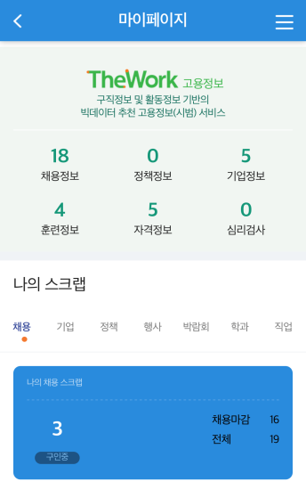
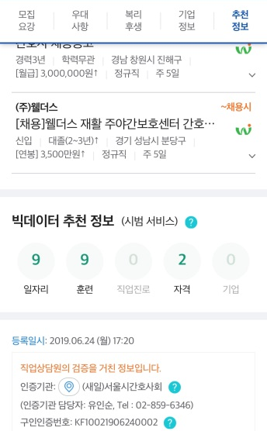
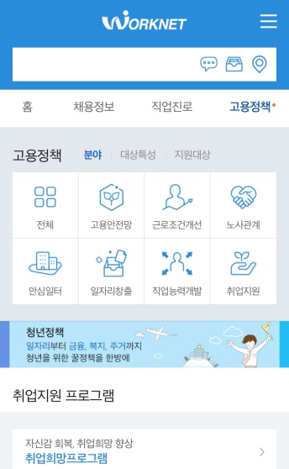
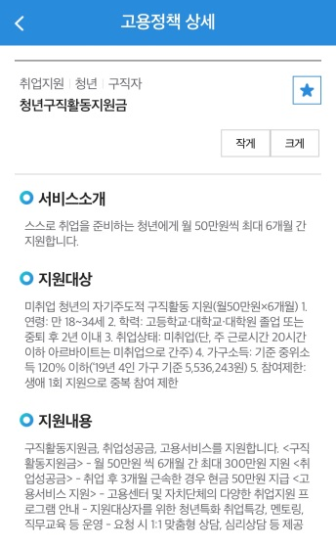
Ⅱ. Main Services
12. Mobile Service
Providing information on job and employment policy recommended by Big data
Recommends customized information on job, training, certification, company, policy, and career guidance based on Big-data analysis
Enables to check information on employment policy benefits to which a jobseeker can apply on mobile phones easily
The Work’s recommend information
Employment Policies

Slide 26
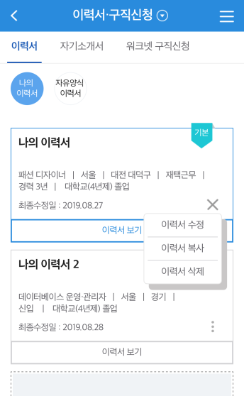
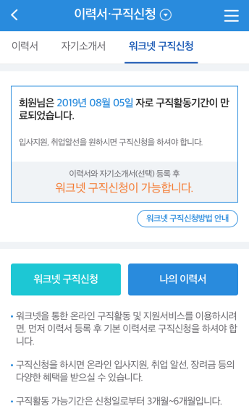
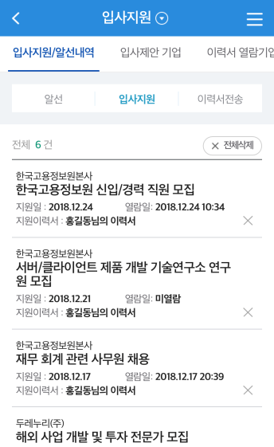
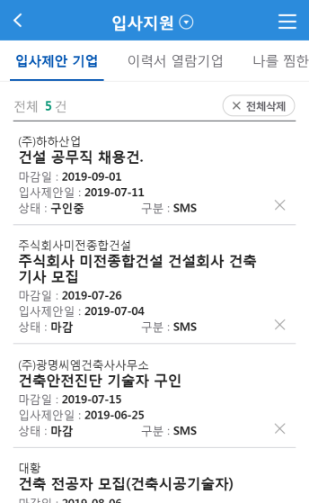
Ⅱ. Main Services
12. Mobile Service
Providing various services for individual members
Provides various employment support services such as job placement and Employment Success Package after applying for a job-seeking service
Provides individual member services such as job application status, job offering companies, resume reading companies which checked one’s resumes, and customized job information
ResumeㆍJob application
Application status
Job offer enterprise

Slide 27
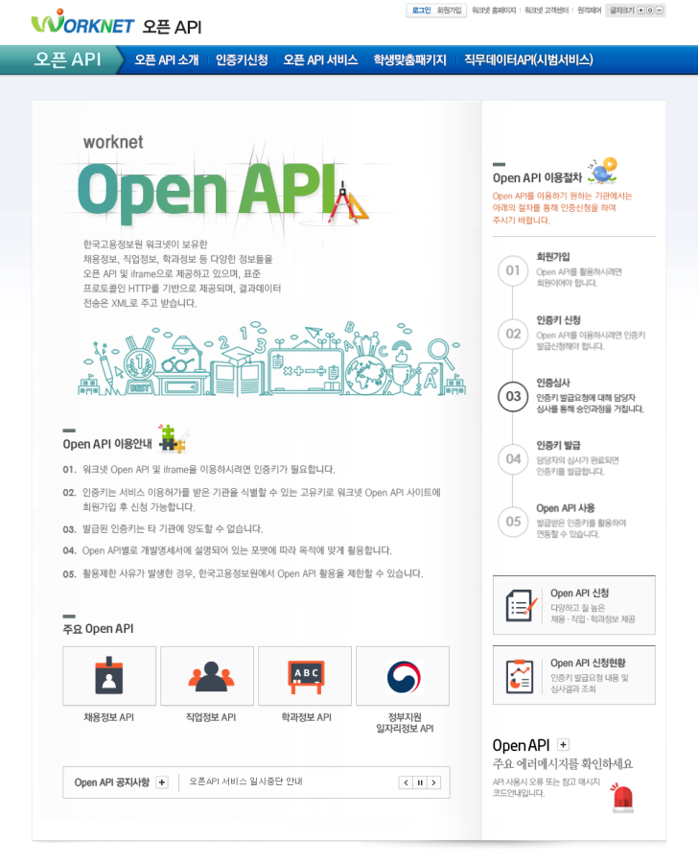
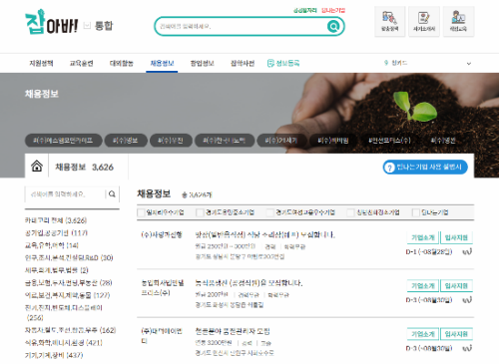
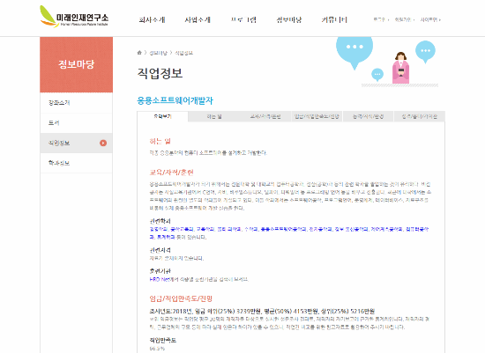
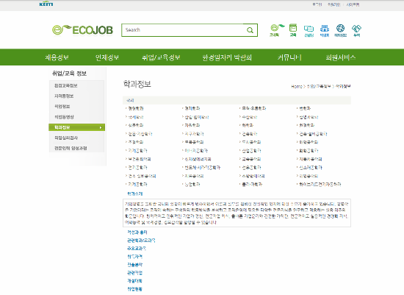
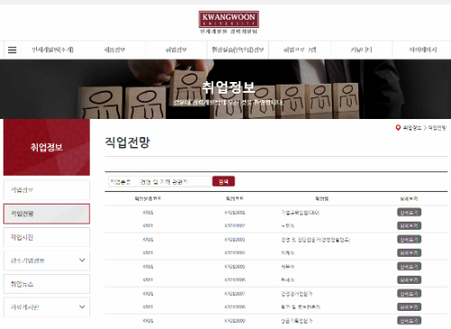
Ⅱ. Main Services
13. Open API
Expanding institutions using Open API such as universities nationwide, public and private companies
Provides 36 kinds of various Open API such as information on job openings, occupation, department curriculum, occupation psychological tests, open recruitment, standard job description, etc.
Job opening info
Occupation info
Curriculum info
Future development plan

Slide 28
Introduction of
Worknet
Ⅲ. Future Development Plan

Slide 29







Ⅲ. Future Development Plan
1. Construction of Job Matching System (As of july 2020)
Realization of services customized to jobseekers and companies in need of staffing focused on job duty
“Realization of services customized to jobseekers and companies in need of staffing focused on job duty”
Inputs Job openings /
job application Information
Provides customized job openings / job application information
Support jobseeker employment
information input
Job matching engine based on machine running
Recommend jobseeker-customized job information
Acquire job, job competence information
Recommend job based
on jobseeker-job competence
AI matching
algorithm
Jobseeker
Write resume based on job competence
Search service based on job competence
Support Job offer to write
job opening
Recommend job offer-customized
Talented person
Recommend standard job descriptions
Big data
Job ontology
Recommend talented person to job opening
Support writing job opening
based on job competence
Support matching based on weight
Recruitment company
Recommend employment policy
Talented person search service
based on job competency

Slide 30



Ⅲ. Future Development Plan
2. Diagram of Job-Matching
Building job-matching services based on job competency by using AI Technology
Keyword extraction
Keyword extraction
Realize Job
competency
Job Ontology
Realize Job
competency
Job-seeker’s Characteristic
Work Experience
Company’s Properties
Job-Matching
Resume
Own Job Competency
Characteristic of Job seeker
Required Job Competency
Recruitment Condition, Properties
Recruitment

Slide 31


Ⅲ. Future Development Plan
3. Building Recommendation Services on Standard Job Description
Writing a job vacancy posting easily based on job competency
  Fill out recruitment information by HR Manager
  Recommend standard job description
  Correction of job description
  1. Recruitment Field
  Job
  Tax account
  · HR/Organization Management
  Capacity unit
  HR Planning
  edit
  2. Tasks
  · Settlement of HR operating plan
  · Settlement of HR cost operating
  plan
  · Manage document of new
  and retired employee
  · The four insurance
  acquisition and lose
  HR Manager
  · manage document of new and retired
  employee
  · The four insurance acquisition and lose
  ( report of total remuneration )
  · diligence and laziness etc.
  Job
  contents
  edit
  Correct details appropriate for company’s conditions
  · Establish HR operating plan
  · HR evaluation / establishment
  · Selection and job arrangement
  · Design education training
  Invoke relevant module
  through recruitment analysis
  knowledge/
  technique
  Strategic HRD
  edit
  Attitude
  Responsible manner
  edit
  Select Search results
  Relevant
  Major
  Business management
  edit
  Recommendation
  Capacity
  Relevant
  Certification
  CMC
  edit
  1. HR /organization
  HR planning
  apply
  Relevant
  Training
  HRM
  edit
  2.business management
  Settlement of business strategy
  적용
  +add contents
  3. financial management
  Tax accounting
  적용
  apply
  + propose job addition

Slide 32




Ⅲ. Future Development Plan
4. Construction of Open Job-Matching Service
Construction of Job Data Dictionary and information disclosure
Job Ontology construction and visualization | Disclosure of Job Data by using Open API
  Job Ontology construction and Visualization
  Disclosure of Job Data by using open API
Job Capacity Onthology
X
X
Job Capacity Onthology
-
HR Planning
Job
competence
HR planning
search
LOD
Publication
+
Settlement for HR strategy
  Knowledge base
OPEN API
Development
-
Settlement for HR operation plan
Settlement of HR operating plan
OWL/RDF download
-
Knowledge
Suggest onthology improvement
Job analysis,
proper manpower calculation
Settlement of
HR planning
LOD
site
+
Technique
SPARQL
Endpoint
+
Attitude
HR
Planning
Job technique and specification preparation, Job analysis survey performance, task list analysis, proper manpower calculation
major
Proper manpower
calculation
Certified labor
consultant
  Enterprise ·organization
  User ·development
certification
The department
Of business
administration
Job Data Disclosure
Job analysis
  (LOD Publication) search established job ontology data and modeling file / download
  (OPEN API) open list and data dictionary search · check · download
Select type of information
correlation set-up
Job
major
certification
enterprise
60%

Slide 33
Thank you

