Slide 1



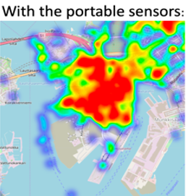
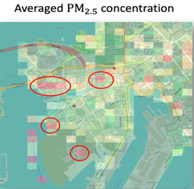
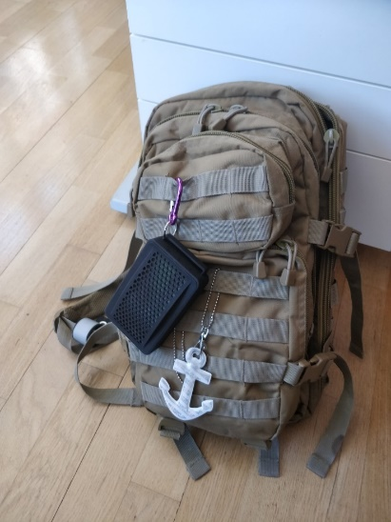
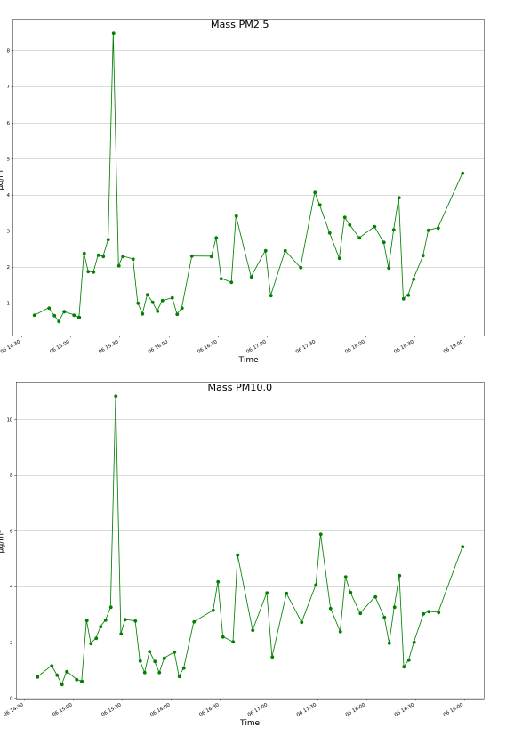
Urban Innovative Action - Healthy Outdoor Premises for Everyone HOPE
European Regional Development Fund Urban Innovative Action Initiative, 11/2018 - 10/2021
  Crowdsourced citizen air quality monitoring with mobile sensors six local campaigns in Helsinki in 2019-2021
  Participatory budgeting and air quality improving interventions to be implemented in three Helsinki
  districts Jätkäsaari, Vallila, Pakila in 2020-21
  Developing the existing air quality monitoring station network in the Helsinki metropolitan area with
  three new hyper-local new generation sensor networks starting in spring 2020
  Air quality data analysis development using advanced modelling, articial intelligence and machine learning,
  developing new Air Quality Index 2.0
  New open API for air quality data and Innovation Competition for startups and SMEs in spring 2020
  Air quality data visualization apps and Green Path route planner for public transport
  Creating better awareness on air quality Issues and healthier and more livable Helsinki for everyone!
  Partnership: City of Helsinki, University of Helsinki, Vaisala, UseLess Company,
  Forum Virium Helsinki, Helsinki Region Environmental Services Authority HSY,
  Finnish Meteorological Insitute FMI
  Contact: Project Manager Jussi Kulonpalo (jussi.kulonpalo@hel.fi). More information: https://hope-airquality.eu/ Twitter: @UIA_HOPE

