Slide 1




DIGITAL TRASFORMATION OF CONTROL AND SURVEILLANCE ACTIVITIES IN AGRIСULTARAL INDUSTRY
Federal Service for Veterinary and Phytosanitary Surveillance (Rosselkhoznadzor)
DIGITAL TRANSFORMATION LEADERS TRAINING CENTER
DIGITAL AGRICULTURAL SURVEILLANCE
The head of digital transformation for senior managers
HSE GRADUATE SCHOOL OF PUBLIC ADMINISTRATION

Slide 2
Digital transformation of CSA to the AI
The goals of digital transformation of control and surveillance activities in the agro-industrial complex
For state | For business | For society
Food and Biosafety assurance Growth of agricultural exports Improving the sustainability of agricultural sector The increase in the speed of managerial decision-making by the management of responsible federal executive bodies due to the prompt presentation of information both from in-house industry-specific information systems and external systems of other executive bodies and its subsequent analysis Improving the administration quality of the federal executive bodies functions by generating "clean" data Decrease in the number of civil servants Increasing the level of accessibility of analytical information for interested federal and regional authorities, as well as business entities Reducing corruption risks | Production growth, promotion of competition Growth of profitability of agricultural producers, profitability increase More profound product quality control by analyzing the origin of raw materials and the traceability of its batches movement Reducing the time for obtaining permits and accompanying documents, analysis of products (raw materials) Reduction of transaction costs, for example, for raw materials search, by obtaining information about alternative suppliers and viewing the reliability rating, optimal logistics Increased demand for products by eliminating unnecessary mediators between the manufacturer and the consumer, resulting in overpricing for products for final consumer Possibility to connect marketplaces taking into account "Clean" data: products - logistics. Illegal business reduction Decrease in the number of on-site inspections by regulatory authorities | Improving the quality and safety of agricultural products Self-sufficiency increase, reduction of dependence on imported products; growth in personal consumption of domestic agricultural products Reducing of expenditures for products by finding more favorable prices at closely located retailers Awareness increase of product properties, taking into account the use of platform for obtaining information Confidence increase in products due to greater traceability of origin and movement of raw materials and finished products

Slide 3
Digital transformation of CSA to the AI
CURRENT SITUATION
FSIS «Mercury» of the Federal Service for Veterinary and Phytosanitary Surveillance
more than 1 million business entities are registered in the system;
more than 236 million electronic veterinary accompanying documents (eVAD) issued in October 2019;
integration of 6 information systems of foreign countries;
722 thousand electronic veterinary accompanying documents (eVAD) per hour;
200 automatic blocking conditions. Automated operation mode when considering violations beyond automatic blocking conditions (monitoring groups at each territorial administration of the Rosselkhoznadzor);
BigData – 40 Тb;
150 specialists - members of monitoring groups;
0,03% of analyzed eVAD by members of monitoring groups per month;
468 thousand (!!!) specialists are needed to process 100% eVAD which makes thorough human control of transactions IMPOSSIBLE.

Slide 4
Digital transformation of CSA to the AI
CURRENT SITUATION
FSIS «Mercury» of the Federal Service for Veterinary and Phytosanitary Surveillance
468 THOUSAND SPECIALISTS
are needed to process 100% eVAD which makes thorough human control of transactions
IMPOSSIBLE
Task: 100% analysis eVAD.
Decision: Artificial intelligence reveals counterfeit and falsified products whilst execution of state surveillance (product certification).

Slide 5








Digital transformation of CSA to the AI
EXAMPLE OF DETECTED CHAIN
Sturgeon caviar 222,7 kg
Sturgeon caviar 222,7 kg
Sturgeon caviar 222,7 kg
Unfair
Limited liability company (LLC) «Ivan da Marya»
The border of the country
Caviar delivery from abroad, 292,2 kg
Conscientious companies
Unfair Individual entrepreneur
(IP) Ivanov
Sturgeon caviar 69,5 kg
Sturgeon caviar 69,5 kg
Sturgeon caviar 69,5 kg
Sturgeon caviar 200 g g/j, 74.1 kg
Sturgeon caviar 100 g g/j 148,6 kg
Sturgeon caviar 50 g i/j, 0,05 kg
Sturgeon caviar 50 g i/j, 7,3 kg
Unfair
IP Ivanov
Sturgeon caviar 200 g g/j 148,6 kg
Sturgeon caviar 100 g g/j 7,3 kg
Sturgeon caviar 200 g g/j, 7,2 kg
Sturgeon caviar 100 g g/j, 2,8 kg
Unfair
IP Ivanov
Unfair
LLC ««Ivan da Marya»
Sturgeon caviar 100 g g/j, 74,1 kg
Unfair
LLC «Ivan da Marya»
Sturgeon caviar п/б, 7,3 kg
Unfair
LLC «Ivan da Marya»
Sturgeon caviar 50 g i/j, 3 kg
Sturgeon caviar 500 g i/j, 17,3 kg
Unfair
LLC «Ivan da Marya»
Unfair
LLC «Ivan da Marya»
Sturgeon caviar 50g i/j, 0,1 kg
Sturgeon caviar 50 g i/j, 0,05 kg
LLC «Ivan da Marya»
Sturgeon caviar 50 g i/j, 0,65 kg
2
Unfair
LLC ««Ivan da Marya»
Conventional signs
Transportation
Manufacture
Trading house
This is how the revealed scheme of fraud with black caviar looks like. Unscrupulous producers falsified products with a total weight of 424,6 kilograms out of 292,2 kilograms of imported black caviar.

Slide 6
Digital transformation of CSA to the AI
Goal setting
Goal:
Transition to a risk-based approach when conducting audits of business entities
Method:
Data driven risk analysis based on real transactions
Business target:
Identification of potential violations during the inventory regarding the volume of goods / products
Task in Data Science Terms: Defining Target Variables :
Typicality of companies in terms of transportation and production operations
Prediction of violations

Slide 7
Digital transformation of CSA to the AI
Data and Methods
Current results
Further steps
Model Training Data
Transactional anonymized data from the Mercury accounting system
Sample Size: Over 600 Million Transactions
The volume of market data for model training : more than 1000 records of detected violations
Mathematical methods
Bayesian methods
Distance between embeds
Collaborative filtering
Prediction of rare combinations :
  Incoming products
  Production chains
  Finished outgoing products
Currently, the model has the following accuracy: if take the top 20% of all sites ordered by score, then 88% of violations will be detected.
Advantages of the Model for Inspectors:
  reduction of time and labor costs
  processing the entire transaction volume
  automatic allocation of sites that need special attention
for sites:
  Reduction of the number of checks
Search for possible ways to convert different units of measure for the same types of products
Implementation of the possibility of violations predicting in production volumes in the model
Implementation of the possibility of violations predicting of the products expiration dates in the model
Search for additional analysts, improving the quality of the model
Implementation of the model in the processes of inspectors in the Mercury accounting system

Slide 8
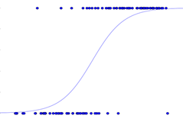
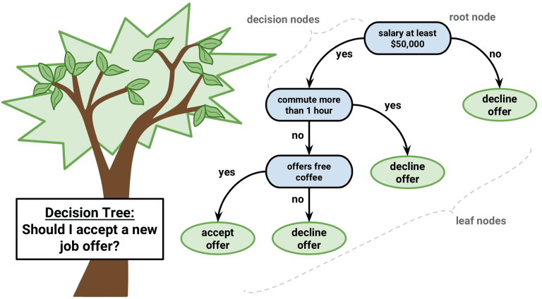
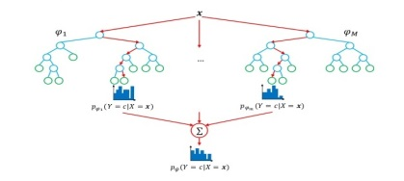
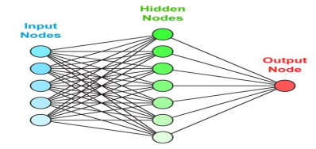
Digital transformation of CSA to the AI
DIGITAL AGRICULTURAL SURVEILLANCE
The choice of mathematical method
Logistic regression
Decision tree
Busting (gradient)
Connectionist network
Prediction of the event probability by the attributes values.
Consistent Decision Set
Composition of Decisive Trees
Neural networks
Interpretability
Simplicity
Complicated dependence
Any data and insights
Types of tasks :
Bayesian methods and their generalizations, collaborative filtering (typical companies)
Logistic regression, forest of random trees (prediction of violations)

Slide 9
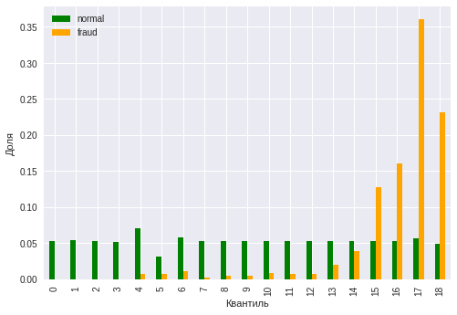
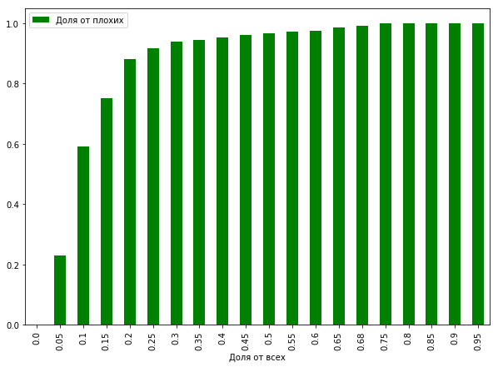
Preliminary Results (3 of 3)
Digital transformation of CSA to the AI
Model accuracy
Share of bad
Share
Quantile
Share of all
Distribution of score in the context of sites groups - with and without violations
Dependence of portion of found sites with violations on the «cut-off» by score

Slide 10




Digital transformation of CSA to the AI
principle of model operation using AI
All 100% EVAD checked
Platform* 1 (Pl.1)
Platform 2 (Pl.2)
Platform 3 (Pl.3 )
…
Platform N (Pl.N )
Pl.1 | 98%
Pl.2 | 85%
Pl.3 | 76%
…
Pl.N | 65%
Pl.1 | 98%
Pl.2 | 85%
Pl.3 | 76%
…
Pl.N | 0,04%
Model for the automatic distribution of platforms in violations probability
Inspector checks only platforms with high score
List of all platforms and the calculated probability of violations (score)
List of all platforms
Correct classification of platforms by inspector
* Agricultural processing enterprise.
Mathematical methods:
Bayesian methods;
Collaborative filtering.
The Rosselkhoznadzor has accumulated almost 40 TB of high quality data on the movement of raw materials and production. Based on a sample for 3 months (600 million records), a relevant model was obtained which processed a 3-month data array in 2 hours. The AI not only confirmed the patterns of falsification of products identified by experts, but also revealed an additional 15-20 suspicious patterns to each of the previously established ones. The accuracy of the AI model was 78 gini. With further development and training of AI, the accuracy can reach 90 gini out of 100 possible.

Slide 11


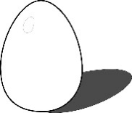




Digital transformation of CSA to the AI
examples of detected violations
Agricultural processing enterprise
cattle
poultry egg
Scheme of the production site.
In 2019, thanks to the FSIS “Mercury”, the territorial administrations of the Rosselkhoznadzor identified 86 phantom sites for the production of various types of food products. For example: cattle meat at the entrance, table egg at the exit.
pork
hake
chicken meat
chicken meat
3 weeks expiration date
One week expiration date

Slide 12










Digital transformation of CSA to the AI
Comparison of the effectiveness of the artificial intelligence model and
the manual work of specialists (on the volume of 236 million eVAD in the selected period)
Artificial Intelligence eVAD Testing Technology
For full-scale range
100%
Artificial intelligence
236 mln.
eVAD / day
List of anomalies
54 employees
Testing by methods
Performance gain
0,03 %
100 %
30 days
1 day
150 employees
54 employees
3 333,33 times
more coverage of the processed eVAD
30 times
shorter the processing time of eVAD
3 times
fewer specialists involved

Slide 13
Digital transformation of CSA to the AI
The effect of introducing artificial intelligence models into the FSIS «Mercury»
to identify violations associated with the introduction of illegal raw materials into the legal products market
Performance indicators with the existing technology for eVAD checking
No. | The indicators name | Quantity
1. | The total number of eVAD to be checked per month | 236 million units
2. | The number of monitored eVAD by 1 employee of the monitoring group per month | 504 units
3. | The number of employees in the monitoring group | 150 people
4. | The portion of audits monitored by the eVAD monitoring group per month | 0,03 %
5. | The necessary number of monitoring group employees to handle all eVAD | 468 254 people
Performance Indicators for the Application of Artificial Intelligence Technologies for eVAD checking
No. | The indicators name | Quantity
1. | The total number of eVAD to be checked per month | 236 million units
2. | The number of monitored eVAD per month | 236 million units
3. | The portion of monitored eVAD per month | 100 %
4. | The necessary number of monitoring group employees to handle all eVAD | 54 people

Slide 14
What will we get?
Digital transformation of CSA to the AI
100% verified electronic veterinary accompanying documents (eVAD)
8600 times
labor productivity growth

Slide 15
What will we get?
Digital transformation of CSA to the AI
the cost of one transaction will be reduced (processing of one eVAD)
from 300 rub.
to 3,5 cop.
1 rouble=100 copecs; 1 euro=approx 69 rubles.

Slide 16
Digital transformation of CSA to the AI
Project Team «DIGITAL AGRICULTURAL SURVEILLANCE»
Name | Title
S. Alekseeva | Deputy Head of the Federal Service for Veterinary and Phytosanitary Surveillance
A. Dotsenko | Deputy Head of the Federal Antimonopoly Service
V. Evtukhov | State Secretary - Deputy Minister of Industry and Trade
K. Savenkov | Deputy Head of the Federal Service for Veterinary and Phytosanitary Surveillance
A. Sokolov | Deputy Minister of Digital Development, Communications and Mass Media of the Russian Federation

Slide 17
THE HEAD
OF DIGITAL TRANSFORMATION
Federal Service for Veterinary and Phytosanitary Surveillance (Rosselkhoznadzor)
Thanks for attention!
DIGITAL TRANSFORMATION LEADERS TRAINING CENTER
HSE GRADUATE SCHOOL OF PUBLIC ADMINISTRATION

