Slide 1


DSDL Product Portfolio

Slide 2
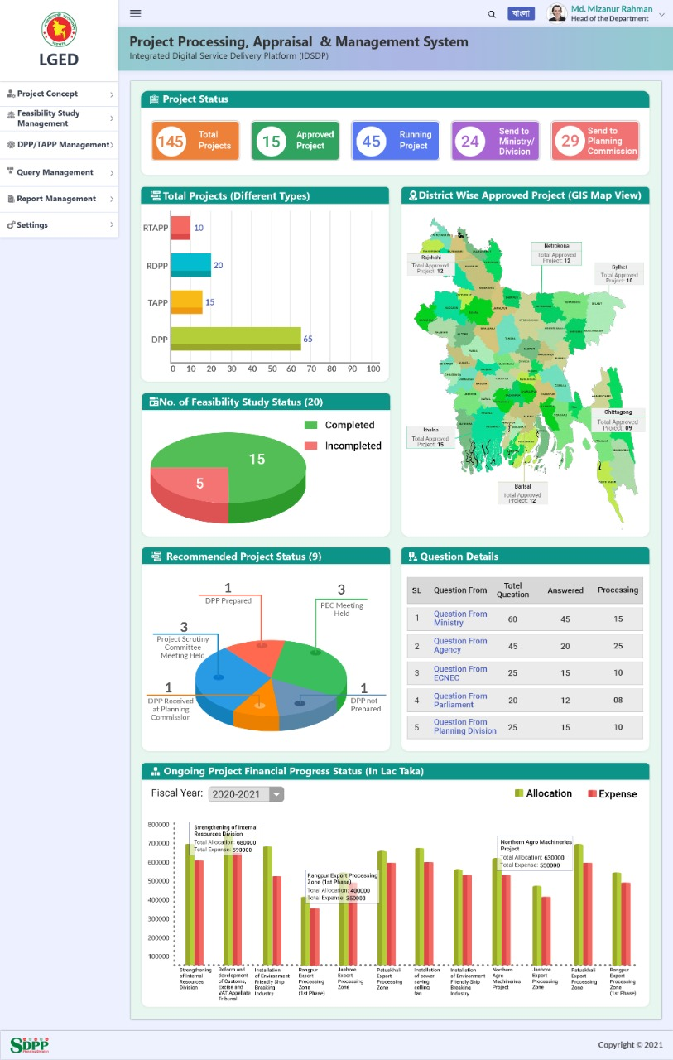
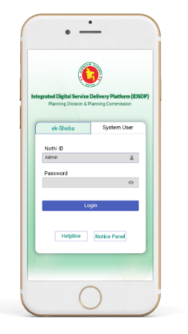
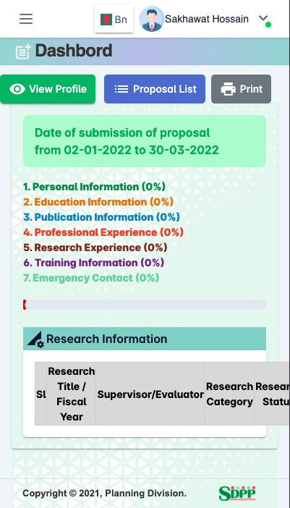
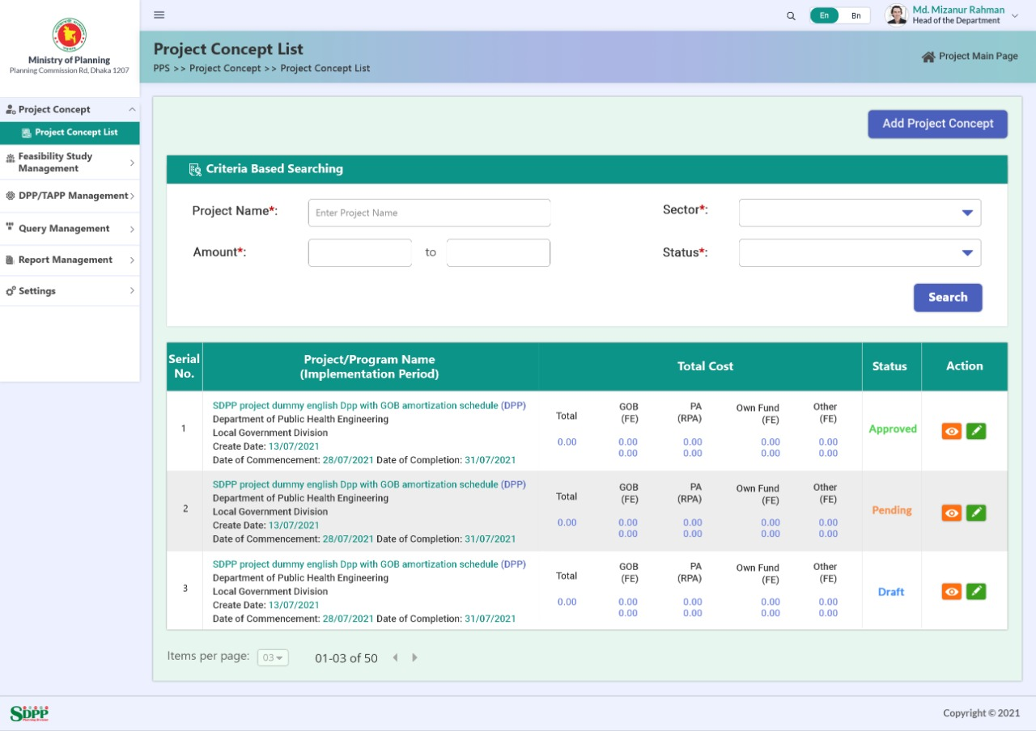
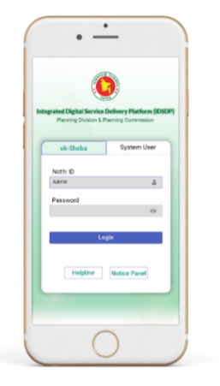
Integrated Service Delivery Platform of
Planning Division
4 Software
Project Processing System (Implemented)
Research Management System (Implemented)
National Planning Management System (Under Development)
GIS Base Resource Management System (Under Development)
Mobile App
Mobile App
Research Management System
Project Processing System

Slide 3
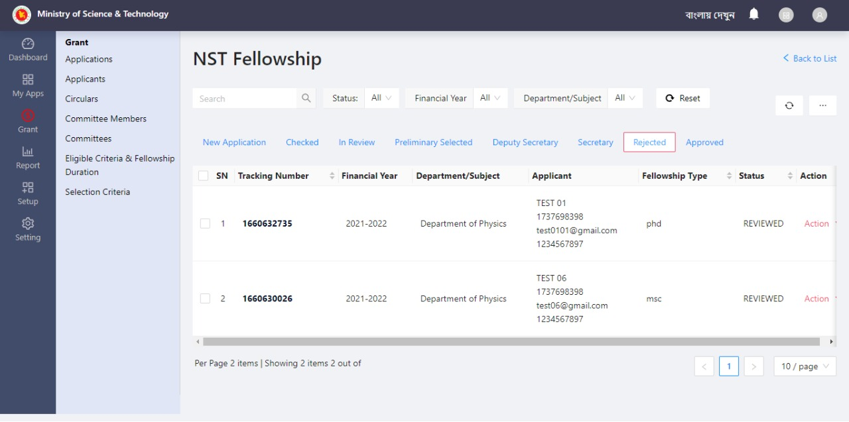
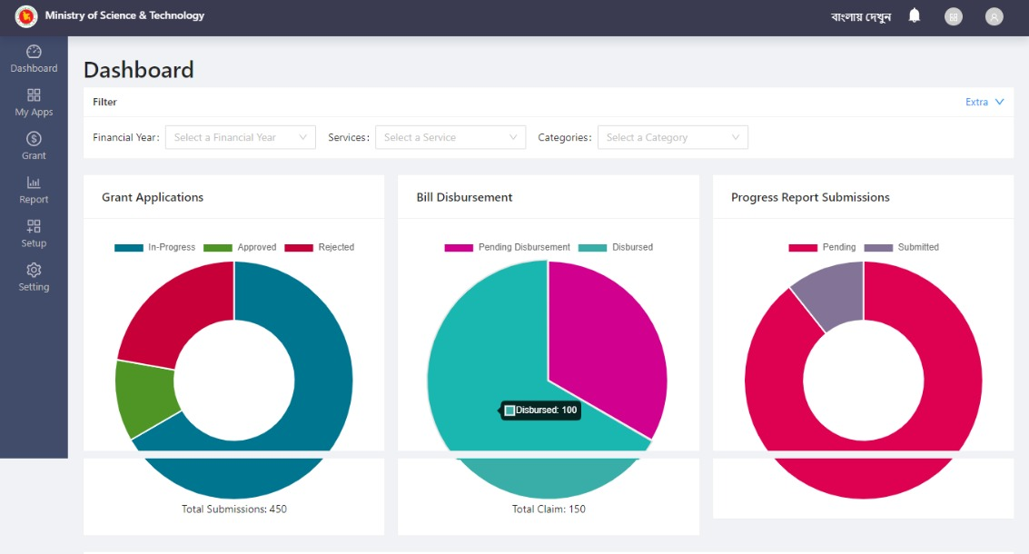
Integrated Service Delivery Platform
Ministry of Science & Technology
Scheme Service Management System
7 Software
License & NOC Service Management System (Under Development)
Schemes Service Management System (Deployed)
Social Safety Net System of CHT (Under Development)
NGOs Service Activities Monitoring System (Under Development)
Accommodation Service Management System (Under Development)
Case & Advisory Service Management System (Under Development)
Scholarship & Training Service Management System (Under Development)

Slide 4
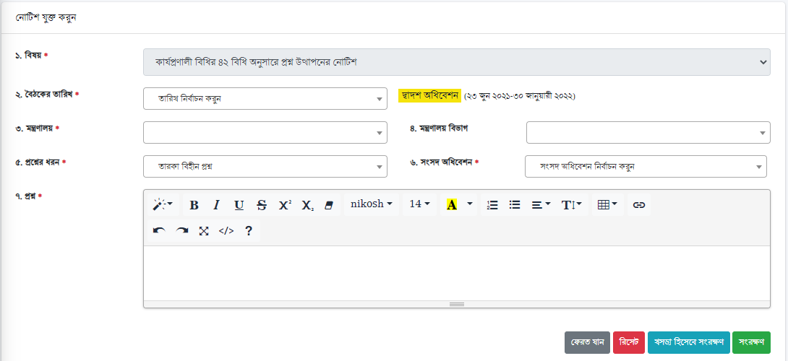
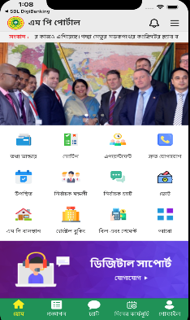
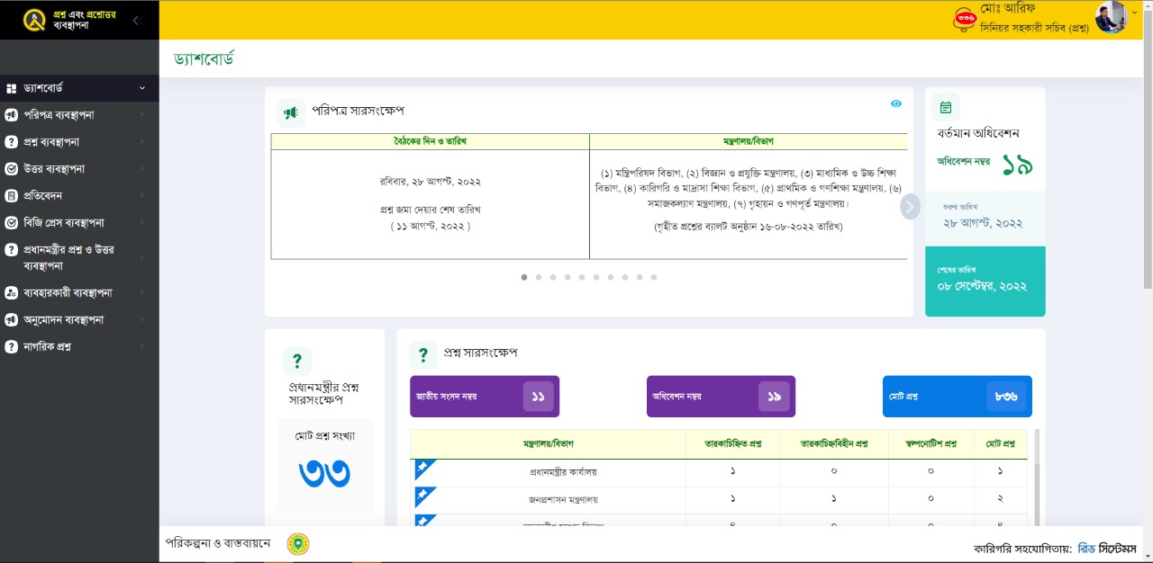
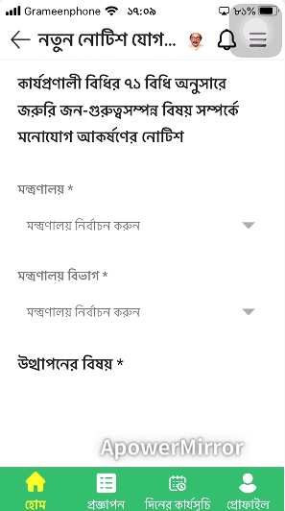
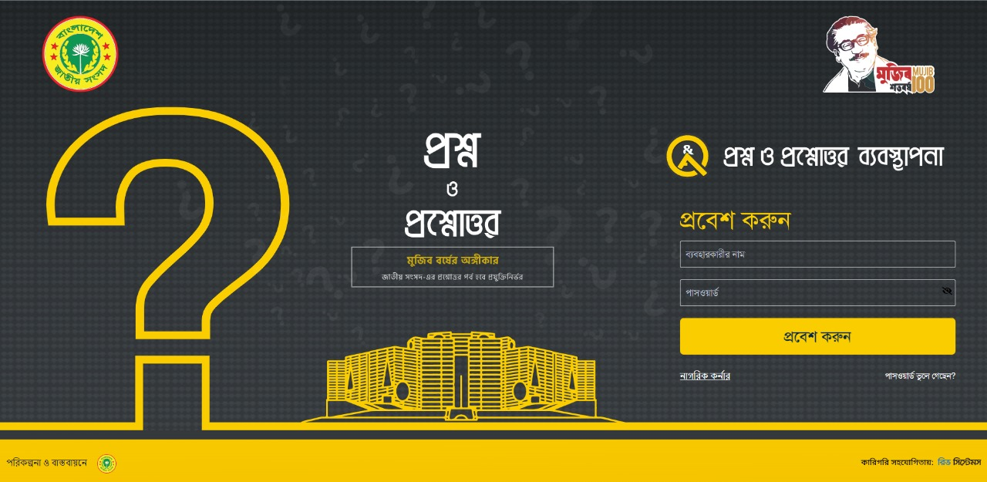
Parliament Automation
9 Software
  1. Question & Answer Management System (Deployed)
  2. MP Portal & Service Management System (Deployed)
  3. Notice & Petition Management System (Deployed)
  4. Parliament Housing & Voting Management System (Deployed)
  Parliamentary Debate, Recording & Archiving Management (Deployed)
  6. E-Bill & Session Management (Deployed)
  7. Digital Broadcasting & Media Management System (Deployed)
  8. Committee Information Management (Deployed)
  9. Library & Research Management System (Deployed)
MP Portal
Mobile Apps
Question & Answer Management System
Mobile Apps

Slide 5
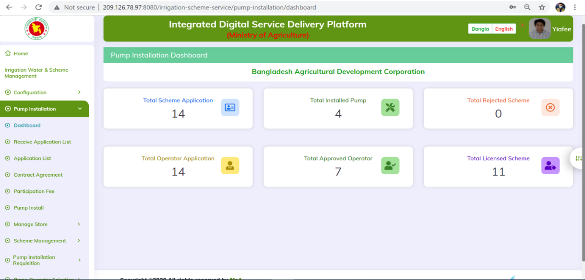
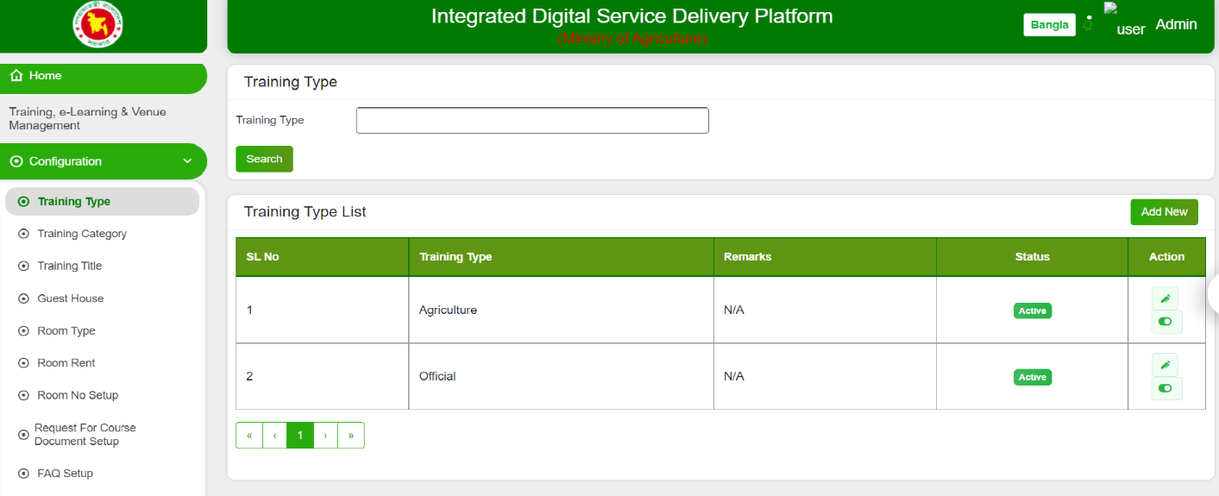
Integrated Digital Service Delivery Platform
Ministry of Agriculture
10 Software
License, Registration, Clearance & Certification Management (Developed)
Agri Research, Testing, Report & Data Repository Service (Developed)
Incentive & Grant Management System (Developed)
Agri marketing & Business Linkage Management System (Developed)
Market Infrastructure & Warehouse Management System (Developed)
National Virtual Crop Pest Museum (Developed)
Crop, Seed, Germplasm & Fertilizer Production, Development, Distribution & Service Management System (Developed)
Irrigation, Water & Scheme Management System (Developed)
Training, e-Learning & Venue Management (Developed)
Agri Portal Enhancement including Mobile Apps (Developed)
Irrigation, Water & Scheme Management System
Training, e-Learning & Venue Management
Notes:
Wakil

Slide 6
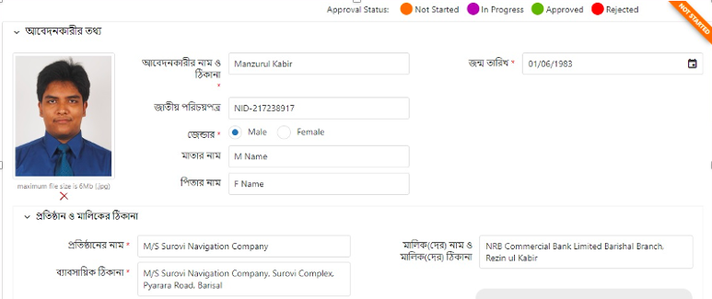
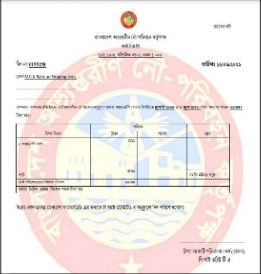
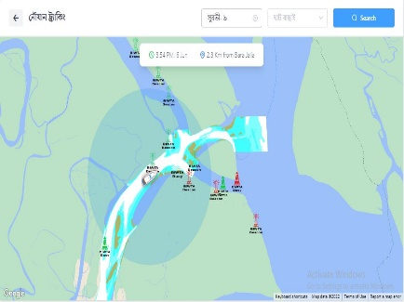
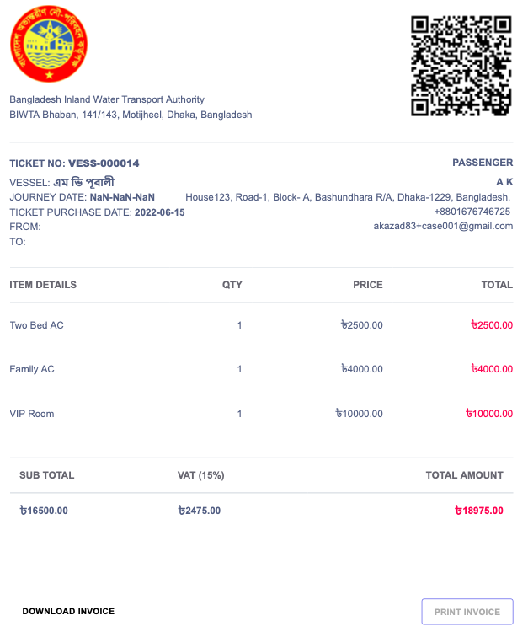
e-Inland Water Traffic Management System
Bangladesh Inland Water Traffic Authority (BIWTA)
10 Software
Vessel Registration & Survey Management (Deployed)
Timetable and Fare Management (Deployed)
Rental Management (Deployed)
Vessel Navigation Management (Deployed)
e-Ghat Management (Deployed)
Onboard Survey Management (Deployed)
Marine Court Case Management (Deployed)
Conservancy Charge Collection Mgt. (Deployed)
e-Ticketing & Passenger service Mgt. (Deployed)
General Configuration Management (Deployed)
Conservancy Charges/Fees Collection Systems
Interactive Interfaces for Navigation
E-Ticketing System
Notes:
Wakil

Slide 7
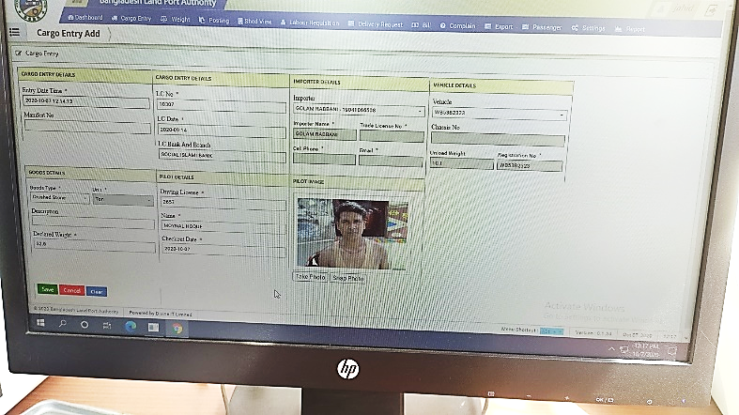
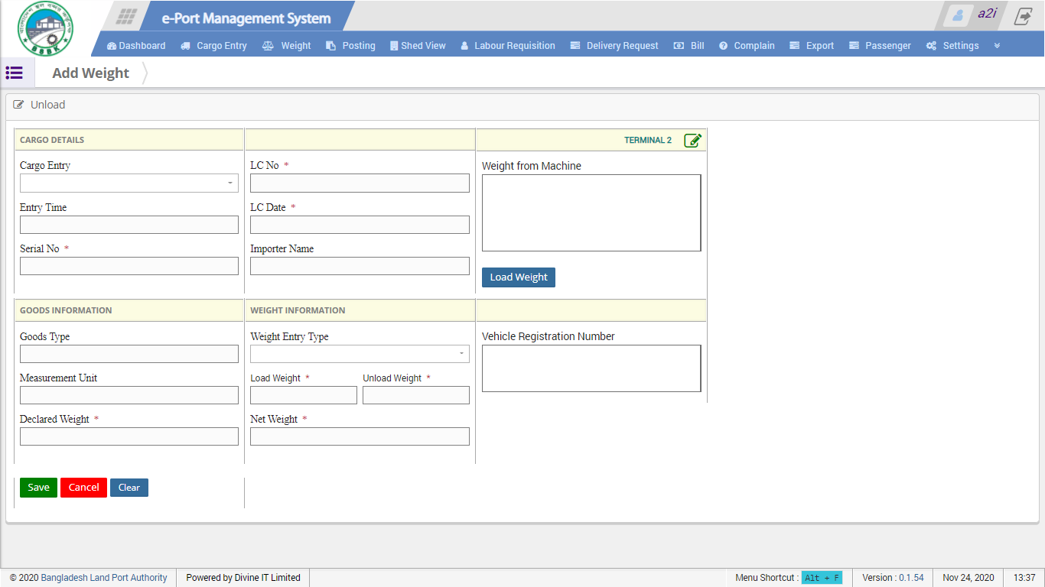
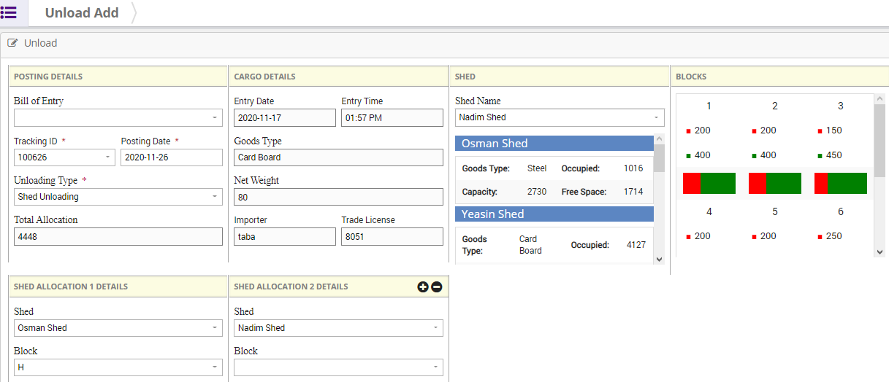
e-Port Management System
Bangladesh Land Port Authority
9 Software
Cargo Management (Deployed)
Weight Management(Deployed)
Posting, Unlading & Delivery Management (Deployed)
Shed/Yard Management (Deployed)
Assessment & Billing Management (Deployed)
Stakeholder Management (Deployed)
Complain Management (Deployed)
User Management (Deployed)
System Configuration (Deployed)
Cargo Management
Shed/Yard Management
Weight Management
Notes:
Wakil

Slide 8
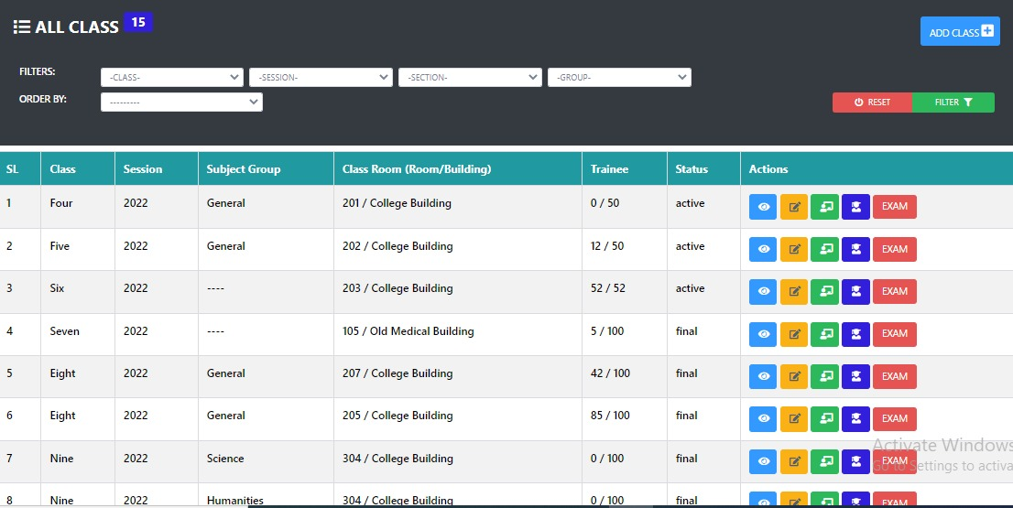
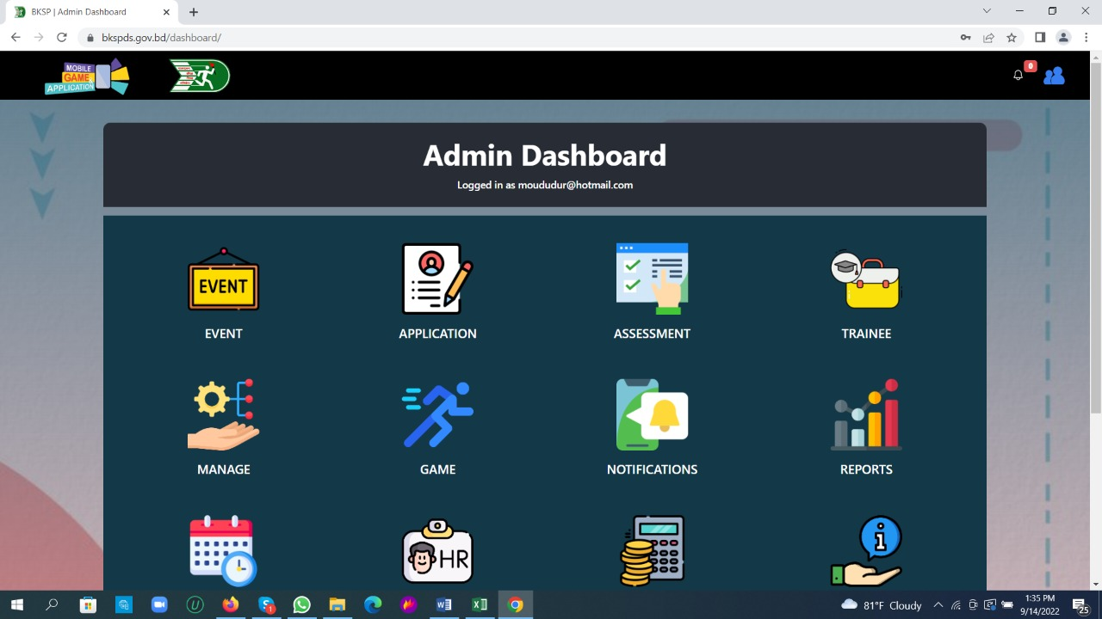
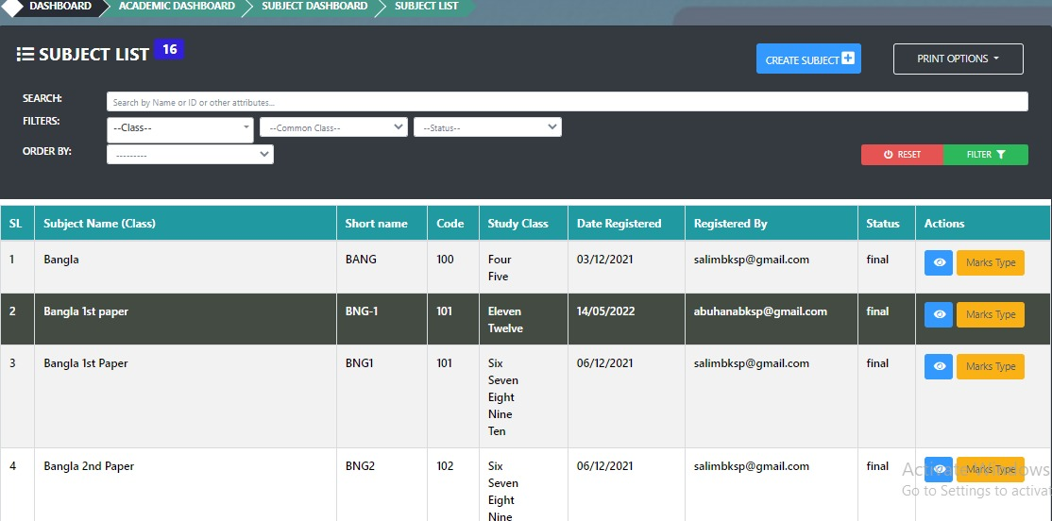
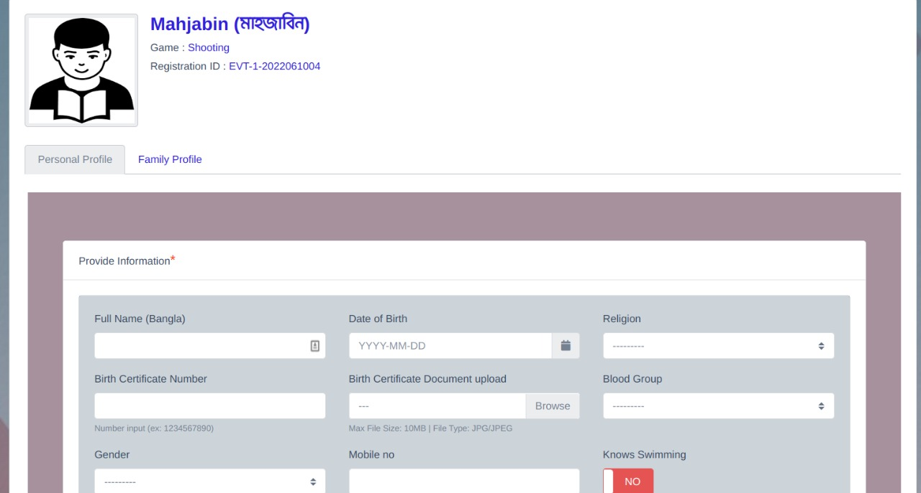
Talent Hunt and Player Management System
Bangladesh Krira Shikkha Protishtan (BKSP)
1 Software
Talent Hunt and Player Management System (Deployment)

Slide 9
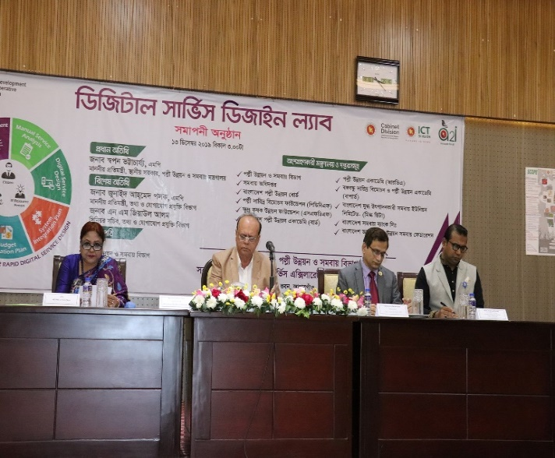
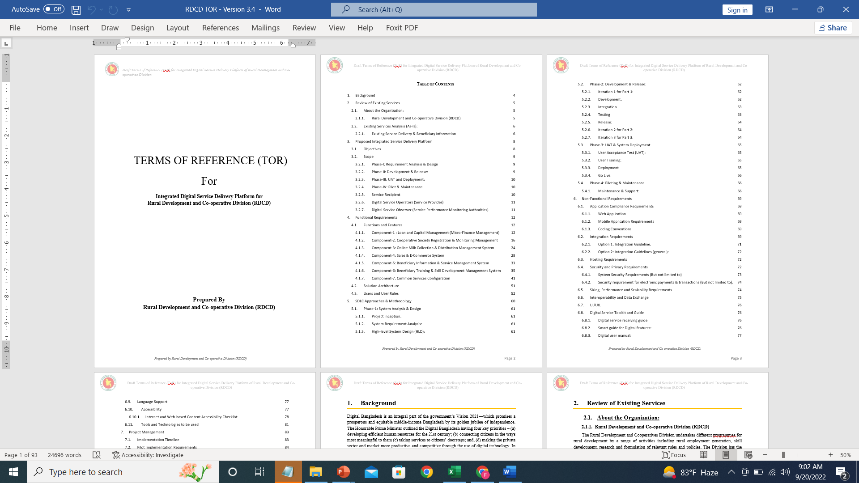
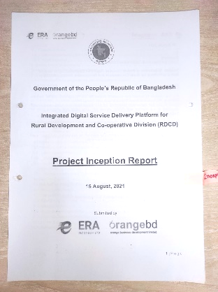
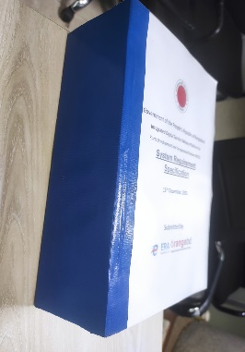
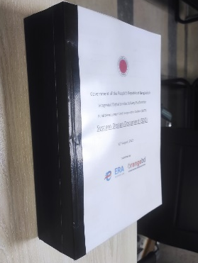
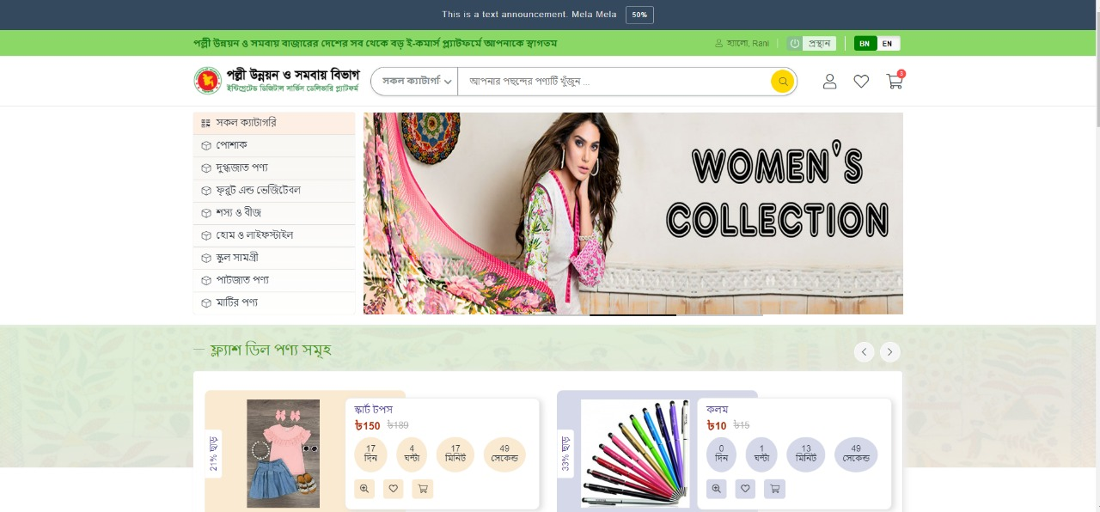
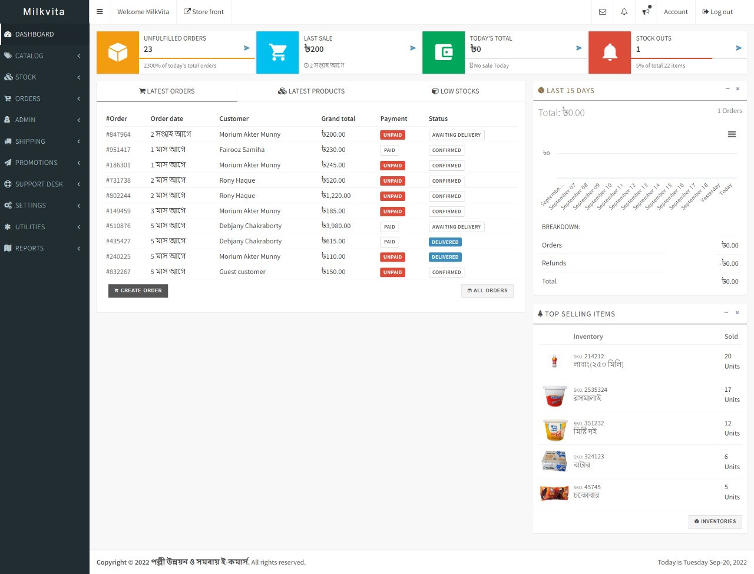
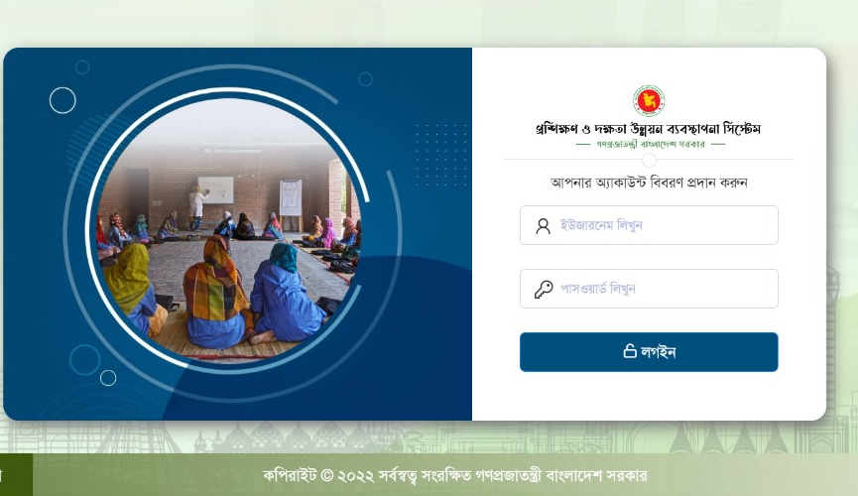
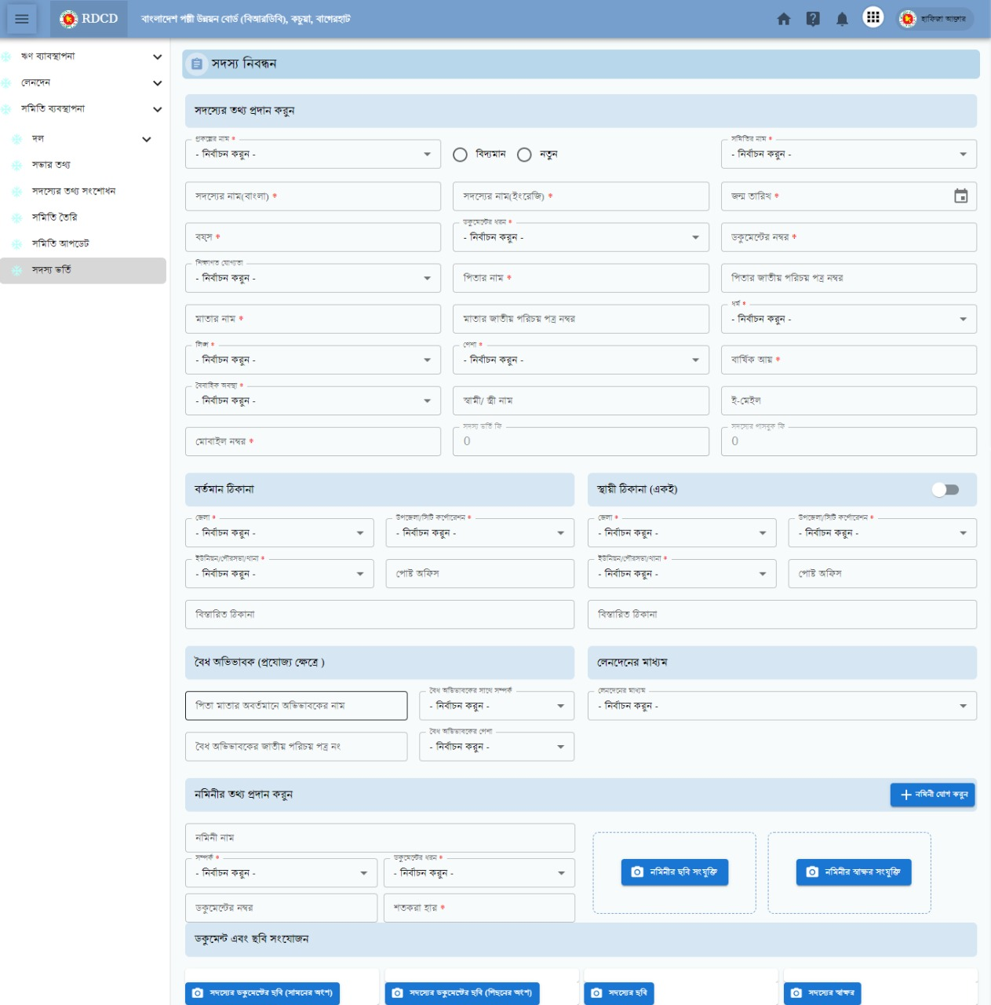
Case Study: Rural Development & Cooperative Division (RDCD)
(10 Organizations)
Tk. 11 Cr. Procurement worth
11,00,100 Beneficiaries
DSDL
185 Services
Procurement
Development
Development Review
Roadmap
6 Software
4816 Offices
Quality Assessment
3 Days
(18 – 20 June 2017)
10-13 Dec, 2019
Organization: 10
Participants: 30
Procurement Document Preparation Assistance
Digital Service Design Lab
93 Page ToR
28 page Inception Report
496 page (SRS)
401 Page (SDD)
Sales & E-Commerce System
Online Milk Collection & Distribution System
Beneficiary Training & Skill Development Management System
Loan and Capital Management System
Integrated Digital Service Delivery Platform
Notes:
Farzana

Slide 10
Thank You
Notes:
Farzana

