Slide 1
IDEA BANK
Single address for thousand ideas
The State Agency for Public Service and Social Innovations under the President of the Republic of Azerbaijan

Slide 2

IDEA Sharing PROCESS
Sign-up at www.ideyabanki.com
Choosing the contest
Sharing the idea

Slide 3
USER Profile
4 idea
Not passed first step
Context of idea
Reapeted idea
3 idea
Context of idea
2 idea
Chosen as a winner
Context of idea
Passed first step
1 idea
Context of idea

Slide 4

Single address for all idea contests
IDEA CONTEST FOR ASAN Wi-Fi project
IDEA CONTEST FOR ABAD project
IDEA CONTEST FOR BASLA PROJECT
IDEA CONTEST FOR E-SERVICES IMPROVEMNET
IDEA CONTEST FOR ASAN SERVICE IMPROVEMENT
OTHER CONTESTS
IDEA CONTEST FOR VOLUNTEERING

Slide 5
IDEA EVALUATION PROCESS
Analyzing all ideas to the determined criteria
Choosing the pertinent ideas by first Commissioner
Appreciation reviewed ideas by idea Commission
Awarding the highest pointed ideas

Slide 6
EVALUATION CRITERIAS
IDEA
actuality
effectiveness
Social importance
creativity

Slide 7



STATISTICS
4000+
Idea Bank users
5000+
Sent ideas
700+
Realized ideas

Slide 8





IDEA BANK on social media
facebook.com/ideyabanki
linkedin.com/in/ideyabanki
instagram.com/ideyabanki/
twitter.com/ideya_banki
Announcements of Active Contests in Idea Bank
Information about Idea Bank trainings in ASAN service centers
- Information about latest technologies in the world
- Information about most recent innovations and inventions in the world

Slide 9

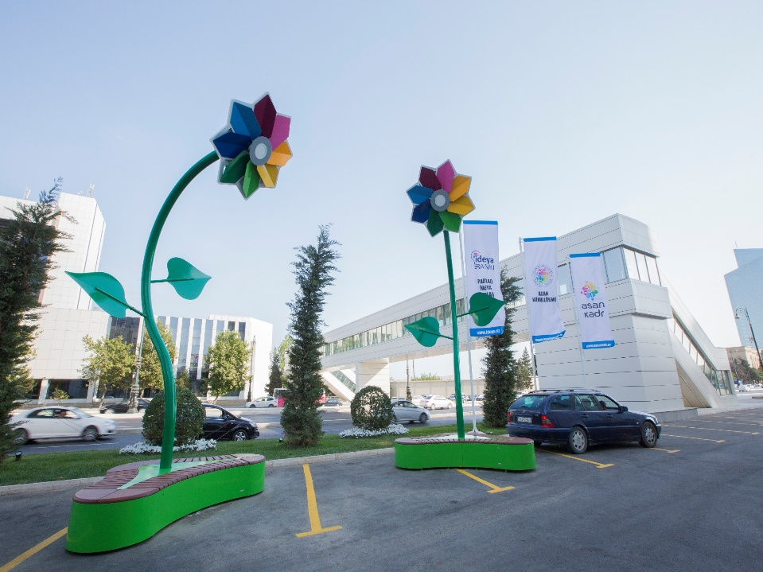
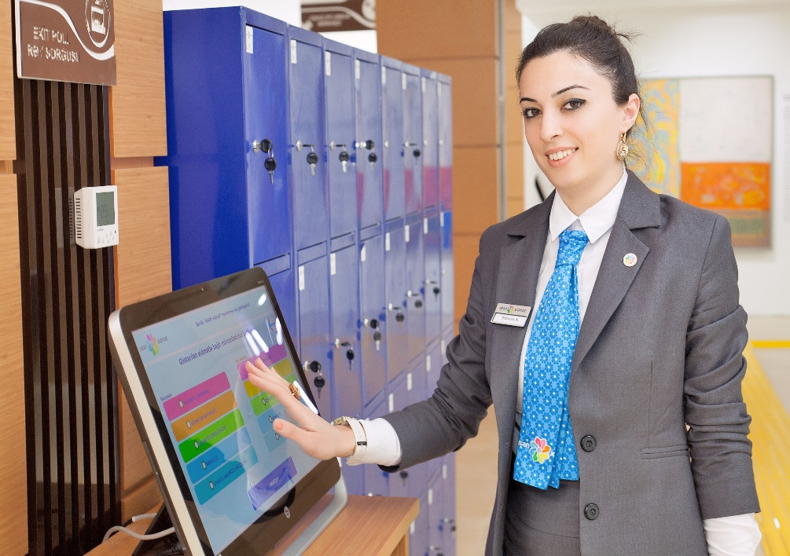

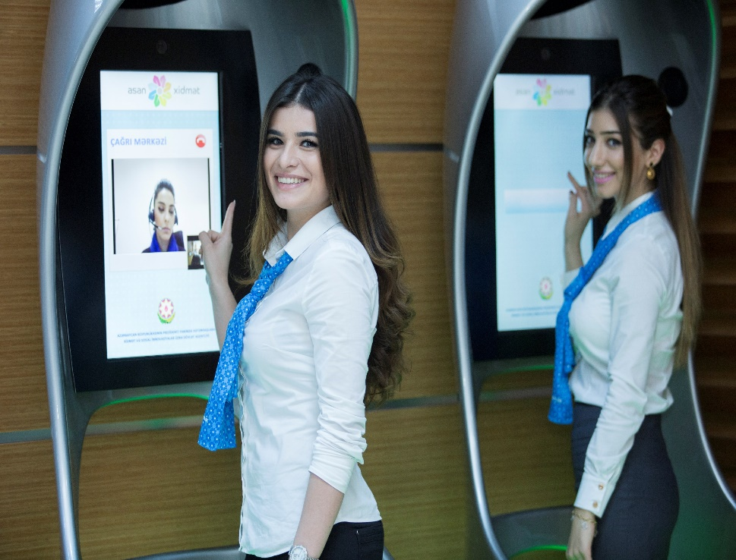

Realised ideas

