Slide 1


City of Austin & The University of Texas at Austin Research Collaborations –
Overview of Interlocal Agreement

Slide 2
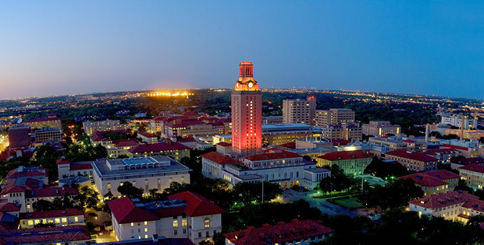
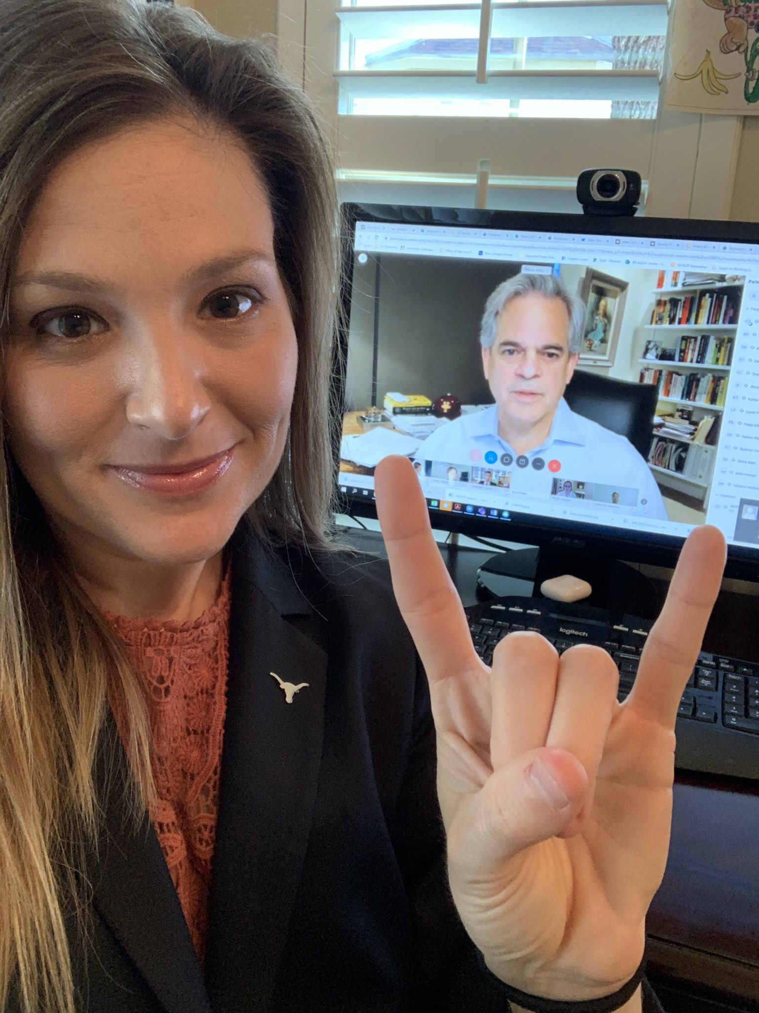
UT/CoA Master Interlocal Agreement
"With the university as a partner, the city has a powerful resource for addressing our most challenging civic issues. The interlocal agreement is the right move to set the city up for long-term success in collaborative research and data-driven decision making."​
​-Mayor Steve Adler​

Slide 3


Origin Story of the
UT/CoA Master Interlocal Agreement
Our Observations
Our Goals
Hard to keep track of the many ways UT and CoA are collaborating in research
Research agreements being processed as business/procurement contracts majorly slows down contract negotiation
No agreed-upon best practices between UT and CoA
  Lots of time and effort lost reinventing the wheel
  Lack of consistent progress reporting
Missed opportunities to connect CoA offices with UT research expertise
UT and the City of Austin need a way to categorize their research collaborations appropriately, as research, so that together we can:
reach agreements faster,
get to work on projects more quickly,
and be more transparent and consistent in how we report our findings and progress.

Slide 4
UT/CoA Master Interlocal Agreement:
At a Glance
Effective 10/1/2020 - 9/30/2025
Authorizes up to $1.5M/year of CoA funds to be provided to UT Principal Investigators (PIs) for research projects
No pre-determined research focus areas or topic areas
Research questions to be driven by CoA's needs, since they are the sponsor/funder; research projects are PI-driven (not work-for-hire)
Basic terms and conditions regarding data sharing and IP have already been negotiated in the ILA, to streamline processing, while leaving room for project-specific term negotiation

Slide 5
Types of Research Projects supported by the ILA
Academic research involving UT faculty, staff or students
Community-based research
Program evaluation
Best practice studies
Strategic planning assistance for CoA
Data analysis
Survey research
Use of CoA departments, services, and/or data for academic research

Slide 6

Benefits of working together...
World-class research expertise
Collaborate on innovative approaches
Data and existing infrastructure
Apply research to real-world problems
Access to future workforce

Slide 7
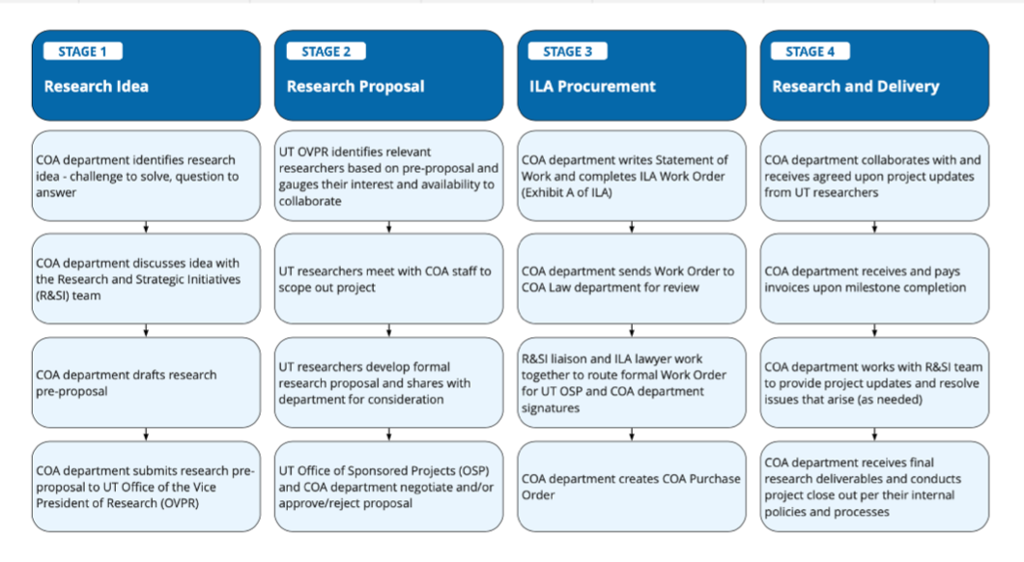

Slide 8
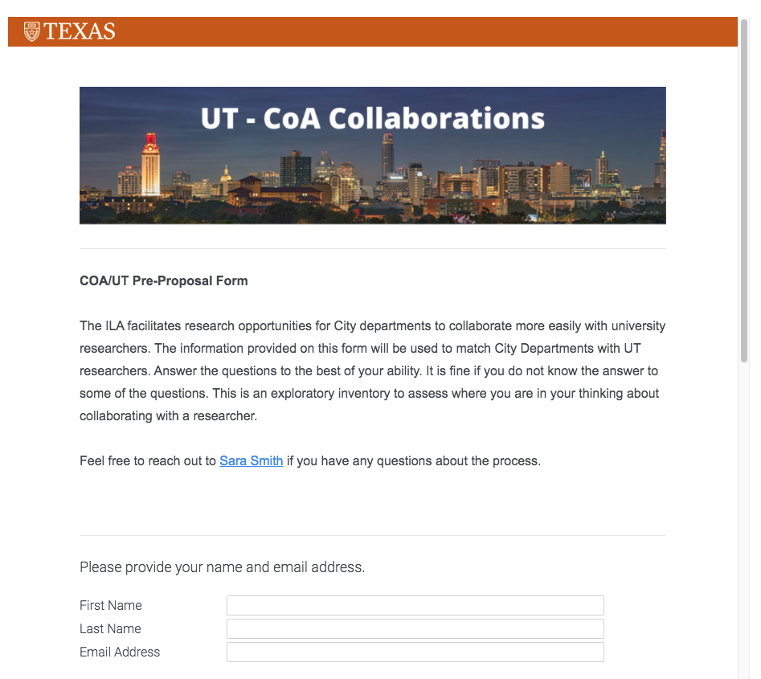
Stage 1: Research Pre-proposal
Research interest
What topic(s) would you like to explore with a researcher?
What questions are you trying to answer through research? What are you trying to solve for?
Participants
What COA department is requesting this research?
Would other COA departments be involved in this research collaboration?
Are there people or departments you envision working with at UT?
Dependencies and constraints
Do you have an anticipated timeline for this research project? Are there any dependencies?
Do you have a budget in mind for this research project?
https://utexas.qualtrics.com/jfe/form/SV_0ClhLT0g9hVRUxw

Slide 9
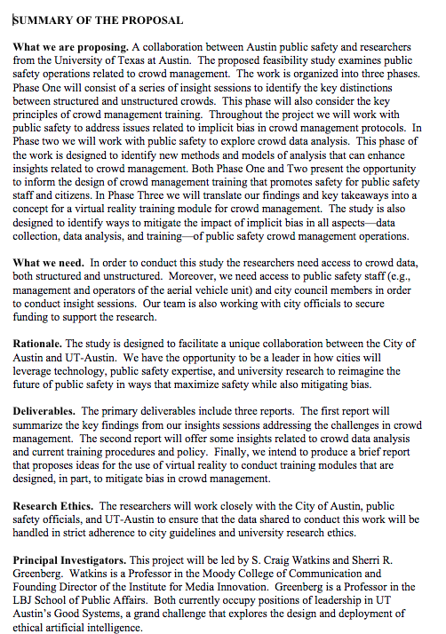
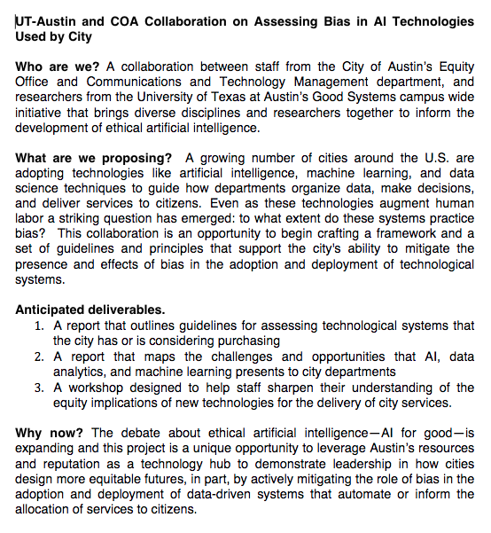
Stage 2: Formal Research Proposal

Slide 10
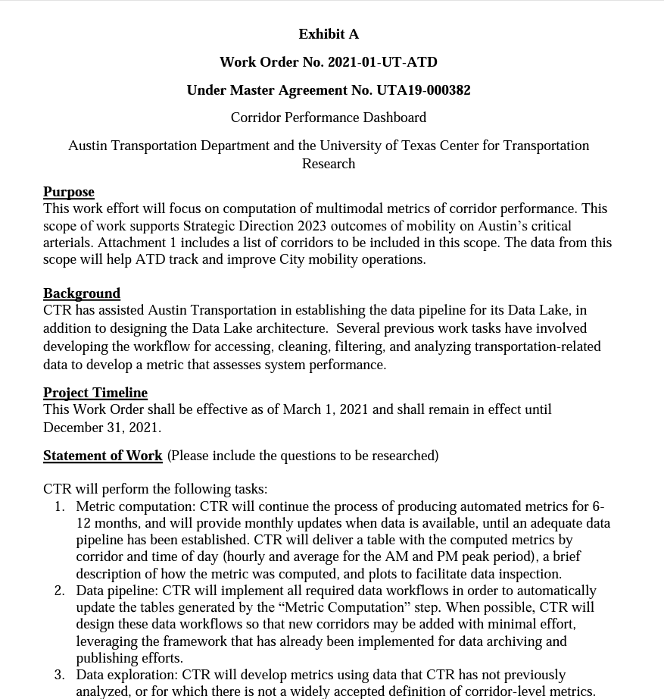
Stage 3: ILA Work Order
Each Work Order shall include, at a minimum:
Project title and a description of the Projects to be performed, including any deliverables;
Identification of relevant City and University Departments, a principal investigator, and points of contact from the City and the University;
The cost of the Projects performed, including a detailed Project budget if required;
The period of performance of the Work Order;
Invoicing Instructions;
Description of any data to be shared;
The University’s determination of whether IRB review and approval are required;
Special terms and conditions, including reporting requirements; and
Any other information required to carry out the Work Order.

