Slide 1



PARTICIPA.GOV
Public administration platform for participatory processes

Slide 2
PARTICIPA.GOV
Participa.Gov was implemented as a result from the SIMPLEX measure.
SIMPLEX
Participa.Gov
Annual programme that integrates simplification, modernization and innovation measures to improve citizens and businesses access to public services and
to increase internal efficiency of public services.
Official public administration platform that supports citizen participatory processes and uses secure and reliable technologies for citizens to vote.
Participatory processes
A mechanism for participatory democracy, which gives citizens the power to make proposals and vote how public budgets should be invested.

Slide 3

PARTICIPA.GOV - DRIVERS
OPEN ADMINISTRATION
  Public participation instruments make it possible to stimulate joint discussion between stakeholders and decision-makers, providing the best conditions for obtaining more thoughtful and equitable decisions, avoiding suspicion in relation to institutions, increasing the probability of consensus and therefore the success of the policies themselves.
  On the other hand, encourage participation in public management represents a change in innovation processes, turning them into human, relational, exploratory and collaborative processes improving the ability to offer better services from the direct knowledge of social needs.
Panor
Pilot at national level
Pilot at local level
Pilot at intra-organizational level

Slide 4






PARTICIPA.GOV - PHASES OF THE PARTICIPATION PROCESS
Participa.Gov consists of the various citizen participation process phases:
1.
Submission of the proposal
2.
Technical analysis
3.
Temporary results and complaints
4.
Votes
5.
Winning proposals
6.
Tracking the execution of the winning proposals

Slide 5




PARTICIPA.GOV BACKOFFICE
Participa.Gov has a back office portal – Participa Backoffice – which includes the necessary modules to provide an efficient and holistic management of the participatory process.
Initiative management
Proposal management
Complaint management
User / profile management
Creation and configuration of an initiative. Definition of business requirements
Proposal validation, publication and analysis (convert proposal to project, associate various proposals, etc.)
Filing complaints, analysis and feedback
User and profile configuration

Slide 6
PARTICIPA.GOV – THE TECHNOLOGICAL PLATFORM
Participa.Gov is a widespread and differentiating platform:
MULTI-ENTITY
MULTI-INITIATIVES
BLOCKCHAIN
COST REDUCTION
(Councils, Government, Public Administration entities, schools, etc.)
(Public initiatives, private initiatives)
(Transparent, secure and anonymous votes)
(Less acquisitions of participation platforms by the Public Administration)
IDENTIFICATION GUARANTEE
PROGRESSIVE WEB APP
(Autenticação.gov -
digital identification, authentication and signature)
(Accessible from any device)

Slide 7

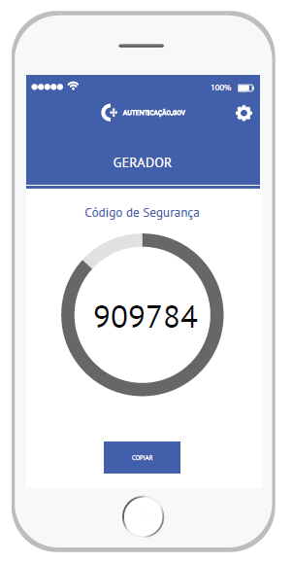
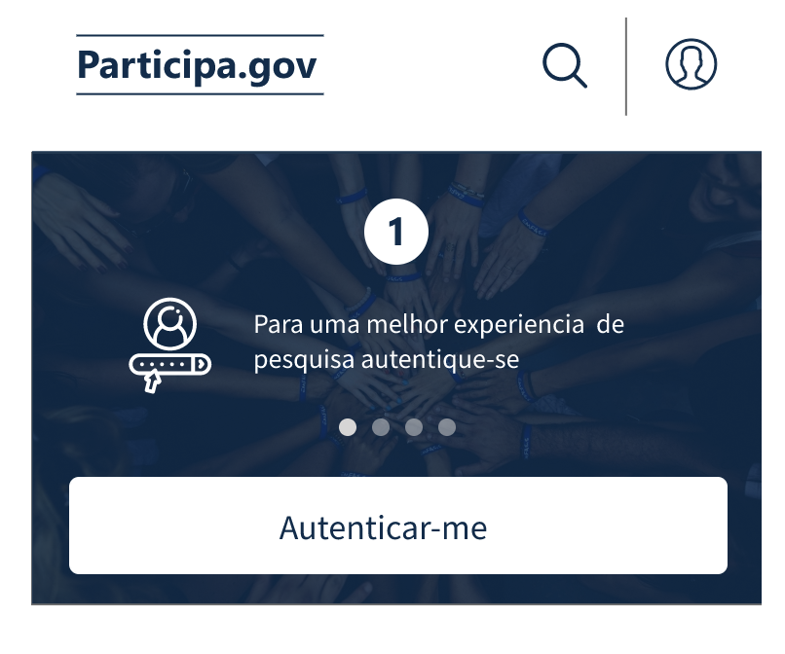
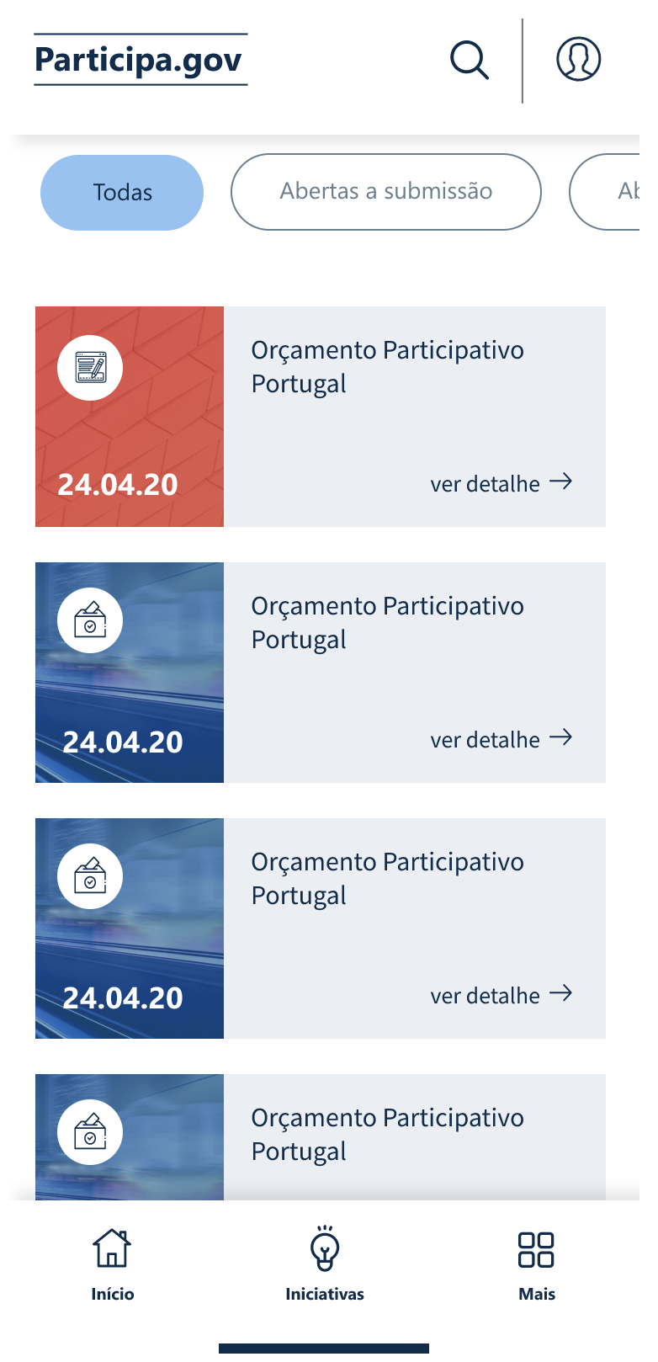

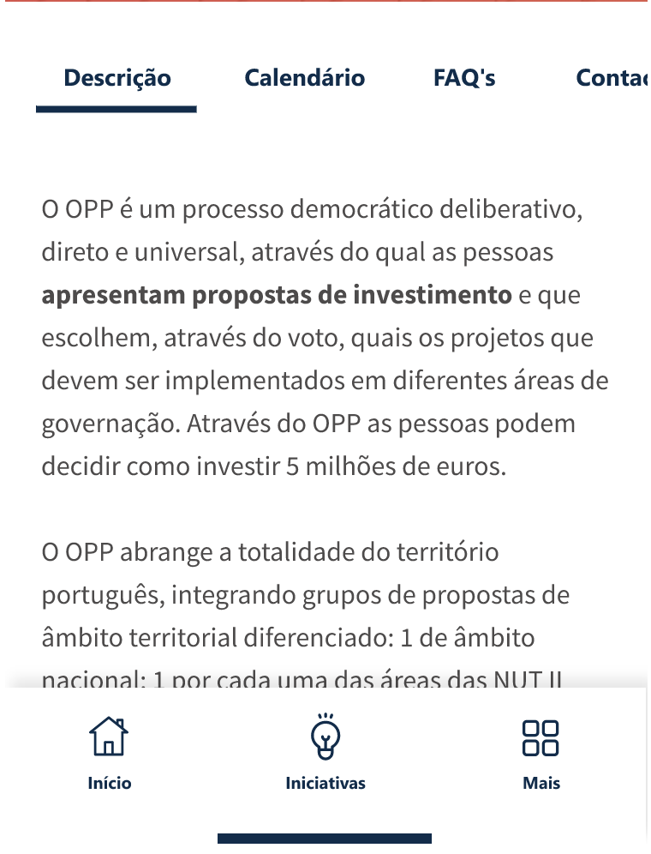
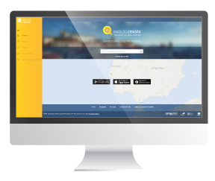
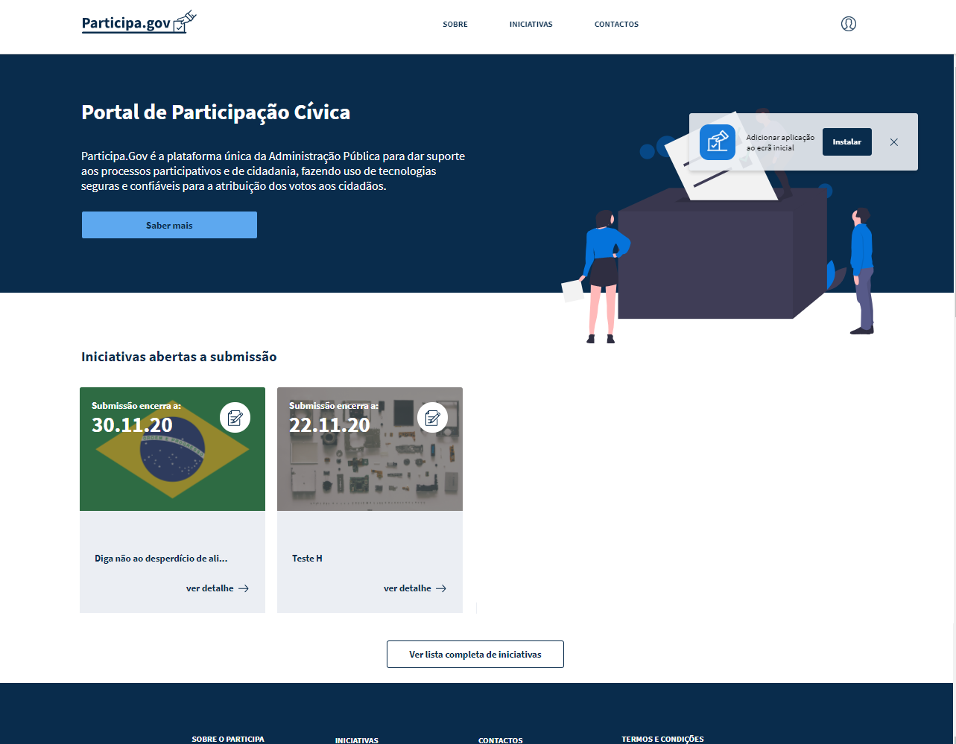
PARTICIPA.GOV - FEATURES
Submission of proposals with or without authentication
Authentication with the Digital Mobile Key or Citizen card in Autenticação.gov
Editing and tracking proposal status in the Reserved Area
Access to a Reserved Area and configuration of user preferences by themes and places of interest
Digital voting using Blockchain technology
Submission of complaints
Access to user voter wallet in Reserved Area
Advanced search of initiatives and proposals

Slide 8
WHY USE PARTICIPA.GOV?
+
TRANSPARENCY
DIGITAL
+
Blockchain
Digital Platform
Transparency and confidence are the biggest challenges of the participatory systems. Participa.Gov platform uses blockchain technology to guarantee transparency, security and anonymity in the voting process , avoiding possible fraud.
Focus on digital and user experience, easy to access, simple to use and to understand the processes.
Participa.Gov
+
ROI
SECURITY
+
Autenticação.gov
Official platform for Public Admin.
Participa.Gov platform uses Autenticação.gov mechanism (identification, authentication and digital signature) to guarantee authenticity and citizens’ security in participatory processes..
This platform will be available for all public administration in the future, no other entity will need to invest in similar solutions in the public administration.

Slide 9

Sofia Mota
Director of the Portuguese IT Competences Center for the Public Administration – TICAPP
sofia.mota@ticapp.gov.pt

