Slide 1

Register of administrative procedures

Slide 2


Programmes e-Government and e-Paper
  What do we need?
  What do we want?
  What can we do?
  How do we achieve that?

Slide 3

Our goals
optimization of administrative procedures
  regulatory reform
  development of contactless services
  digitalization
  exchange of data ex-officio
  reducing costs
  introducing standards to public services
  consultations with businesses and citizens
Main goal is better business environment and public services
Indicator: reducing administrative burden as a share of GDP from 3,26% (2016) to 3,0% (2020)

Slide 4
Optimization
Digitalization
Register of administrative procedures
simplification of procedures
elimination of un-necessary documents and steps
savings for businesses (decreasing of costs of services)
all necessary information about procedures – updated and available online at one place
life-events and business episodes
Legal-security for businesses
Digital procedures for everyone
transformation of services
Single window for services and for all information

Slide 5
e-PAPIR goals
Consulting the partners
Trainings and workshops
SMEs, big companies, NGOs
initiatives for change of ineffective regulation
initiatives for simplification of procedures
introducing standards to public services
education of law-makers about optimization and digitalization of procedures and standards of public services they should provide to users
Guide for creating contactless services

Slide 6


Slide 7
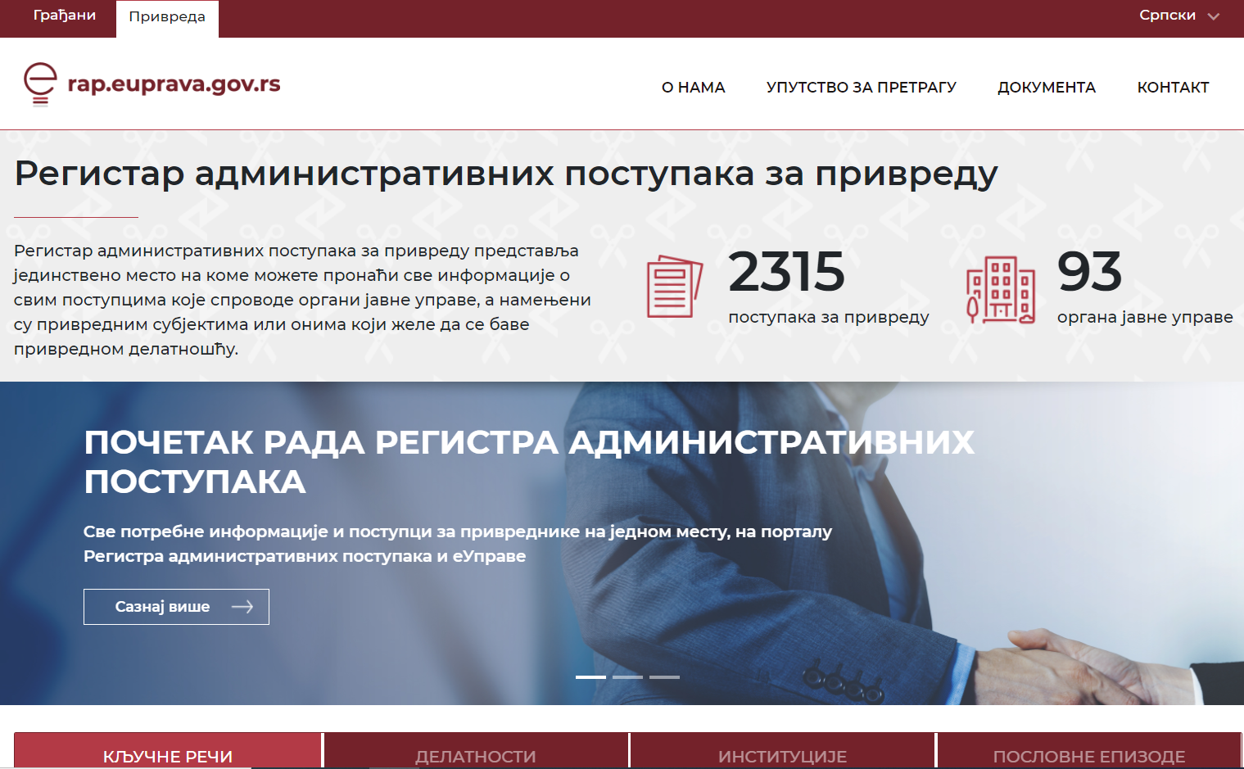

Slide 8

Thank you for your attention!
ninoslav.kekic@rsjp.gov.rs

