Slide 1
Demonstration Support Project on Digital Logistics Service for the Ministry of Land, Infrastructure and Transport
Seoul, the city of co-existence, innovation and smart logistics !
2022 Report on the Start of the
Demonstration Support Project on
Digital Logistics Service for Seoul
Consortium of Seoul × private company

Slide 2
CONTENTS
2022 Report on the Start of the Demonstration Project on Digital Logistics Service
Ⅰ
Status
Ⅱ
Issues & Analysis
Ⅲ
Vision & Strategy
Ⅳ
Details of Project
Ⅴ
Project plan
- Establishment of the Joint Distribution Center for Our Neighborhood
Ⅵ
Future Plan, and Etc.

Slide 3
Ⅰ
C/H/A/P/T/E/R
Status
2022 Report on the Start of the
Demonstration Project on Digital Logistics Service
for the Ministry of Land, Infrastructure and Transport

Slide 4
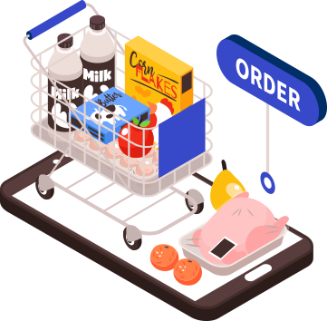
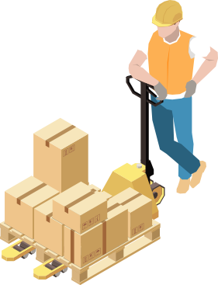
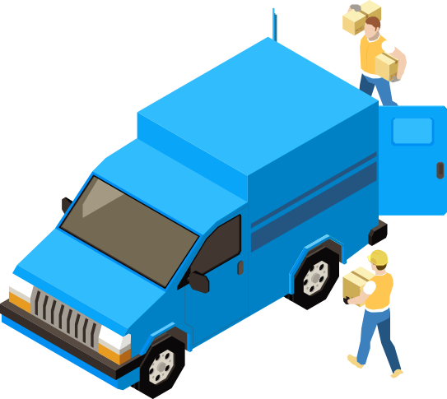


01
  ‘Advent of the logistics era’ in which consumer logistics surge with the vitalization of non-F2F transaction
  Logistics market is growing rapidly based on
  an increase in online transaction, diversification of distribution channel, and etc.
  Most consumer logistics (50% or more) is
  concentrated in the metropolitan area
  Transaction amount for online shopping
  Parcel shipment volume for Seoul
  Annual use of parcel delivery per person
  KRW 193 trn
  485%
  135%
  1.4 bn boxes
  88%
  128 cases
  (375 cases per household)
  640 mn boxes
  68 cases
  (160 cases per household)
  KRW 33 trn
  '15
  '21
  '15
  '21
  '15
  '21

Slide 5
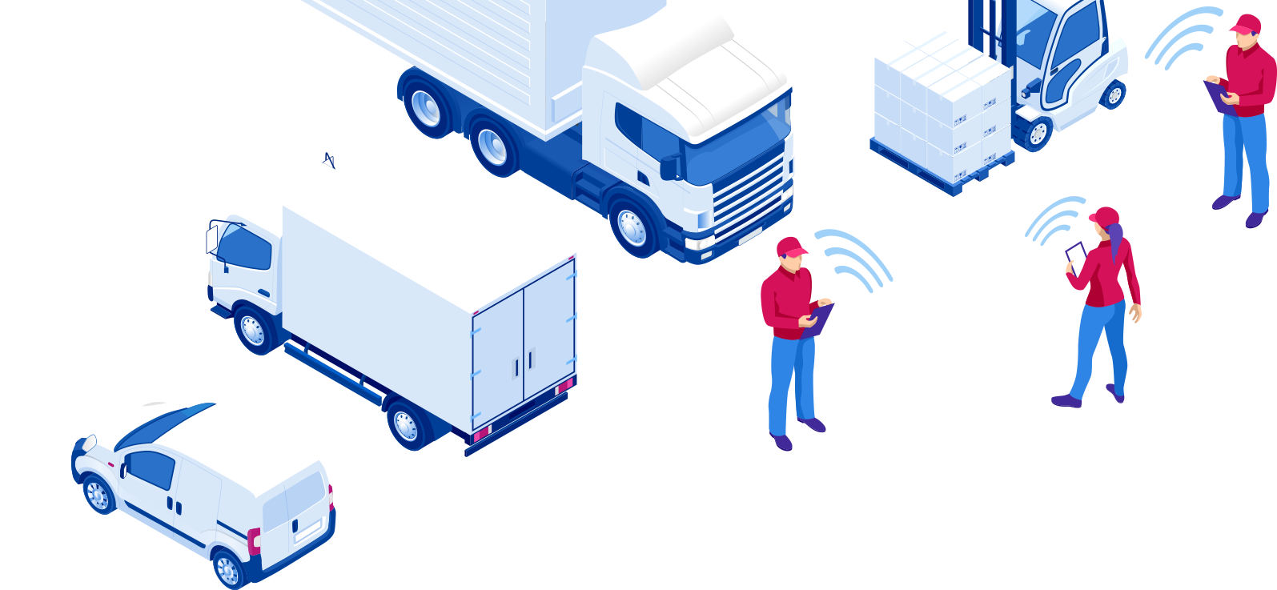







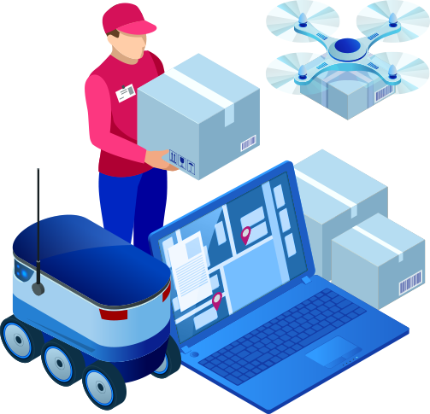
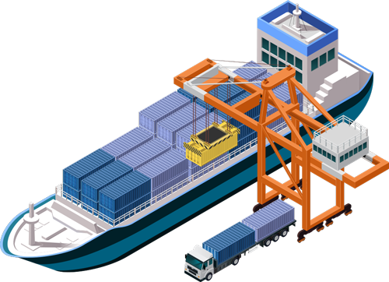
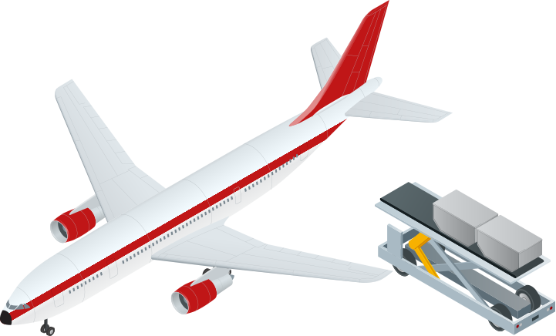


02
  ‘Conversion to digital logistics’ as a result of the 4th Industrial Revolution
Transformation in logistics innovation in the 4th Industrial Revolution era RolandBerger,logistics4.0
  Labor and land-centered logistics
  is converted to digital logistics
  with a convergence of advanced technology
  Traditional logistics
  Future logistics
Logistics 4.0
Autonomy in
operating logistics
Logistics 3.0
Systemization of
logistics management
Support for
manufacturing and
import/export
Aiming for convenience
of life and for citizens
Direction
Logistics 2.0
Mechanization
of loading
Present
Logistics 1.0
Mechanization
of transport
IoT, AI and big data-based logistics
Robot warehouse, drone, autonomous vehicle
Convergence
(Logistics+distribution+ICT,
and etc.)
After the 80’s
Procurement →
Storage →
Shipping
Adoption of WMS and TMS
Adoption of electronic customs
Service
After the 60’s
After the 20th century
Automatic warehouse, automatic sorter
Containerization of marine transport
Railroad, truck-based land transport
Freight-based marine transport
IoT, AI,
Big data-based
Technology
Based on labor
Diversification such as
air and underground
MEthod
Centered on land

Slide 6












03
  ‘Expansion of the On-Demand logistics service’ that is customized to
  various consumer preferences
  Official start of logistics that responds
  to demand such as lowest price,
  express delivery and fresh delivery
  Expansion of various O2O that is targeting the niche market, and
  change in the consumption pattern that is growing dramatically
  while targeting young consumers
Logistics company
Expansion into consumer logistics service (B2C) such as corporate logistics (B2B) → fulfillment
Online to Offline
Amount of online shopping transaction
Amount of mobile
shopping transaction
Share of
mobile transaction
Distribution company
  Food and beverage
  23.9%
  4.0%
Enhancement of platform-based competitiveness
(Entrance into new businesses for comprehensive platform such as Shopping→Music, Video, and etc.
  KRW 2.2313 trn
  Food service
  8.2%
  KRW 11.
  7378 trn
  13.8%
  72.4%
  KRW 2.1930 trn
  KRW 16.
  2151 trn in total
  (Composition ratio)
  Appliance · Electronics · Communication device
  8.8%
  68.4%
Start-up
  KRW 9.4722 trn
  KRW 1.7823 trn
  Daily supplies
  KRW 1.4272 trn
  11%
  13.5%
Adoption of new service for convenience in living such as express delivery, custom delivery and fresh delivery
  Clothing
  KRW 1.3291 trn
  2020.09
  2021.09
  2020.09
  2021.09

Slide 7
Ⅱ
C/H/A/P/T/E/R
Issues & Analysis
2022 Report on the Start of the
Demonstration Project on Digital Logistics Service
for the Ministry of Land, Infrastructure and Transport

Slide 8

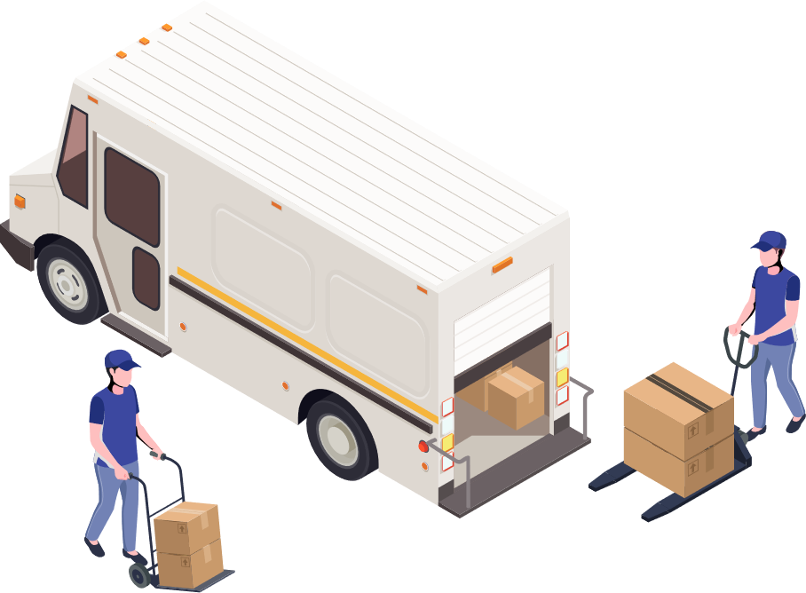
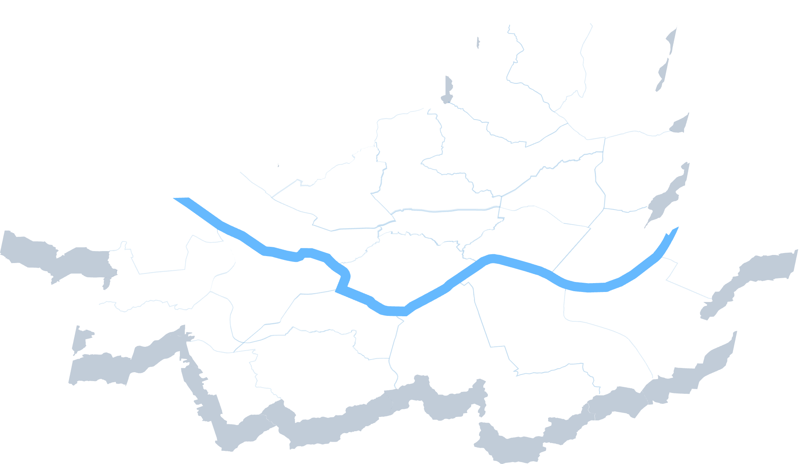

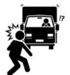
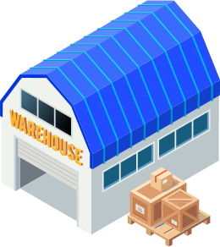
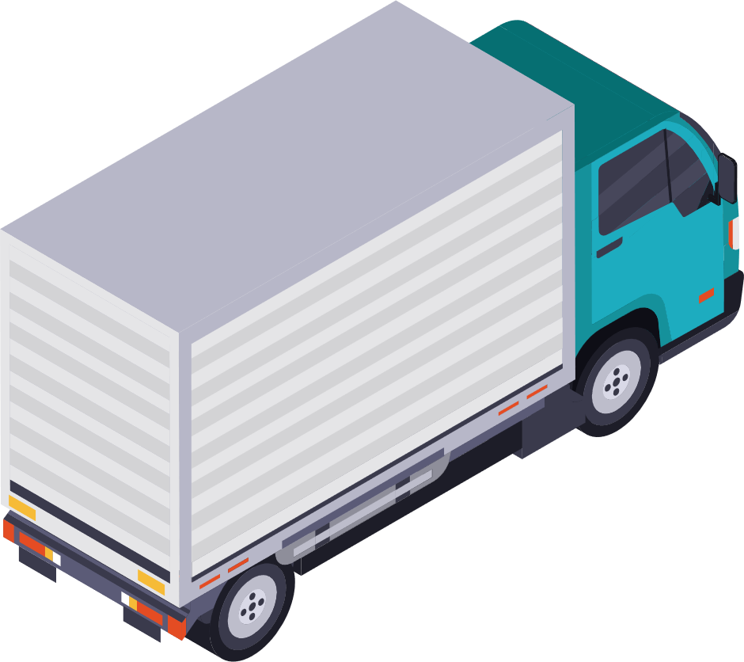
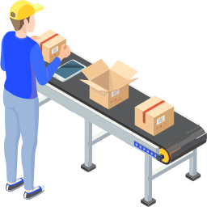
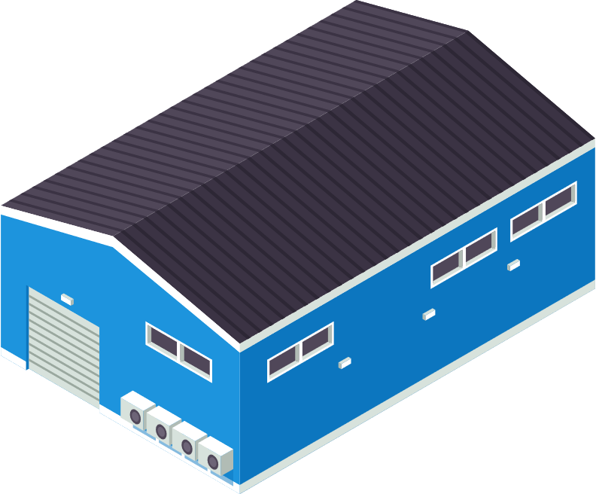
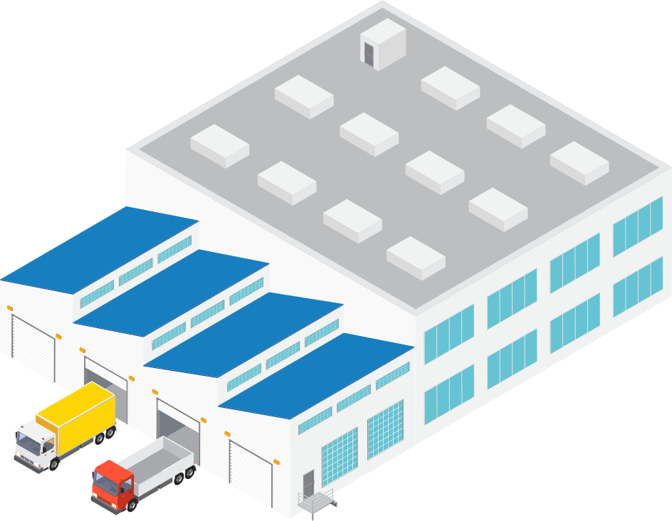
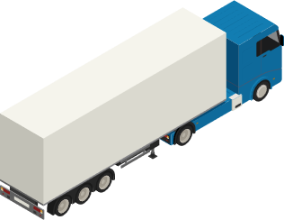
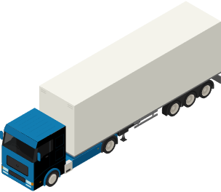


01
  Inefficient shipping system due to a shortage of logistics infrastructure
  in Seoul (Trigger environmental/transportation/safety issues)
Only small logistics facilities increased (5 centers) for the past 5 years since the establishment of Seoul Logistics Complex located in Jangji-dong, Songpa-gu ('15)
  10 logistics complex and 580 logistics warehouses in Gyeonggi-do, 1 logistics complex and 31 logistics warehouses in Seoul
It is difficult to construct logistics facilities in the city due to increase in land price and shortage of lot
Online transactions are on the rise, but there is a lack of logistics infrastructure that can support traditional markets, small businesses, and etc.
  Status of inefficient logistics shipping
  Issues
Logistics warehouse
Traffic congestion
Environmental pollution
Threat to
safety
4
Consumer
5
  Additional 25km of mileage per one freight truck,
  along with 90 ton per year in pollutants
  Increase in courier delivery leading to
  50% increase in deaths caused by freight cars
Logistics center
3
Seller
[Gyeonggi-do] Logistics hub
1
* Source: Seoul Institute
* Source: Transportation statistics of Seoul (’21)
  Advanced logistics complexes (3 centers) are being developed for the city, but it takes long to completion → Need to establish an innovative plan to enhance the inefficient delivery system
2

Slide 9
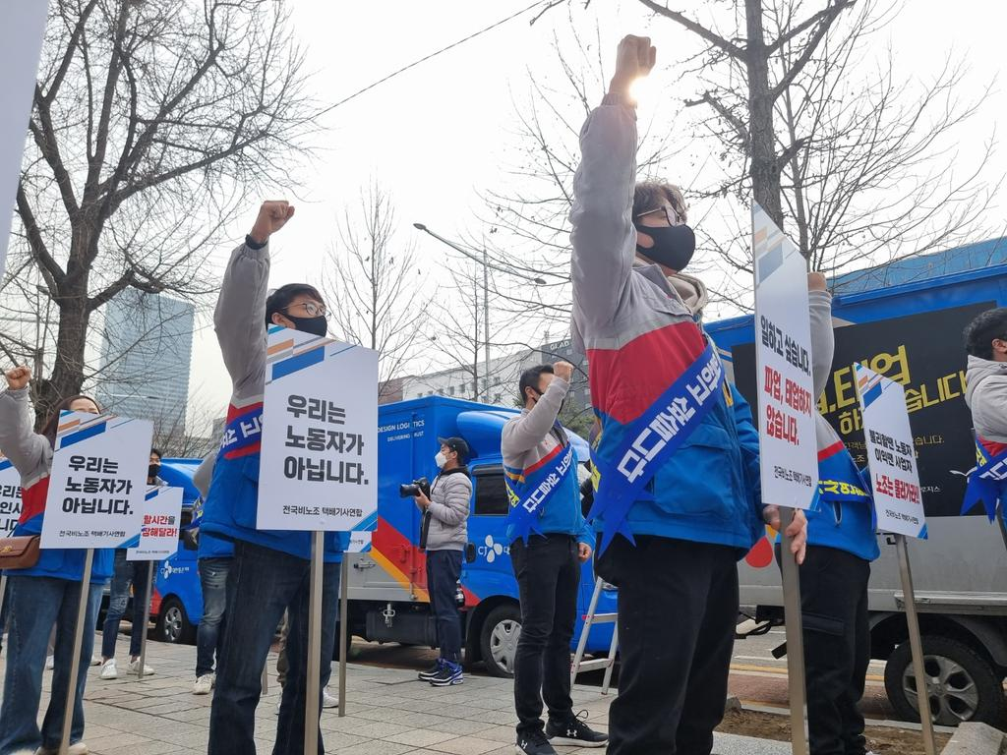
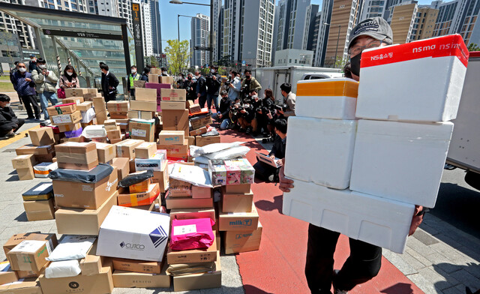
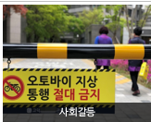
02
  Increase in the delivery volume & intensified competition in the speed of courier business as a result of vitalization of non-F2F transaction
Frequent conflicts among stakeholders such as courier company, laborers and residents cause social issues
Courier company vs Delivery drivers
Delivery drivers vs Residents
Social conflicts
  Delivery drivers ask for an enhanced working environment
  that is currently causing deaths from overwork
  Courier trucks prohibited from entering into apartments due to safety issues
  Urgently need co-existence measures to resolve social conflicts

Slide 10
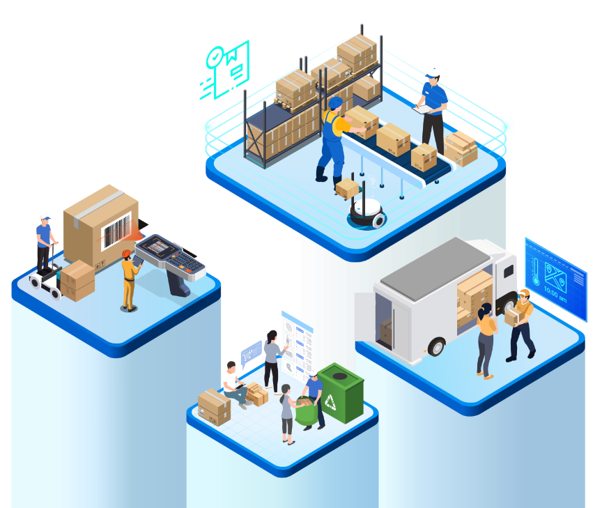


03
  Need systematic public support measures for an innovative, value-added convergence logistics
Focus on the logistics industry as the industry of the future that will drive creation of jobs, co-existence and growth
Need to urgently convert to smart logistics and support vitalization of the consumer logistics market that is rapidly growing such as same-day and early-morning delivery
Advancement & digitization
Sustainable environment
Shared/linked convergence infrastructure
Securing responsiveness to future of the industry
People-centered/good job
Securing global competitiveness
  Need to establish systematic support measures for the future logistics industry to be able to secure sustainable competitiveness in addition to developing policies to vitalize logistics that is close to every day lives and reflects the demands of consumers

Slide 11

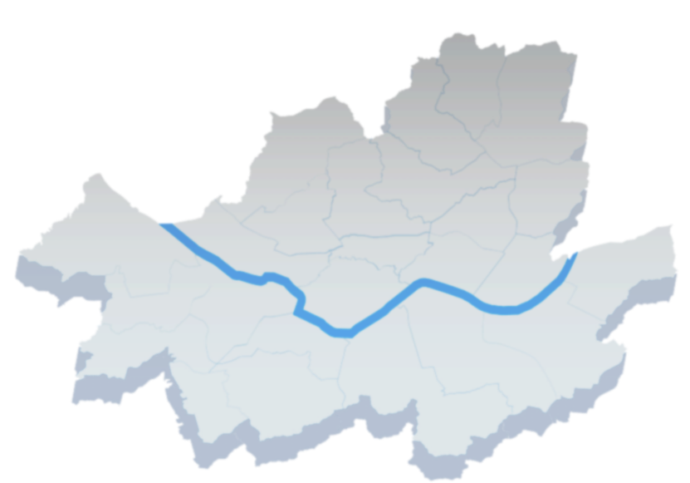
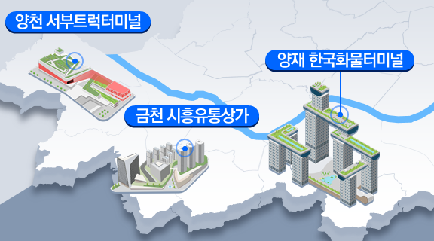
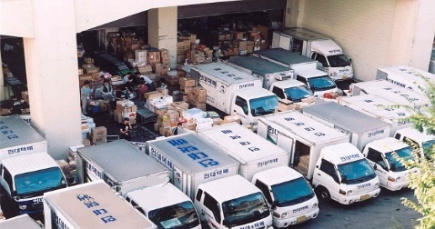
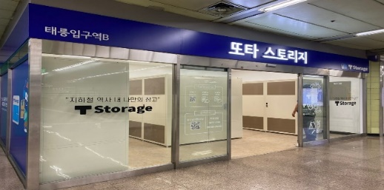

04
  Analysis on the condition of sites in ‘Seoul’ as the potential sites for the demonstration project on logistics innovation
As the largest city in Korea and the capital city, Seoul is highly concentrated, and it is the most appropriate place for the smart city logistics system to shift the paradigm in city logistics
It is the optimal place for a demonstration on logistics to resolve issues such as increase in delivery logistics and traffic congestion/accidents, and the demonstration project can resolve issues of city logistics and contribute to improving the quality of living for citizens
Status of city logistics in Seoul
Statistics of Seoul and condition for the location
Establishment of an advanced logistics complex in the city
  Developing a convergence building consisting of logistics+upstream+support facility (3 centers)
  There is an urgent need to construct a digitized smart logistic system to raise the efficiency of delivery in line with the increase in consumer logistics resulting from an expansion in e-commerce and Covid-19, with delivery in Seoul amounting to 1.18 bn boxes as of 2020 (296 cases per household)
  35% of employees from the base logistics industry work in Seoul, and 21.5% of nation-wide logistics companies are pursuing projects, with Seoul being the starting point and destination point of key transportation networks and the center of national logistics
Logistics warehouse & consumer logistics center
  Epicenter of the national economy where total production within Seoul and adjacent metropolitan region accounts for 49.4% of GDP
  Seoul is truly a megacity with a population of 9.8 mn, and 25 autonomous districts
34 logistics warehouses
(1,000㎡ or greater)
Use idle space in subway stations,
Establish consumer logistics centers
(50 centers by ’25)

Slide 12
Ⅲ
C/H/A/P/T/E/R
Vision & Strategy
2022 Report on the Start of the
Demonstration Project on Digital Logistics Service
for the Ministry of Land, Infrastructure and Transport

Slide 13

01
  Vision and direction for City of Seoul
  VISION
Construct a coexisting/eco-friendly/smart logistics system of the future
  Direction
Provide services for the convenience of residents
Improve logistics efficiency in the city
Establish an eco-friendly logistics base
3 areas
    Last mile logistics innovation
3 initiatives
1
  Joint Distribution Center in Our Neighborhood
  Improve the logistics system through joint distribution
  Establish a safe and eco-friendly logistics transportation environment
  Circulate resource by using reusable delivery boxes
  Enhance the environment by collecting recycled items
  Delivery service for fresh food and laundry
  Joint participation in regional care such as delivery of daily necessities

Slide 14




02
  Vision and implementation system for the City of Seoul – Construction of the a governance of cooperation
Construct a governance of cooperation to drive a successful project (3 institutions in total)
  Construct a governance of private institutions that can execute the demonstration project together with the City of Seoul through a public offering
Project led by
Joint distribution
Operating institution
  Pursuing the Joint distribution project across apartments in Seocho-gu
  Applying the joint logistics knowhow
  Using idle space in the post office
  Using existing logistics infrastructure
  Pursuing the same-day delivery business for short distance
  Adopting a pilot of the eco-friendly logistics business

Slide 15
Ⅳ
C/H/A/P/T/E/R
Details of Project
2022 Report on the Start of the
Demonstration Project on Digital Logistics Service
for the Ministry of Land, Infrastructure and Transport

Slide 16
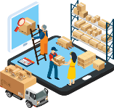

01
  Timeline
    ’21.07.
    ’21.10.
    ’21.10.
    ’22.01.
    ’22.02.
    ’22.03.
    ’22.04.~06.
    ’22.07.
    ’22.08.
1st selection for the Demonstration Support Project on Digital Logistics by the Ministry of Land, Infrastructure and Transport (3.4)
(KRW 2 bn)
2nd selection for the Demonstration Support Project on Digital Logistics by the Ministry of Land, Infrastructure and Transport (4.21)
(KRW 950 mn)
Establishment of an implementation plan to establish the base for smart city logistics in Seoul
Notice to recruit participating institutions
(4.21~6.17)
- Delivery : None registered
- Market: 8 registered
Discussion on detailed project and adjustment of budget
Establishment of the 『Master Plan for the consumer logistics system of Seoul』
2nd Notice to recruit participating institutions
((7.15~7.19)
- 7 institutions
applied
- 3 institutions finally selected
Basic plan to set a base for smart city logistics
Secure municipal budget
KRW 3.3 bn in total
Notice to recruit institutions in Seoul (1.28~2.11)
joint Distribution
in Our Neighborhood

Slide 17

02
  Smart city logistics logo for Seoul
Logo created to enhance the awareness of citizens
  Create and utilize an integrated logo for Seoul to encompass the identity of each business
  Planning to promote the policy by seeking various utilization methods such as external promotion material, signboard and packaging materials
  Scale out application to 3rd project, 4th project and so forth when expanding the scope of business in the future
joint distribution in our neighborhood
Significance
Slogan for Seoul ‘Donghaeng (Together) Seoul’
Portrays the image of an electric vehicle, which is an eco-friendly means for delivery
Yellow signifies warmth and blue signifies growth

Slide 18
Ⅴ
C/H/A/P/T/E/R
Project plan
2022 Report on the Start of the
Demonstration Project on Digital Logistics Service
for the Ministry of Land, Infrastructure and Transport

Slide 19
Establishment of the
Joint Distribution Center
in Our Neighborhood
01

Slide 20
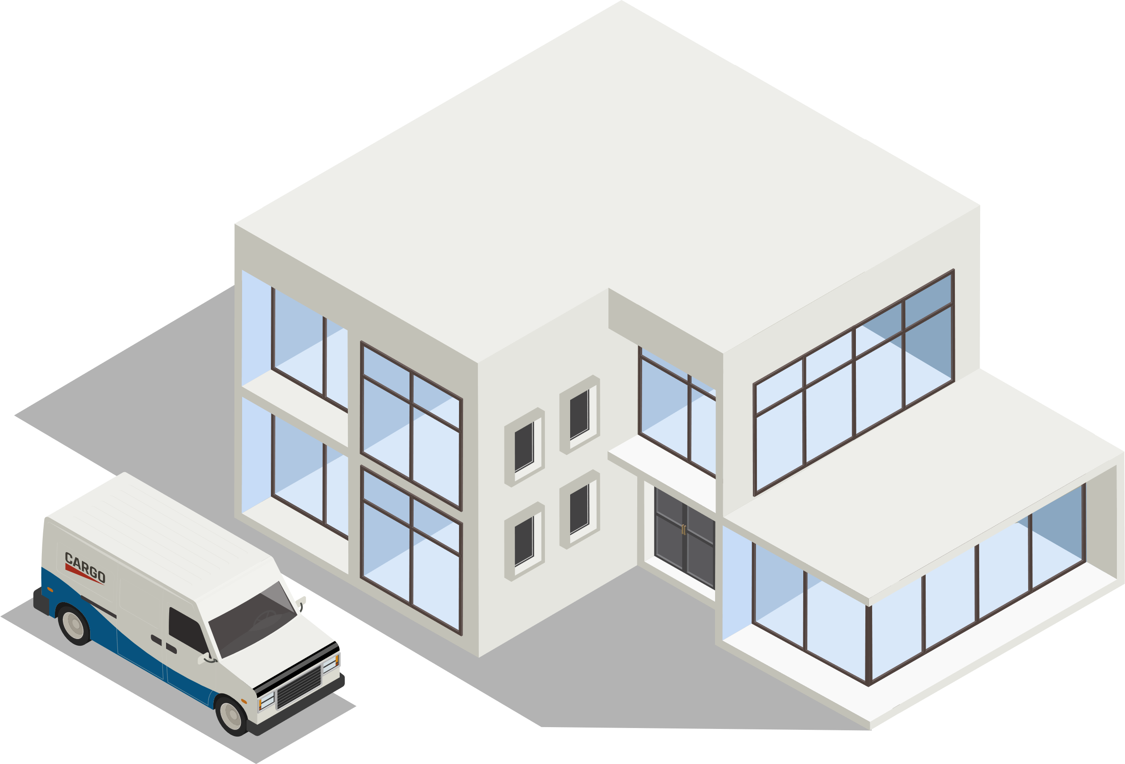
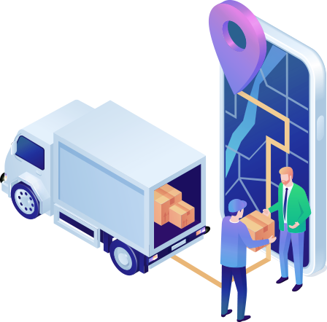

01 Joint Distribution Center in Our Neighborhood
02 Express delivery in our market
03 Complex logistics of gas station
01
  Background
Current delivery shipment structure (Goods delivered by visiting each consumer by courier company)
has limits in efficiently processing the recently surging volume of consumer delivery
    Joint Distribution Center
Increase in volume (driving distance) leads to increase in work
load of delivery drivers and causes transportation/environmental issues
  “50% increase in deaths caused by delivery trucks” due to an increase in delivery volume in ‘21
Increase in use of delivery induces the need for a service in which
consumers can receive delivery at the desired time,
while ensuring safety from crimes related to parcel delivery
with
Need a paradigm shift for the consumer logistics delivery system
Pursue a pilot ‘Joint Distribution Center in Our Neighborhood’
* Source: 서울시 교통 통계(’21)

Slide 21
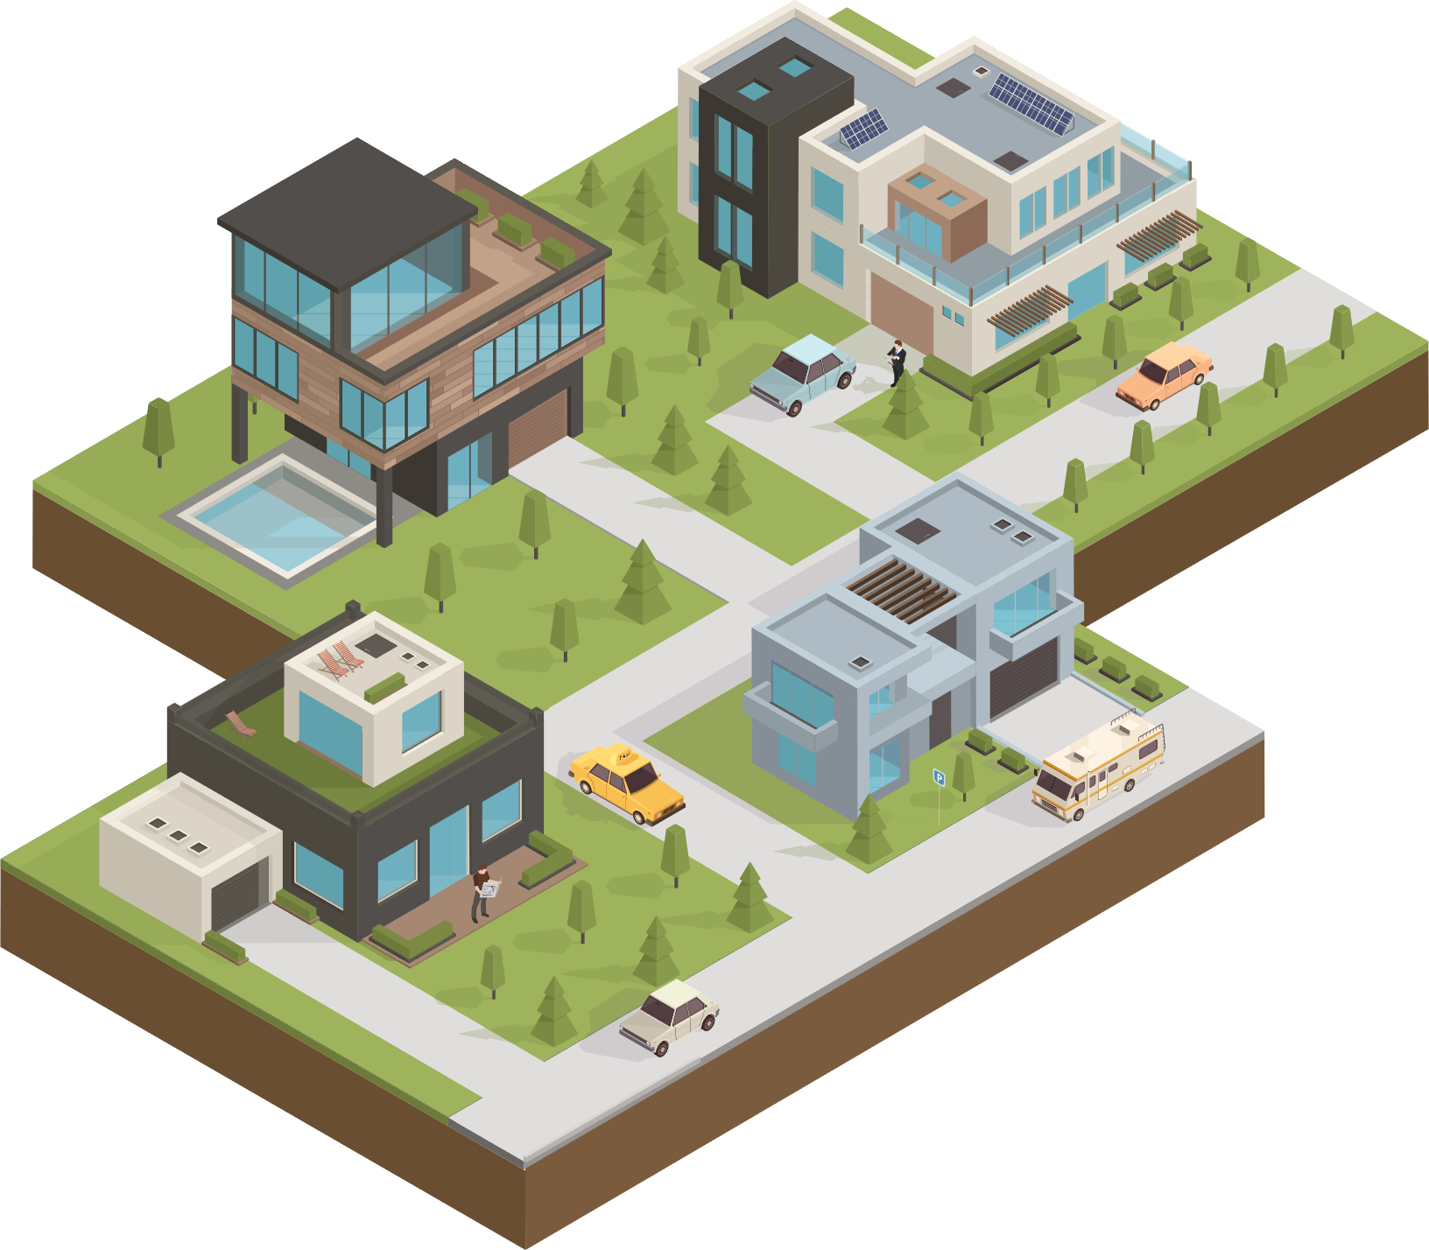
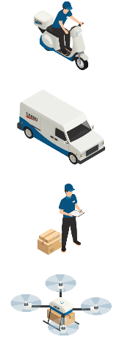
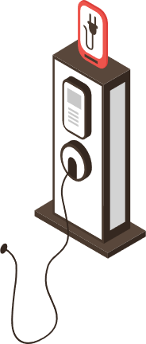

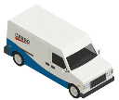


02
  Concept of the Joint Distribution Center in Our Neighborhood
What is the Joint Distribution Center in Our Neighborhood?
  It is the “Delivery base for consumer logistics in the city” that gathers all of the deliveries of the courier companies in one place and hires youths in the region (regional job creation) to comprehensively deliver the parcels to the homes of the consumers at the desired time
    Joint Distribution Center

Slide 22
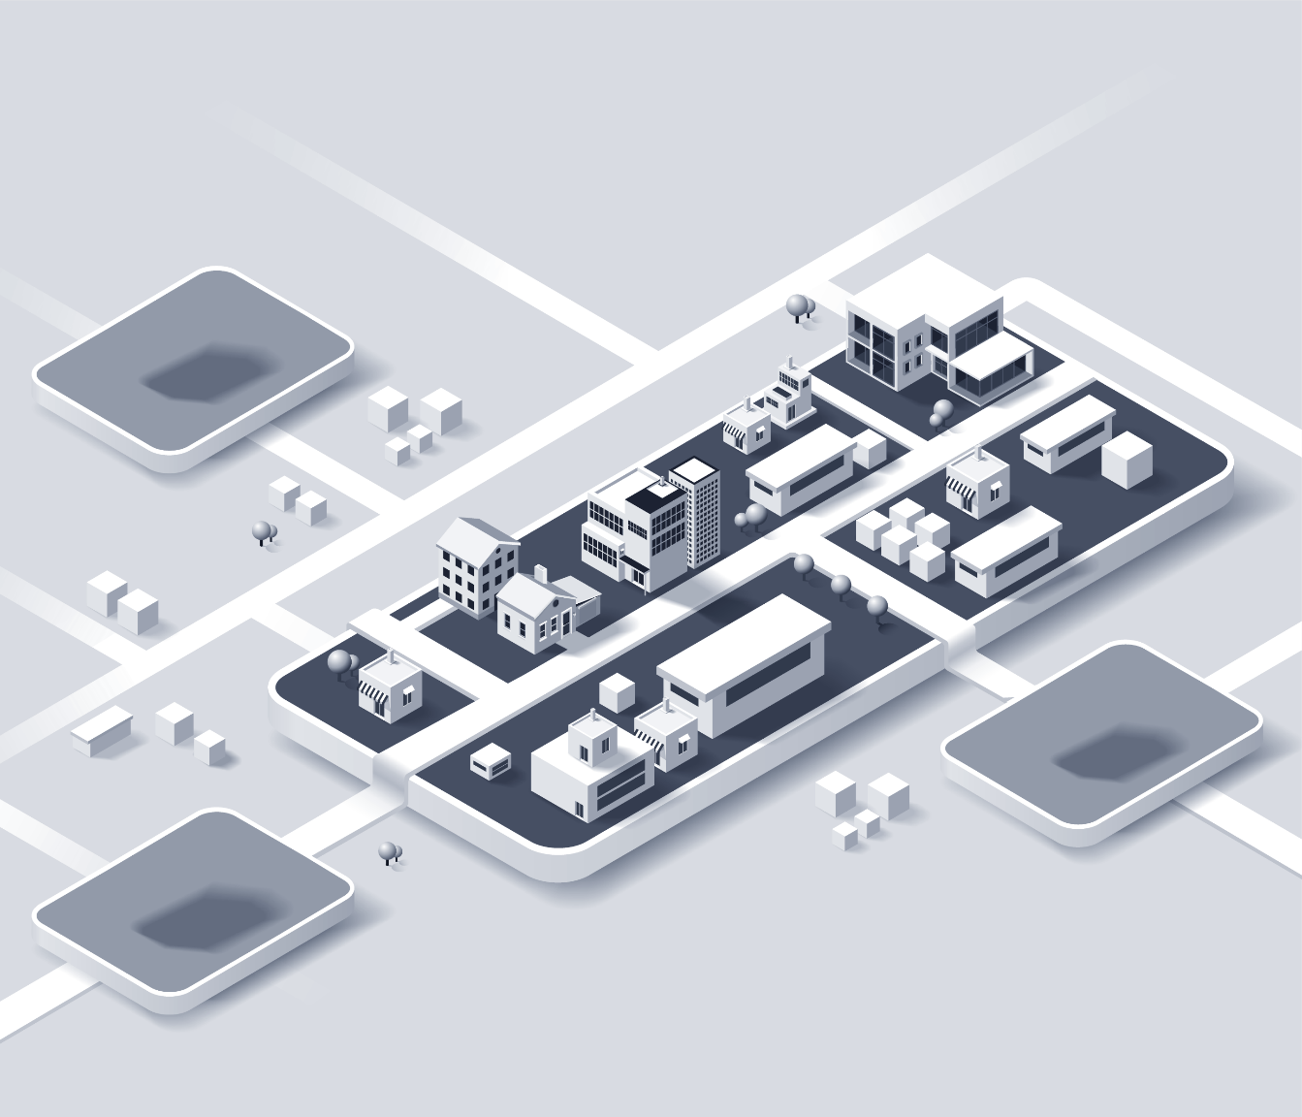


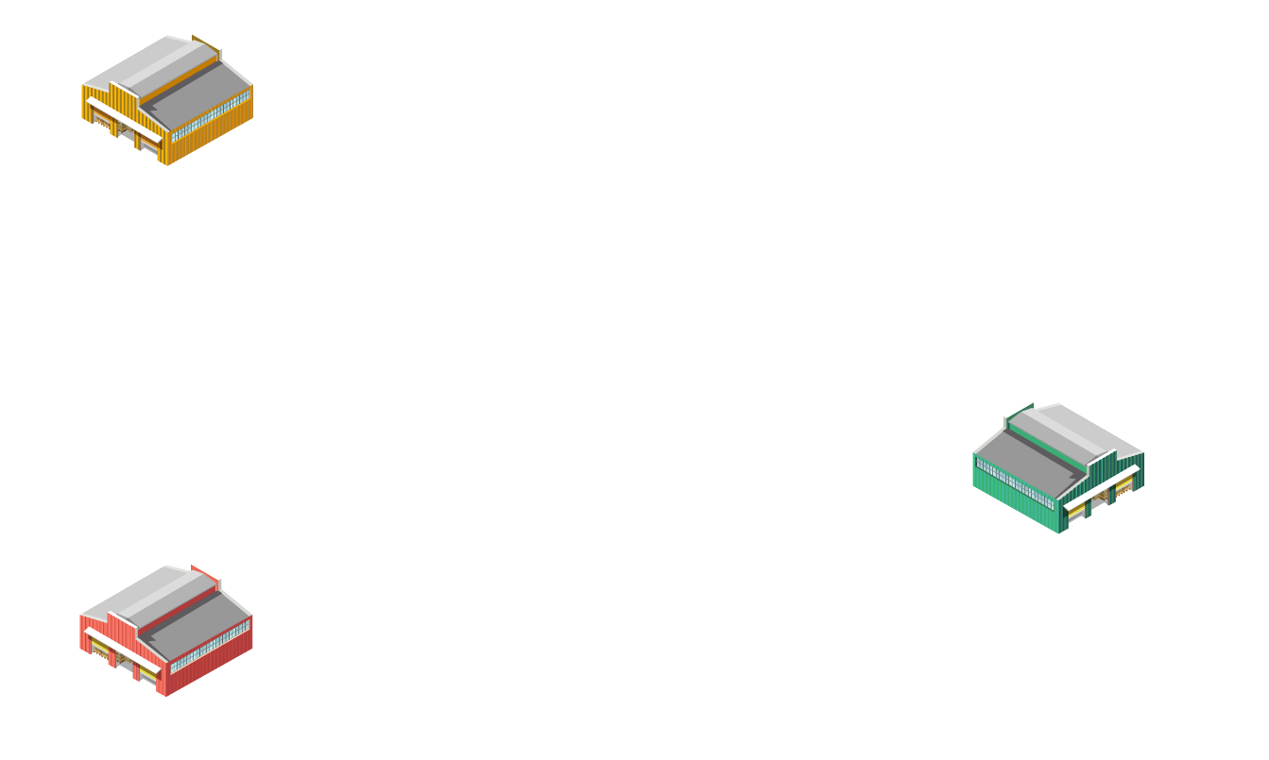

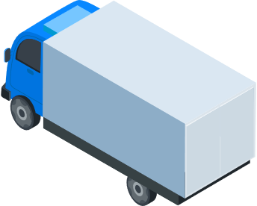
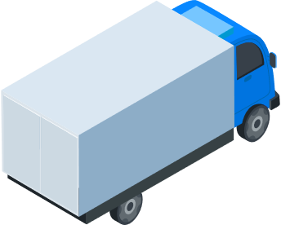
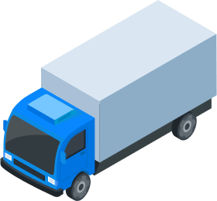







03
  Projected change in the delivery system
To - Be
As - Is
Integrated/comprehensive
delivery
Delivery traffic congestion
by courier company
Courier company C
    Joint distribution센터
Courier company C
Courier company B
Courier company B
Courier company A
Courier company A
Smart Eco
Mobility

Slide 23
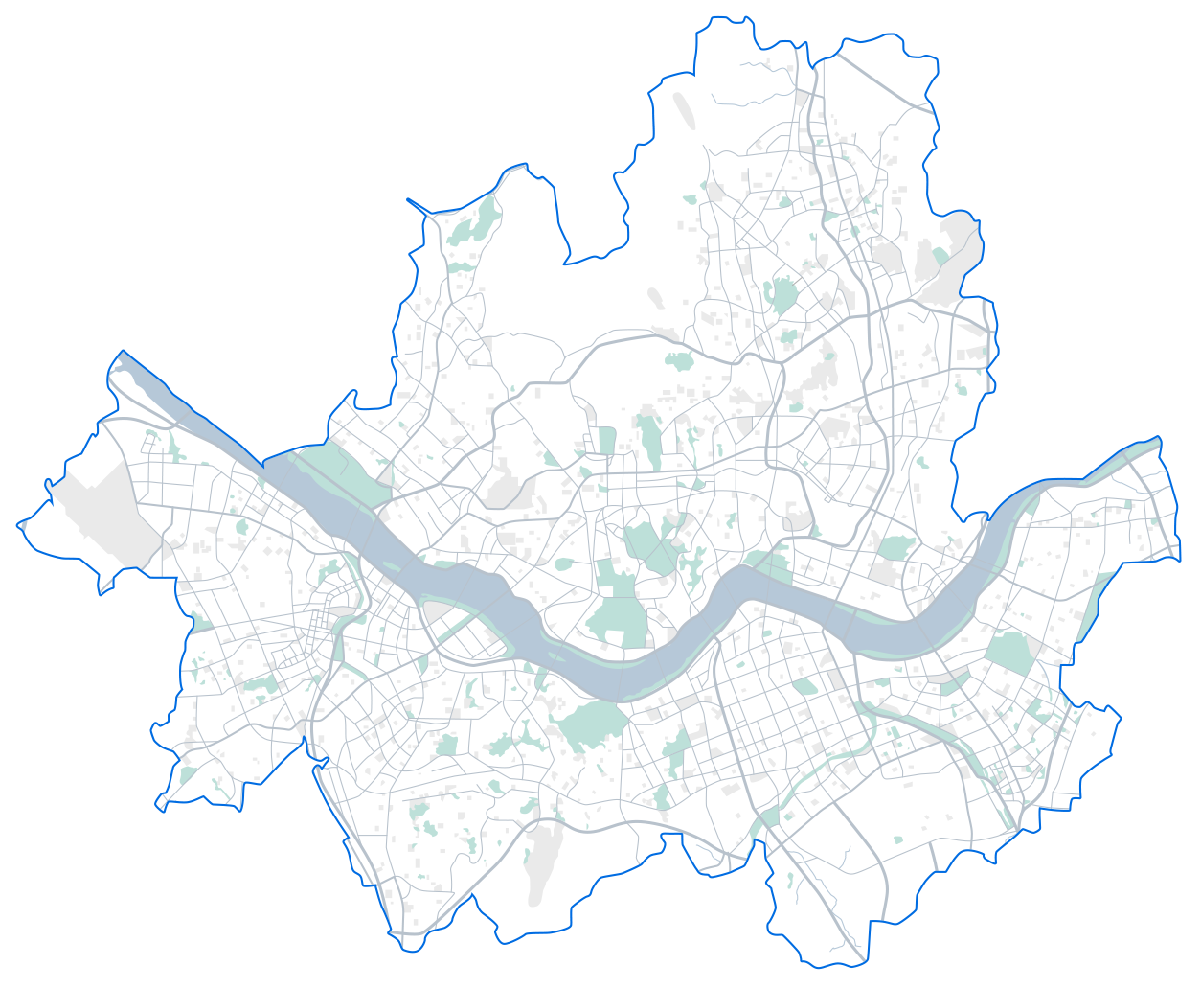
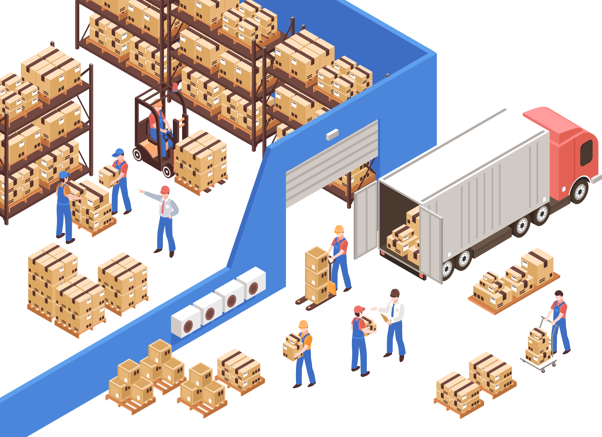


04
  Project overview and implementation system
Project overview
Location of establishment
3 centers (Yangcheon-gu, Geumcheon-gu, Gangdong-gu)
Details of demonstration
Establish the Joint Distribution Center for consumer logistics and consolidate the deliveries of each courier company into 1 center to deliver comprehensively
Budget
KRW 3.1bn (National expense KRW 1.55 bn, City expense KRW 1.55 bn)
(Sep~Nov) Establish → (Dec~) Operate
  ※ Demonstration period: Demonstrate for 2 years after establishment (~’24.12.)
Timeline
  Project implementation system
  Support purchase of eco-friendly vehicles, expense for establishing the facility, and so forth
  Manage and supervise the operating institution
  Evaluate the demonstration project and review performance
City of
Seoul
  Establish the Joint Distribution Center
  Operate the Joint Distribution Center including hiring and
  management of delivery personnel
  Secure resource for operation (delivery fee, and etc.)
Operating
institutions
  ※ Select the operating institutions (Jul ’22) : Robin, Korea Postal Service Agency, Wonders

Slide 24


05
  Progress so far
Progress of the project
2021
10.
  Establishment of the basic plan to establish a base for smart city logistics in Seoul
2022
01.28.
  Establishment of an implementation plan to establish a base for smart city logistics in 2022 (Policy to implement city transportation)
03. ~ 04.
  Selection and participation in the demonstration support project on digital logistics by the Ministry of Land, Infrastructure and Transport (Secured KRW 2.95 bn in National expense (KRW 800 mn for our market))
  ※ Joint Distribution in Our Neighborhood: Not registered
04. ~ 06.
  Public recruitment of institutions to pursue the project for the autonomous district
06.29.
  Change in the plan on the establishment of the Joint Distribution Center in Our Neighborhood
  (Change in the entity participating in the project : (Before) Autonomous district → (After) City of Seoul )
06.30. ~ 07.14.
  Public notice for institutions to participate (private) in the establishment of the Joint Distribution Center in Our Neighborhood
  ※ Registration of 7 institutions
07.15.~19.
  Site evaluation of participating institutions for the establishment of the Joint Distribution Center in Our Neighborhood
07.22.
  Selection of participating institutions for the establishment of the Joint Distribution Center in Our Neighborhood
  (3 institutions)
07.22. ~
  Discussion on budget and project plan with participating institutions
08.26.
  Finalization of the project budget by participating institutions

Slide 25
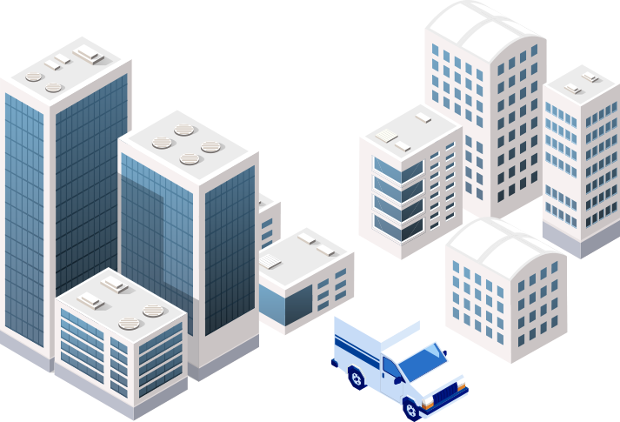
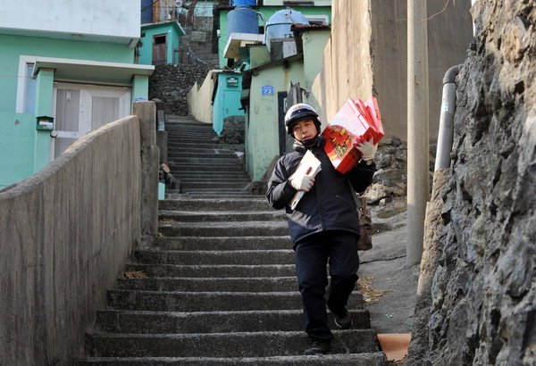
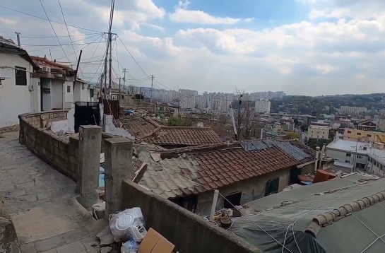
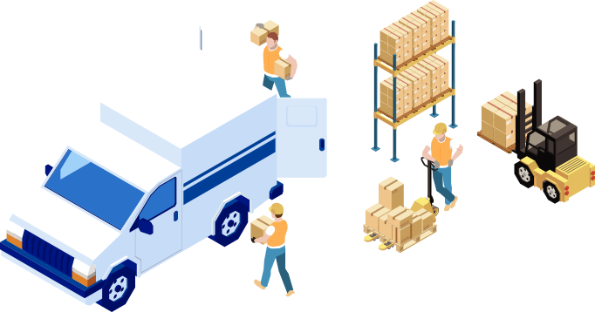
06
  Criteria for establishment and details
  Conditions for establishment
  Establishment principle: First support establishment in regions with difficulty in delivery while demonstrating various regional models
  Size & location
  Space in idle private buildings (lease, and etc.) where 330㎡(100 pyeong) of floor area can be secured
  ※ Secure entrance/exit pathway for freight trucks and parking space for freight trucks
  Types of region
  First support establishment in regions with difficulty in delivery while demonstrating various regional models
  (Regions with difficulty in delivery) Regions where delivery drivers tend to avoid because it is difficult for trucks to access
  (Regions with delivery conflicts) Regions with conflicts between residents-courier companies
  (Regions requiring joint distribution), and etc.
  Types of space
  Regions that can enable delivery and collection of items based on relevant schemes
  (Private idle space) Facilities including private logistics warehouses that can be secured through lease and such

Slide 26
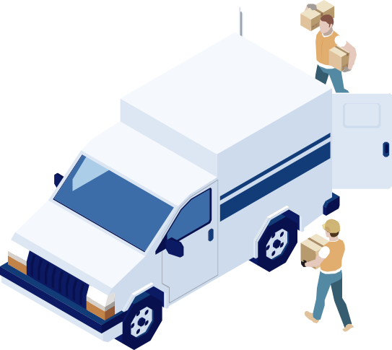


07
  Guideline on establishing the Joint Distribution Center in Our Neighborhood for Seoul
  Operating condition
Condition for
joint distribution
  Consolidation of delivery volume from at least 3 couriers and distribution companies
  Include at least 2 from 5 companies, CJ, Hanjin, Lotte. Logen, and the post office
  * Distribution company (E.g.,): Coupang, Market Kurly, SSG, and etc.
  Cost of adopting delivery means such as electric delivery vehicles, expense to establish the joint distribution facility, and etc.
  Provide support on the lease when using private buildings during the project period
  Labor cost on the delivery personnel and such are covered with own operating profit
  - Pursue project so that the project can continue to operate without separate budget even after the demonstration period
Details of
budgetary support
Joint distribution
Construct an integrated delivery system (At least 3 companies)
Jobs
  Use regional employment of youths, middle aged residents, senior residents, and etc.
Details of
operation
  Link to pilot project in line with the regional characteristics such as care delivery and support for safe transaction of secondhand goods
Relevant projects
Eco-friendly logistics
  All delivery vehicles should consist of electric vehicles, and eco-friendly delivery system should be operated such as collection of multi-use containers
Performance
management
Manage performance by sharing data and evaluating for 2 years after establishment

Slide 27
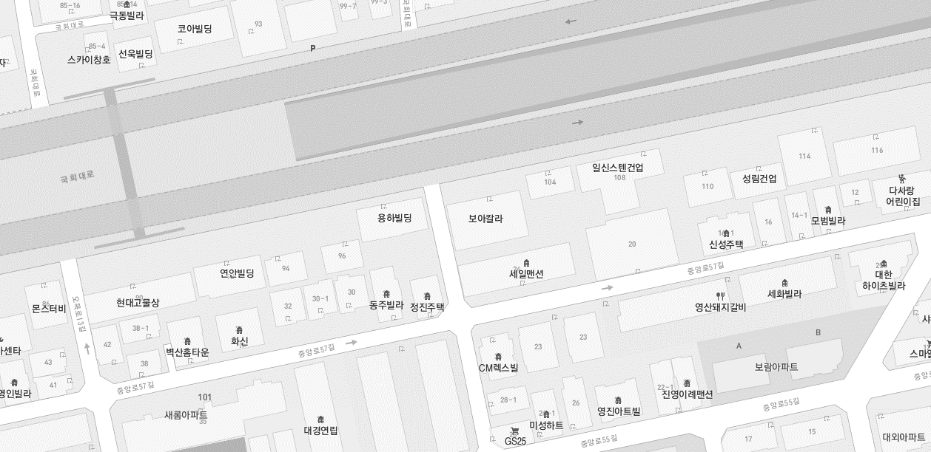
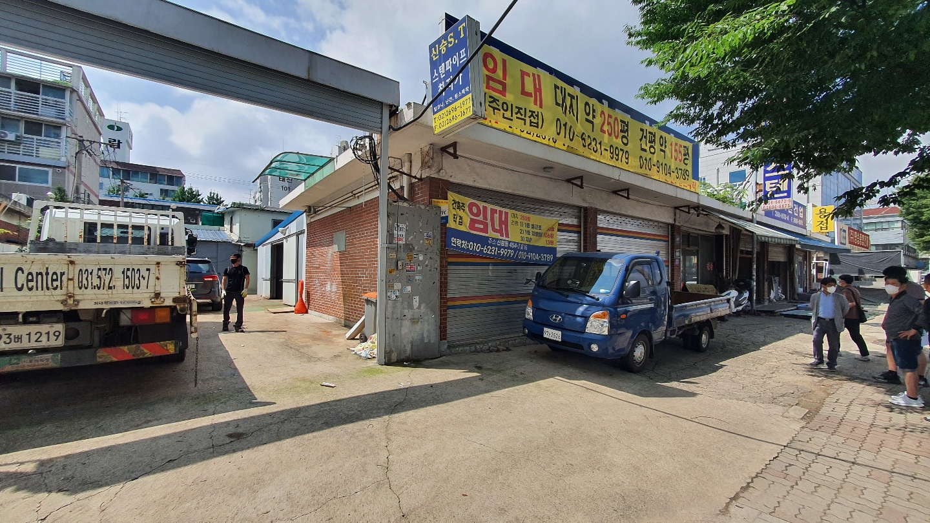
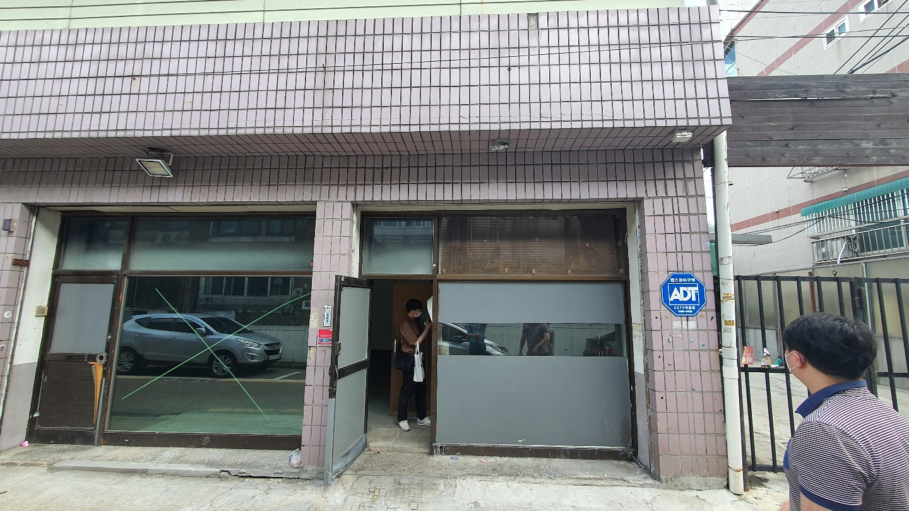
08
  (Yangcheon-gu) Establish a regional integrated delivery base within regions with difficulty in delivery
Location of site
Panoramic view of site
  Gukhoe-daero
  Base
Address
Gukhoe-daero 108, Yangcheon-gu
Vehicle purchase
KRW 6 mn
Floor area
778.8㎡
Individual
National
KRW 7.5 mn
Remodeling cost
KRW 4 mn
National
Surrounding roads
Two-way 8 lane road
Budget
(proposed)
City
KRW 7.5 mn
Facility lease
KRW 3.5 mn
Parking space
Can park around 10 trucks within the site
Individual
KRW 6 mn
Logistics equipment
KRW 1.5 mn
City
Delivery demand
Approx. 290,000 households in Yangcheon-gu region
KRW 6 mn
KRW 21 mn in total
Individually responsible
- 20 EV freight trucks
Target households for delivery in 2H of ’24
72,000

Slide 28

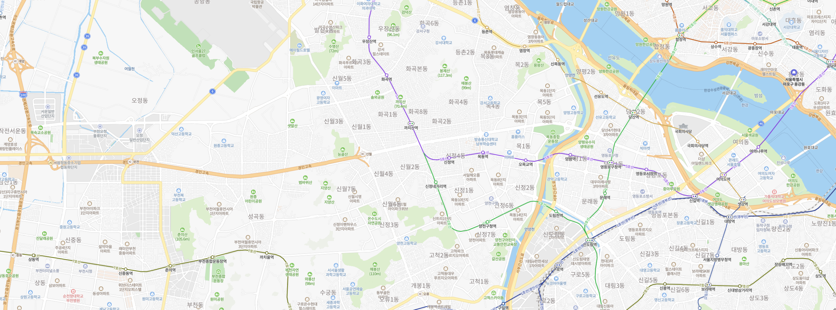
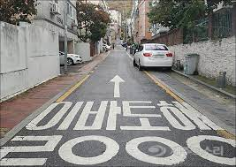
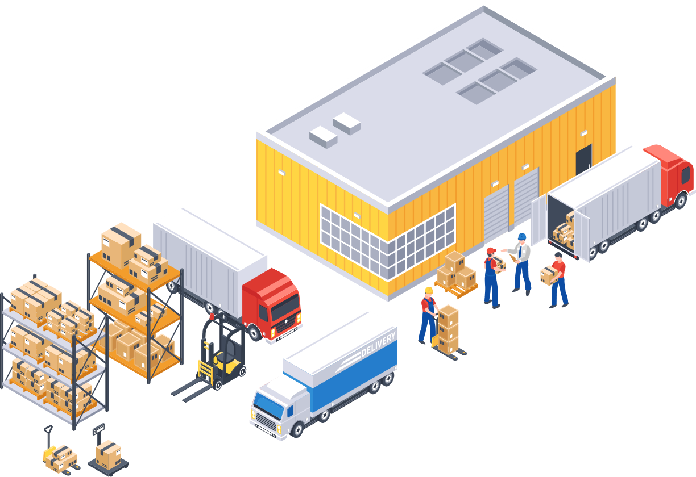

08
  (Yangcheon-gu) Establishment of the integrated regional delivery base within a region with difficulty in delivery
  Analysis on project site
In case of Yangcheon-gu, there are many narrow roads and one-sided roads, which causes traffic jams
and thus, enhancements should be made through joint distribution
Yangcheon Joint Distribution Center has
the optimal conditions for gathering logistics and moving vehicles
  Easy to gather logistics because it is the center of forwarders such as CJ Logistics
  It is easy for freight vehicles to enter because it is located on the side of a two-way 8 lane road
  Excellent accessibility because it is located on the roadside, nearby Shinwol IC, Seobu Expressway and Airport Expressway
  Securing passage way for vehicles: Can enter the two-way 8 lane road right away through the Joint Distribution Center
    양천
    Joint distribution 센터
  Yangcheon Joint Distribution Center

Slide 29
08
  (Yangcheon-gu) Establishment of the integrated regional delivery base within regions with difficulty in delivery
Detailed operation plan
 |  | Within ’23 | Within ’24
Size of manpower |  | Delivery drivers 30 | Delivery drivers 40
Operating hours | Delivery receipt and sorting | 8:00~10:00
 | Delivery time | 8:30 ~17:00 ※ Separately hire personnel for sorting, and sort between 8~10 am
Size of vehicle |  | Operate 40 in total Separately purchase 20 individually purchased vehicles and 20 vehicles supported by City of Seoul
Delivery region |  | 72,198 households including 15-dong in Yangcheon-gu
Additional service |  | Collection of multi-use containers (’23~) Collection of laundry in the region Linked to services that are closely related to living such as regular delivery of home meal replacements
Delivery region
  Yangcheon Joint Distribution Center
  Yangcheon Joint Distribution Center

Slide 30



09
  (Geumcheon-gu) Demonstration of joint distribution within the idle space in the post office
Location of site
Panoramic view of site
  286-9
  Geumcheon Post Office Intersection
Address
286-9, Doksan 4-dong, Geumcheon-gu, Seoul
Vehicle purchase
KRW 0.5 mn
Floor area
548㎡ for 3 stories and parking/unloading area
Individual
Remodeling cost
KRW 2 mn
National
KRW 3.75 mn
Facility lease
KRW 2 mn
National
Surrounding roads
Two-way 10 lane road
Budget
(proposed)
City
KRW 3.75 mn
Logistics equipment
KRW 1 mn
Parking space
Can park 2 or more cars using the parking lot
inside the Geumcheon Post Office
Individual
KRW 1.87 mn
Promotion expense
Dev’t expense
KRW 2 mn
City
KRW 1.87 mn
Delivery demand
Approx. 80,000 households in the Geumcheon-gu region
-
Labor cost for pursuing
the Joint Distribution Project by
Korea Postal Service Agency
Individually responsible
Target households for delivery in 2H of ’24
60,000 households
KRW 9.37 mn in total

Slide 31

09
  (Geumcheon-gu) Demonstration of joint distribution within the idle space in the post office
  Analysis of the project site
Can achieve highly efficient project as it is a densely populated region
Many cases of traffic congestion due to public facilities and characteristics of industrial base
  Population density as compared to area of 25 autonomous districts in Seoul (8th as of ‘20)
  Region concentrated with urban sprawl such as multi-unit, multi-household homes around industrial regions
  Most of the mountainous regions are Green Belt areas
  Approx. 38% of the total population work in industrial complexes
  Connected to Seohaean Expressway, Gangnam Beltway and Seobu Expressway, and the traffic congestion is the highest in Seoul
  According to the status of resident registration for more than ½ of the delivery targets that reside in type 1-3 general residential areas (22.06), 230,000 reside in multi-unit homes/apartments
  Can visualize the business impact with high density in delivery region as compared to the size of the region
  Low population density centered on industrial complex
Gasan-dong
Doksan
3-dong
  Concentration of industrial workers in 20s and 30s
Doksan
4-dong
  High population density centered on residential areas
Optimal internal/external shipping conditions in overall shipping for the Joint Distribution Center
Doksan
1-dong
Doksan
2-dong
Siheung
4-dong
Siheung
bon-dong
Immediate utilization
  Can immediately carry out a project with the idle space in Geumcheon Post Office, and there is no need to alter the purpose of use as it is an existing logistics facility
  High number of households as compared
  To low population density
Siheung
1-dong
Siheung
2-dong
Siheung
5-dong
Logistics infrastructure
  Can utilize departure and arrival, freight vehicle parking lot, freight elevators and such that are used for existing logistics by the post office
  [ Population density (Total density) ]
Siheung
3-dong
  Less than 100/ha
Securing vehicle passageway
  Can enter the two-way 10 lane road right away through the Joint Distribution Center
  100 ~ 200
  200 ~ 300
  300 ~ 400
  400/ha or more

Slide 32




09
  (Geumcheon-gu) Demonstration of joint distribution within the idle space in the post office
Detailed plan
Delivery region
Delivery region
 |  | Within ’23 | Within ’24
Size of manpower |  | Delivery drivers 16 | Delivery drivers 30
Operating hours | Volume receipt and sorting | 8:00 ~ 10:00
 | 1st delivery | 10:00 ~ 14:00 (Including 1 hour lunch)
 | 2nd delivery | 15:00 ~ 17:00
 | Delivery time | Close registration at 5pm and process same-day delivery based on the time in which the partner courier company receives the goods
Size of vehicle |  | 2 cars purchased with support from City of Seoul & individual businesses recruited | Purchase electric, low-floor van truck as a result of increase in volume (Individually responsible)
Delivery region |  | 79,710 suites including apartments and houses in Geumcheon-gu
Additional service |  | MFC for small businesses and care delivery for the vulnerable class in the region (~50)
Establishment plan
  Procurement bidding on facility construction, asset purchase, and etc.
  Contract with space remodeling and interior company
  Spatial design/facility construction (Restrooms, heating/cooling, and etc.)
  Construction of electricity/firefighting/network equipment
  Installation of logistics facility for joint distribution (3rd floor)
MFC
Load/sorting site
  Sep ’22
  Oct ’22
  Nov ’22

Slide 33


10
  (Gangdong-gu) Demonstration of integrated eco-delivery
Location of site
Panoramic view of site
  501-5
  Kwangmoon High School Intersection
Address
501-5, Godeok-dong, Gangdong-gu, Seoul
Vehicle purchase
KRW 0.8 mn
Individual
Remodeling cost
KRW 1 mn
Floor area
180㎡ for 1 story and parking/unloading space
National
KRW 4.25 mn
Facility lease
KRW 3 mn
Surrounding roads
Two-way 6 lane road
Budget
(proposed)
National
City
KRW 4.25 mn
Logistics equipment
KRW 1.2 mn
Parking space
Can park 3 cars using the parking lot in the building
Individual
KRW 2.12 mn
Labor cost
KRW 2 mn
City
Promotion expense
KRW 0.5 mn
Delivery demand
Approx. 9,000 households
KRW 2.12 mn
9,000 households
KRW 10.62 mn in total
Individually responsible
-
Cost to use electronics, develop application, and etc.
Target households for delivery in 2H of ’24

Slide 34



10
  (Gangdong-gu) Demonstration of integrated eco-delivery
  Analysis of the business site
Park-type apartment
Has the optimal internal/external condition across the overall shipment for the Joint Distribution Center
Accessibility to location
  Can support same-delivery and immediate delivery in areas that are near the regions targeted for delivery
  Within 1km radius of Godeok Gracium
  Within 200m radius of Godeok I’Park
Dongnam-ro 81 gil 8,
Gangdong-gu, Seoul
Securing traffic route
  Can enter directly into a two-way 6 lane road from the Joint Distribution Center
  Joint distribution
  District 2
  Joint distribution
  District 1
  Joint distribution
  District 3
There is a need for the project from the perspective of delivery drivers and residents because this is an area where courier delivery conflicts persist due to park-type apartments, and etc.
  Region with persistent courier delivery conflicts because delivery trucks are prohibited from entering the 1st floor
  Can enhance the convenience for the delivery drivers and elevate efficiency of delivery through joint distribute in order to resolve issues of health and low delivery efficiency with existing low floor box trucks

Slide 35

10
  (Gangdong-gu) Demonstration of integrated eco-delivery
Detailed operation plan
Delivery region
 |  | Within ’23 | Within ’24
Size of manpower |  | Delivery drivers 12 | Delivery drivers 18
Operating hours | Receipt | 11:00 ~ 12:00 Incoming vehicles from each courier company
 | Unpacking/Repacking | 12:00 ~ 14:00
 | Delivery | 14:00 ~ 17:00 Delivery to each household (2 delivery trucks)
 | Collection | 22:00 ~ 01:00 Collection of eco-box & recycle bag
 | Sorting of recycled items | 01:00 ~ 04:00 Sort recycled items at a certain space
 | Recycled items discharged | 15:00~17:00
 | Delivery time | Close registration for receipt of delivery for collaborating courier companies at 5 pm and process same-day delivery
Size of vehicle |  | 3 cars purchased with support from City of Seoul & individual businesses recruited | Purchase electric, low-floor van truck as a result of increase in volume (Individually responsible)
Delivery region |  | 4 apartment regions such as Godeok I’Park in Gangdong-gu (9,000 households)
Dongnam-ro 81-gil 8,
Gangdong-gu, Seoul
  Joint distribution
  District 2
  Joint distribution
  District 1
  Joint distribution
  District 3
Establishment model (Proposal)
  Contract with space remodeling and interior company
  Spatial design/facility construction (Restrooms, heating/cooling, and etc.)
  Construction of electricity/firefighting/network equipment
  Installation of logistics facility for joint distribution
  ’22년 11월
  Sep ’22
  Oct ’22
  Nov ’22

Slide 36







10
  (Gangdong-gu) Demonstration of integrated eco-delivery
Eco-delivery process
Delivery
Collection
Arrival of parcels from each courier company
Unpacking
Integrated delivery through eco-box
Recycling of delivery box, and etc.
Delivery drivers collect and recycle items when eco-box or recycling boxes filled with recycling items are placed outside

Slide 37
11
  Achievement target (KPI)
Category | Name of institution | `22 | `23 |  | `24
 |  | Q4 | 1H | 2H | 1H | 2H
Daily delivery volume (Number) | Robin | 1,050 | 5,300 | 9,500 | 10,500 | 12,700
 | Korea Postal Service Agency | 500 | 1,500 | 3,000 | 4,500 | 6,000
 | Wonders | 1,000 | 2,000 | 7,000 | 9,000 | 9,000
Total |  | 2,550 | 8,800 | 19,500 | 24,000 | 28,000
Number of delivery households (Number of households) | Robin | 40,200 | 45,200 | 50,200 | 61,200 | 72,200
 | Korea Postal Service Agency | 5,000 | 15,000 | 30,000 | 45,000 | 60,000
 | Wonders | 1,100 | 6,100 | 9,700 | 9,700 | 9,700
Total |  | 46,300 | 66,300 | 89,900 | 115,900 | 142,000
Future plan
Year | Details
2023 | Analysis and evaluation of business performance (site evaluation, ad-hoc evaluation) * Formation of an expert evaluation group
2024 | Additional establishment of Joint Distribution Center (2~4 centers)
2025 | Additional establishment of Joint Distribution Center (2~4 centers)
Achieve integrated delivery of 28,000 parcels in a day to 140,000 households within the demonstration period
Notes:
KPI 표 수정 및 향후계획 추가

Slide 38

12
  Expected effect
Category | As of 1H of ’22 | End of ’23 |  | End of ’24 |  | Improvement in efficiency (As of end of ’24) | Remarks
 |  | Existing method | Joint distribution | Existing method | Joint distribution
No, of delivery drivers (No. of delivery trucks) | 36 | 102 | 57 | 145 | 88 | 40% | -
Delivery volume per truck | 240 | - | 310 | - | 310 | 30% | Based on robin
Delivery time per delivery driver | 13 hours | - | 8 hours | - | 8 hours | 40%
Total daily mileage of the delivery vehicle | - | 180km | Max. 90km | 250km | Max. 120km | 50%
Total daily CO2 emission in the region | - | 1.2kg | 0 | 1.77kg | 0 | 100%
40% improvement in delivery efficiency, 40%↓in working hours of delivery drivers, 50%↓in vehicle mileage, 550kg↓in annual CO2 emission
  Resolve transportation, safety and environment issues
  Enhance efficiency of city logistics
  Improve working condition of delivery drivers
  Enhance convenience for residents

Slide 39
13
  Monthly agenda
    ’22.07.
    ’22.08.
    ’22.09.
    ’22.10.
    ’22.11.
    ’22.12.
    ’23.01.
    ’23.02.
    ’23.03.
    ’23.04.
    ’23.05.
    ’23.06.
Link to Ministry of Land, Infrastructure and Transport
Set budget
Prepare for demonstration
Execute demonstration
Evaluate demonstration
Report session on the
start of project
Distribute subsidy of the Ministry of Land, Infrastructure and Transport
Reflection of
national/city budget
1st execution of budget
2nd execution of budget
Discussion about the budget
Sign agreement
Establish project plan
Establish the joint distribution center and build a system for joint distribution
Execute joint distribution ('22.11~'24.12)
1st evaluation
Settle budget
2nd evaluation of project
& satisfaction survey

Slide 40
Ⅵ
C/H/A/P/T/E/R
Future plan, and etc.
2022 Report on the Start of the
Demonstration Project on Digital Logistics Service
for the Ministry of Land, Infrastructure and Transport
Notes:
챕터6로 변경 필요

Slide 41
01
01
  Future plan
    ’22.09.
    ’22.10.
    ’22.11.
    ’22.12.
    ’23.~ 24.
Distribute 2nd subsidy
Enter into a supplementary agreement and distribute 1st
subsidy
Complete the Joint Distribution Center and start operating joint distribution
Expand the target of project after validating the performance until ’23
Establish the Joint Distribution Center
joint Distribution in
Our Neighborhood

Slide 42
Demonstration Support Project on Digital Logistics Service for the Ministry of Land, Infrastructure and Transport
  Thank you
2022 Report on the Start of the
Demonstration Support Project on Digital Logistics Service
for the Ministry of Land, Infrastructure and Transport
Seoul, the city of co-existence, innovation and smart logistics !
Consortium of Seoul × private company

