Slide 1


Building an IRB-mediated Driver Advisory Council
Uber India DAC: First session
23rd March 2022

Slide 2

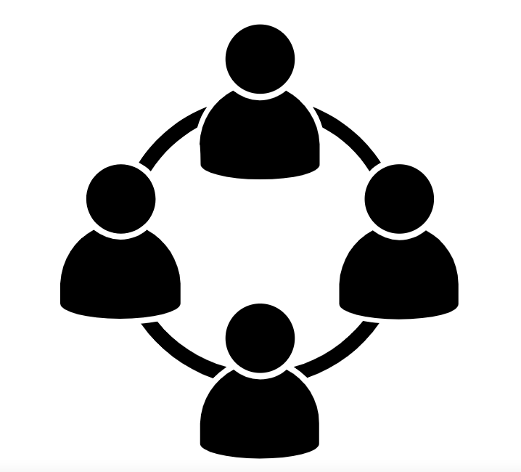
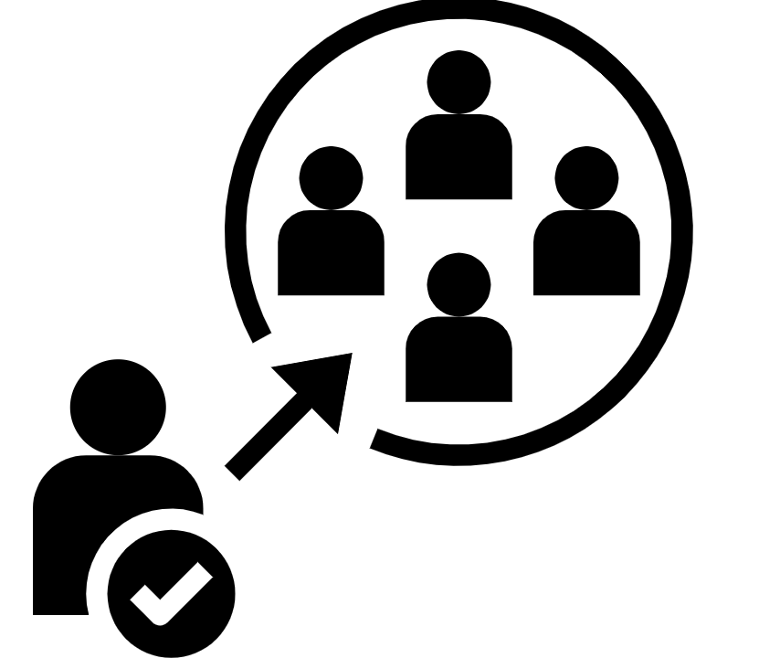
Driver Advisory Council: The what, why and how
What is a Driver Advisory Council?
Why do we need a DAC?
How does it benefit drivers?
DAC is an independent forum for drivers to connect with each other, build a united voice on concerns that affect them and participate in governance of the platform
DAC is a focal point of contact between driver partners and Uber platform, providing a safe space for problem-solving, ideation and strategy development
Driver partners will be able to practice self-governance, discuss critical issues and share feedback with management

Slide 3


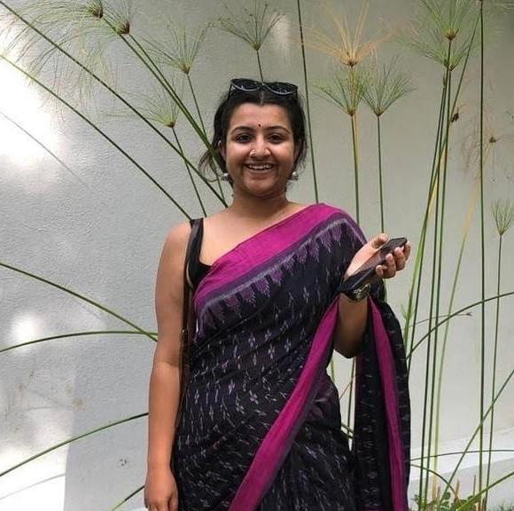
WHO ARE WE?
THE TEAM
Aapti Institute
A public research institution that examines the impact of technology on society and human interactions
We generate insights for policy-making and technology development based on grounded research and analysis
SARAYU NATARAJAN
Founder, Aapti
KANIMOZHI UDAYKUMAR
Data Analyst, Aapti
AAPTI’S ROLE IN THE DAC
Aapti is the independent review board that has shortlisted and selected drivers partners in the DAC. Going forward, Aapti will set the agenda, moderate discussions between drivers and management, and bring out innovative solutions to drivers’ issues
SOUJANYA SRIDHARAN
Research Analyst, Aapti

Slide 4






ENGAGEMENT GUIDELINES FOR ADVISORS
BE PRESENT
RESPECT EVERYBODY
Attend all meetings, to the best of your abilities
Listen to others’ views without hurling insults or rude behavior
ENGAGE ACTIVELY
MAINTAIN CONFIDENTIALITY
Participate in discussions, debate and voting in meetings
Keep the DAC a safe space by upholding trust and privacy
ALL BEFORE ONE
PRACTICE KINDNESS
Prioritize group or collective interests over individual goals
Allow everybody to share their stories, resist temptation to judge

Slide 5






EXCLUSION OF ADVISORS FROM THE COUNCIL
DELISTED ON UBER APP
VIOLATING ENGAGEMENT GUIDELINES
Advisors removed from Uber app can no longer participate in the DAC
Advisors who violate confidentiality and/or exhibit rude behavior will be excluded
WAITLISTED ON UBER APP
ABSENCE FROM MEETINGS
Advisors waitlisted on Uber will be excluded from DAC meetings until their status is resolved
Non-attendance in 2 consecutive meetings, without prior notice, can lead to exclusion
INACTIVE ON UBER APP
PROTECTION FROM DE-PLATFORMING
If Advisor has failed to complete at least 10 trips in the last 60 days, they will be removed from the DAC
Exclusion from the DAC will not automatically lead to
de-platforming from the Uber app

Slide 6


How to reach Aapti
Contact via email
Aapti can be reached on irb.uber@aapti.in. The team will take between 5 – 10 days to reply and is conversant in English, Hindi, Kannada, Telugu and Tamil
Contact via Telegram app
Advisors are encouraged to stay connected with each other and the Aapti team by engaging on the Telegram group

