Slide 1

Lisbon Procurement Planning Platform for Innovation and Sustainability (Lx PPP-IS)
the backbone for a strategic sourcing approach towards sustainability and innovation
Lisbon Municipality
Support Presentation to OPSI - Case Study Submission
October 2022

Slide 2



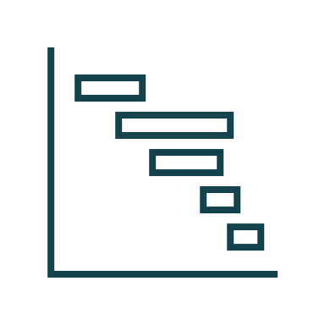


Contents
LISBON PROCUREMENT PLANNING PLATFORM
FOR INNOVATION AND SUSTAINABILITY
Lx PPP-IS
1
2
Procurement Strategy
E-Procurement
3
4
Procurement Planning Platform
Conclusion Remarks

Slide 3



1
Lx PPP-IS
PROCUREMENT STRATEGY

Slide 4

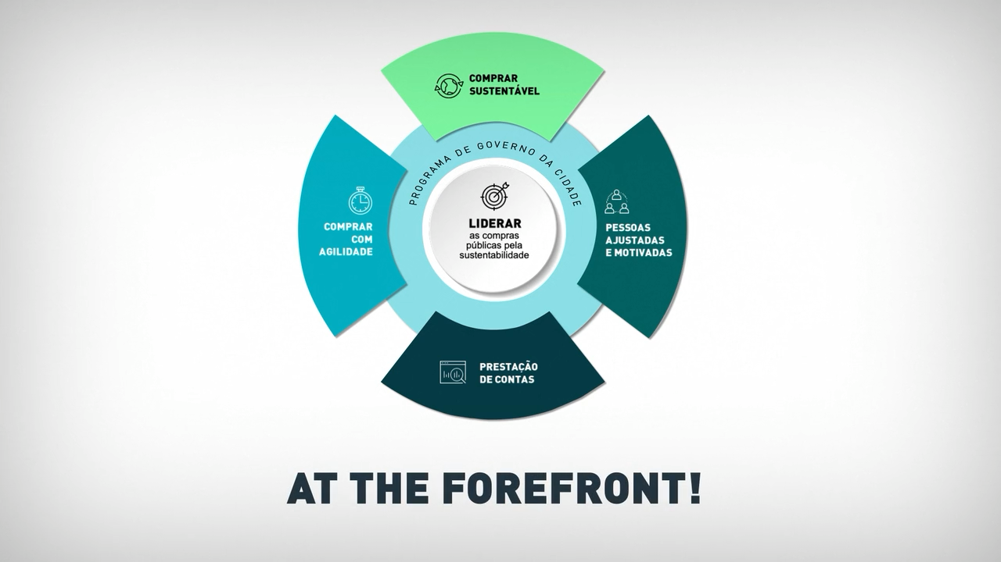



Procurement Planning Platform Procurement Strategy
The Lisbon Municipality Procurement Strategy 2021-2023 aimed to set the foundations for a sustainable procurement focus.
LISBON MUNICIPALITY PROCUREMENT STRATEGY 2021-2023
SUSTAINABLE
PROCUREMENT
TEAM MOTIVATION & CAPACITY BUILDING
PROCUREMENT PROCESS AGILITY
SUSTAINABLE PROCUREMENT LEADERSHIP
ACCOUNTABILITY & TRANSPARENCY
Leading sustainability with Public Procurement

Slide 5
Lx PPP-IS Procurement Strategy
The Digital Strategy is a driver for the Lisbon Municipality Public Procurement Strategy
01
SUSTAINABLE SOLUTIONS
Incentivizing local supply chains
02
PROCUREMENT PROCESS AGILITY
Digital Transformation
LISBON MUNICIPALITY
PROCUREMENT STRATEGY
2021-2023
PP Council
Procurement Planning Platform LX PPP-IS & Budget Planning of Goods, Services and Works
Commitmnent with Sustainability: Lisbon Supplier
Pre-Tendering Procurement Platform
ISO 20400 Sustainable Procurement
Workshops on Sustainability
PP Innovation Lab & Open Innovation Programs with Suppliers
Contract Management Apps
Guidelines for Sustainable PP
Supplier Platform: PP Plan publication, evaluation (inc. sustainability) sustainability; open innovation
SUSTAINABLE
PROCUREMENT
Sustainable PP Event (yearly)
Construction and demolition waste System for public works contracts (sustainability & circularity)
Contract Management Solutions
Portal for Schools
Technical guidance for maintenance and rehabilitation of school buildings.
04
CAPACITY BUILDING
Digital transition, new skills
TEAM MOTIVATION & CAPACITY BUILDING
PROCUREMENT PROCESS AGILITY
Sustainability in Proposal evaluation criteria
SUSTAINABLE PROCUREMENT LEADERSHIP
PP professionals Training Program
03
TRANSPARENCY
Market Opportunities
Procurement Network Portal
Training on new evaluation and award criteria
ACCOUNTABILITY & TRANSPARENCY
Category management dashboard
Sustainable Procurement Training Programs
Savings monitoring and allocation to sustainability projects
Benchmarking
Leading sustainability with Public Procurement
Open Contracting Data Standard (OCDS) Adoption
Technical guidance for Procurement Network focal points
Procurement Reporting (yearly) through Data Analytics
Procurement Network Knowledge sharing events
Data Analytics for PP KPI
New Working Space & Remote Work

Slide 6
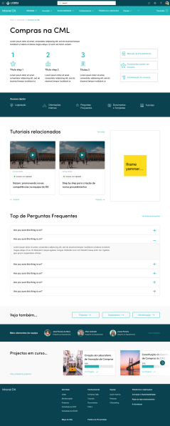
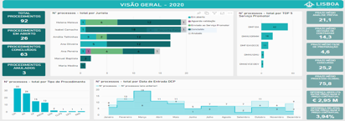
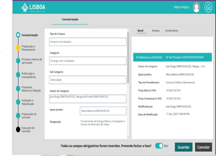
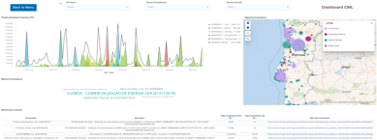
Lx PPP-IS Procurement Strategy
The Digital Strategy is a driver for the Lisbon Municipality Public Procurement Strategy, several digital tools were developed over these 3 years.
Digital Projects Developed / Under Continuous Improvement
Procurement Network Portal (Sharepoint Online)
Procurement Planning Platform LX PPP-IS
Data Analytics for PP KPI (PowerBI)
Apps for Centralized Contracting Support (Microsoft Power Apps)
Data Analytics for Procurement Reporting (with benchmarking)

Slide 7


2
PROCUREMENT PLANNING PLATFORM
E-PROCUREMENT

Slide 8


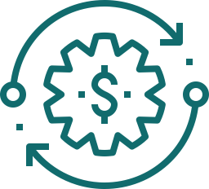




Lx PPP-IS e-Procurement and Digital Transition Strategy
The Digital Strategy for Lisbon Municipality Public Procurement is addressing areas that have insufficient coverage or outdated processes and support tools. Two Platforms are transforming the internal procurement process - Procurement Planning and e-Expenditure - and providing the learning experience on creating an e-procurement life-cycle enablement.
BUDGET & PROCUREMENT PLANNING
PROCUREMENT PROCESS
CONTRACT EXECUTION
REPORTING & PROCUREMENT INTELLIGENCE
Procurement & Budget Planning
Tendering Process
OPEX / Projects & CAPEX
Performance / Outcomes
Re(PLANNING)
Budgeting
Expense and Projects Classification
Financing Sources
CPV / Expenditure Authorisation and budget commitment /Contract Registry, Plans, Warranties
POs / invoices
Settlement and Payment, Asset Registry; Warranties management
(re)Financial Planning
Reporting
Acountability
SGPI (Projects, Assets, GIS); SAP MM; BI (PowerBI)
ACCP; SAP FI E MM; GESCOR e E-doc
ACINGOV (e-tendering); Tribunal de Contas (Audit Court); Portal Base
SAP FI, MM, PS and CO; WEBGEST
E-Invoice ESPAP
SAP PS e CO;
BI - BUDGET;
SGPI
(current projects portfolio)
Lx PPP-IS (PROCUREMENT PLANNING PLATFORM)
E-DESPESA PLATFORM (E-Expenditure Prcocess)
PROCUREMENT ANALYTICS
BUDGETING+ PLATFORM (Piloting SDG, Sustainability and Climate Impact)

Slide 9

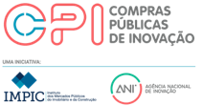
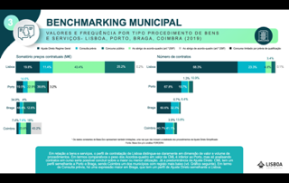
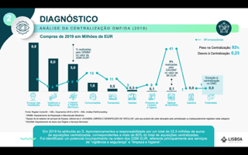


Lx PPP-IS e-Procurement and Digital Transition Strategy
Procurement planning emerged as the critical area to address: balancing strategic sourcing with decentralized purchasing
The Central Purchasing Body (CPB) sets the overall procurement strategy. CPB procures centralized categories, such as Energy, Fuel, Water, Office Supplies, and Transports, and defines if other BUs can act as Centralized Procurement Units for the Municipality (Specialization approach).
Nevertheless, the CPB is responsible for the legal review of all tenders above EUR 75K.
CPB also have a sustainability review aligned with ISO 20400 and an Innovation component aligned with PPI and Open Innovation action plan.
This hybrid approach to procurement allows decentralized procurement through a network of more than 500 procurement-related staff (near 10.000 in total).
Context
Urgency: an excuse to proceed with non-planned procurements;
Complexity of specifications: an excuse for not considering sustainability and circularity in most PP tenders;
Scarce contracting of innovative SMEs and start-ups, and the lead time is one of the vital issues that repulses these economic operators.
Lack of commitment of 1st tier suppliers towards innovation and sustainable supply chain action.
Challenges

Slide 10


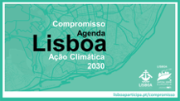
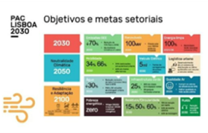




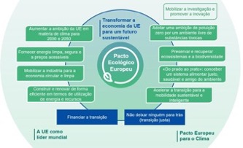

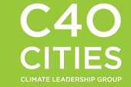
Lx PPP-IS e-Procurement and Digital Transition Strategy
Procurement planning is key for an effective approach to a myriad otargets such as: climate action, carbon reduction, infrastructure and asset review.
CPB focus was to foster innovation and sustainability, helping to prioritize green and responsible procurement while promoting local economic development through innovation.
Public Procurement is instrumental for achieving a climate-neutral goal and other strategic goals.
Drivers
39,1
1
1
1
Other National Strategies and Plans
National Legislation
City Government Program and Lisbon Municipaliy Guidelines

Slide 11



Lx PPP-IS e-Procurement and Digital Transition Strategy
TheTendering Platform currently in use is acinGOV and it is certified by the GoP, integration of data from/for is a challenge to be taken along with Procurement Planning and Pre-Tendering developments.
Pre-Tendering Phase
Tendering Phase
Post-Tendering Phase
LX PPP-IS
Procurement Planning Platform Procurement Planning Platform (launched 2021)
Pre-Tendering Platform (Project to Start in November 2022)
Tendering Platform (continuous)
Contract Management Solutions
PROCUREMENT PLANNING
Notice Publication
Procurement Strategy Deployment
Tenders as Projects
Needs Assessment
Evaluation
Supplier Evaluation
Invoice Management / Settlement
Payments
Pre-Tender Inputs / Procurement Strategy
Proposal Submission
Sustainability and Circularity Support
Innovation Management
Public Procurement Planning
Awarding
E-Catalogues
Tender Planning
Qualification Submission
Innovation Management
Budget Planning
Contracting
Contract Changes
Financials (FI) and Materials Management (MM)
E-DESPESA (E-Expenditure)
The current and future systems are targeted for the adoption of OCDS
Design Phase – New Modules
Design Phase – Upgrades

Slide 12

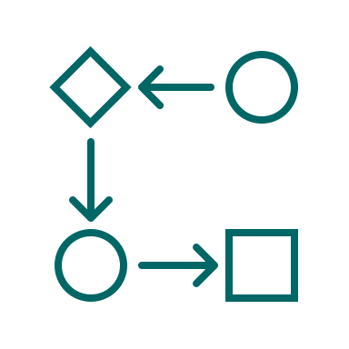



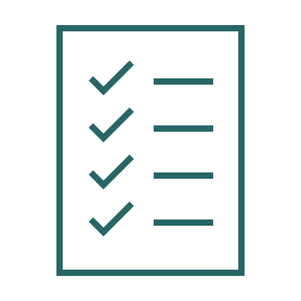
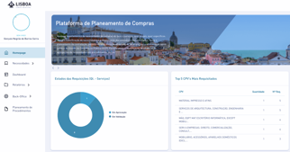



Lx PPP-IS e-Procurement and Digital Transition Strategy
The internal team uses an agile project management approach.
Project Name: LX PPP-IS Public Procurement Planning Platform
Execution
Project Description:
PROCUREMENT PLANNING
PROCUREMENT PROCESS AGILITY
Platform to support the assessment of needs for the procurement of goods, services and works. Supports the procurement planning, allowing an adequate allocation of means and resources. It allows the identification and prioritization of sustainable and innovative procurement. It also allows the identification of the potential for aggregation of needs in centralized procedures.
05/2020
05/2022
39,1
Project Characteristics:
PO: Isabel Camacho
PM: Filipa Gomes
Expert: Gonçalo Negrão
Team Members: Procurement Department Team and Pilot Clients
Key Expected Outcomes
Next wave Milestones
1
Procurement Annual Plan 2023 concluded by end of November with Budget 2023 approval.
Procurement Annual Plan 2023 published in Open Data at LisboaAberta Portal
Procurement Plan baseline (end of Oct. 2022)
New IT/IS catalogue
Public Adm. Innovation (PT)
Few procurement planning platforms in the market. Recognized as good practice by ICLEI.
+
+
Extension to Undertakings
Replication at other Municipalities
1
1
Uptake / Repçlication Ptotential

Slide 13
Lx PPP-IS e-Procurement and Digital Transition Strategy
Internal budget rules relates with procurement are being revised, following the improvements PP digital transformation. As an example, we share the rules for 2023 Budget execution related with PP Planning.
Budget Rules
Municipal Procurement Planning
By the end of the third quarter of each year, all Organic Units, Units under Municipal Management, and Schools must register in the LX PPP-IS - Procurement Planning Platform their purchasing needs for goods, services and works for the following years, as well as the respective procurement tender procedures.
The Procurement Unit will analyse the information resulting from the registry of next years needs:
  to promote a sustainable-led sourcing strategy: economic, social and environmental,
  to identify opportunities for circular procurement;
  to identify PP of innovative solutions (PPI);
  to rationalise existing resources;
  to diversify tender selection;
  to optimise the aggregation of needs.
The Procurement Unit will mediate/propose adjustments with the BUs regarding setting a Procurement Plan with strategic objectives and outcomes. The Vice-Mayor will validate the resulting Procurement Plan.
All needs for acquiring goods, services, and works not included in the annual planning must be registered in the Procurement Planning Platform, with the necessary justification.
PROCUREMENT PLANNING

Slide 14


Lx PPP-IS e-Procurement and Digital Transition Strategy
The LX PPP-IS Procurement Planning Platform platform is one of the components of the new architecture of systems to support Lisbon Municipality procurement activity.
PROCUREMENT PLANNING
Needs Assessment
Registration of annual needs for goods, services and works
Assess specific needs (specific e-Forms / e-Catalogues), related with centralized categories (Water, Energy, Office Supplies, Security, Cleaning)
PP Planning (yearly)
Create PP Plan Baseline and Final, and Provide Data for monitoring progress – Planned vs Executed
Registration of needs not foreseen (extraordinary) in the annual surveys
Budget Planning
Set-up of budget thresholds for the categories of goods, services and works
Provide financial classification and prioritisation of needs by the BUs
Provide early-stage information for Asset-related expenditure (GIS)
Tender Planning & Pre-Tendering Inputs
Support tender planning and identify opportunities to diversify the adoption of PP procedures
Reinforce transparency and compliance with PP legal and regulatory principles
Provide data for subsequent pre-tendering phase: streamlining and reducing time related with the procurement process

Slide 15



Lx PPP-IS e-Procurement and Digital Transition Strategy
The LX PPP-IS Procurement Planning Platform is the backbone for a strategic sourcing approach that encompasses sustainability and innovation aiming to engage the market.
Sustainability
To establish sustainability targets at the PP Planning stage, defining a baseline for comparing with the contract data (also improving the level of information provided to IMPIC: Base.Gov Portal).
Identify intended sustainability and circularity specifications or criteria to be applied
Challenge BUs for targeting assets review, and needs function-based approaches
Prioritise value chain and supply chain assessments to identify obstacles to sustainability (implement by waves)
PROCUREMENT PLANNING
Innovation
Increase PPI, benefiting from the New Competence Center for PPI (ANI and IMPIC)
Identify Open Innovation initiatives: involving 1st tier suppliers and Innovative SME
Incentivize a pilot-culture and Public Procurement Incubator approach and take further advantage of the experience of the Smart Open Lisbon Programs
Select targets for preliminary market consultations
Market Impact
Adopt of Open Contracting Data Standard (OCDS) for publishing the PP Annual Plan
Publish Procurement Roadmap for market engagement: PP types and Initiatives that complement the PP Plan
Set-up Workshops with suppliers to explain current needs and receive feedback on potential solutions (next: 19 and 20 October)

Slide 16


Lx PPP-IS e-Procurement and Digital Transition Strategy
Internal budget rules relates with procurement are being revised, following the improvements PP digital transformation. As an example, we share the rules for 2022 Budget execution related with PP Planning.
Note: Preliminary Plan will be the baseline to be measured against the final plan and against contract data with PP analytics tool
PROCUREMENT PLANNING
1Q 22
2Q 22
4Q 22
4Q 22
2023 PP Platform Improvements
Needs Assessment
Internal Discussions
Final PP Plan
Steps of Procurement Planning
Procurement Plan Open Data Release
2023 PP setup
Work Sessions on Categories
Preliminary Plan
Market targeted Discussions
2Q 22
3Q22
4Q 22
4Q22
1Q23
"Building Solutions Together: Sustainability Criteria to Apply in Future Procurement Processes"

Slide 17

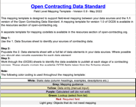
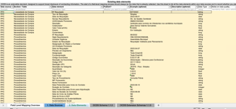
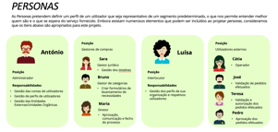
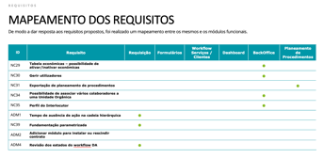
Lx PPP-IS e-Procurement and Digital Transition Strategy
In 2021, Lisbon Municipality PP took advantage from a Rapid Development Tool, Outsystems, and drove an Agile approach to developing a new tool, led by the PP Unit.
Technology Used
The software development was done in Outsystems, a PT-born unicorn, Rapid Development Tool, that supports workflows and integration with other applications with high-usability standards (UI/UX included in the project).
Requirements
Our PP team defined the functional requirements and uses an agile/scrum approach (product backlog).
We have consider OCDS standard.
High-usability (UI/UX principles included in the project), In an early stage, we determined the UX standard so we could then move to a quick development phase.
I.P.
Lisbon Municipality owns the PPP and started presenting the tool to other Public Entities.
The technical developers document technically their developments and the IT Department reviews those developments.
Uptake / Replication
The PP platform is developed considering its extension to Municipal Undertakings, and Schools.
Public Entities are asking for PPP presentations. Our focus is to build a user community and explore opportunities such as joint-need assessment and subsequent joint-sourcing strategies.

Slide 18
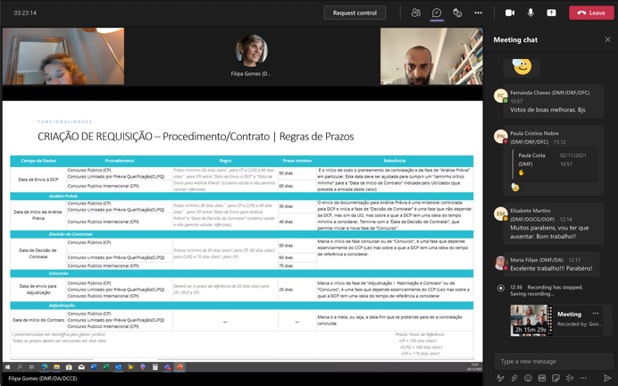
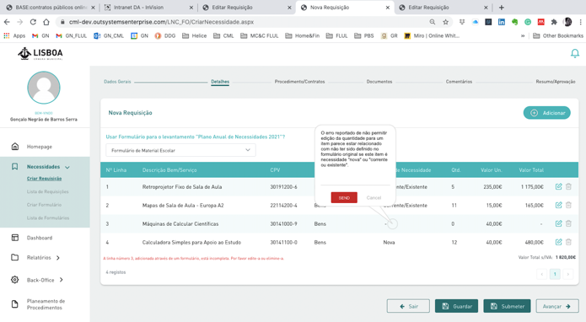
Lx PPP-IS e-Procurement and Digital Transition Strategy
The design phase was led by the Procurement Department. Interactive testing tools were provided to users to capture feedback.
Design Phase
Testing Phase

Slide 19
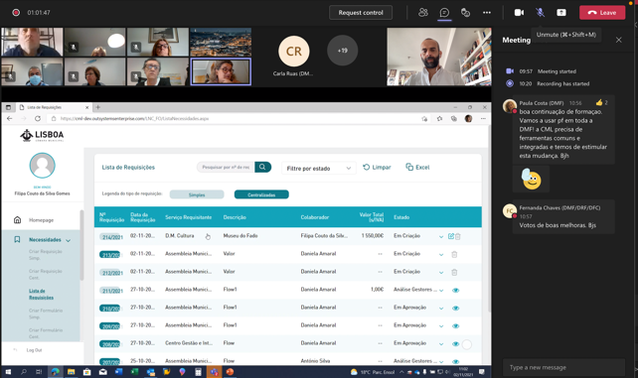
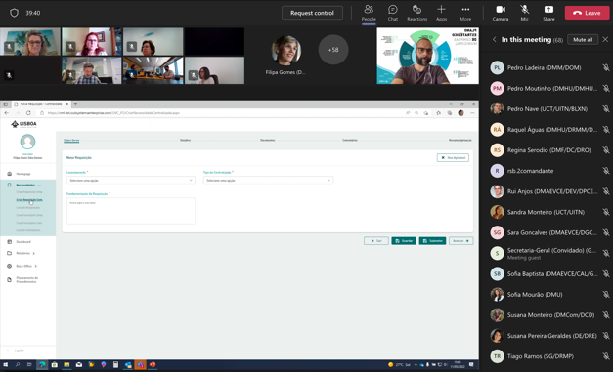
Lx PPP-IS e-Procurement and Digital Transition Strategy
In The interaction with users was extended to Workshops to gather insights and capture future requirements for the product backlog
Procurement Department Training
UsersTraining

Slide 20
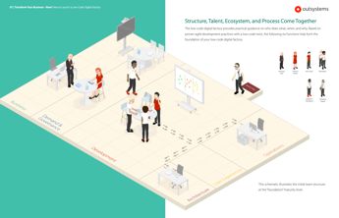
Lx PPP-IS e-Procurement and Digital Transition Strategy
The PPP helped to incentivize the cloud-based approach and the independence towards developers.
I.P.
Lisbon Municipality owns the PPP.
The technical developers document technically their developments and the IT Department reviews those developments.
Developers
We have hired certified development companies recognized as Outsystems developers: in the first phase NTT Data (Everis) and Deloitte. We have spent the total of EUR 50 K in two contracts.
The PT Central Purchasing Body deployed a recent Framework Agreement for the development of Outsystems solutions.
Integration
The system is integrated with our private cloud (Azure), which allows single-sign-one and data security;
We have developed an API that interchanges data between Outsystems and SAP and Document Management. Integration with tendering plaforrm is in the pipeline.
IT support
The IT Department has deployed an internal Outsystems Factory to support the applications maintenance and development. Different IT suppliers can emulate components and reuse them and follow the design guidance (UI and UX).
Lisbon Municipality has developed +10 applications with this software.

Slide 21
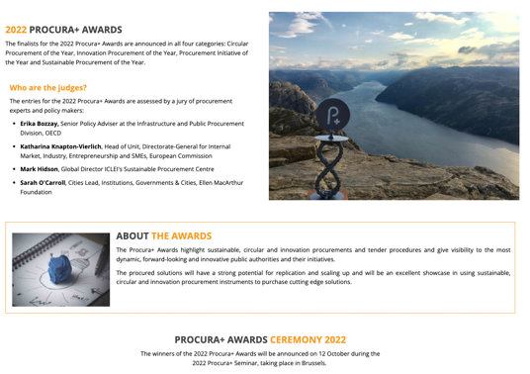
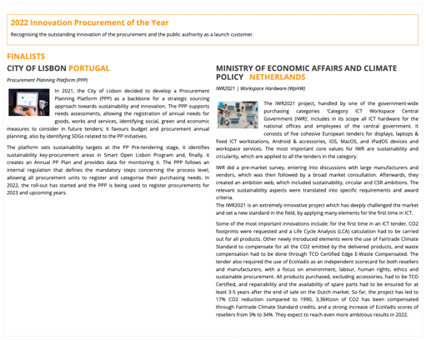

Lx PPP-IS e-Procurement and Digital Transition Strategy
The LX PPP-IS Procurement Planning Platform is finalist of the 2022 Innovation Procurement of the Year Procura+ Awards together with the Ministry of Economic Affairs and Climate Policy from The Netherlands.
https://procuraplus.org/awards/

Slide 22


3
PROCUREMENT PLANNING
PLATFORM

Slide 23
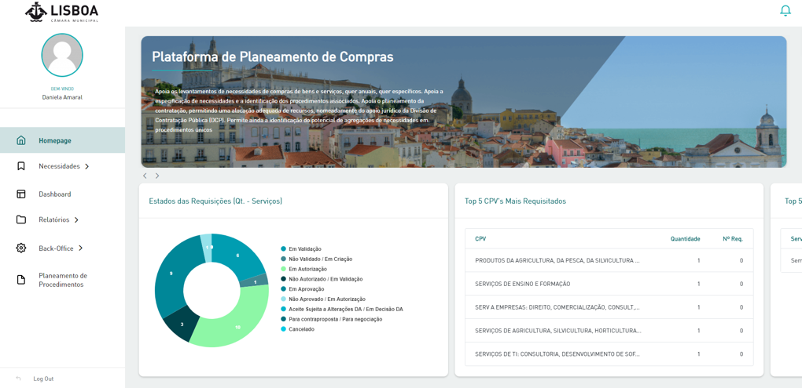
Homepage
Lx PPP-IS Functionalities
FUNCTIONALITIES
After logging into the platform, the user is redirected to the Homepage page. It is a welcome page, where the user can also have quick access to relevant information from his Unit. The pages and features of the platform have limited access according to user profiles.
The following slides in this section are high-level overview of selected functionalities

Slide 24
Business Units & Users
Lx PPP-IS Functionalities
After logging into the platform, the user is redirected to the Homepage page. It is a welcome page, where the user can also have quick access to relevant information from his Unit. The pages and features of the platform have limited access according to user profiles.
Approval Levels
The BU page can be accessed by: Administrator, Approver, Director, Purchasing Manager, Legal Manager, BU Procurement Liaison, Operator, Authoriser and Validator.

Slide 25
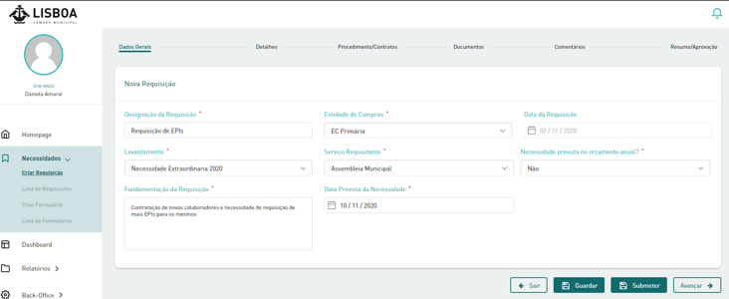
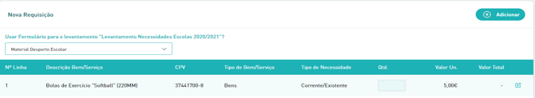
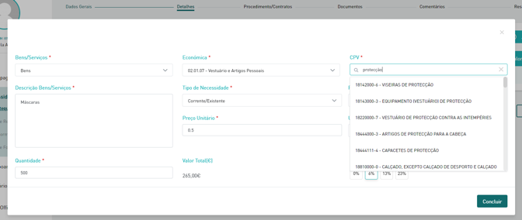
Procurement needs (assessment)
Lx PPP-IS Functionalities
FUNCTIONALITIES
The purchase need can be fulfilled both by the operator and by any employee defined in the approval flow. This procedure is divided into 5 intuitive and complementary steps, at the end of which all information is centralized in a summary screen.
CPV coding, related Expenditure Type
The user is able to quickly fill the needs of standard categories of goods or services using e-forms configured by the Category Manager.
Adding items
Correlation through CPV code with:
strategic sourcing priorities;
carbon footprint.

Slide 26
Procurement needs (assessment)
Lx PPP-IS Functionalities
FUNCTIONALITIES
The purchase need can be fulfilled both by the operator and by any employee defined in the approval flow. This procedure is divided into 5 intuitive and complementary steps, at the end of which all information is centralized in a summary screen.
Preliminary Data on Sustainability
Adding items

Slide 27
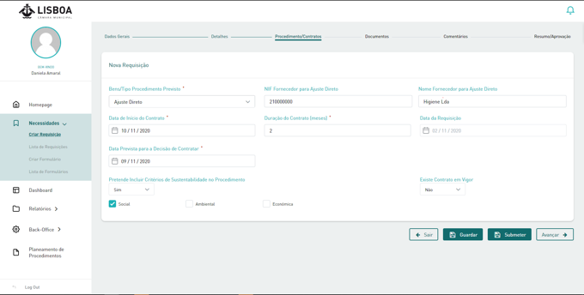
Procurement needs (assessment)
Lx PPP-IS Functionalities
FUNCTIONALITIES
Após a adição de bens e/ou serviços, o utilizador avança para a seleção de procedimentos/contratos onde estão implementadas regras do CCP e da CML.
Tender Type Selection
Rules
PT PP Law (CCP): Selection of tender procedure according to value thresholds(PT & EU).
Internal Lisbon Municipality Rules:
Centralized legal and technical validation by the Procurement Unit required for all tenders above EUR 75 K;
Centralized legal and technical validation and automatic adjustment and guidance for the milestones of each phase: rules based on current Analytics calculation of each tender lead-time (and BU performance levels, and type of CPV – under development)

Slide 28
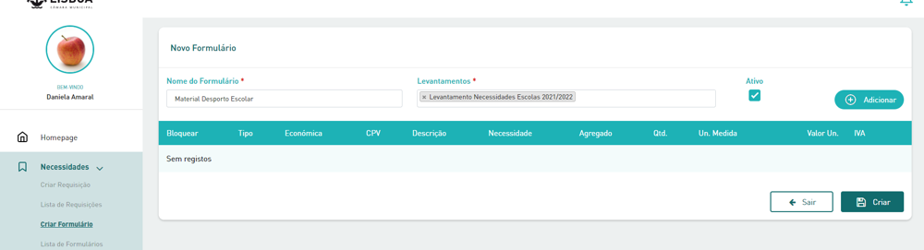
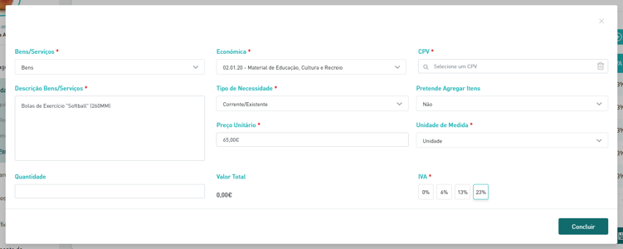
e-Forms / e-Catalogues
Lx PPP-IS Functionalities
FUNCTIONALITIES
Category Managers can create e-forms that facilitate the data collection process related to procurement needs by users and e-forms for specifying procurement needs that allow the collection of additional information from centralized categories.
1
2

Slide 29
e-Forms / e-Catalogues
Lx PPP-IS Functionalities
FUNCTIONALITIES
Category Managers for Forms and e-Catalogues with specific information to collect from the BUs. Categories such as: Electric Power, Gas, Water, Cleaning (services and products), Telco, Security, Office Supplies, etc.
Example for Cleaning Services
Asset Reference: validated through the Municipality’s GIS for Projects and Assets
Cleaning Shifts
Cleaning Frequency
Area covered (m²)

Slide 30
Approval Workflow
Lx PPP-IS Functionalities
FUNCTIONALITIES
The approval flow includes rules for notifications and rules for preventing excessive action
At each stage of the flow, the user can add a comment associated with the step of the approval. There are specific workflows for centralized and non-centralized procurement needs.
If the approval flow has been pending for more than 48 hours (configurable value), the employee who must take action is notified by email. After this notification, the user will have 48 hours to execute is action (configurable); otherwise, the request will move to the next level, and the non-response at the previous level will be registered.

Slide 31
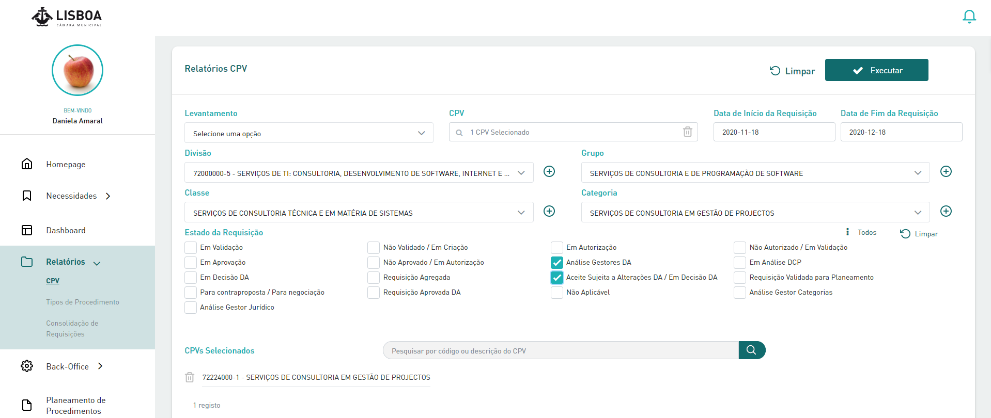
CPV Reporting
Lx PPP-IS Functionalities
FUNCTIONALITIES
There are specific reporting tools
Selection Criteria
CPVs selected by the user

Slide 32
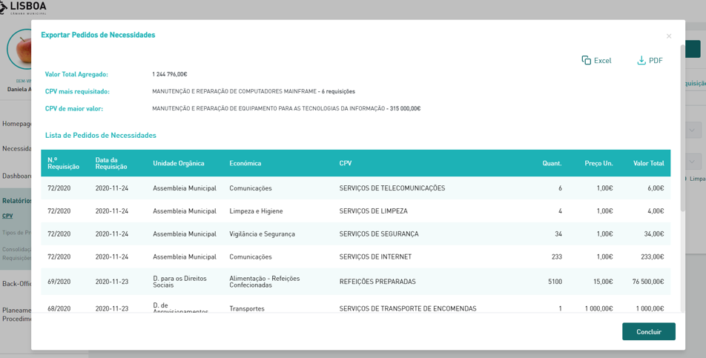
CPV Reporting
Lx PPP-IS Functionalities
FUNCTIONALITIES
After executing the report, the user has access to a popup listing of the requisitions. The user can extract this information via excel, PDF. The system also provides data sets for the Municipality’s Analytics (PowerBI).
Summarized Data
Export Options include PowerBI

Slide 33
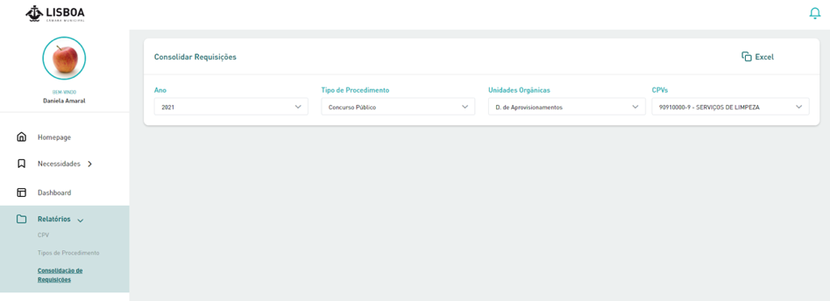
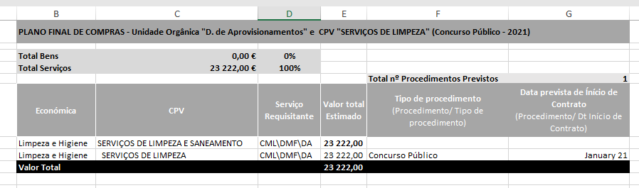
Tender Planning Reporting
Lx PPP-IS Functionalities
FUNCTIONALITIES
1
Also in the reports, the user can export information regarding the procurement planning.
Filters for Data Selection
Exporting for Excel and PowerBI
2

Slide 34
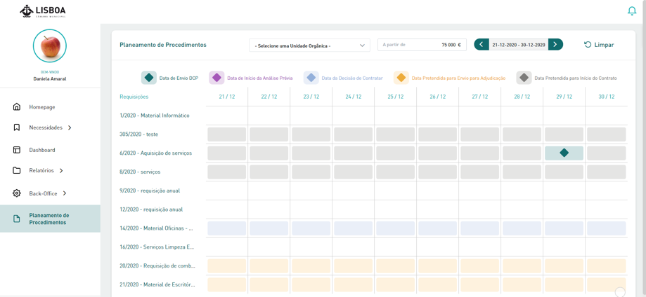
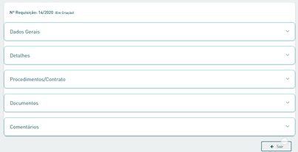
TENDER PLANNING
Lx PPP-IS Functionalities
FUNCTIONALITIES
1
Users can visualize and export information regarding the procurement planning.
2
Access to the overall info by clicking on a tender

Slide 35
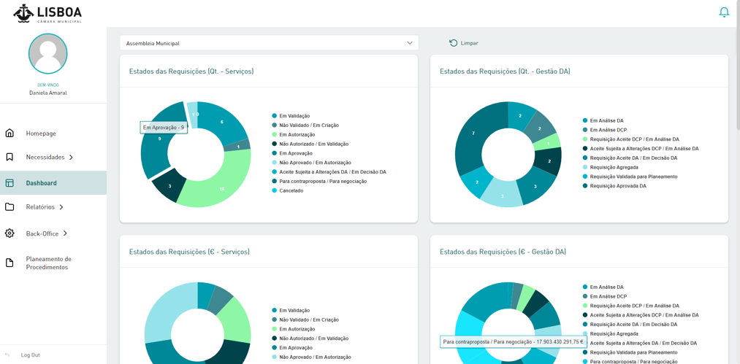
DASHBOARD
Lx PPP-IS Functionalities
FUNCTIONALITIES
On the Dashboard, the user can follow up on the progress of the procurement planning process

Slide 36
4
FINAL
REMARKS

Slide 37




Lx PPP-IS e-Procurement and Digital Transition Strategy
The PPP is integrated with other strategic projects that are being developed.
ACCOUNTABILITY & TRANSPARENCY
Project
Goal
Status
Outcomes
Incremental automation of the calculation of Procurement KPI
Increased use of PowerBI to calculate metrics and KPI's associated with the purchasing process
Benchmarking with similar public entities
Piloting Open Source Tools for massive data analysys and ML.
Procurement Report automated December 2022 (including Inclusion of new Risk, Sustainability metrics);
Introduction of Supply Carbon Footprint data in 2023;
Requirements for Procurement Report analytics and automation tool defined by end of 2023.
Procurement Reporting / Data Analytics Model for Procurement
Design Open Data Model (OCDS) with support from the Open Contracting Partnership (OCP)
Prepare the publication of Procurement Planning data 2023.
Open data schema for Procurement Planning and the remaining steps in the procurement process
Technical requirements for the publication of the annual procurement plan defined
Open Data Model for Public Procurement
| 37

Slide 38



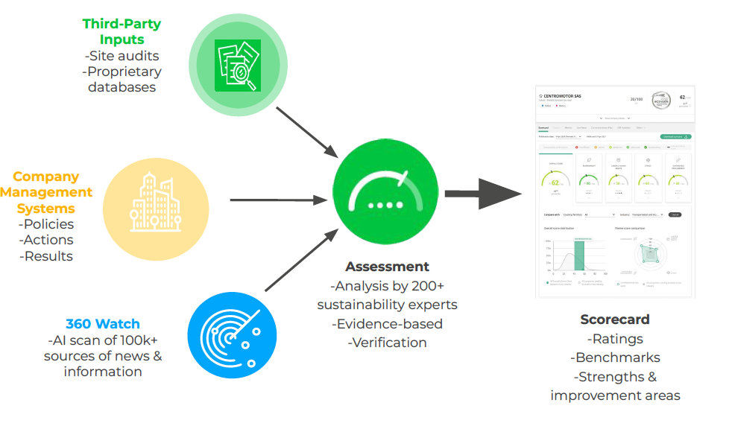
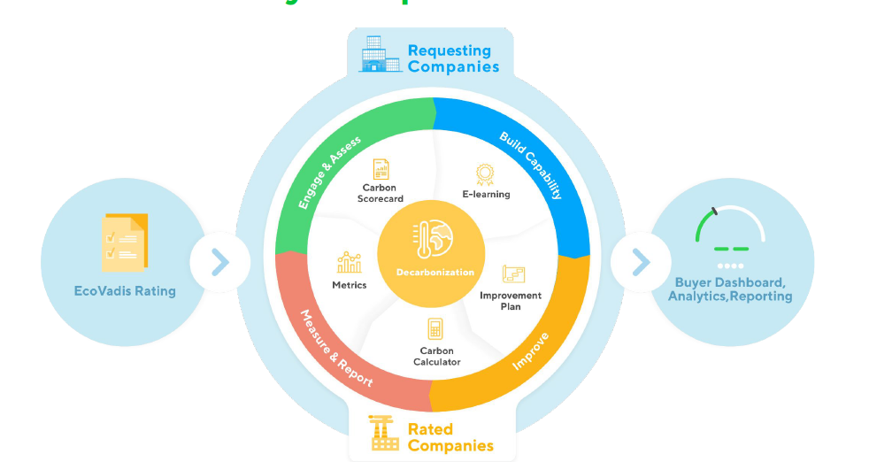
Lx PPP-IS e-Procurement and Digital Transition Strategy
The PPP is integrated with other strategic projects that are being developed, using open data, stakeholder engagement, and technological innovations. This integrated approach is aimed to provide the city of Lisbon with an effective climate-driven procurement plan and promoting the uptake of circular and sustainable procurement, both social and environmental.
Project
Goal
Status
Outcomes
SUSTAINABLE
PROCUREMENT
Conduct a pilot project to measurably promote sustainable procurement in Lisbon using open data, technology, and collaboration approaches (e.g. piloting OCP's Green Flags guidance and Open & Sustainable Public Procurement toolkit and EMF's Circular Public Procurement: a framework for cities);
Integrating Supplier Sustainability Scores as decision support system for direct procurement (together with benchmarking);
Integrating carbon footprint related with PP supply chain to monitor and drive carbon neutrality.
Understanding of how valuable current sustainable procurement guidance are in a real implementation environment;
Transposing Lisbon's sustainability commitments into measurable public procurement objectives (KPIs).
Early procurement data analysis (from PPP and historical) to evaluate which of the objectives identified can be measured using existing data and what data gaps exist to measure other objectives;
KPI tracking mechanism, including technology solution (i.e. visual dashboard) and integration into existing processes to encourage early adoption;
Co-design solutions for better sustainability performance over time.
Sustainable Procurement with Open Data
+
Pre-Tendering Platform
PROCUREMENT PROCESS AGILITY
| 38

Slide 39
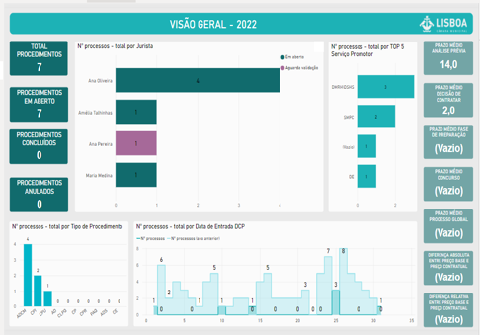
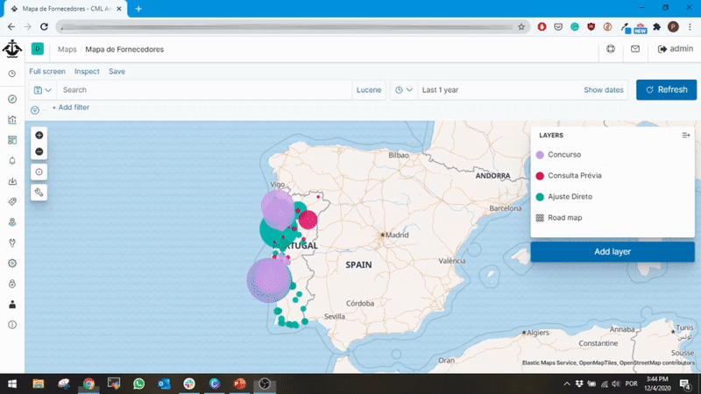
Lx PPP-IS e-Procurement and Digital Transition Strategy
The PPP data is analysed with Data Analytics Tools. The tool is performing benchmarking with other Municipalities: 10 years of data extracted through an API from the national database. PP contract a startup – Forcera, for this project.
| 39

Slide 40


Lx PPP-IS e-Procurement and Digital Transition Strategy
The role of PP is twofold: that of re-evaluating the Information Systems and Processes and proceeding with digital acceleration, and preparing the market for a recovery cycle guided by the incremental adoption of sustainability & innovation.
2022– e-Procurement and Digital Related Planned Projects
Publication of +2023 Procurement Plan
Q4 22
OCDS full PP assessment and PP Analytics Upgrade (Ongoing with support from a local analytics start-up and OCP)
Q3 22
Pre-Tendering Platform - 1st wave (Defining Functional Requirements for a new Platform that bridges Procurement Planning with the e-Tender Solution, to foster innovation and sustainability in the Pre-Tendering Phase)
Q4 22
Budget – Climate Impact & SDG - 1st wave
Q4 22
OCDS Implementation – for the whole PP life-cycle (target is to publish at Lisbon Open Data Portal the Procurement Annual Plan +2023)
Q4 22
PP Planning Platform – Upgrade [Outsystems]
Q1 23
Pre-Tendering new Module: includes Climate Impacts and Sustainability Guidance (with OCP)
Q3 22
Supplier Innovation & Sustainability Portal
Q1 23
Design
Pilot
Deploy
Upgrade
| 40

Slide 41
Lisbon Procurement Planning Platform for Innovation and Sustainability (Lx PPP-IS)
the backbone for a strategic sourcing approach towards sustainability and innovation
Lisbon Municipality
Support Presentation to OPSI - Case Study Submission
Gonçalo Negrão / ext.goncalo.negrao@cm-lisboa.pt

