Slide 1
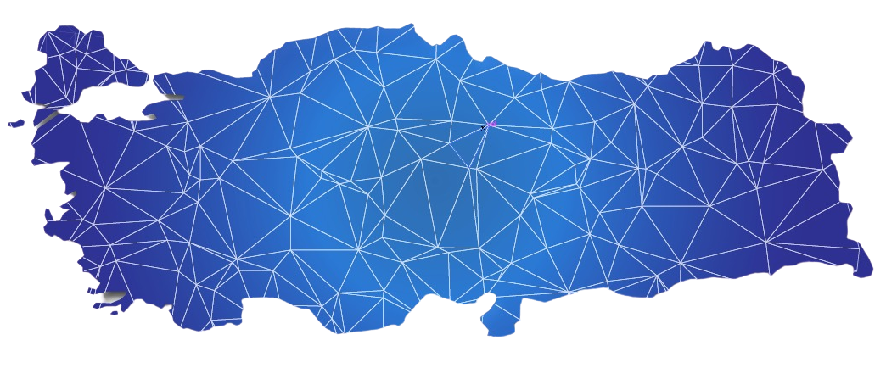


Urban and Rural Settlement Systems in Turkey

Slide 2
Content
  Goal of the Project
  Geographical Scope
  Data Sources
  Methodology Used in the Analysis
  Results of the Project
    Service Centers
    Hinterlands and Functional Regions
    Decision Support System

Slide 3


Urban and Rural Settlement Systems In Turkey
Identifying the existing structure of the settlement system of Turkey
Goal of YER-SİS
  Structure of settlements: Relations between settlements
  Service centers
  Hinterlands and functional regions

Slide 4



Geographical Scope
ALL SETTLEMENTS OF TURKEY
URBAN
RURAL
Provinces 81
Districts 973
37,036 Villages, neighborhoods and towns
04

Slide 5



Data Sources
National Data
  Official Statistics
    Stock Data
    Flow Data
  Administrative Records
URBAN
  Field Research
  The rural field research-applied to all 37,036 villages, towns, and neighbourhoods
  Transportation survey-applied in district terminals
RURAL

Slide 6









Data Sources: Dimensions of Relations Between Settlements
Urban | Rural
Education (Secondary education, Tertiary education) | Education
Health | Health
Transportation | Transportation
Trade | Trade
Communication | Workforce Mobility
Cargo

Slide 7
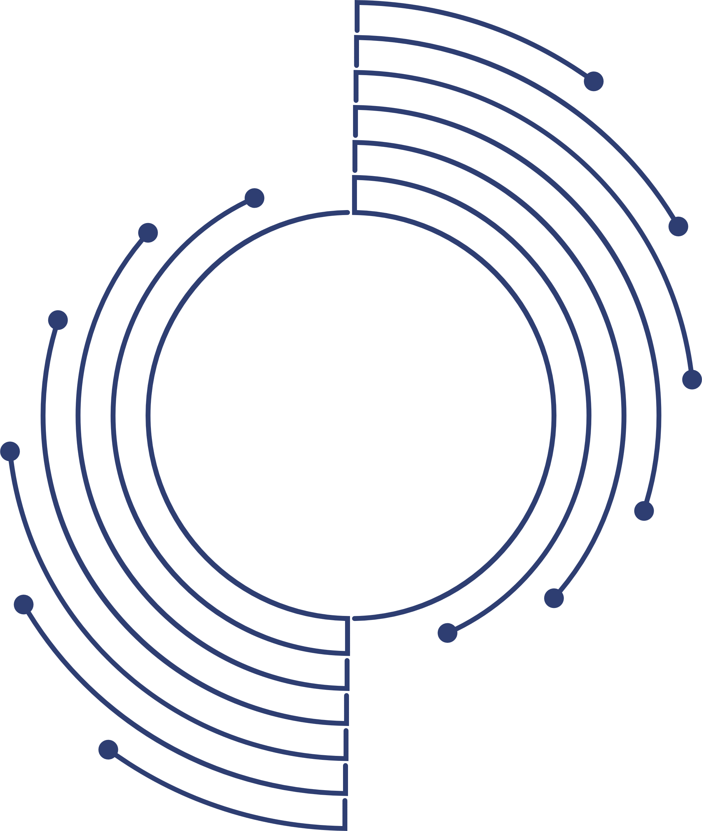

Data Sources: Field Study (Survey)
Facility, equipment and infrastructure services
Livelihoods
Structure of agricultural production
Structure of manufacturing
Usage of agricultural products
Where basic needs are met
Manufacturing of agricultural products
Workforce mobility
Periodical changes in population
Transportation relations
Priority issues and requests
  Information about foreign nationals

Slide 8

Methodolgy Used in the Analyzes of YER-SIS
Methodology
An Innovative and Original Hybrid Model:
The study utilises its own hybrid approach of
central place theory and network analysis

Slide 9
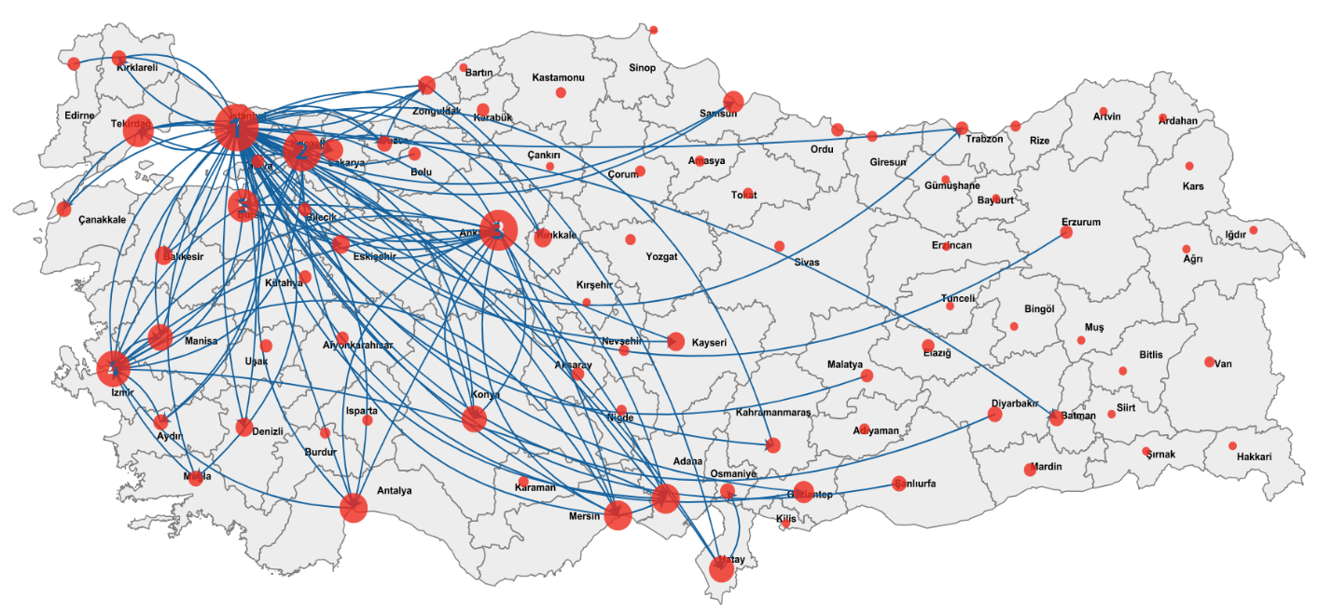
The First 100 Trade Relations of Provinces
Istanbul
Kocaeli
Ankara

Slide 10
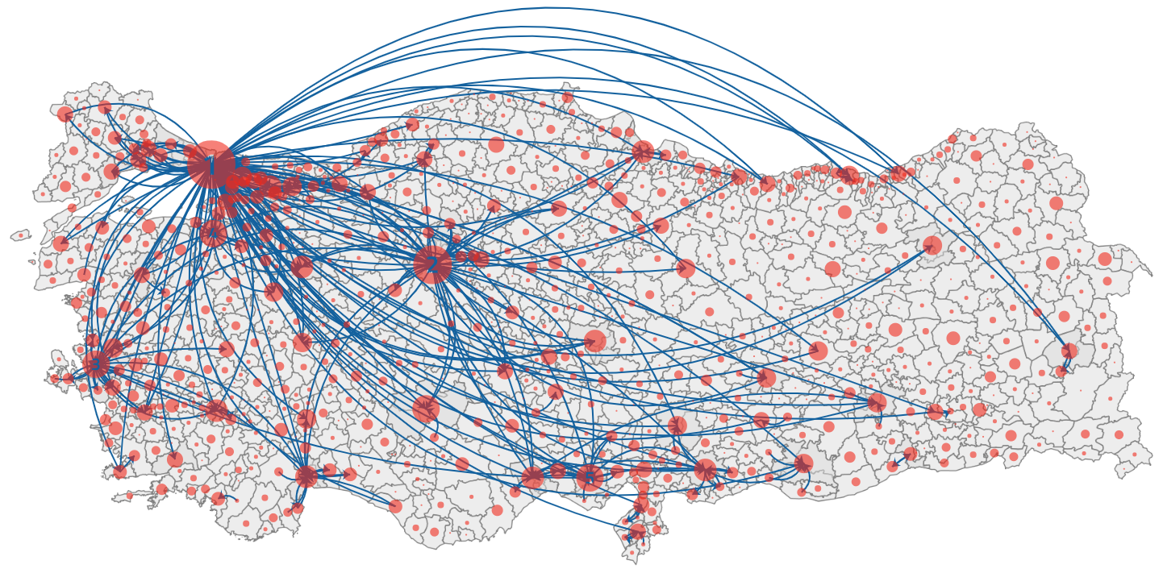
The First 300 Relations in Urban Integrated Network
Istanbul
Ankara
Izmir
Bursa
Adana
Istanbul
Ankara
Izmir

Slide 11

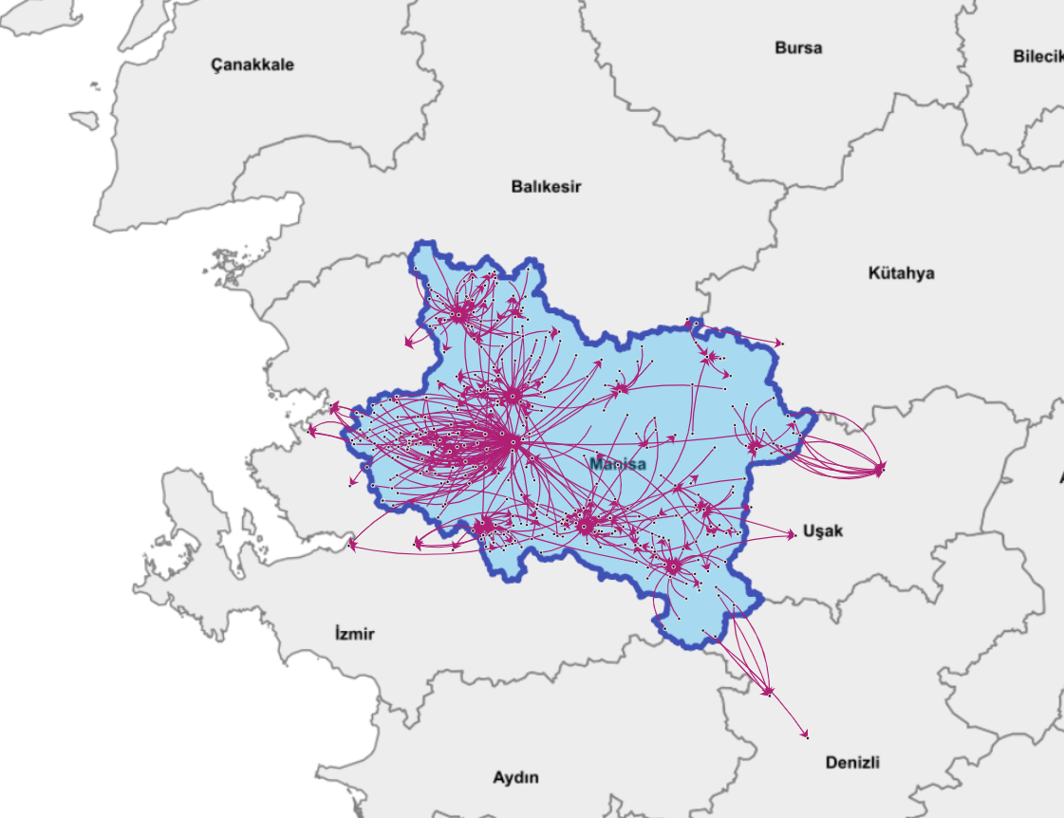
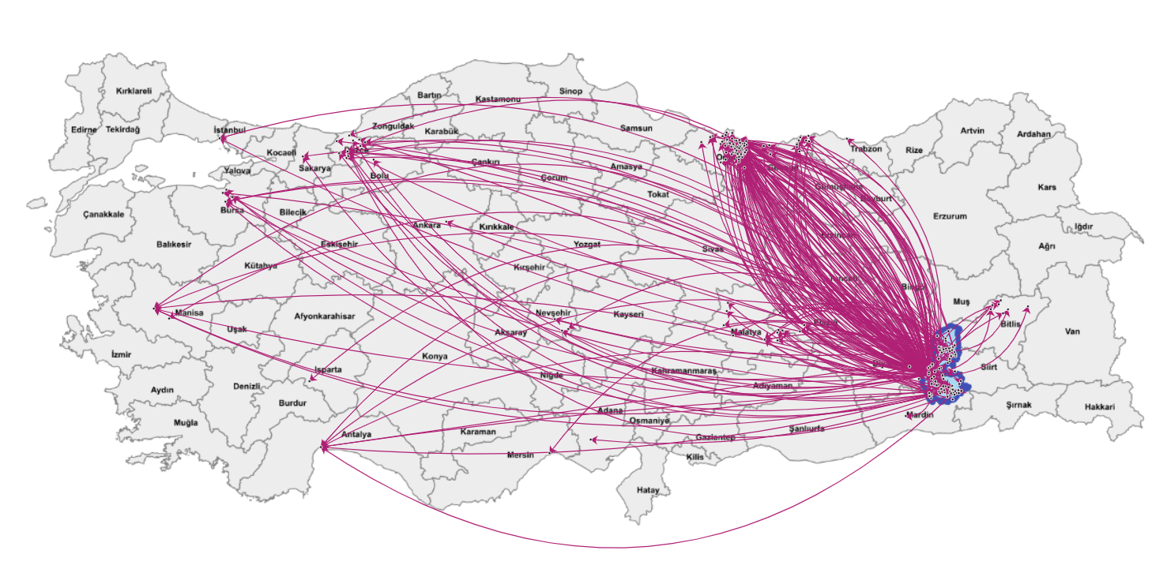
Workforce Mobility in Rural Network
Daily-regular workforce mobility
Workforce mobility for seasonal agricultural works
Ordu
Manisa
Izmir
Batman

Slide 12

Determination of Service Centers
Service Centers
Settlements that serve at least one settlement other than itself for at least one dimension

Slide 13

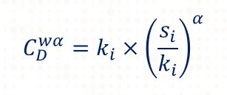
Determination of Service Centers
Calculating the scores
Scores for each dimensions are obtained by applying «Generalized Degree Centrality» which is generated by Opsahl at al. (2010).
Calculating the service scores in every dimensions
C: Generalized degree centrality
k: Number of settlements served
s: Total size of the service provided to other settlements
α: calibration parameter
21

Slide 14

Determination of Service Centers
URBAN
RURAL
Global clustering coefficients related to urban networks are used as weights.
First principal component weights of principal component analysis is used.
YER-SİS
Determining the weights for each dimension
Variables | Clustering coefficient | Weights
Communication | 0.99 | 0.21
Trade | 0.97 | 0.20
Cargo | 0.85 | 0.18
Transportation | 0.41 | 0.09
Health | 0.77 | 0.16
Secondary Education | 0.25 | 0.05
Tertiary Education | 0.54 | 0.11
Variables | Weight of First Component | Weights
Health | 0.9140 | 0.2403
Trade | 0.9057 | 0.2381
Education | 0.8756 | 0.2302
Transportation | 0.8176 | 0.2150
Workforce (seasonal) | -0.2885 | 0.0759
Workforce (regular) | 0.0023 | 0.0006
Absolute total | 3.8037 | 1.0000
22

Slide 15

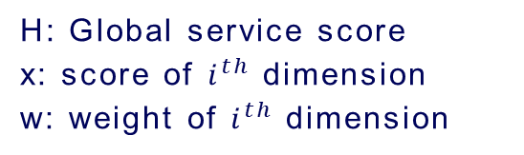
Determination of Service Centers
CALCULATING THE SCORES
Calculating the global service scores for each settlement
YER-SİS
Sevice center levels are determined by applying head and tail breaks and Jenks natural breaks algorithms.
H: Global service score
x: score of $i^{th}$ dimension
w: weight of $i^{th}$ dimension
i
i
23

Slide 16
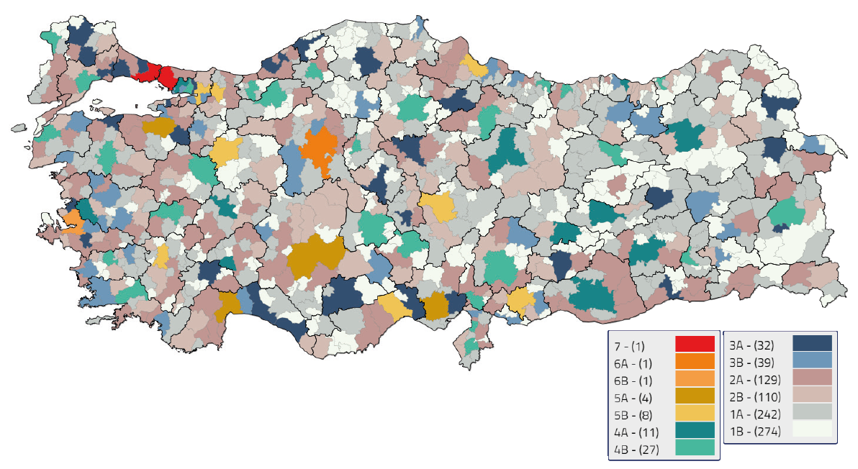
Urban Service Centers (Integrated)
Istanbul
Ankara
Izmir

Slide 17
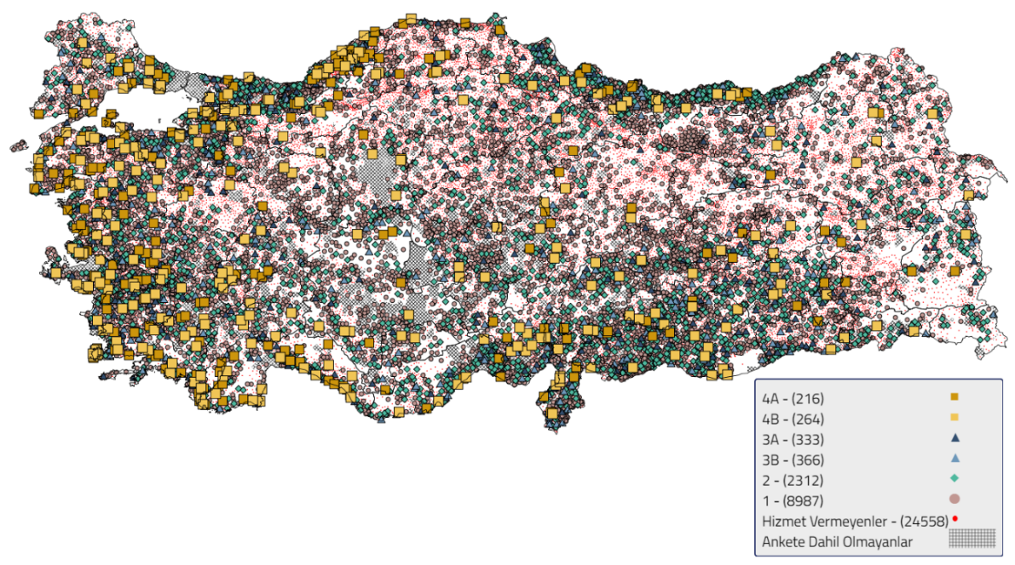
Rural Service Centers (Integrated)
Not serving - (24559)
Not included in surveys

Slide 18
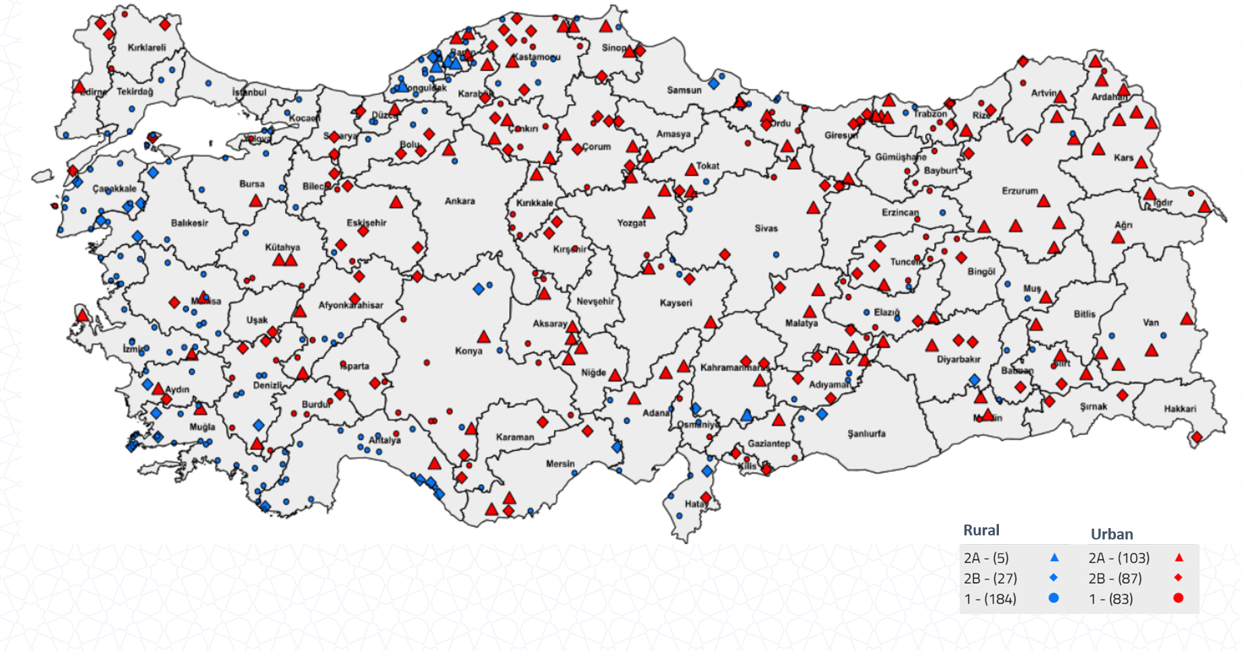
Transition Service Centers (Urban-Rural)

Slide 19

Regions Defined in YER-SIS
Hinterlands and Functional Regions
Regions created by connecting one settlement to another where it receives service most

Slide 20
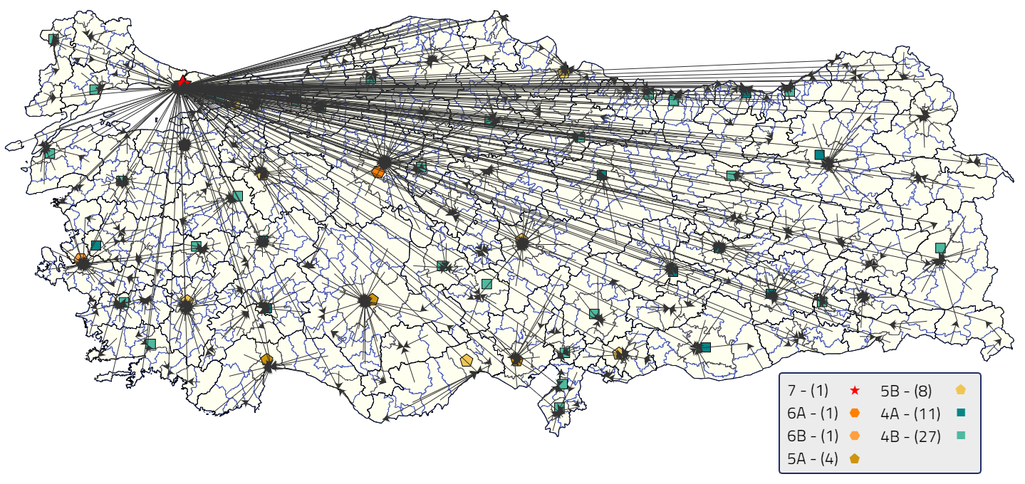
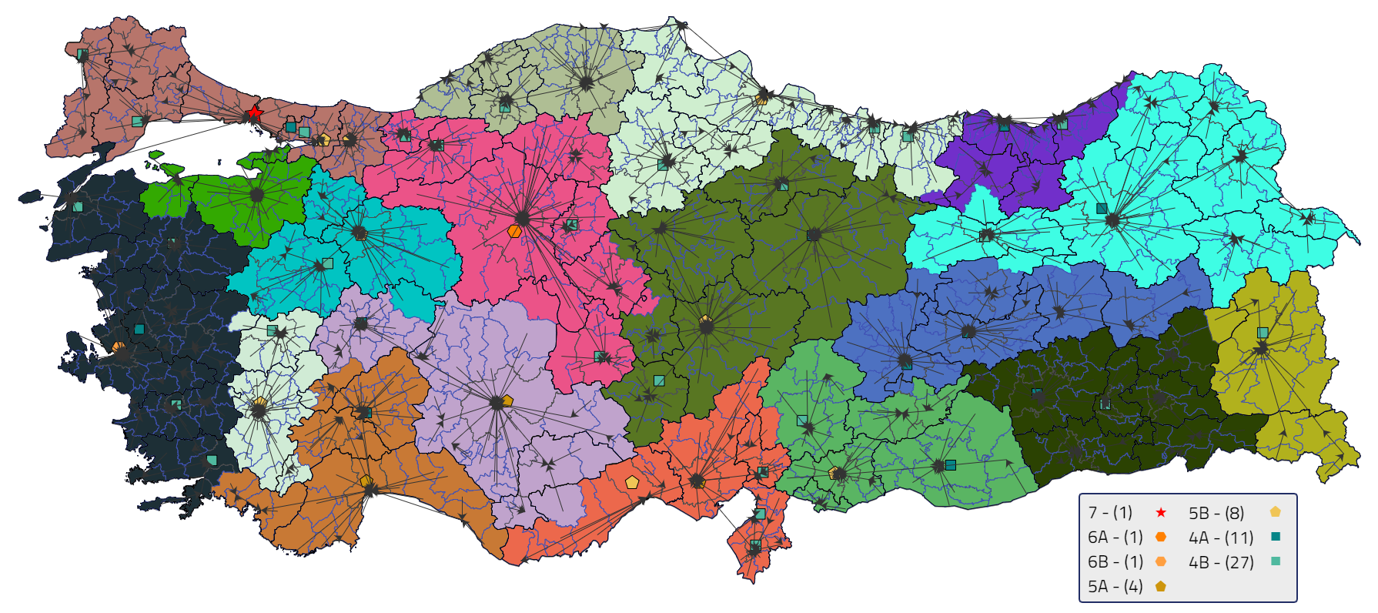
Regions Defined in YER-SIS
When no spatial constraints are used, İstanbul takes the whole Turkey under its influence
By applying some restrictions as neighborhood and distance, 18 functional areas are obtained.

Slide 21
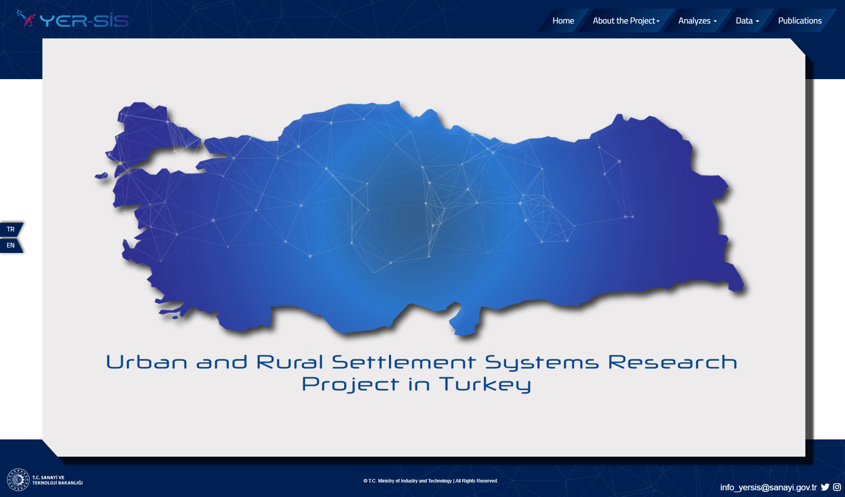
Decision Support System
25

Slide 22

REPUBLIC OF TURKEY
Ministry of Industry and Technology
Directorate General of Development Agencies
www.yersis.gov.tr

