Slide 1




INNOVATION CENTRE for
Intelligent information processing
Department | Geography
Promotors | Alain De Wulf, Frank Witlox, Haosheng Huang, Nico Van de Weghe, Philippe De Maeyer, Rudi Goossens
i-KNOW Annual Event
May 17, 2021 (online)

Slide 2
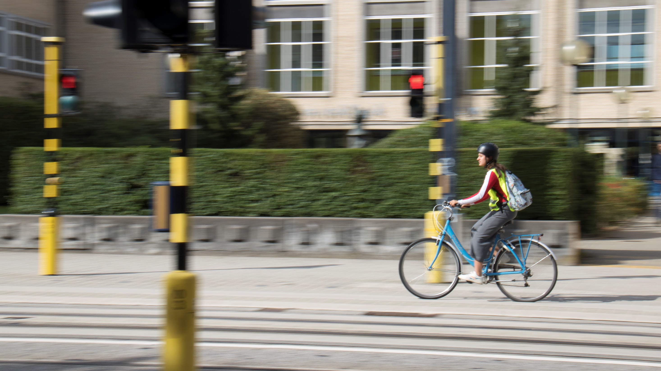


The Bicycle Barometer
Ghent University – Sustainable Mobility Research Network

Slide 3
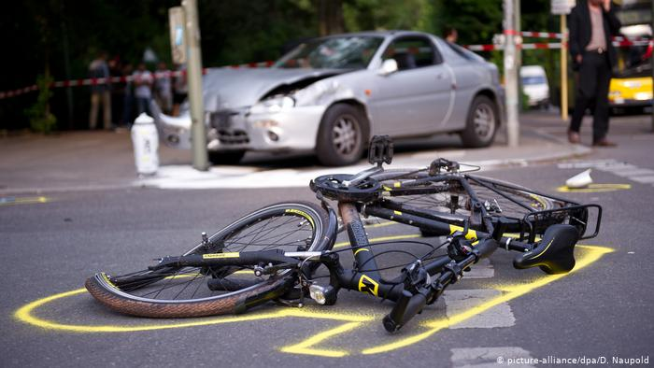
The problem
Adolescents who bicycle to high school have a higher probability of getting injured in traffic accidents than those travelling by other transport modes.
However, their voice is seldom heard on local policy or city level.
sven.verstrepen@ugent.be

Slide 4
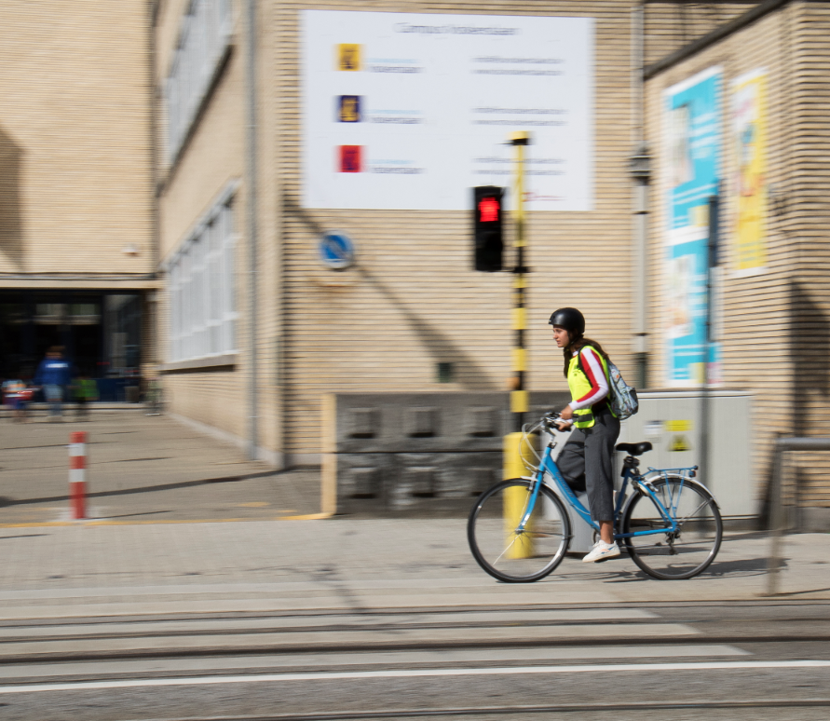
The solution
UGent has developed a web platform where high school students can track their daily routes and capture information about their perceived bicycle safety.
Citizen science in classroom situation supported by science teachers.
Resulting reports are used to improve public infrastructure and local safety investment decisions.
Inclusive multimedia training material.
Already 80 high schools in Flanders are successfully using this platform.
sven.verstrepen@ugent.be

Slide 5
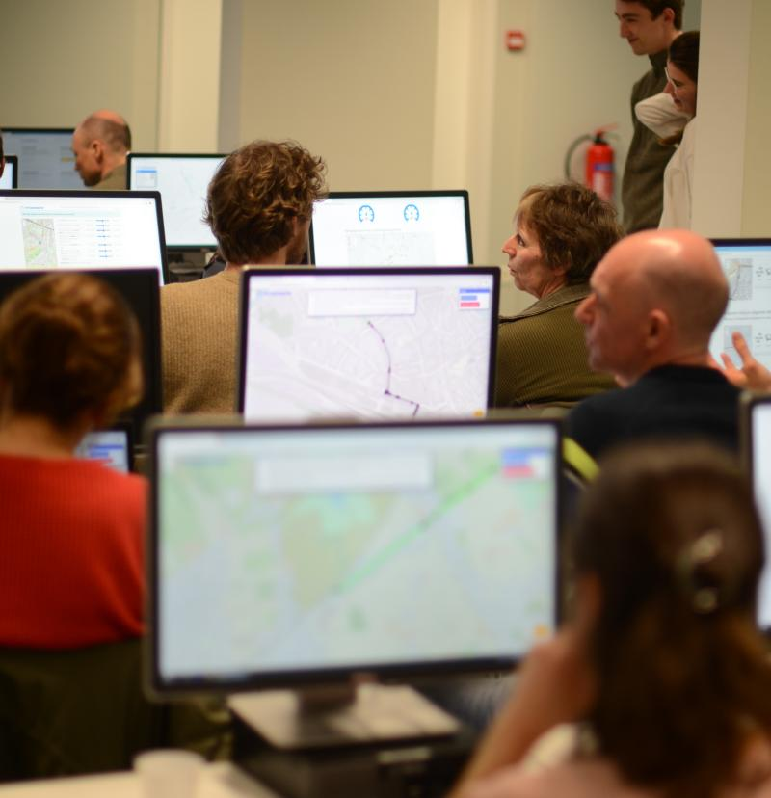
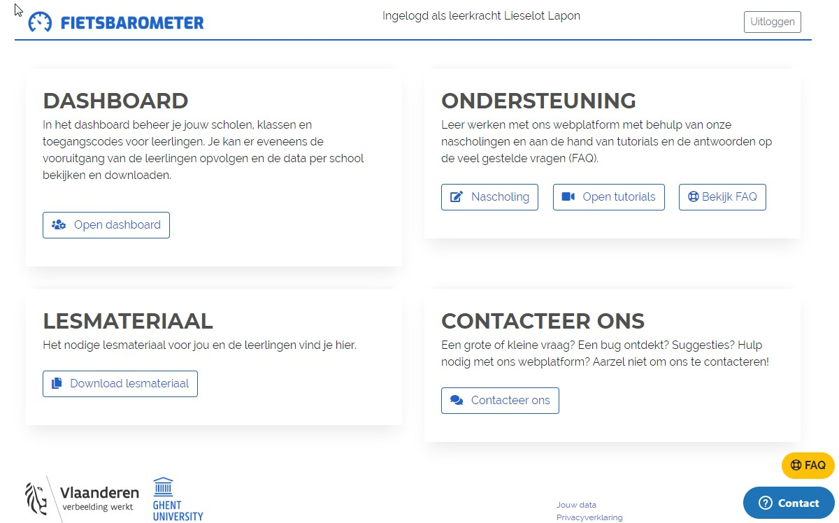
teacher platform
sven.verstrepen@ugent.be

Slide 6
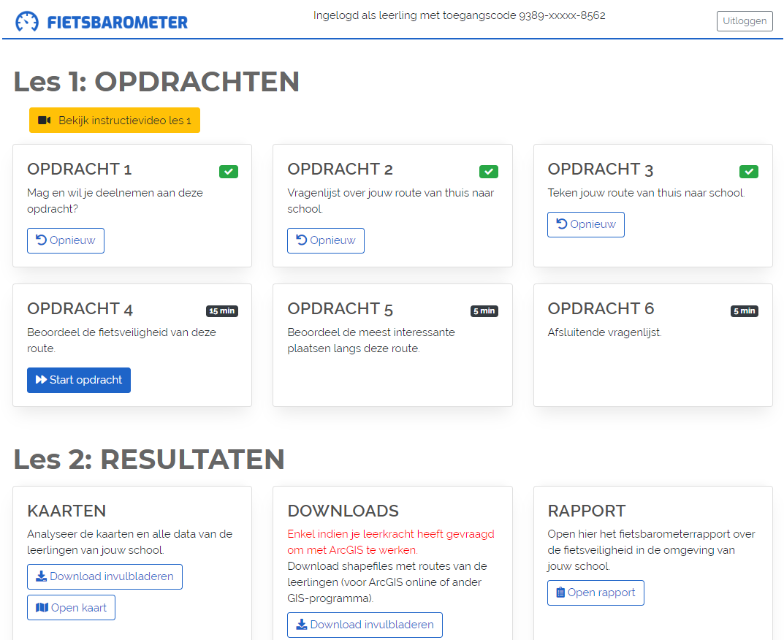
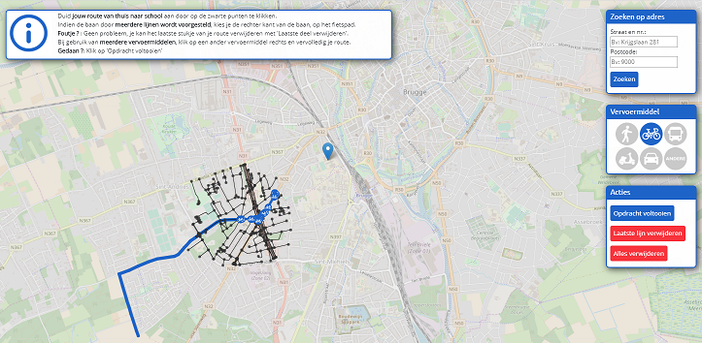
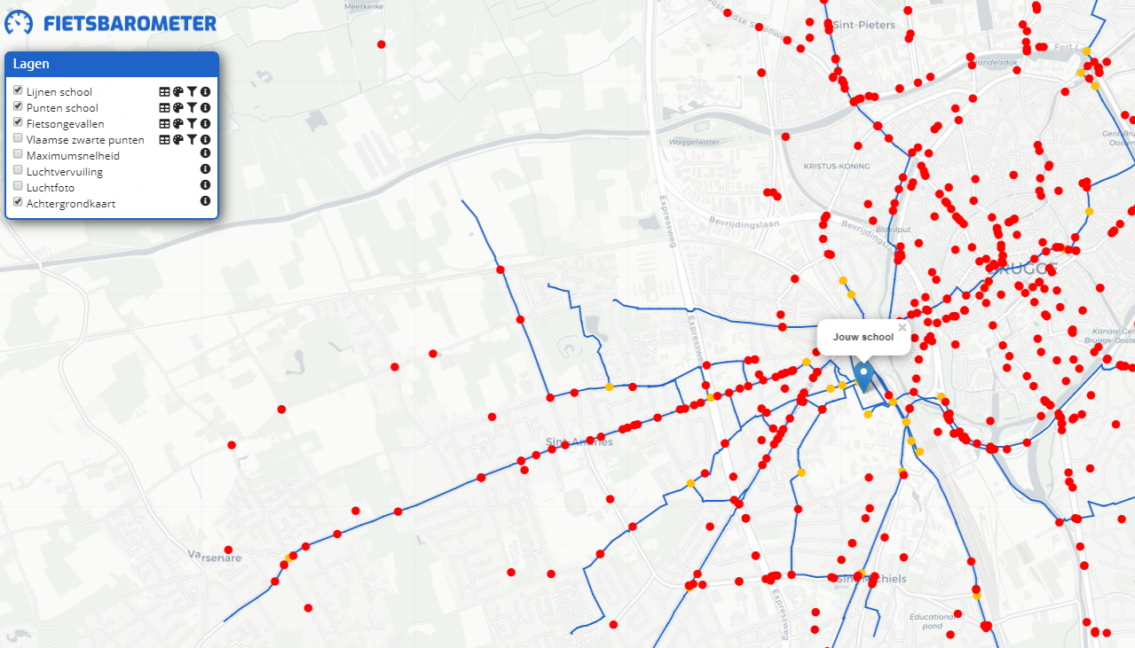
Student platform
sven.verstrepen@ugent.be
Notes:
Ook andere digitale kaartlagen kunnen makkelijk toegevoegd worden – cf. Fietsongevalsdata MOW, kaart luchtkwaliteit;

Slide 7
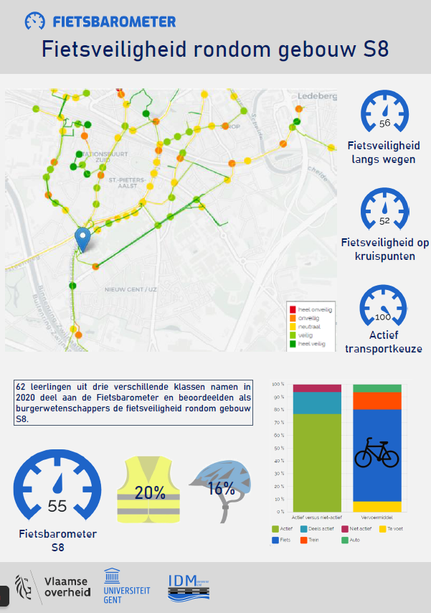
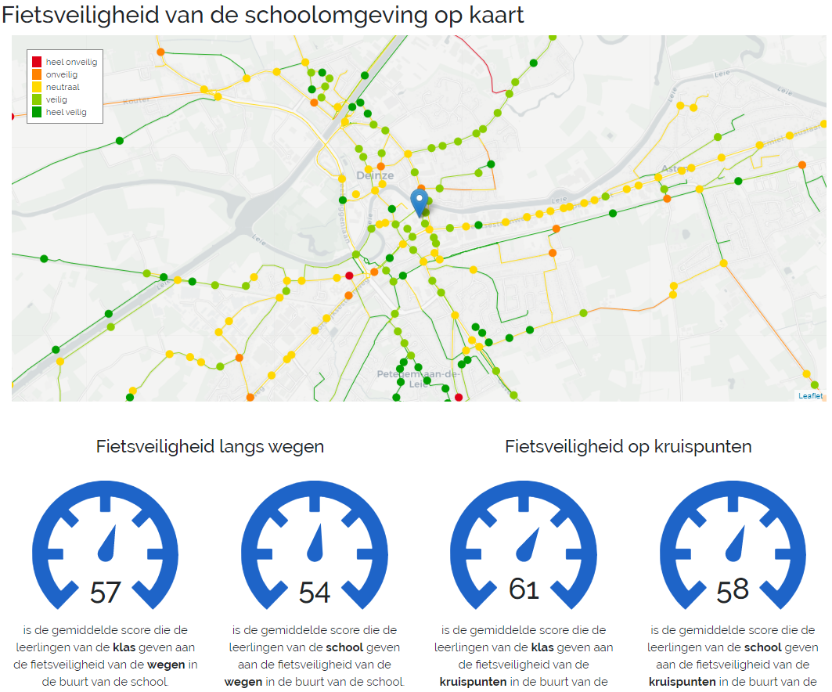
Output reports
sven.verstrepen@ugent.be

Slide 8



Sven Verstrepen
Senior Innovation Officer Urban Mobility
TechTRansfer
E sven.verstrepen@ugent.be
T +32 9 264 79 49
M +32 498 51 81 67 www.ugent.be/techtransfer
Universiteit Gent
@ugenttt
@ugent
Ghent University

