Slide 1




2023 Healthy Cities Annual Business Meeting
and Technical Conference
THRIVING TOGETHER: NAVIGATING HEALTH IN THE WELL-BEING ECONOMY
22.11.2023
16.00

Slide 2



Sola-Calculator For Well-Being Assessment
Authors
Miikka Vuorinen, Chief of evaluation (Sosped Center), miikka.Vuorinen@sosped.fi
Tanja Tilles-Tirkkonen, Wellbeing coordinator (Kuopio city) tanja.tilles-tirkkonen@kuopio.fi
Andra Aldea-Löppönen, Project Manager (Wellbeing Services County of Central Finland) andra.aldea-lopponen@hyvaks.fi
Tomi Mäki-Opas, Professor (University of Eastern Finland UEF) tomi.maki-opas@uef.fi
Natalie Joubert, Doctoral Researcher (University of Eastern Finland UEF) natalie.Joubert@uef.fi

Slide 3

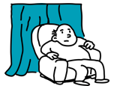
Social problems are more
complex than city budgets
When we have the means to show how different social phenomena are causing costs & savings to different sectors, we have sufficient arguments to start do budgeting in a new manner.
Instead of evaluating and valuing interventions, we could also evaluate and value social phenomena.
Instead of producing evaluation reports with one year time span, we could develop evaluation dashboards with 5 and 10 years time span as well.
The ability to make social valuation more scalable, credible and useful is essential.
“Biggest hindrance for building new outcome-based financing mechanisms or for starting new social impact bonds are not the investors. They want to invest. It’s more often about politicians and civil servants who find it too difficult.”
Andreea Anastasiu
Executive Director of the Government Outcomes Lab (Oxford University)

Slide 4
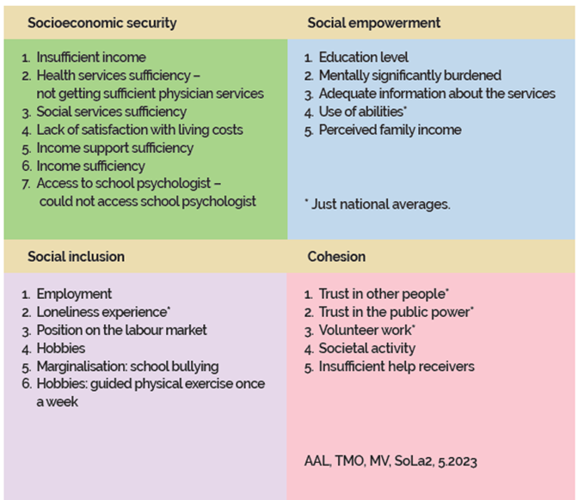
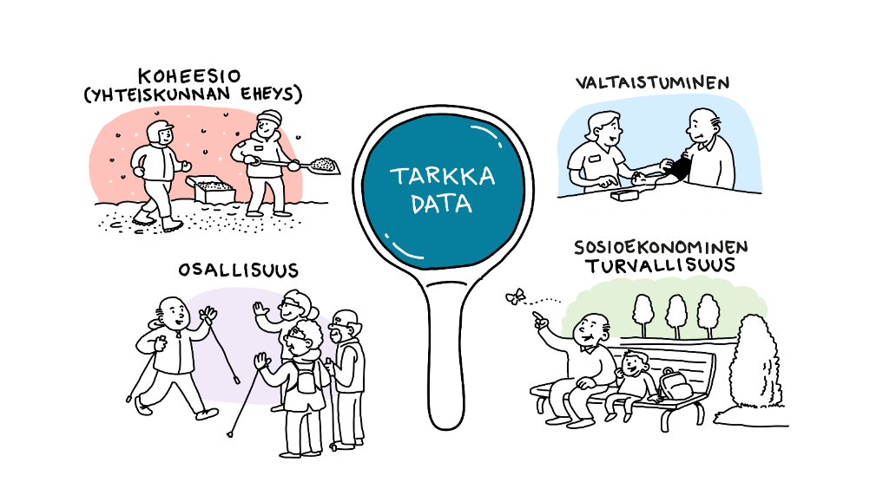


Social Quality model
A Way to Measure the quality of society
Social Quality framework (Abbott et al. 2012, Pieper et al. 2019, p. 575 Vaarama & Mäki-Opas 2020 p. 68)

Slide 5

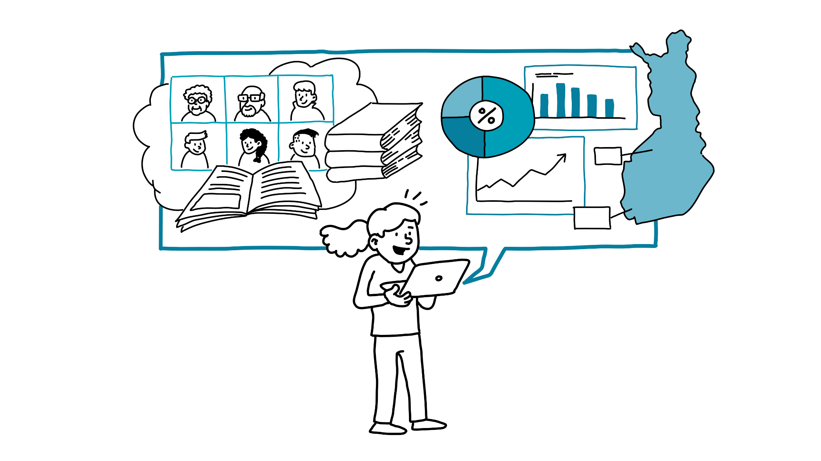
Societal social quality, wellbeing reinforcement and costs SOLA project
The project aims at developing a tool for measuring social quality (Sola Calculator)
Decision makers can also use the estimates in connection to the wellbeing report.
The project helps develop knowledge management on city and county -levels
      Coordination and pilots: Wellbeing Services County of Central Finland
      Test-users: Finnish municipalities, cities & wellbeing services counties
      Building of the SOLA tool: Sosped Centre
      Process evaluation & SOLA trainings: UEF/ House of Effectiveness
      Duration: 2022-2024
      Financing: Health promotion budget, Ministry of Social Affairs and Health
SOLA Calculator’s joint development
based on the users’ feedback

Slide 6

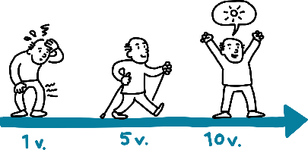

Methodology
Using register, research and regional data to create a phenomenon-based impact dataset
  Enables the verification of so-called “regional impact”
  Impact modelling can be done with two numbers
  Time span of the evaluation 1, 5, 10 years.
All the values and proxies can be edited.
Similar approaches for assessing social impact are hardly known in the light of research
(Rautiainen et al 2015 & Mäki-Opas et al 2020 & Hult & et al 2021).
Methodology is being used e.g. for evaluating housing services, NGO’s, fire-brigades and European Social Fund´s impact. Methodology is developed by Sosped Center
“We have been hearing for years how these things cannot be measured.”
A senior civil servant from a ministry
1 year
5 years
10 years

Slide 7


Results
From an economic perspective, estimates of the economic impact of various phenomena at the level of the municipality/ wellbeing services’ county
An assessment of the measure’s regional coverage, regional impact and regional economic impact.
The tool is free to use and the user has ownership of the data. The organization’s own data may refine the estimates.
All figures and coefficients can be edited. The user can build new phenomena into the tool.
“With this kind of instrument we could start more easily target impact financing into local level. We need more scalable and easier ways to measure and value social impact ”
Representative of a bank

Slide 8


In Kuopio, the costs of some well-being challenges and the savings brought by prevention were evaluated and presented in the well-being report
Experiences
Cost reductions, savings from weekly guided physical exercise
+ 1,09
MEUR
Total per year/after ten years
+ 722€
per person / year (10th year)
+ 239€
per person / year
(1st year)
In 2021, 43% of the primary school pupils in Kuopio enrolled in weekly guided physical exercise. Implementation of the activity incurs costs. However, the cost reduction exceeded the incurred costs and produced significant savings in the long term. Cost savings came in the short and long term, especially in relation to the improved well-being and health as well as greater social activity. In the longer term, the importance of the factors related to employment will also be emphasized.
Other examples
Understanding the consequences of school bullying on a city level
IPS Individual Placement and Support intervention evaluation (Central Finland). Assessing the economical value of supportive service process for people with mental health disorders (employment support services, psychiatric treatment and rehabilitation services)

Slide 9
Targets and aims for the future
Science- and data-based investments for well-being.
Phenomenon-based budgeting culture.
Impact investing as a natural part of health promotion.
Cities’ evaluation reporting in line with National sustainability strategy and SDG’s.
More decisions supporting comprehensive, sustainable budgeting
Thank You! ☺

