Slide 1

FOOD CARDS
FOOD CARD
Heidi Tõnisson
Heidi Tõnisson
Project manager

Slide 2

Why Rimi? Our journey to Food card…
Helping people in need has always been important to Rimi
Working with Food Bank for years
Rimi participated and won the first and also the second public procurement
Cooperation with the State new interesting challange

Slide 3

Food card gives people in need a opportunity to buy food they need and like
FOOD CARD
This period more than 11 300 households are getting help
More than 19 000 people are getting help
1 Food card per each household
72% of the cards are being used
63% of the Food card money have been spent (have time until 31.12.2023)
Per one card avarage spent is 15,5 eur

Slide 4
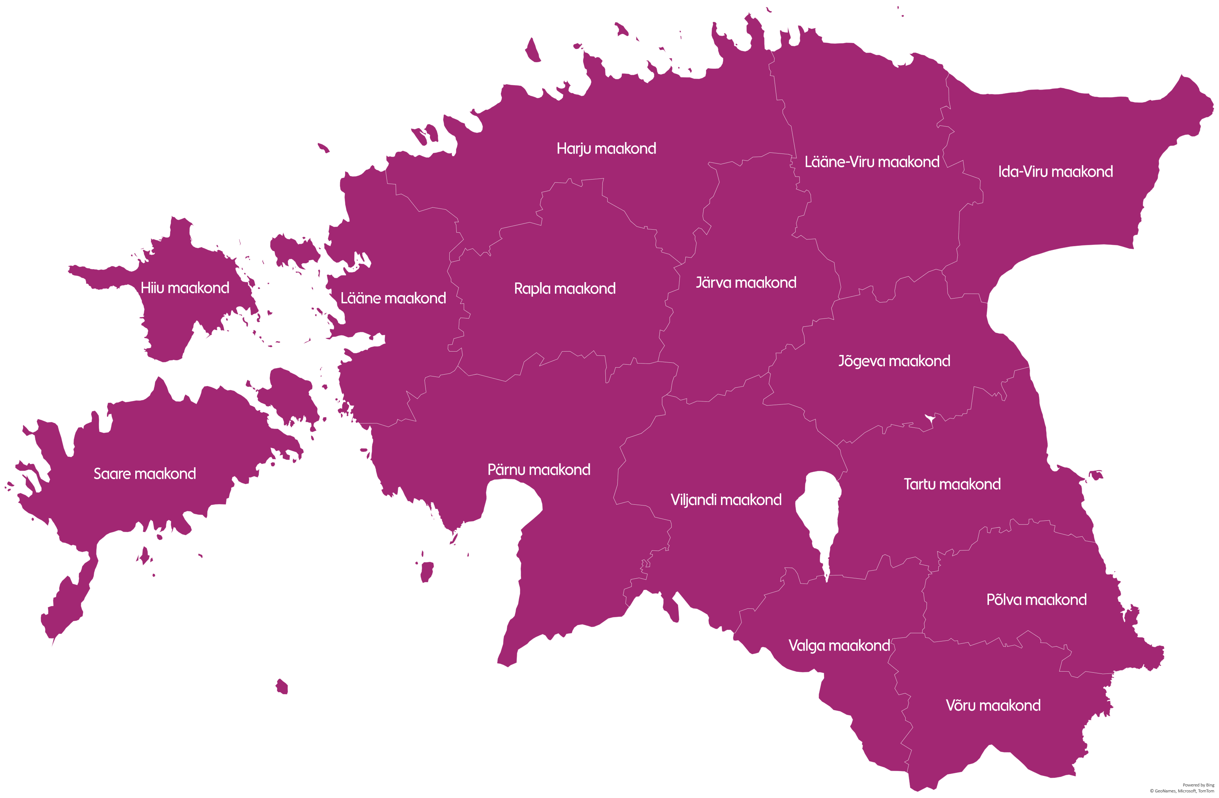
Card usage results show that new way of help is actively used:
74% of cards are activated* .
10 out of 15 regions has >70% activation rate.
On average, every food card customer has already completed 3 purchases with average spendings equal to 15.5 €.
Detailed Rimi locations are available here: https://www.rimi.ee/kauplused
Tallinn
35
2 759 used / 3 504 total
78.7% activated cards
3.6 purchases per card
14.2€ spending per 1 purchase
7
3
4
1 009 used / 1 424 total
70.2% activated cards
2.8 purchases per card
15.4€ spending per 1 purchase
411 used / 567 total
73.4% activated cards
2.7 purchases per card
17.1€ spending per 1 purchase
1 034 used / 1 473 total
70.9% activated cards
2.8 purchases per card
15.7€ spending per 1 purchase
1
2
2
2
58 used / 88 total
65.9% activated cards
2.1 purchases per card
16.6€ spending per 1 purchase
171 used / 225 total
76.0% activated cards
3.3 purchases per card
13.9€ spending per 1 purchase
383 used / 522 total
72.5% activated cards
2.9 purchases per card
15.4€ spending per 1 purchase
170 used / 236 total
65.6% activated cards
2.9 purchases per card
17.0€ spending per 1 purchase
2
96 used / 122 total
78.7% activated cards
2.8 purchases per card
16.7€ spending per 1 purchase
2
6
2
10
117 used / 200 total
58.5% activated cards
2.4 purchases per card
18.4€ spending per 1 purchase
510 used / 729 total
70.0% activated cards
3.3 purchases per card
15.0€ spending per 1 purchase
164 used / 250 total
72.0% activated cards
2.8 purchases per card
15.6€ spending per 1 purchase
760 used / 1 016 total
74.8% activated cards
3.3 purchases per card
14.8€ spending per 1 purchase
1
1
108 used / 190 total
56.8% activated cards
2.4 purchases per card
18.6€ spending per 1 purchase
284 used / 378 total
75.1% activated cards
3.2 purchases per card
17.0€ spending per 1 purchase
2
1
Number of Rimi stores
228 used / 344 total
66.3% activated cards
2.8 purchases per card
17.1€ spending per 1 purchase
*Status: 08.12.2023. Activated cards = % share of card with at least 1 purchase vs the total number of cards issued.
Total = New card issued + top-upped cards (issued in previous periods)

Slide 5
Tallinn and Harju maakond are main destinations for e-commerce deliveries, while in other areas this service is less popular among food card customers
In the current period, more than 50% of orders were completed in Tallinn and Harju maakond.
This result demonstrates that the number of stores in certain region does not have any significant impact on the usage of e-commerce services.

Slide 6
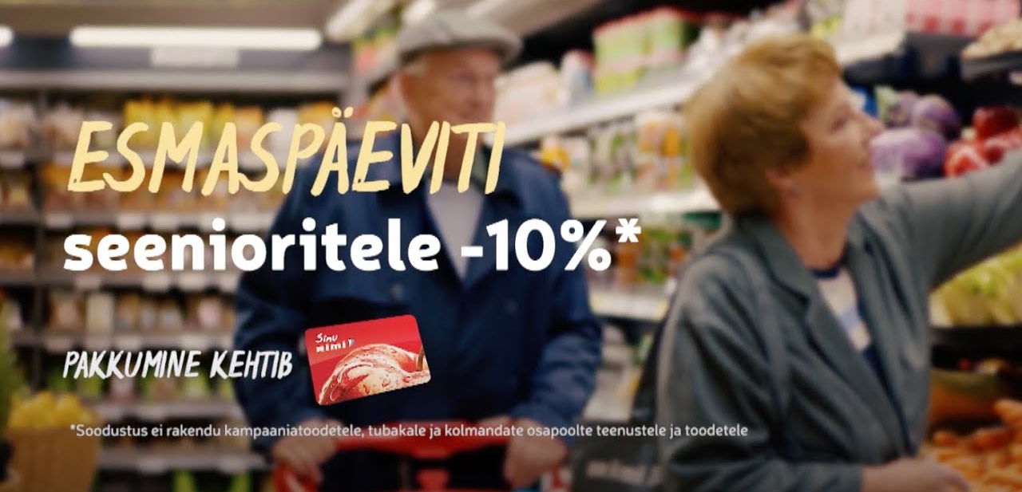
Monday is a usual store visit day for food card customers
On Mondays Rimi offers 10% discount for 63+ age customers.
More info:
www.rimi.ee/kampaaniad/seeniori-esmaspaev

Slide 7
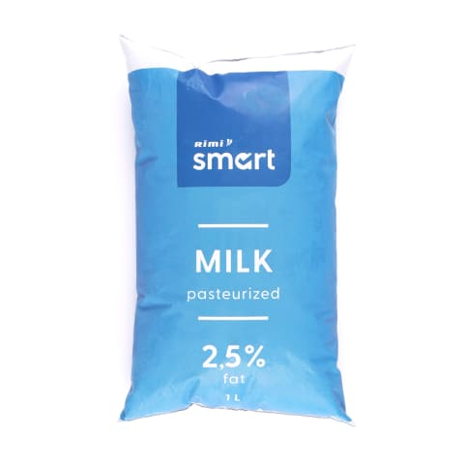
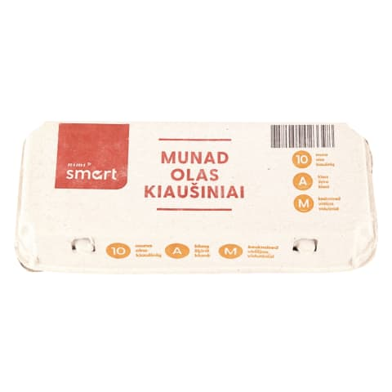

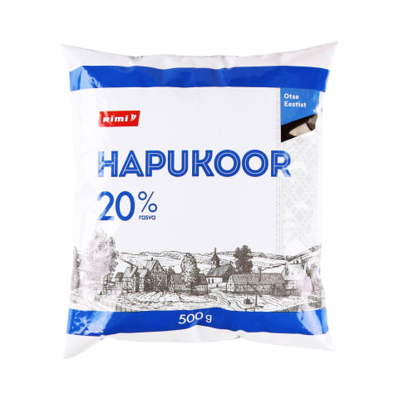
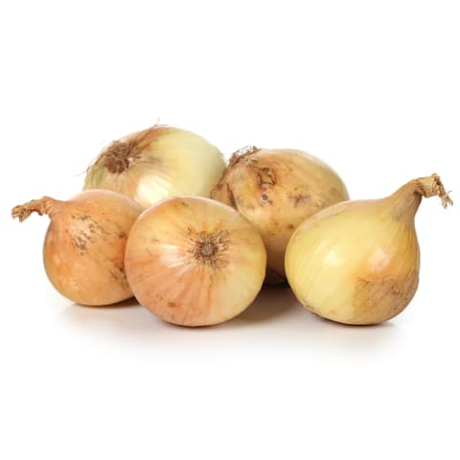
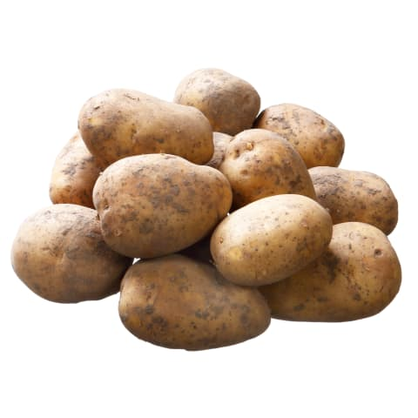
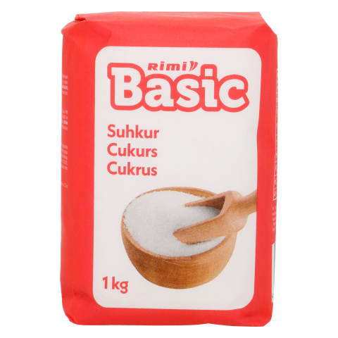
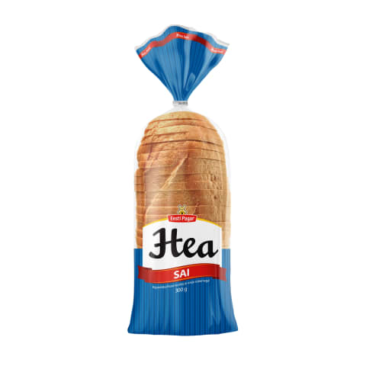
Typical choice for Food card customers: simple and affordable products, which are used in multiple recipes
1
2
3
4
5
6
7
8
*Top 8 products by a number of purchases.

Slide 8
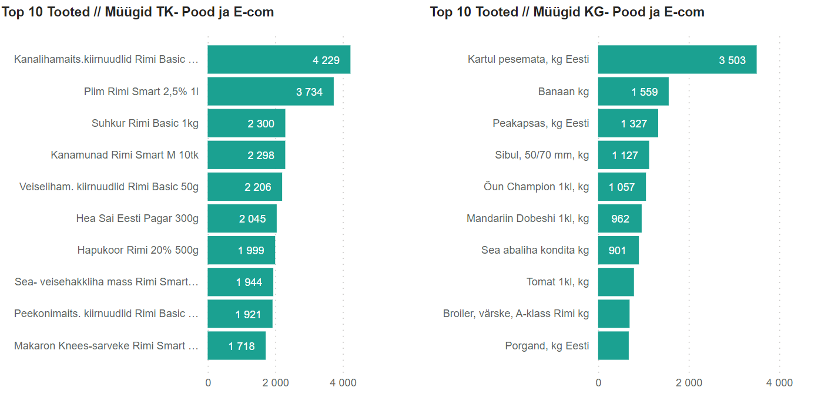
In terms of quantities, food card customers usually buy instant noodles, milk, sugar, potato, banana, and cabbage
Top 10 Products By Sales Qty in PCs
Top 10 Products By Sales Qty in KGs

Slide 9

Customers and social workers are satisfied with Food card system
Customers like food card, cause they can choose themselves, what to buy
Social workers give a positive feedback
Counties where stores are not close, customers have found a solution, how to make purchases.

Slide 10

Notes:
AND I thank you all☺
!

