Slide 1
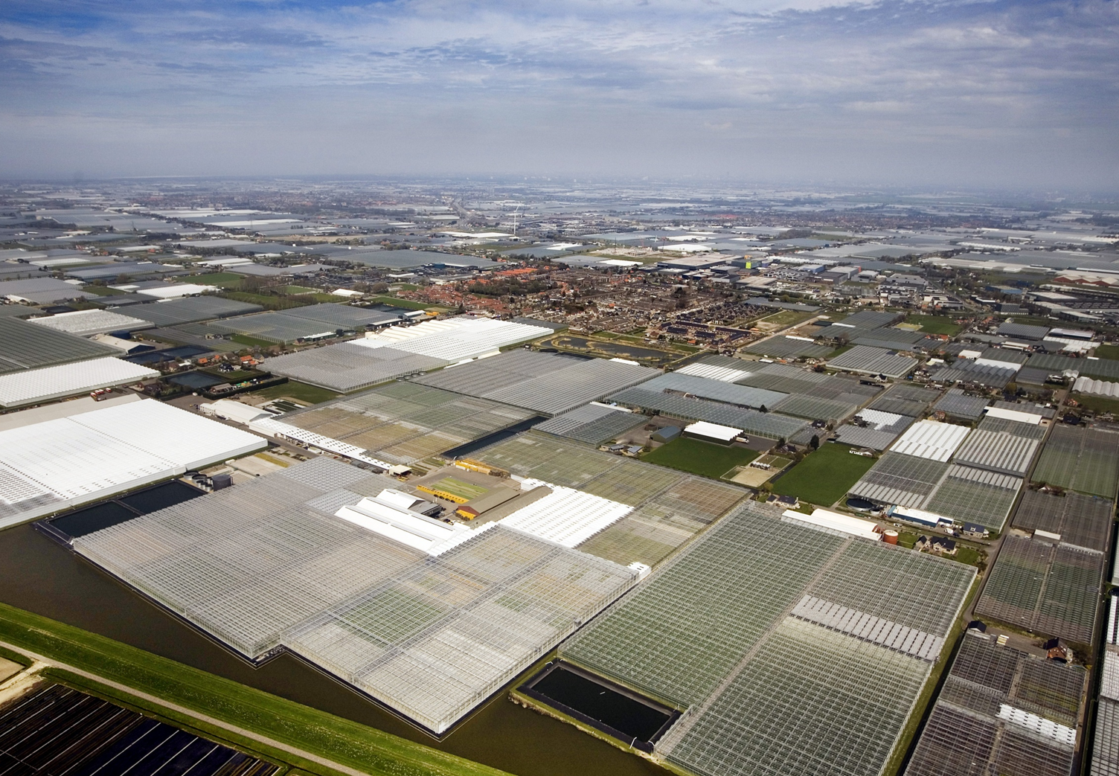
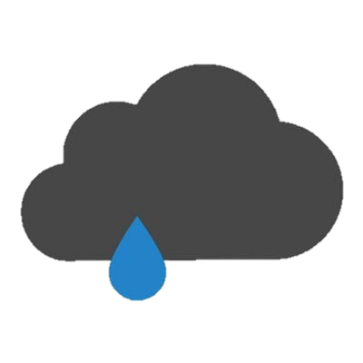
Rainlevelr
30 november 2023, excursion @ SVCO
Straits Committee – North Sea Conference

Slide 2
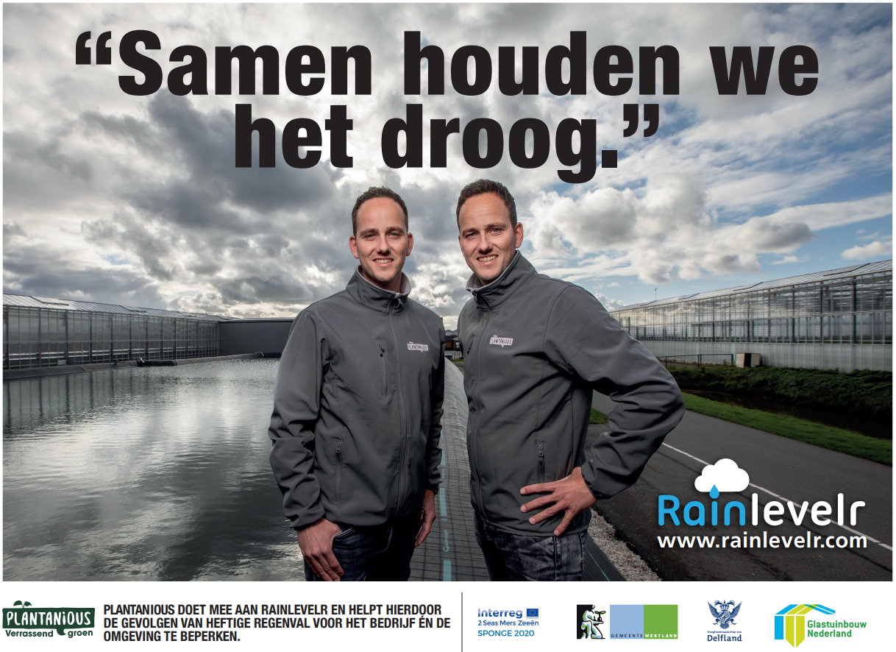
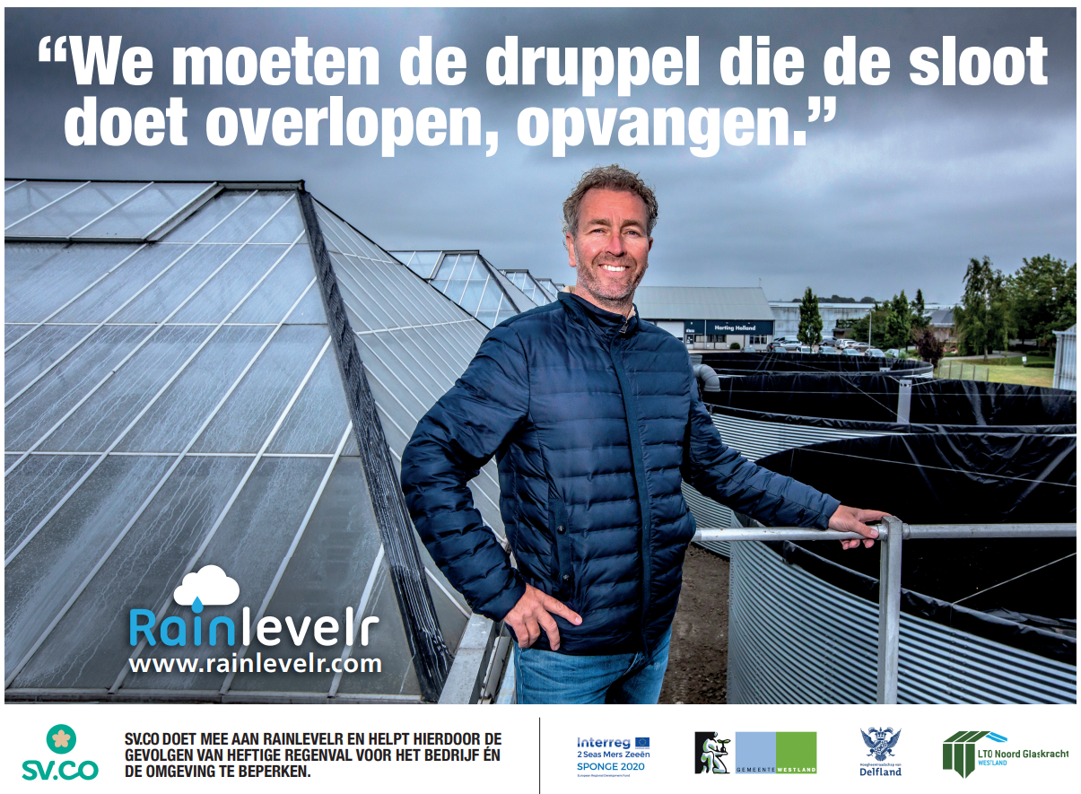

Slide 3
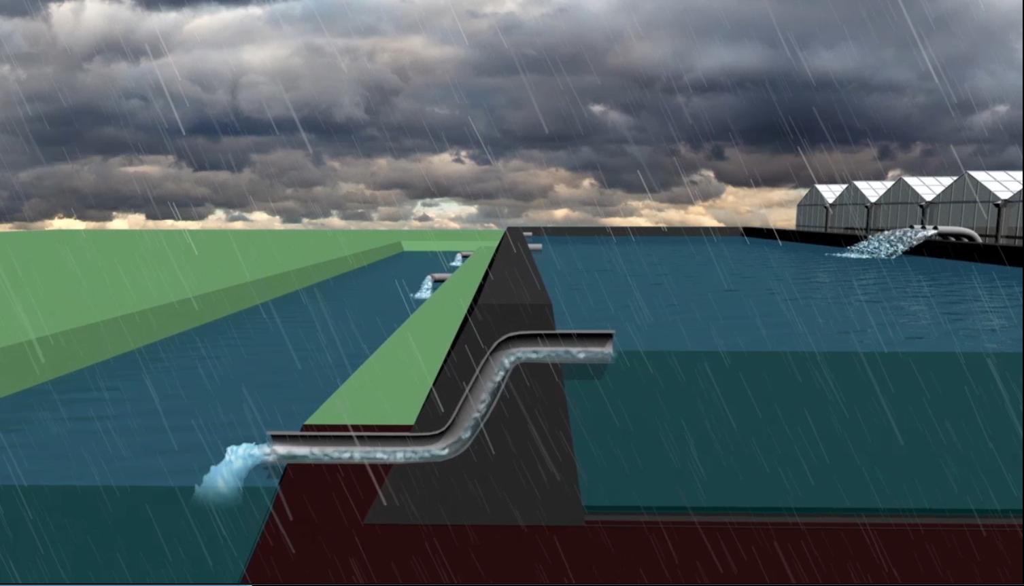
How does Rainlevelr work?
Rain falls on the roof of the greenhouse
It’s collected and transferred to the basin
Storage for watering the plants
When the basin is full, the rain will flow straight into the surface water system

Slide 4
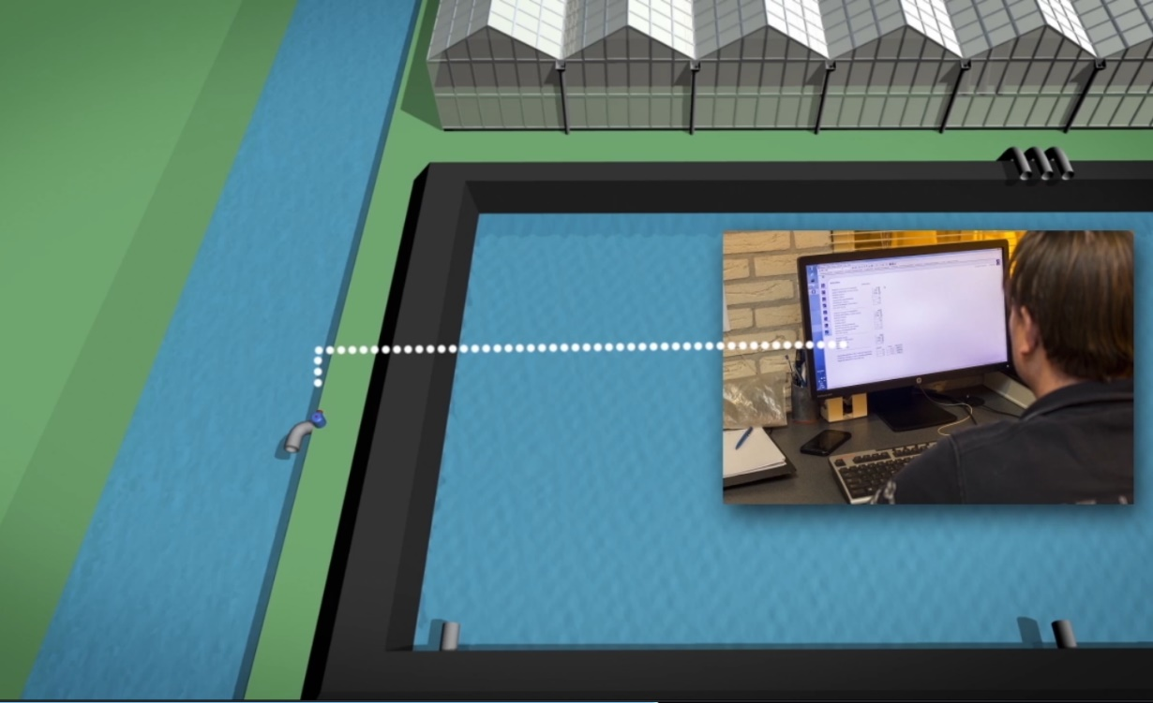
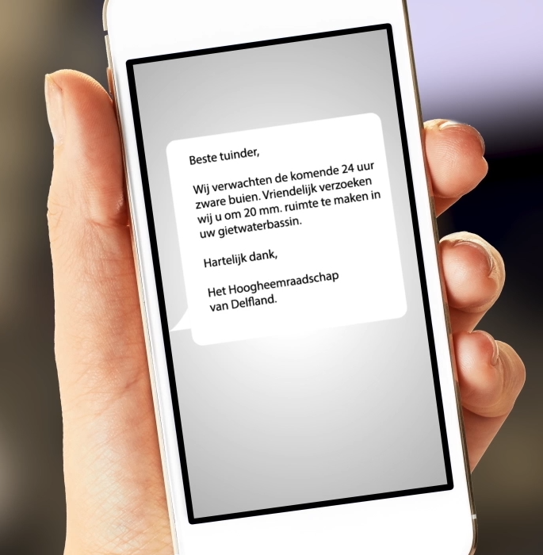
In advance of expected heavy rain we send a message to the Rainlevelr- participants --> ‘please anticipate and make space to collect a certain amount of millimeters of precipitation’
It’s the participant who decides whether he actually discharges water from his basin and how much
From his computer he gives input to the valve, which closes automatically when the indicated waterlevel in the basin is reached (and the requested space is available)

Slide 5
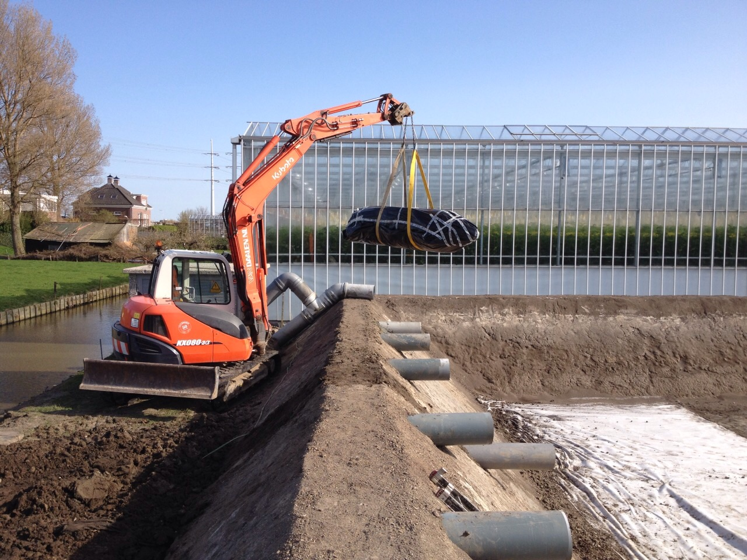
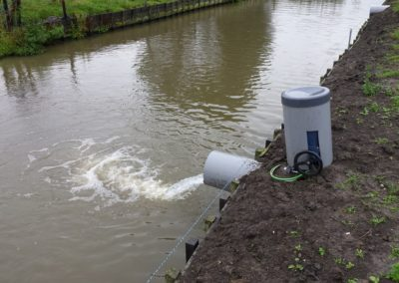
What is needed for Rainlevelr?
A pipe from the basin to discharge the water
A valve which can be controled from the company’s central computer

Slide 6
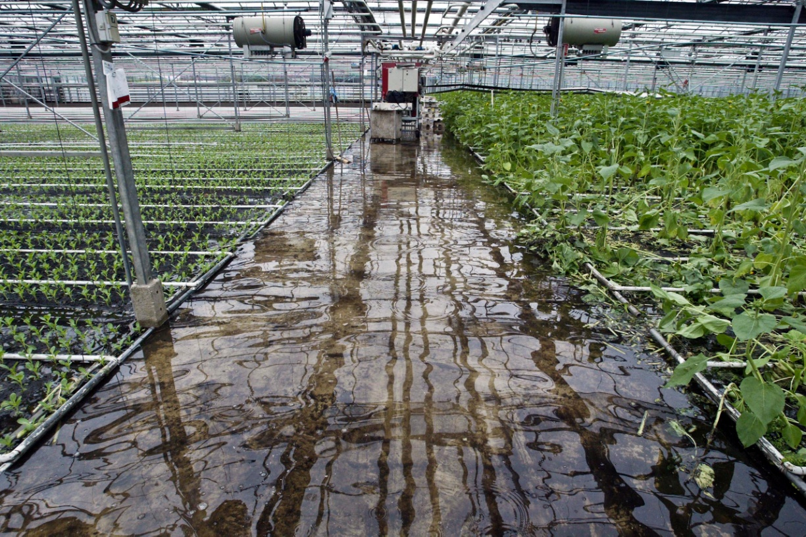
Sence of urgency in Delfland
Flooding in 1998

Slide 7
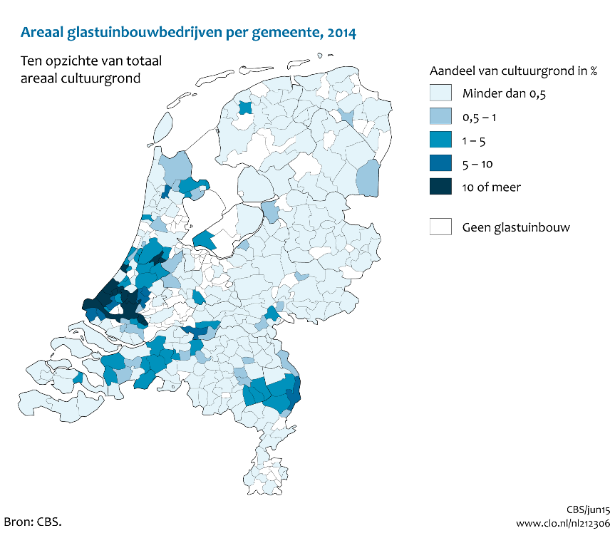
Glass Growers
Netherlands 10.078 ha
Delfland: 3.875 ha
Westland 2.854 ha
Ca 10 % Delfland area is glass
34 % Westland area is glass!
This is the highest concentration of glass in the Netherlands

Slide 8
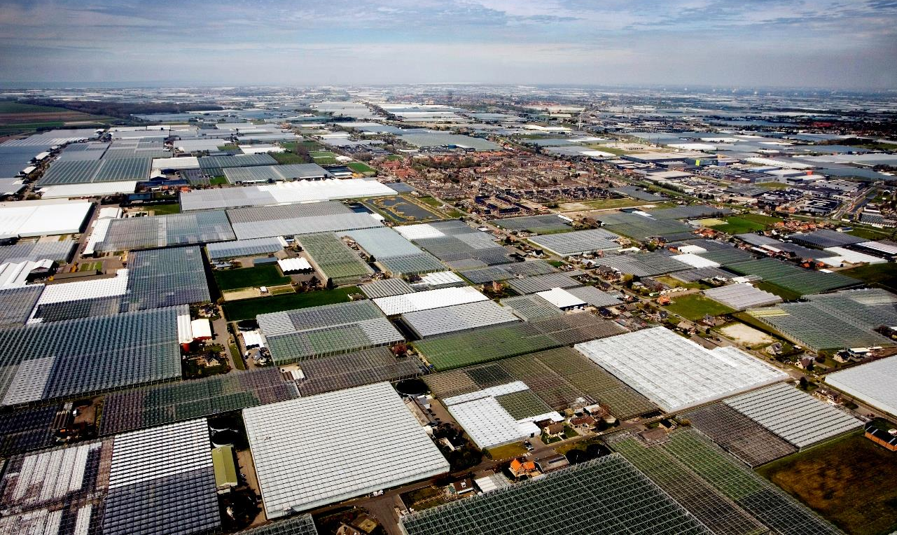
Risk of flooding
Our water system is under pressure of the water flow from the greenhouses (hardened surface)
Climate change: heavier rainfall
Sense of urgency from within the horticultural sector: growers want to contribute in preventing flooding
Notes:
Op achtergrond foto van deel beheergebied Delfland: goed te zien hoe verhard het gebied is -> dorp te midden van kassen

Slide 9
Reflection by SVCO
Why is SVCO participating in Rainlevelr?
What does SVCO think about Rainlevelr?
What does work, what can be done better?
How to make Rainlevelr even more successfull?

Slide 10

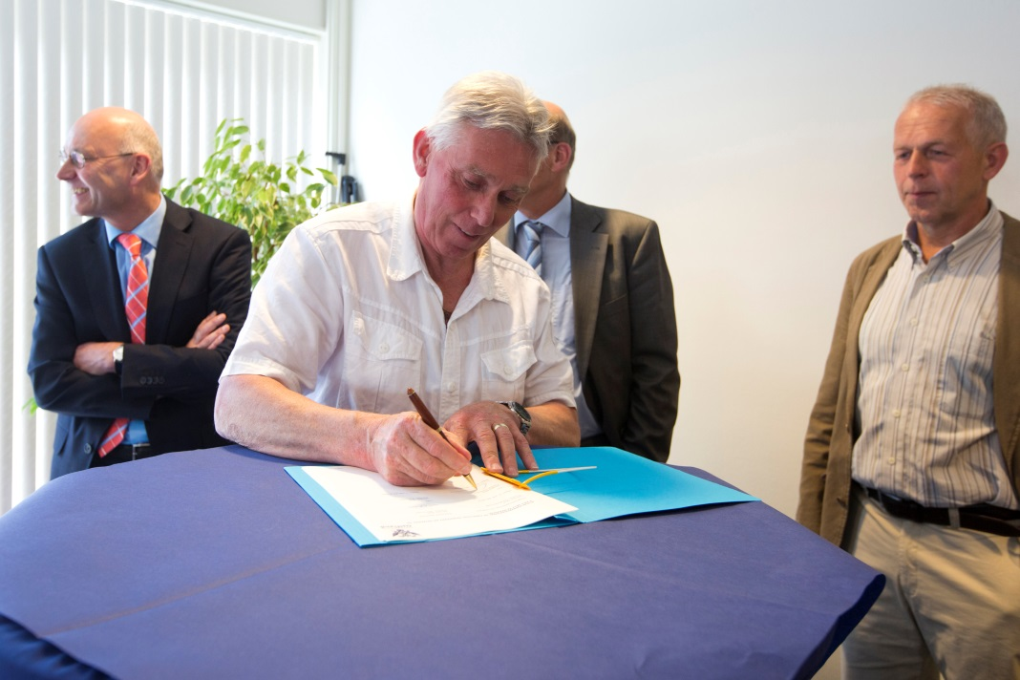
Collaboration between the Delfland Waterboard, the Westland municipality and glass growers
2012: pilot fase 1
2013-2016 fase 2
From 2017 till now:
regular policy
Aim: 80% of all glass area connected to the system over a 20 year period

Slide 11
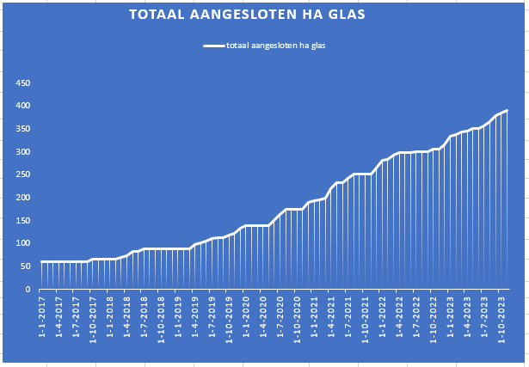
Update 20 October 2023:
* 75 Rainlevelr participants
* 390 ha glass
Retention of 10 mm of rain means retention of 39.000 m3
By comparison:
Capacity retention area Woudse polder: 500.000 m3
Capacity retention area Wollebrand: 250.000 m3

Slide 12
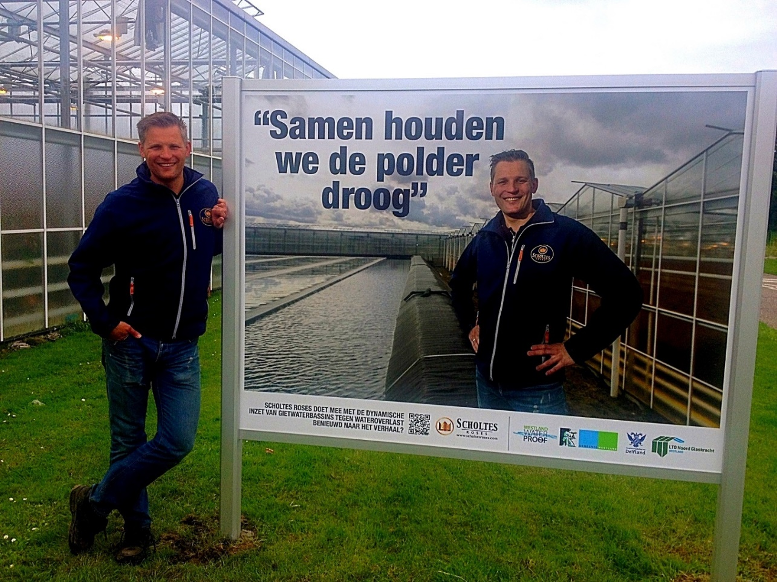
Policy
Participation is on a voluntary basis!
Participants decide about the discharge, Delfland only advises.
Only rainwater is collected in the basin, no residues
The waterboard refunds the building costs (15 k per unit), operates the digital portal and ensures communication on the project.
Participants own and maintain the unit

Slide 13
Developments
Automation
Integration in future ‘irrigation water supply’ developments (f.e. underground storage)
Copy the concept to other areas and sectors like industrial estates

Slide 14
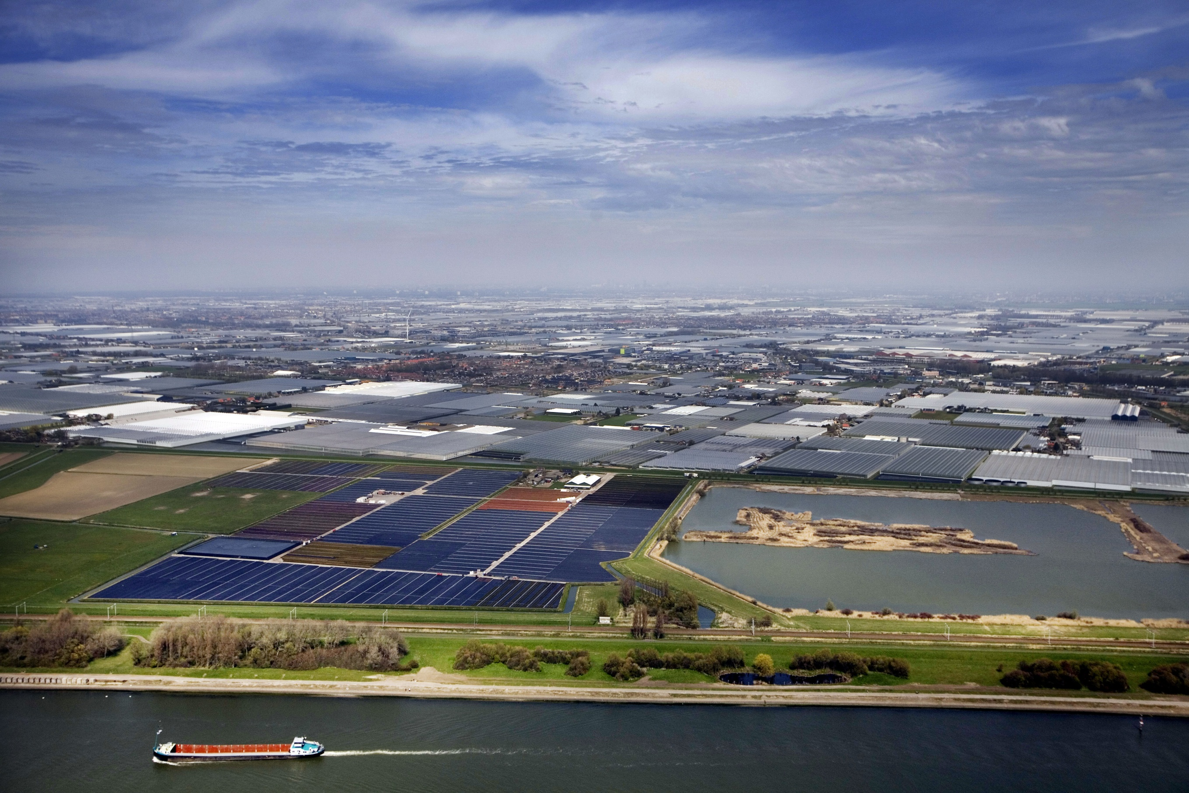
Thank you for your attention!
Questions?
For more info: www.rainlevelr.com
(English video: https://vimeo.com/260036705)

Slide 15
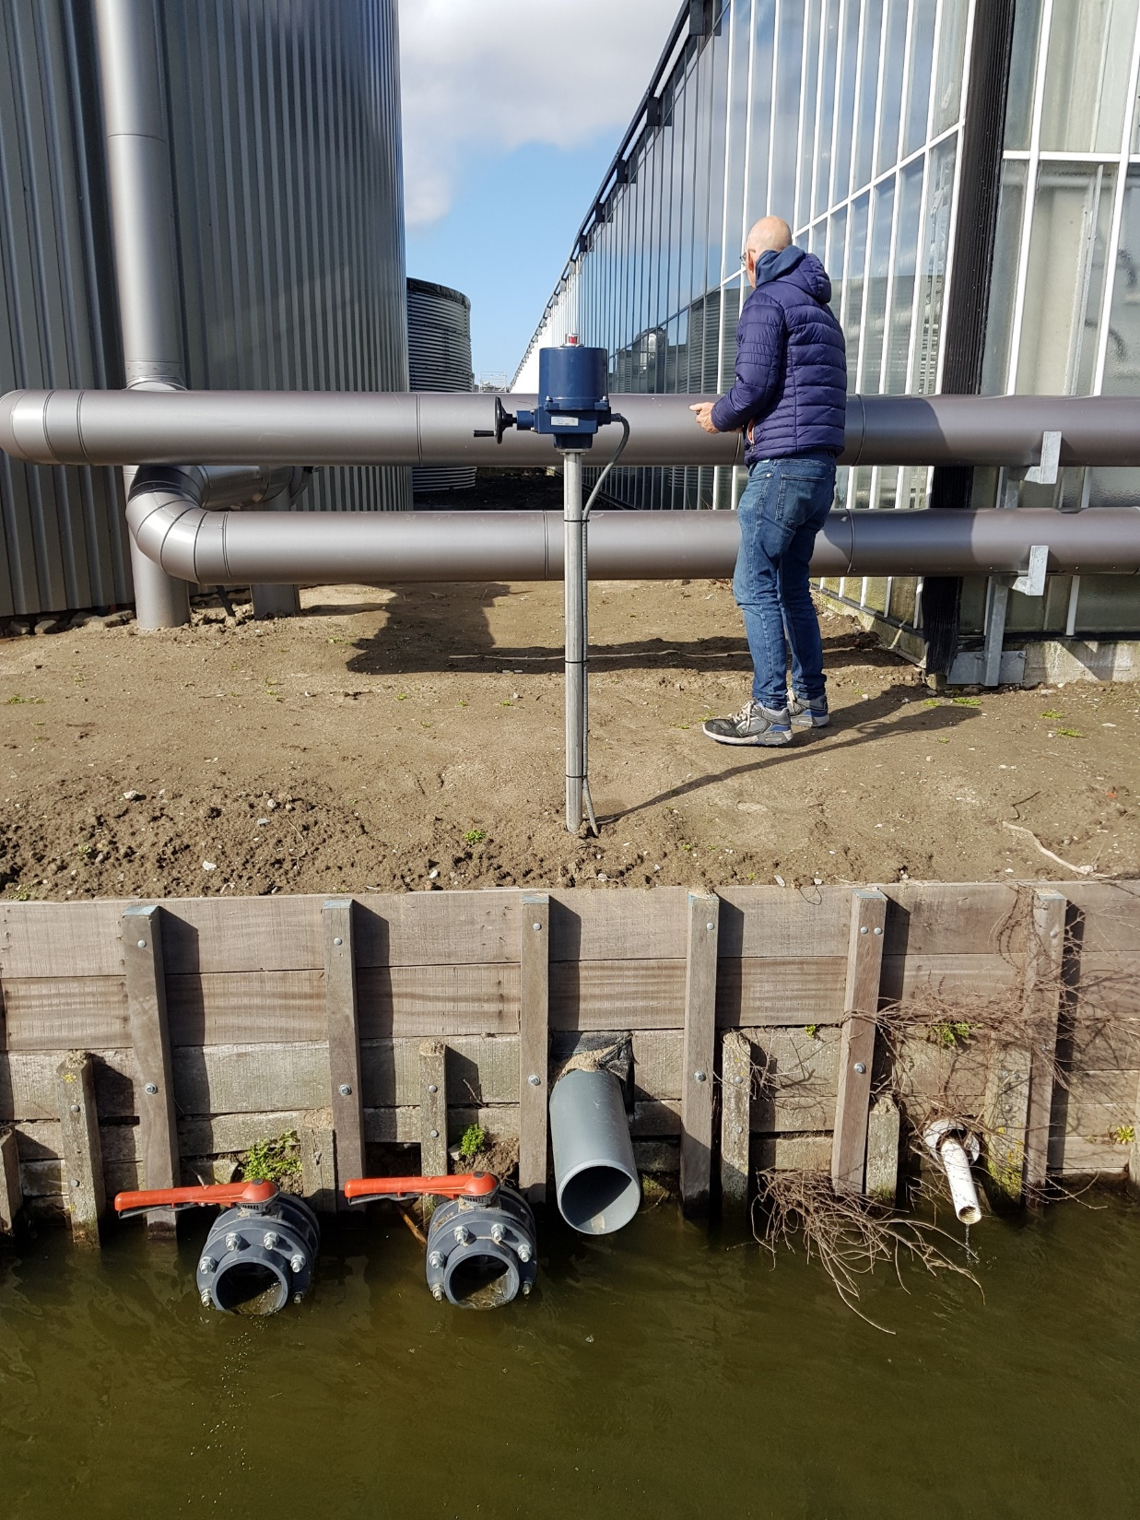
Rainlevelr system
@ SVCO Zijtwende
Valve and pipe

Slide 16
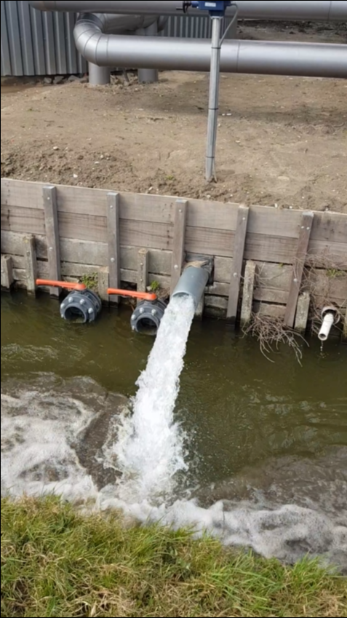
Rainlevelr system
@ SVCO Zijtwende
Water discharge test
(a bend was placed after this test, to protect the opposite bank)

